Slide 1
Interactions between Biotic Components of Ecosystems

Slide 2
Biotic Interactions
within Populations

Slide 3
Types of Interactions
A Symbiotic Relationship (or Symbiosis) refers to the interaction between members of two different species that live together in close association
Can be Positive or Negative

Slide 4
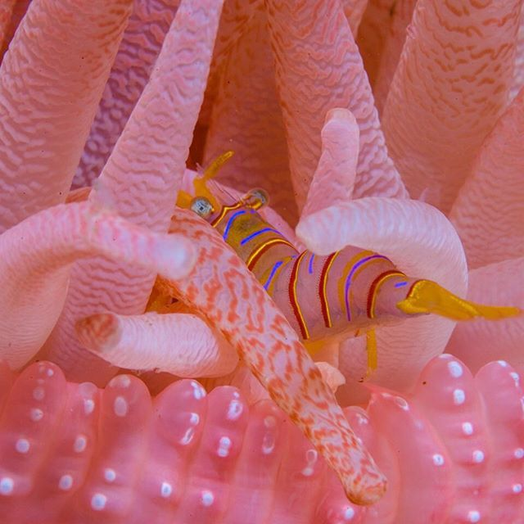
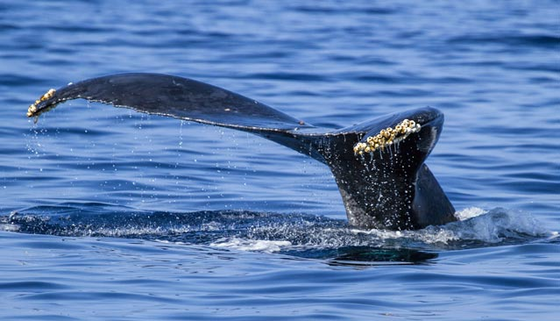
Commensalism
One species benefits and the other species is neither helped or harmed.
Host species may provide shelter or transportation for the others species.
Eg. Crimson anemone provides shelter and protection for the candy-striped shrimp. Colouring allows the shrimp to hide from predators, and the anemone is not harmed.
Eg Barnalces attach to whales and are transport to new locations

Slide 5
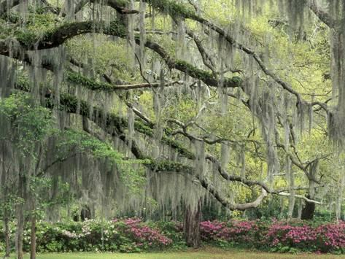
Commensalism
Eg. Spanish Moss is an epiphyte (plants that anchor onto other plants and have no roots of their own)

Slide 6
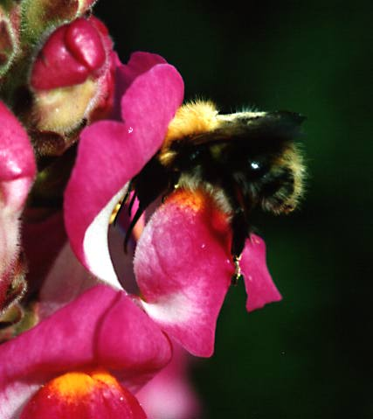
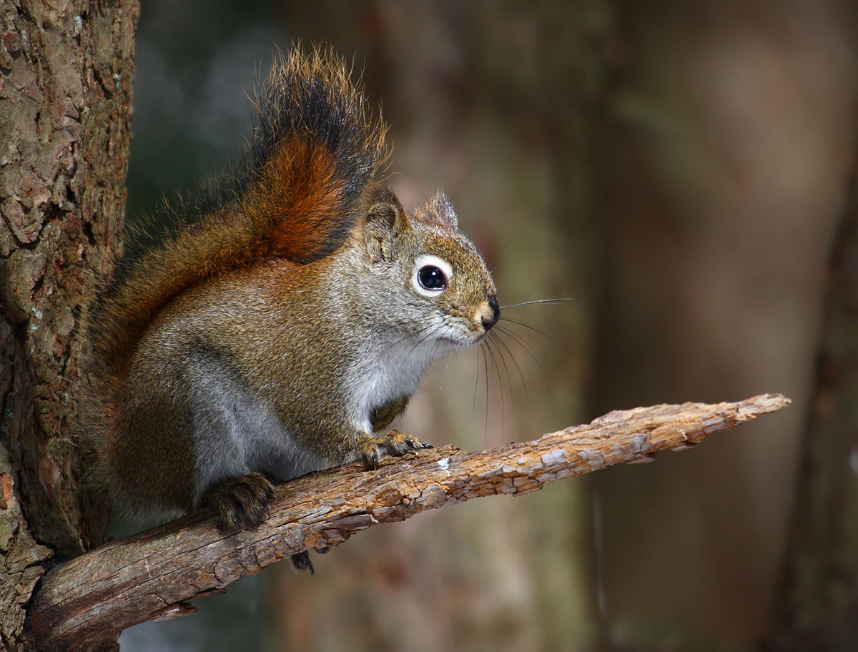
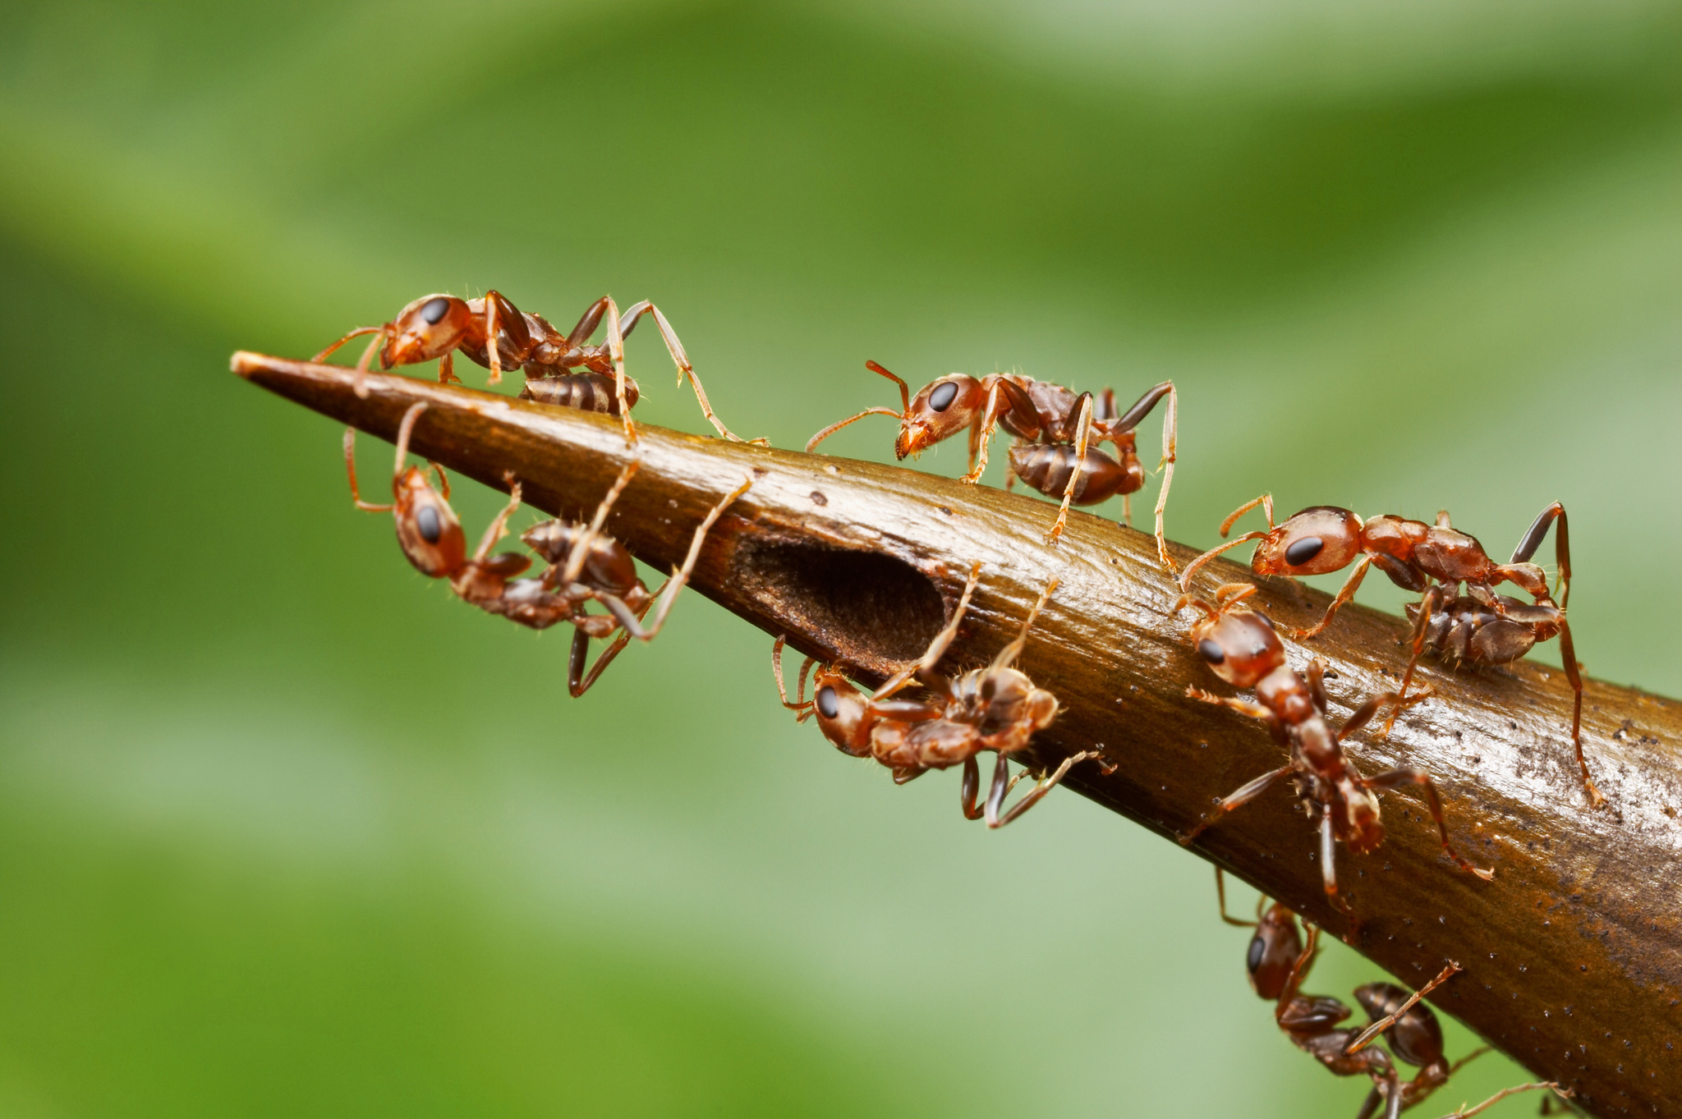
Mutualism
Both organisms benefit
Eg flowers and bees
Eg. Squirrels eat underground fungus that is critcial to the tree’s ability to absorb water an nutrients. After eating the fungus, the squirrels spread fungal spores over the forest floor, promoting the spread of the fungus.
Eg. Ant species sip nectar from and live in the hollow thorns of Acacia tree. They will attack any other insects or animals that come to the tree.

Slide 7
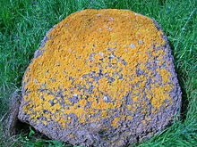
Lichen
Over 2500 types of lichens exist and are found in every biome on Earth
Each lichen consists of an alga and a fungus
Alga produces sugars and oxygen for the fungus through photosynthesis
In return the fungus provide carbon dioxide, water, minerals, and protection from dehydration for the alga.

Slide 8
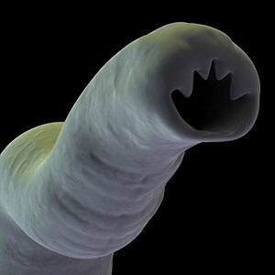
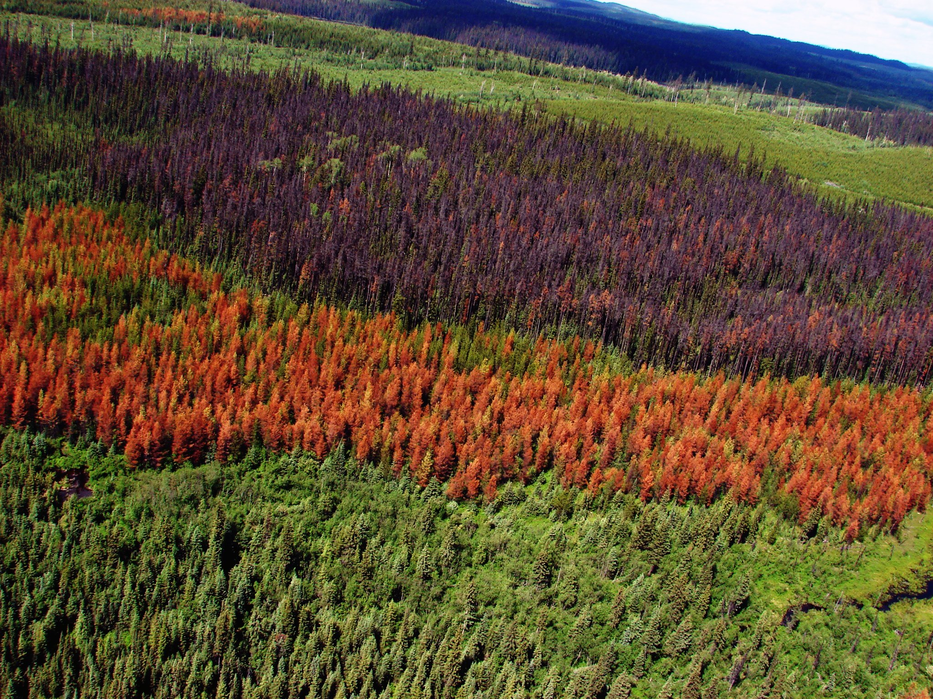
Parasitism
One species benefits and another is harmed
Eg. Parasites are much smaller than host and live off the host’s blood or tissue.
Hookworms live in soil and animal feces. Attached to dogs enter the bloodstream and travel to the intestine where it attaches by its teeth in the intestinal wall.
Eg. Mountain Pine Beetle devastates much of BC’s pine forests

Slide 9
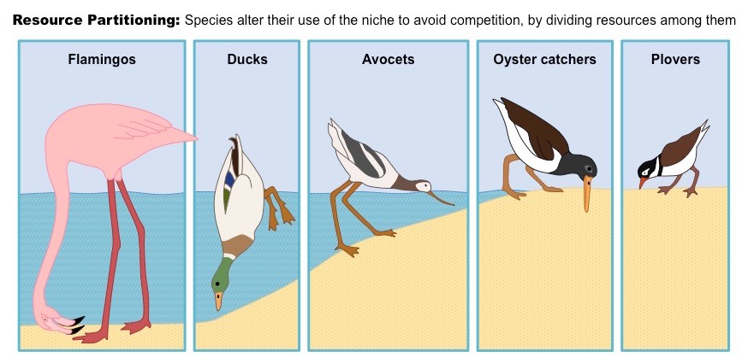
Niche
A niche is an organism’s role in the ecosystem in which they live
Includes all the physical, chemical, and biological interactions required for a species to survive, grow, and reproduce.

Slide 10
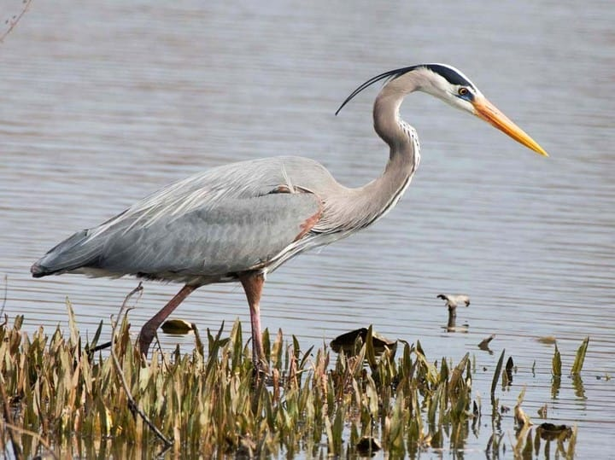
Niche
Organisms interact with other individuals of the same species or with individuals of others species.
Eg. Great blue herons always live near water, where they can fish and next in nearby trees and bushes.
Because of their long legs, great blue herons can find food in deeper water, which allows them to occupy a niche that other heron species with shorter legs cannot.

Slide 11
Interactions involve competition for food, water, sunlight, or habitat.

Slide 12
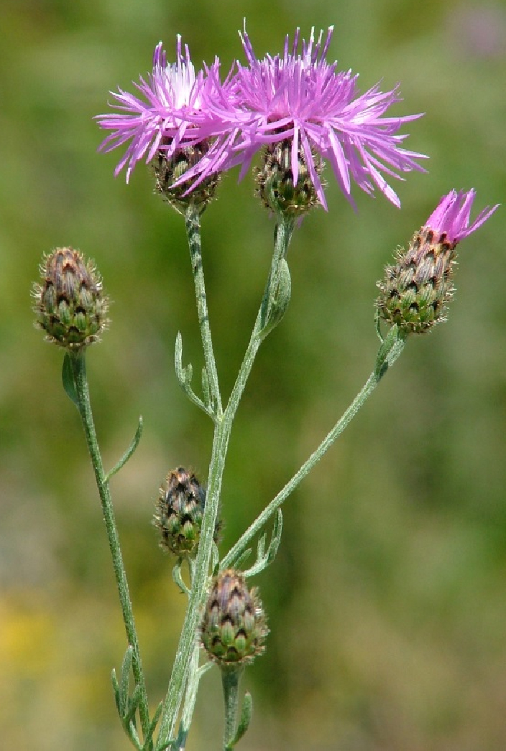
Competition
Competition is a harmful interaction between two or more organisms, causing them to compete for the same resource (such as food) in the same location a the same time.
Some plants have characteristics that make them successful competitors.
Eg. Spotted knapweed releases chemical into the soil, which prevents the growth of other plants and allow the knap weed to populate a field quickly.
Notes:
Same niche
Produces 25 000 seeds from one plant. One of th eworst rangeland weeds in BC
Coyotes and wolves may compete for food

Slide 13
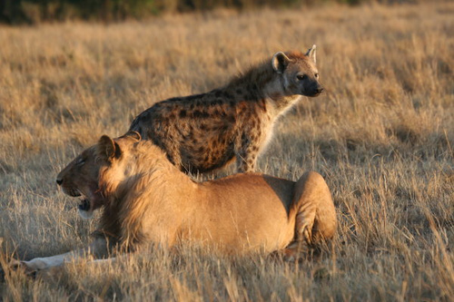
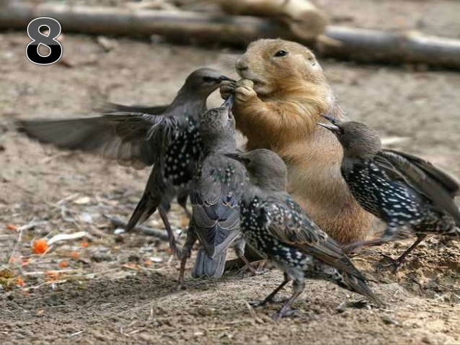
Competition
Lions and Hyenas compete for similar food and space.
Notes:
Produces 25 000 seeds from one plant. One of th eworst rangeland weeds in BC
Coyotes and wolves may compete for food

Slide 14
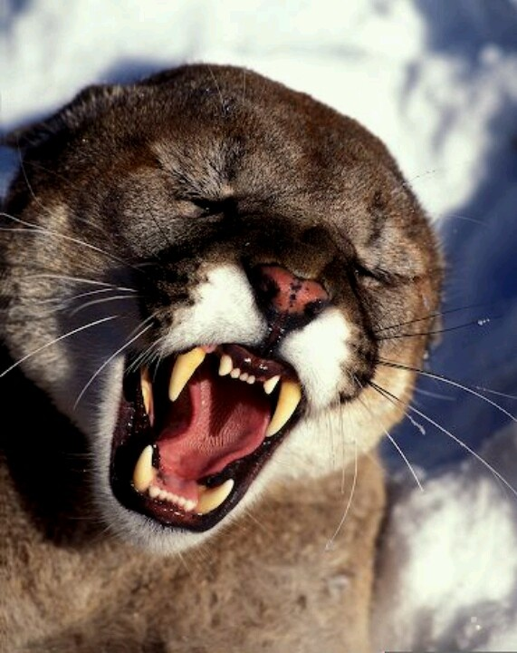
Predation
Describes Predator-prey interactions
One organism (predator) eats all or part of another organism (prey).
One organism benefits and the other is harmed.
Predatory have adaptation's that make them effective predators
Eg. Keen sense of smell,
Eg. sharp, pointed teeth

Slide 15
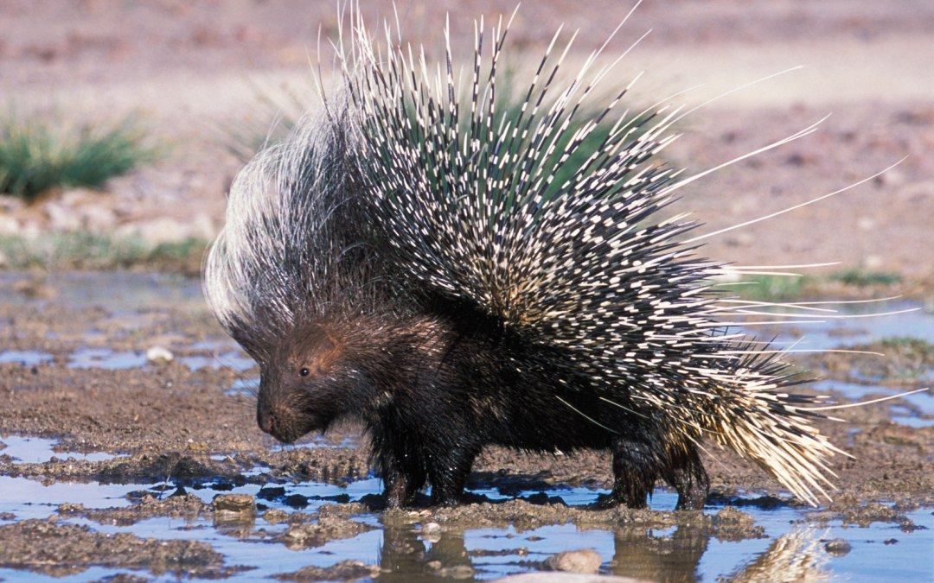
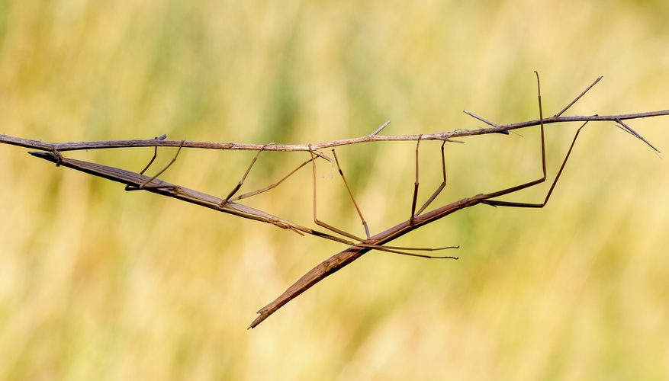
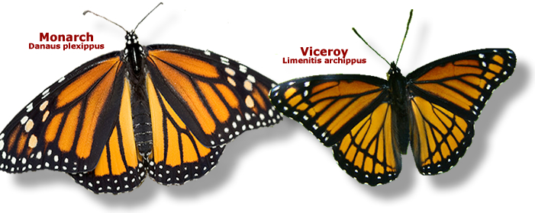
Predation
Prey have adaptations to keep them from being eaten such as:
Protection,
Camouflage,
Mimicry
Notes:
Vicery butterfly looks like the bitter-tasting monach butterfly, Eg turtles and clams have hard shells

Slide 16
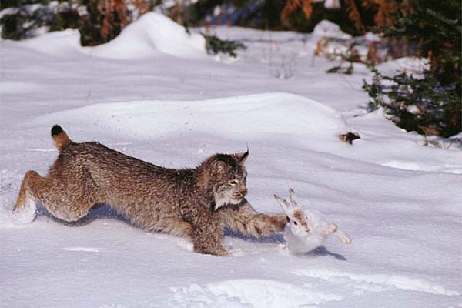
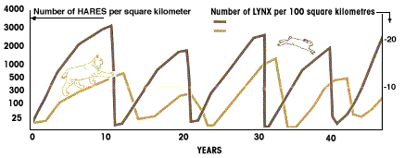
Predator-Prey Relationships
The size of a prey population can be affected by the number of predators
Eg. Lynx and Hare populations

Slide 17
Check your Understanding
What is symbiosis?
What is commensalism
Give an example of mutualism
Give an example of parasitism
What is a niche?
What resources do organism compete for?
What is predation?
Provide one example of a predator.
State two ways in which prey avoid predators.

Slide 18
Predator Prey Activity

