Slide 1
Clouds
Formation and Types
Pages 506 -511

Slide 2
Clouds
A cloud is a collection small water droplets or (ice crystals) suspended in the air.
Forms when the air rises and cools, and condenses.
Above 0°C → water droplets
Below 0°C → ice crystals
Need a surface (nuclei) on which to condense (dust, pollen, spores, pollution).

Slide 4
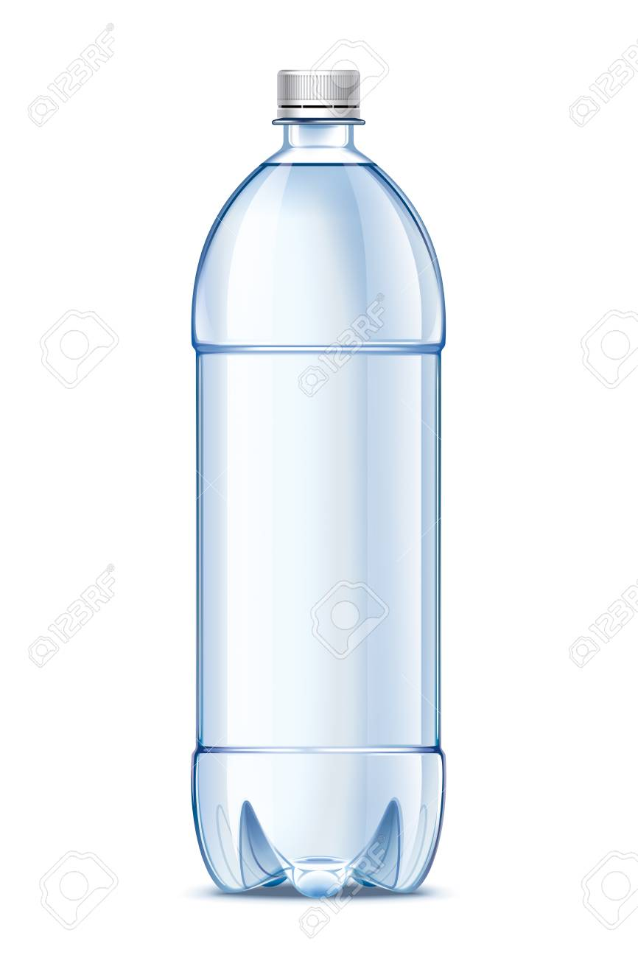
Cloud in a Bottle At home activity:
Materials: Empty plastic water bottle, match, water.
Fill a plastic water bottle ¾ up with water.
Strike a match, let it burn a bit then drop it into the water. Immediately seal the bottle with the cap.
Alternately Squeeze and release the bottle. Do you see the cloud appear and disappear?

Slide 5
Cloud in a bottle demo
https://www.youtube.com/watch?v=G70y90BVes4

Slide 6
Cloud demo: What happened?
The match added smoke particles which provides the water particles with something to condense on (condensation nuclei).
Squeezing the bottle increases pressure.
Letting go reduces pressure, allowing water to cool and condense.

Slide 7
Why does air cool when it rises?
When air rises it expands because it is moving from higher to lower pressure. (Air pressure decreases with altitude).
Air cools when it expands because the frequency collisions decreases as air expands (more space between the particles)
Air coming out of a tire or aerosol can is cool.

Slide 8
Methods of Cloud Formation
Different clouds form in different ways depending on:
what causes the warm, moist air to rise into the upper troposphere.
3 Main cloud formation methods

Slide 9
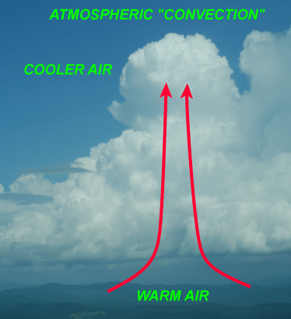
1. Convection: Warm, moist air rising.

Slide 10
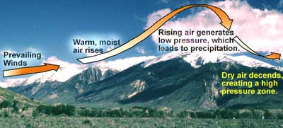
2. Lifting: Warm, moist air moving up the side of a mountain. Along its journey, the air is lifted higher into the troposphere where the pressure is lower. The water vapor in the air is allowed to cool and form clouds. This is why we often see clouds over mountains.

Slide 11
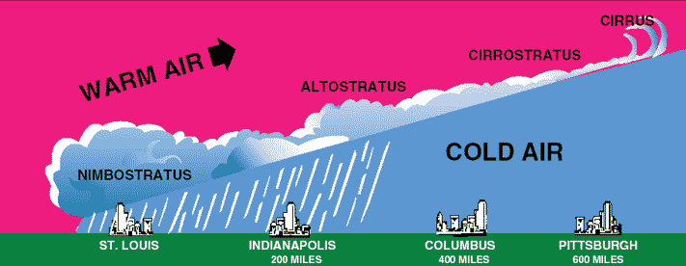
3. Frontal Activity Warm, moist air being forced to rise by a cooler air mass. The warm, moist air rises into the troposphere. The lower pressure of the upper troposphere causes the water vapor in the warm air to cool and form a cloud.

Slide 12
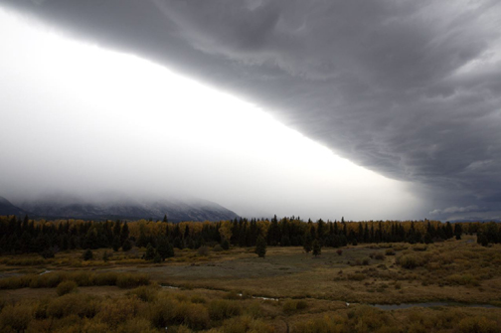
Frontal Activity

Slide 13
Types of Clouds
Clouds are classified by shape, altitude, and their precipitation.
The three main cloud shapes are:
stratus clouds, cumulus clouds, and cirrus clouds.
The three altitude groups are:
low clouds, middle clouds, and high clouds.

Slide 14
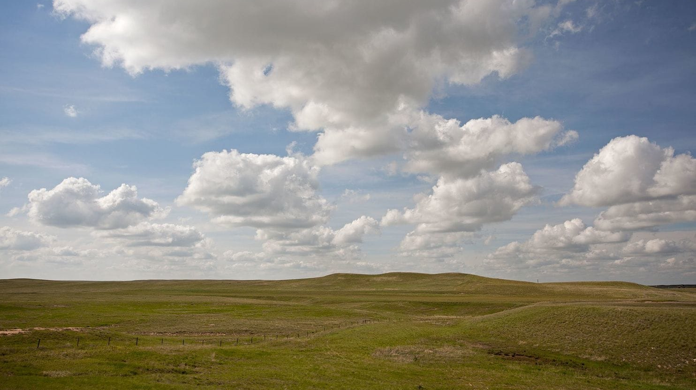
Cumulus - Heaped
Puffy, white clouds that tend to have flat bottoms
Formed when warm air rises
Indicates fair weather
Piled, lumpy, billowy
Notes:
These clouds are awesome. They have flat bases and appear fluffy or cotton-like. They also get their name from the Latin “cumulo” — which means “pile.” Like stratus clouds, they are low, though they are more vertical. Cumulus clouds don’t produce precipitation, but they can grow to do so. In certain situations, cumulus clouds are lead clouds, meaning that meaner clouds could be coming.

Slide 15
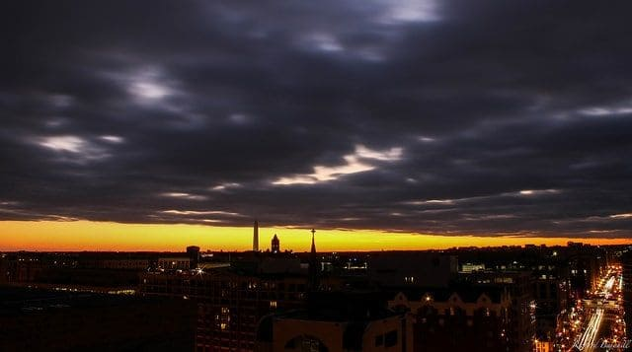
Stratus - Layered
Form in layers
Cover large area, often blocks out sun or moon
Formed by gentle lifting of a large mass of air
Sheets, blanket
Notes:
These are low-level clouds, varying from off-white to almost a dark gray. “Stratus” comes from the Latin prefix “strato,” which means “layer.” A lot of science-y words come from Latin. These clouds can produce light drizzle and/or snow. Stratus clouds are a lot like fog.
These clouds are morons. They just sit there, hovering overhead. Stratus clouds are exactly like the guy you knew in high school who continued living in his parent’s basement until he was 52. Stratus clouds do not aspire to be better clouds. They are content to remain there, mired in their mediocrity, just like your 52-year-old friend.

Slide 16
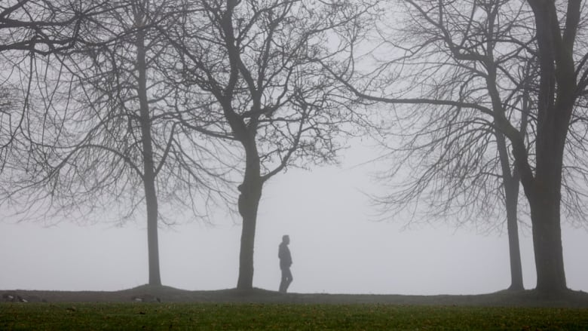
FOG
FOG – stratus cloud that comes in contact with the ground

Slide 17
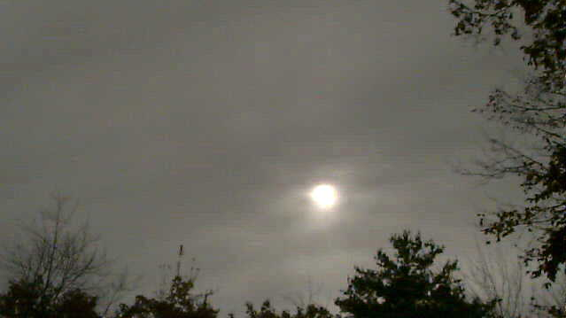
Cirrostratus
Blanket the sky and are usually translucent

Slide 18
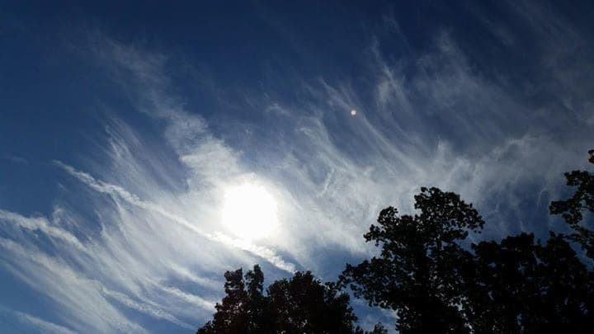
Cirrus – Curl of hair
Thin, feathery, white clouds
Highest altitudes
Formed when the wind is strong
Indicates approaching bad weather
Wispy looking, horse tails
Form where air is cold, so made of ice crystals
Notes:
These clouds are stupid and annoying. They yield nothing. No rain, no snow. They hardly block out any sun. They serve no purpose. It’s impossible to look at these clouds and make shapes out of them. In short, they lack imagination.

Slide 19
Nimbus – Rain Cloud
When nimbo or nimbus is part of the cloud’s name it means precipitation might fall
There are two types:
cumulonimbus (cumulus clouds)
nimbostratus (stratus clouds).

Slide 20
Cumulonimbus A cumulus cloud that indicates thunderstorms and heavy rain.
Notes:
Biggest Clouds. These clouds are dense, vertical clouds and are known for their instability, like when Bruce Banner gets angry. They can produce severe weather like tornadoes and can further develop into apocalyptic supercells. During a storm, it’s okay to call these by their very humble name, “thunderhead.”

Slide 21
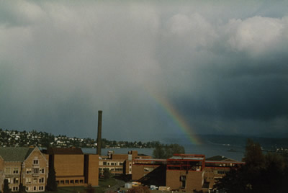
Nimbostratus A stratus cloud that produces light to heavy continuous rain, sleet, or snow

Slide 22
Clouds are also classified by altitude
Low Clouds = Stratus: below 2000m Middle Clouds = Alto: 2000m to 6000m High Clouds = Cirrus: start at 6000m and up

Slide 25
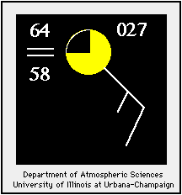
Cloud Cover indicated by weather stations
The symbol highlighted in yellow indicates the amount of cloud cover observed at the time the observation is taken. In this case, broken clouds were reported.

Slide 26
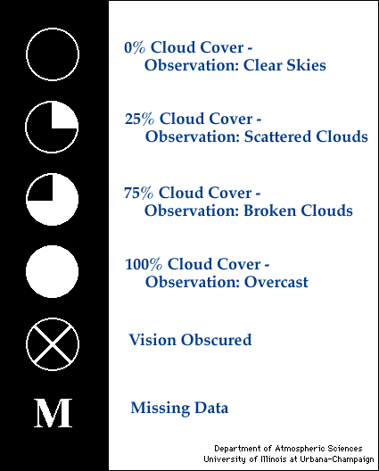
Cloud Cover Chart

Slide 27
Special Clouds

Slide 28
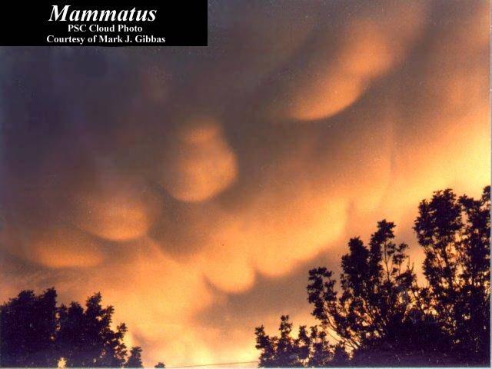
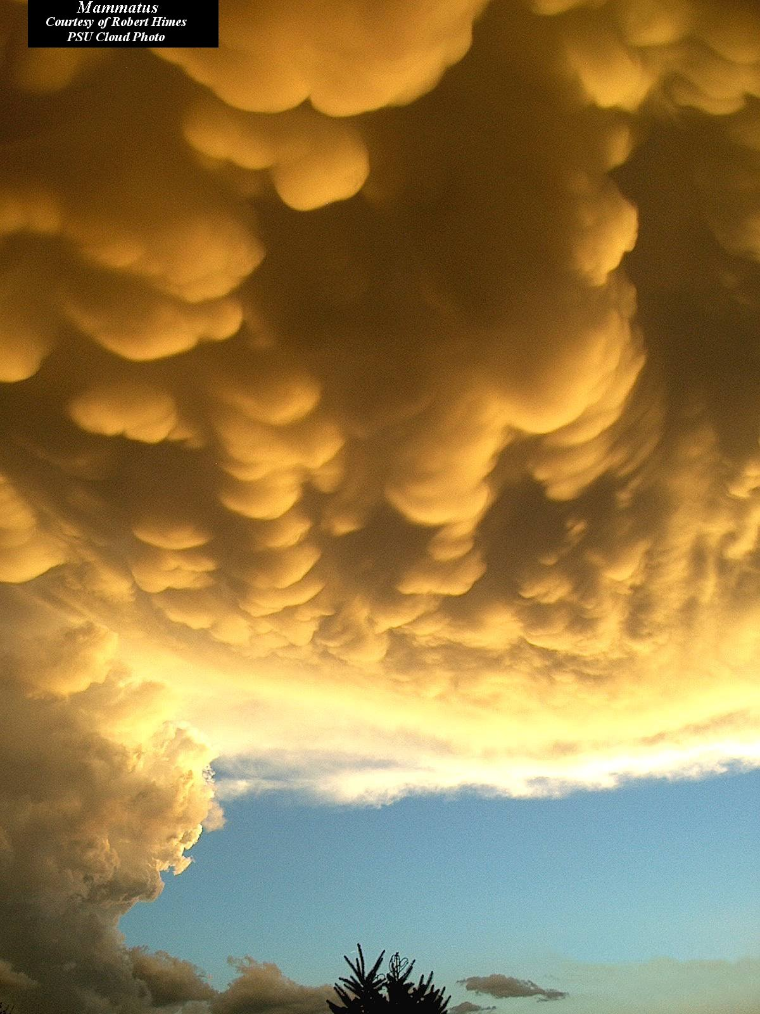
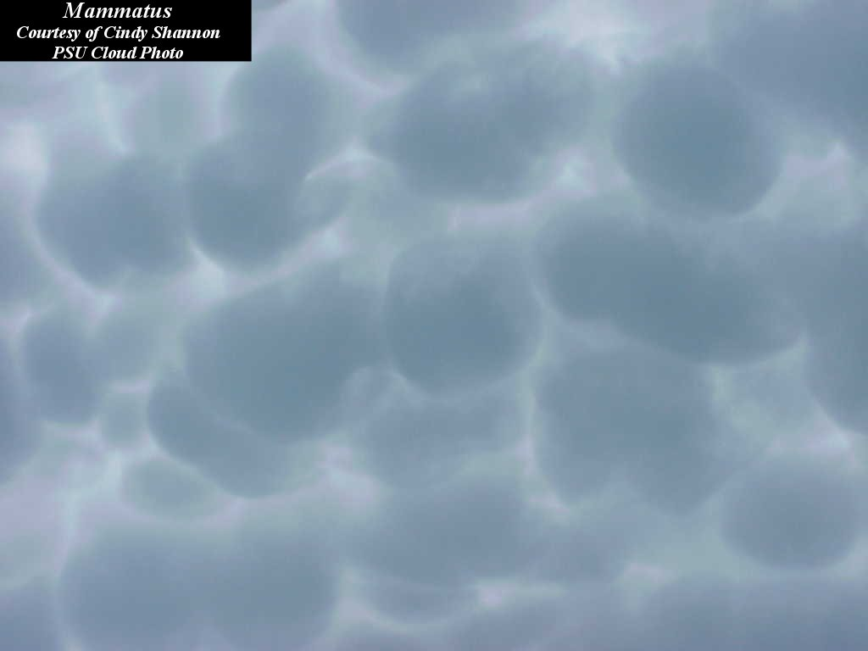
Special Clouds:
Mammatus Clouds

Slide 29
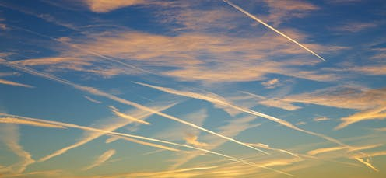
Contrails
short for "condensation trails“
Line-shaped clouds produced by aircraft engine exhaust
composed primarily of water, in the form of ice crystals.

Slide 31
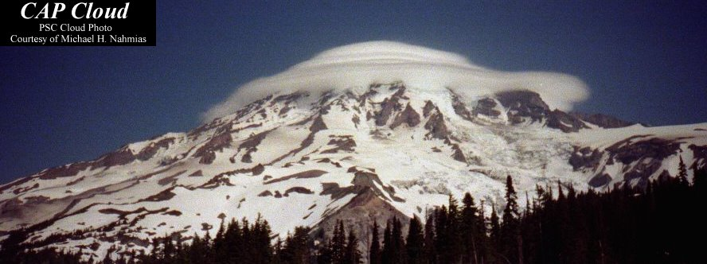
Orographic clouds
Produced by the flow of air interacting Orographic clouds – produced by the flow of air ineracting with mountainous terrain
mountainous terrain.
CAP cloud

Slide 32
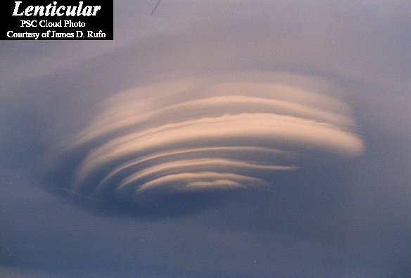
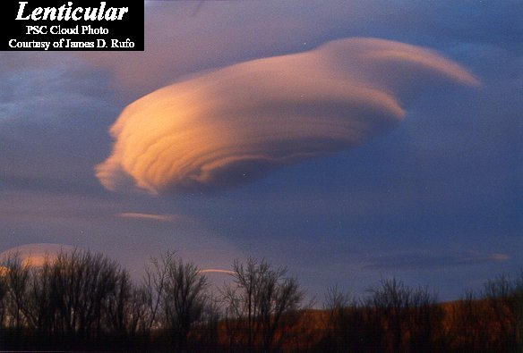
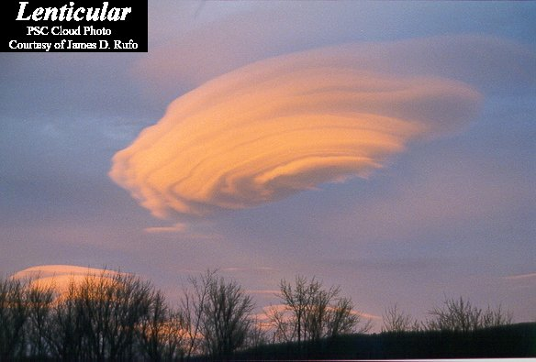
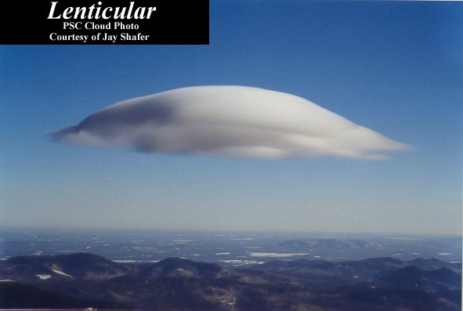
Lenticular
cloud
Lens-shaped clouds that can result from
strong wind flow over
rugged terrain

Slide 33
Sun Dog

Slide 35
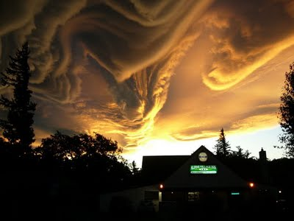
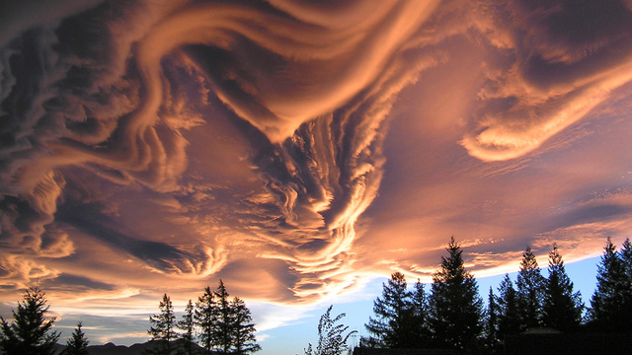
These clouds are called Undulatus Asperatus.
They are very rare

Slide 36
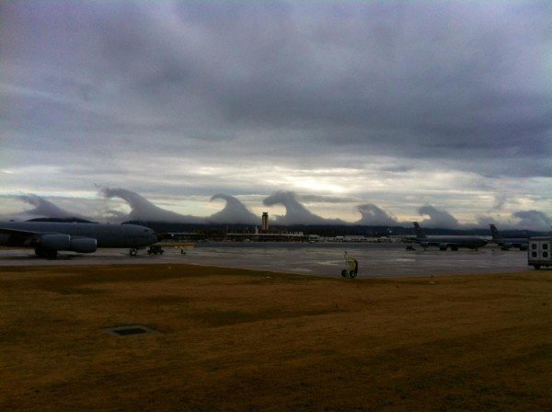

Slide 37
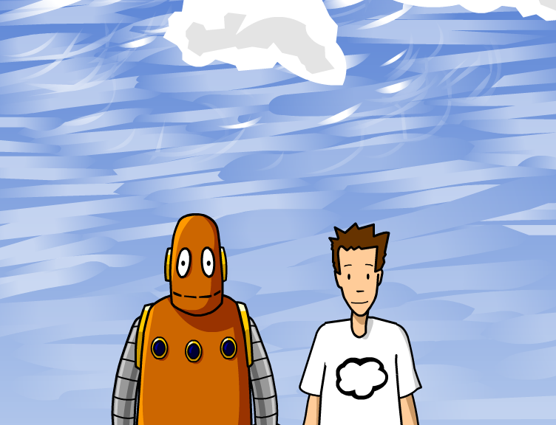
http://www.brainpop.com/science/weather/clouds/

Slide 38
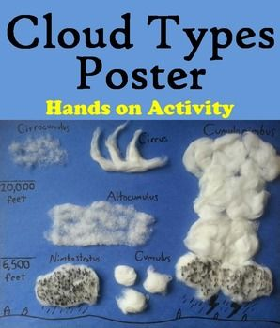

Slide 40
Practice
Read p 506-511
Cloud WS
Answer #10,11, 12a, 13a, 15 on p511

Slide 41
Activity
Make a rain gauge

Slide 42
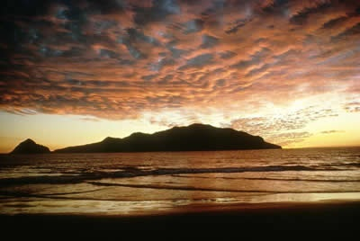
Stratocumulus - typically form after it rains, but before the sky clears. Has characteristics of both stratus and cumulus clouds.

Slide 43
Medium Altitude clouds 2000-6000m
Alltocumulus
Appear “puffier” than high level cirrocumuls because we’re closer to them
They can contain ice crystals and/or water droplets and may occuasionlly be associate with some light ppt.
Notes:
These clouds are generally gray and resemble a layer. The sun can be seen through these guys if they are thin enough. There is a lot of science behind these clouds because they are formed by the lifting of large and stable air masses

Slide 44
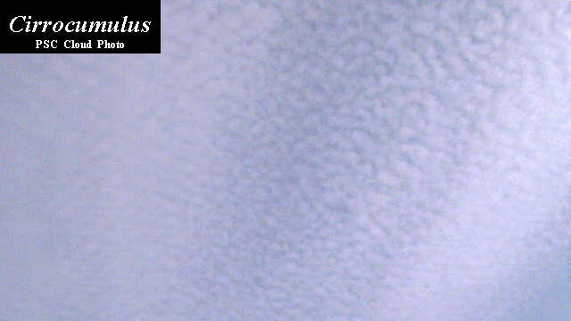
High Altitude Clouds
Cirruocumulus

Slide 45
LOW altitude clouds – below 2000m
Low clouds are most often composed of water droplets, but can have ice crystals in colder climates
Cumulus

Slide 46
Stratocumulus

Slide 47
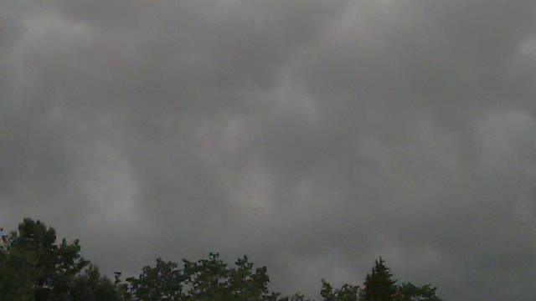
Stratus
People often refer to a stratus cloud filled sky as “overcast”

Slide 48
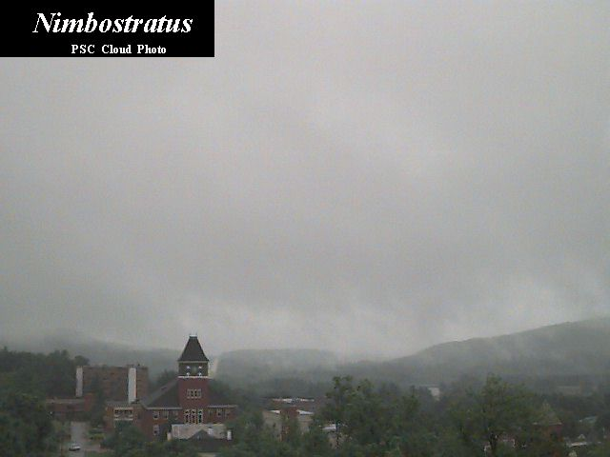
Multilayer Clouds - Nimbostratus
Gray and rainy day is usually filled with Nimbstratus
Associated with larges areas of continuous precipitation

Slide 49
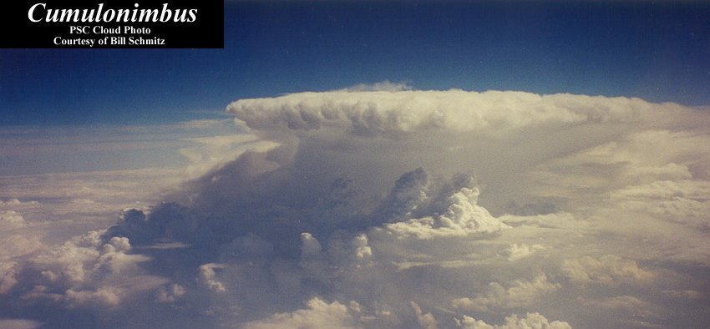
10. CUMULONIMBUS
Can extend above 60,000 feet
They usually have large anvil-shaped tops
These are the clouds that can produce
lightning, thunder, heavy rains, hail, strong winds, and tornadoes.

Slide 50
Cloud Type by Rain
Finally, we can classify them based on the presence of rain
Nimbus: any cloud that rains
Cumulonimbus: taller, towering versions of cumulus clouds. Their height can be from two to five miles. These clouds often form thunderstorms.
Nimbostratus: low, flat clouds that are often associated with steady precipitation and occur in thick, continuous layers and are often dark gray in color.

Slide 51
What the Clouds Tell Us
Cirrus (high) – fine weather
Cirrocumulus (high puffy) – unsettled weather
Cirrostratus (high horizontal) – approaching rain or snow
Altostratus – rain or snow likely if cloud thickens
Nimbostratus – rain or snow!
Stratus – maybe light rain or drizzle
Cumulus – sunny days
Cumulonimbus – thunderstorms, showers, hail

Slide 52
What the Clouds Tell Us
Dark clouds – storm clouds, high water droplet content and density, so they block light
Green tinge – thunderstorm clouds whose ice particles scatter light
Yellow tinge – contains smoke (forest fires)

Slide 54
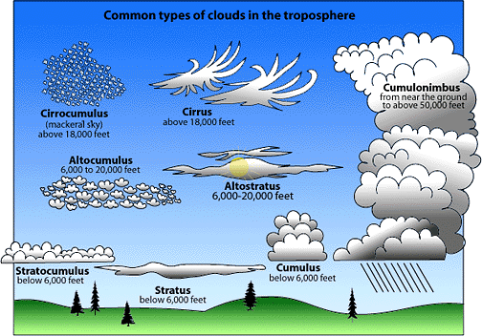

Slide 55
Determining Cloud Level
To determine cumulus cloud level hold your hand out at arm’s length and compare the size of the cloud “part” to the following:
Low-level cumulus clouds are about the same size, or
larger than, your fist.
Mid-level cumulus clouds are farther away and the individual
cloud pieces are about the size of your thumb.
High-level cumulus clouds are smaller still, with individual
cloud pieces about the size of the nail on your
little finger.

