Slide 1
Errors in DNA
Mutations

Slide 2
What is a mutation?
A Mutation is any change in the genetic material (DNA).

Slide 3
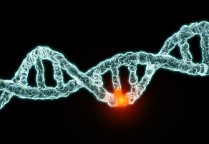
Two main types of Mutations:
Gene Mutations
May affect one point in the DNA in the form of a single nucleotide being added, deleted or substituted during DNA replication.
Notes:
Silent – no change
Missense – different protein
Nonsense – stop codon
→Genetic Disorder, cancer

Slide 4
Types of Gene Mutation
Notes:
Point mutations (substitions):
Silent – no change
Missense – different aa
Nonsense – stop
Frameshift – addition/deletion

Slide 5
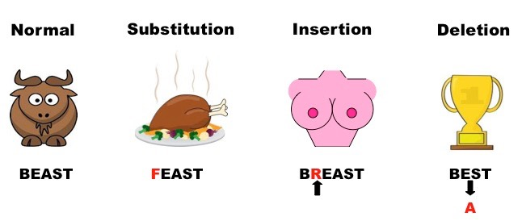
Type of Gene Mutations

Slide 6
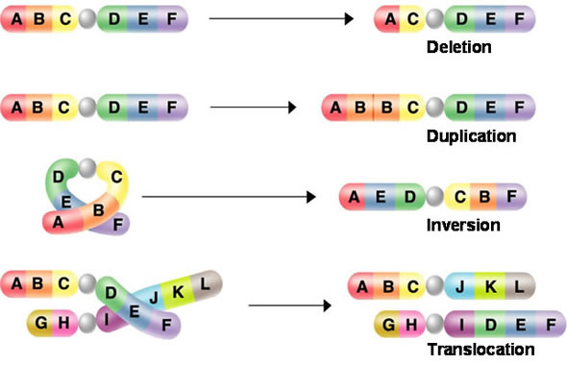
2. Chromosome Mutations
Pieces of chromosomes may be added, deleted or switched, or sometimes they may fail to separate during meiosis (nondisjunction)
.
Notes:
Result: Genetic Disorder
These are basic descriptions, may result in genetic disorders.
Addition: the gain of a portion of a homologous chromosome
Deletion: the loss of a portion of a chromosome
Translocation: the gain of a portion of a non- homologous chromosome

Slide 7
What happens when your DNA is damaged?
Ted Ed video
https://ed.ted.com/lessons/what-happens-when-your-dna-is-damaged-monica-menesini

Slide 8
What happens when DNA changes?
If the DNA sequence is altered,
→ the incorrect message is delivered to the cytoplasm,
→ ribosomes “read” the incorrect message.
incorrect or incomplete protein or non at all.
→ cellular functions may not be carried out.

Slide 9
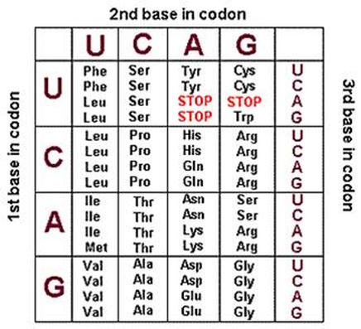
Codon Chart
What does UGC code for?
Notes:
Cysteine
Cysteine
Stop codon – terminates the protein sequence

Slide 10
Codon Chart
What does UGC code for?
Cystine
Notes:
Cysteine
Cysteine
Stop codon – terminates the protein sequence

Slide 11
Codon Chart
What does UGC code for?
What if the C was replaced by U?
Notes:
Cysteine
Cysteine
Stop codon – terminates the protein sequence

Slide 12
Codon Chart
What does UGC code for?
What if the C was replaced by U?
Still Cystine
Same amino acid,
therefore no change in protein
Notes:
Cysteine
Cysteine
Stop codon – terminates the protein sequence

Slide 13
Codon Chart
What does UGC code for?
What if the C was replaced by U?
What if the C was replaced by A?
Notes:
Cysteine
Cysteine
Stop codon – terminates the protein sequence

Slide 14
Codon Chart
What does UGC code for?
What if the C was replaced by U?
What if the C was replaced by A?
STOP codon
→ Protein incomplete
Notes:
Cysteine
Cysteine
Stop codon – terminates the protein sequence

Slide 15
What causes mutations?
Mistake during DNA replication
nucleotide being added, deleted or substituted during DNA replication.
Notes:
If enough mutations add up → cancer

Slide 16
What causes mutations?
2. DNA is damaged by environmental factors (mutagens).
Mutagen is any factor that causes a mutation such as radiation (X-rays, UV rays), cigarette smoke, poisonous chemicals.
Notes:
If enough mutations add up → cancer

Slide 19
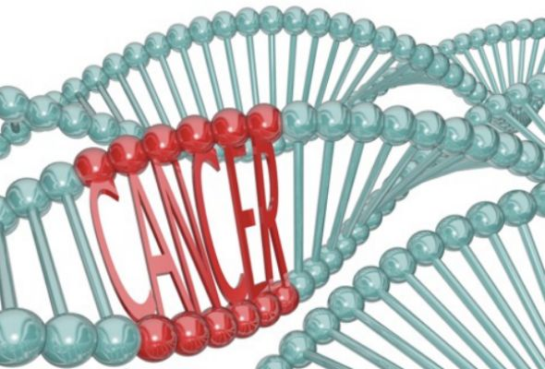
Notes:
Cancer is a multiple hit scenario, hence usually occurs later in life after being exposed to many mutagen over time, mutations added up.

Slide 20
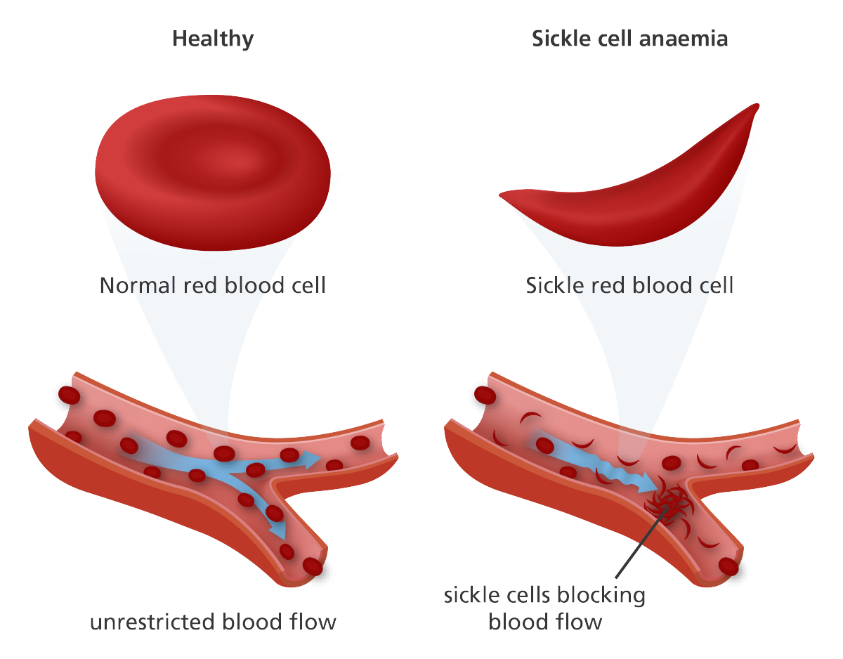
Are Mutations harmful?
Mutations can be beneficial, harmful or neutral. Most are harmful.
NEGATIVE (harmful) mutation: People born with Sickle Cell Anemia have a mutated gene that makes their red blood cells have a curved shape instead of the normal disc shape. The curves shape prevents the cells from carrying oxygen well and blocks blood flow in blood vessels.

Slide 21
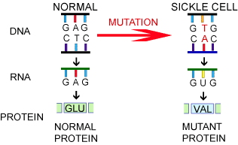
Sickle Cell Anemia: point mutation
Notes:
One amino acid change

Slide 22
Positive (Helpful) Mutations
Example: some plants carry a mutated gene that protect them from certain diseases
Example: some people have a mutated gene that produces a special protein that prevents the HIV virus from infecting them.
Example: some people have a mutated gene of a protein that is better at removing bad cholesterol from cells and dissolving arterial plaques, and therefore have significantly lower risk of heart attack and stroke.

Slide 23
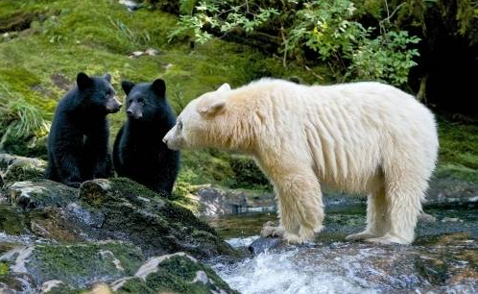
Neutral Mutation
Most mutations are neutral, meaning it does not affect the organism in any way.
Example: Some mutations are only one nitrogenous base switch and may not change the code for the protein, thus having no effect.
Example: Spirit Bear of coastal BC have a mutated gene that makes their fur white instead of black.

Slide 24
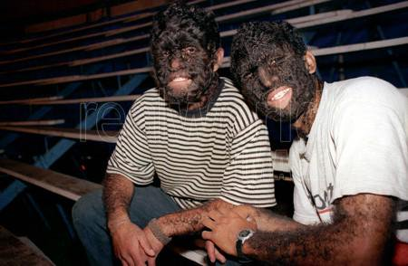
Neutral mutation: Hypertrichosis
Notes:
Both men and women affected by the mutation pass on the defective gene to 50 percent of their offspring. The line ends in family members who are born with normal hair growth.
gene called SOX3
Werewolf Syndrome

Slide 25
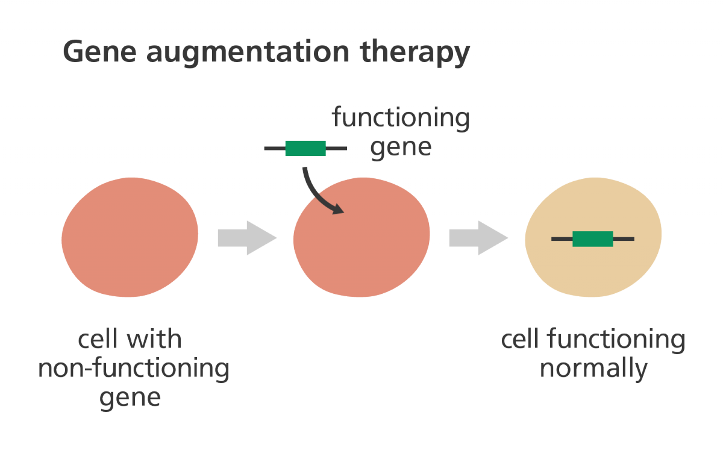
Can Mutations be fixed?
Some mutations can be treated with drugs or surgery.
Gene therapy is a new technique:
the mutated gene is replaced with a healthy copy of the gene.
the healthy copy must first attach to a chromosome within a patient’s cell. Then the gene needs to make the correct type and amount of protein.
Notes:
Or block the affected gene that is producing the wrong thing

Slide 26
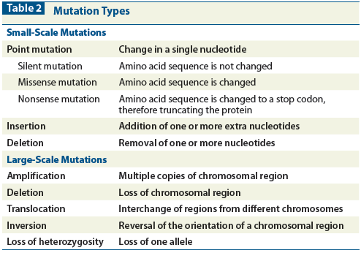

Slide 27
Activity: Lost in Translation
Geneskool Beetle

