Slide 1
Microscopes

Slide 2
Which one is the prokaryotic cell?
Notes:
What makes prokaryotic cells different from Eukaryotic cells?

Slide 3
Brainstorm
Why are we interested in seeing very small things?
What do we need to see very small things?

Slide 4
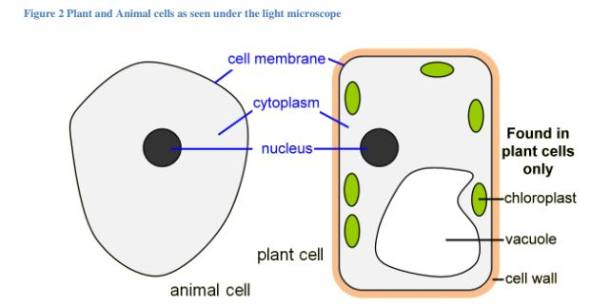
How can we see the parts of a cell?
Some organelles can be seen by looking through a compound light microscope while other need a higher power microscope to observe.
Notes:
Which organelles do you only find in plant cells
Which organelle is larger in a plant cell than in an animal cell?

Slide 5
Organelles that can be seen with a light microscope

Slide 6
History of the microscope
Sci Show
https://www.youtube.com/watch?v=Ue-86MDmjns
Notes:
5 min

Slide 7
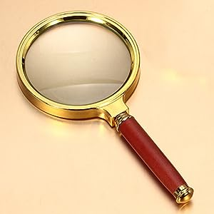
Observing Very Small Living Things
There are many ways to observe very small things.
  magnifying lenses
Water flea (Daphnia)

Slide 8
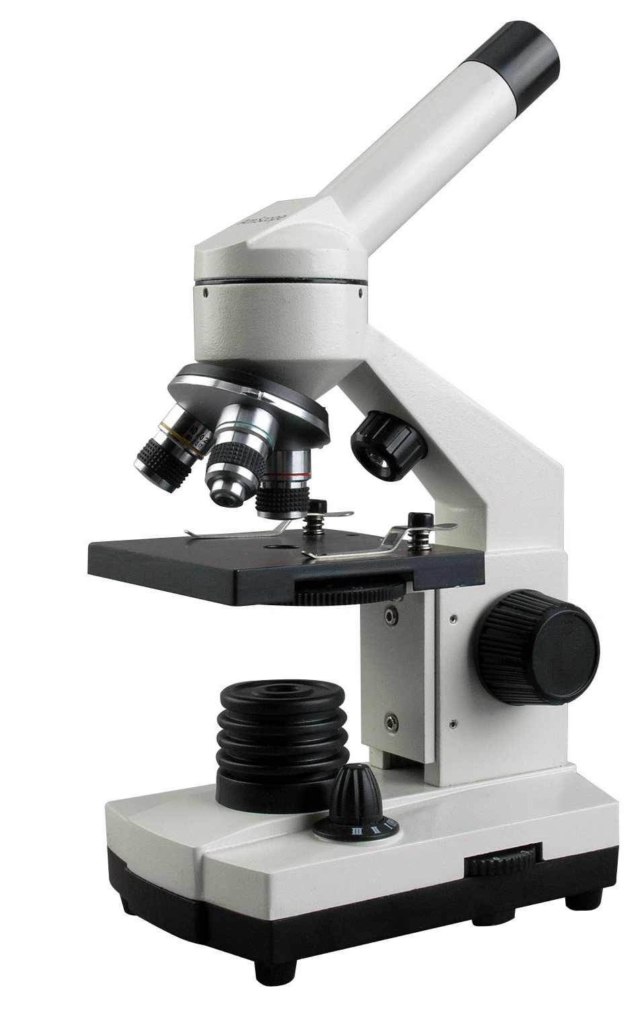
Observing Very Small Living Things
  magnifying lenses
  compound light microscopes
Water flea (Daphnia)

Slide 9
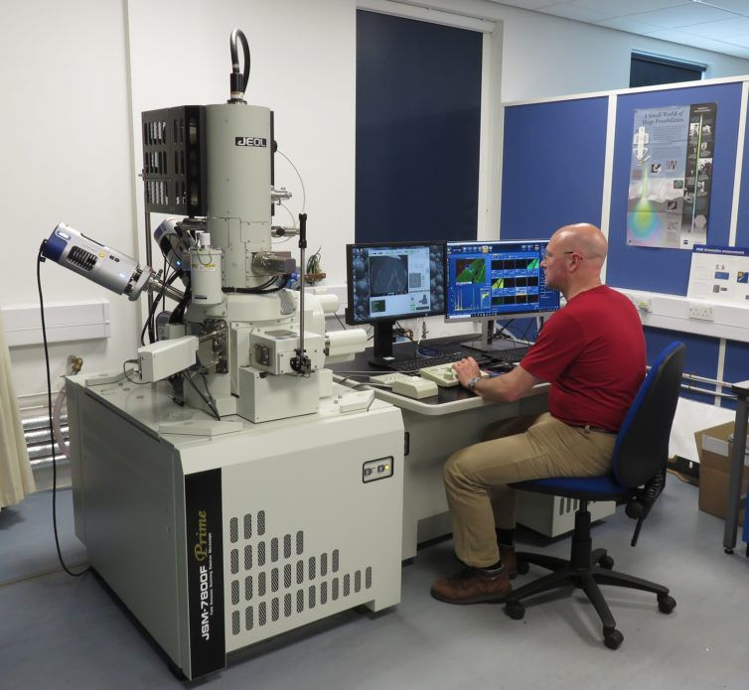
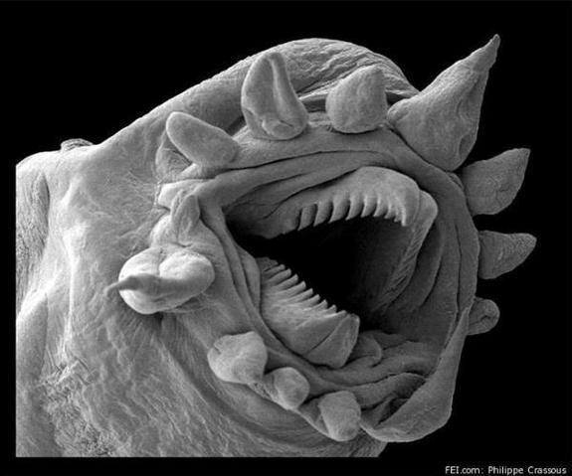
Observing Very Small Living Things
  Electron microscopes
Water flea (Daphnia)
See page 11

Slide 10
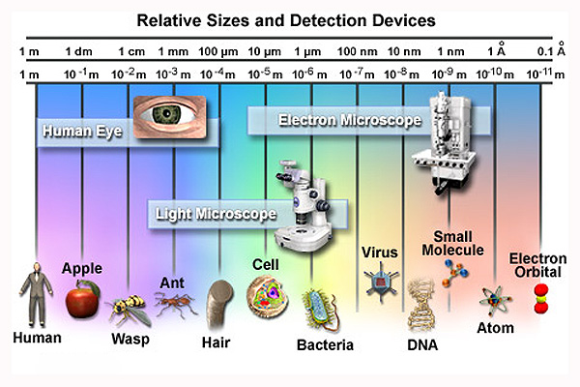

Slide 11
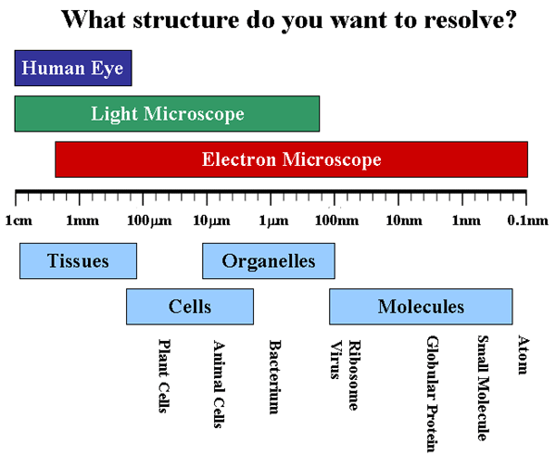

Slide 12
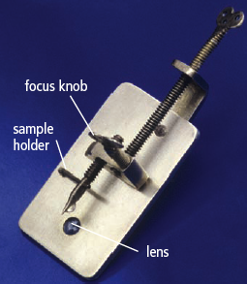
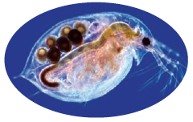
Early Microscopes
In 1590’s Hans and Zacharias Janssen, a father-son team of spectacle makers invented First light microscope who They put several lenses in a tube and made a very important discovery.
Notes:
The microscope is used by scientists to observe very small unicellular and multicellular living things.
Early microscopes were built in the late 1600’s.
The history of the microscope begins with Zacharias Jansen's invention of the first light microscope in the 1590's. Anton van Leeuwenhoek later made significant improvements to the compound microscope.

Slide 13
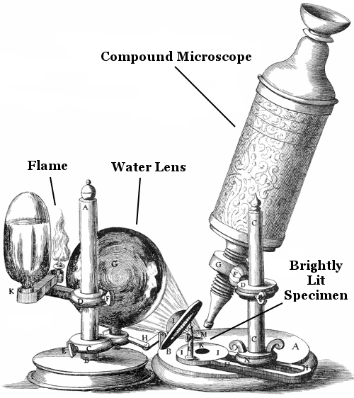
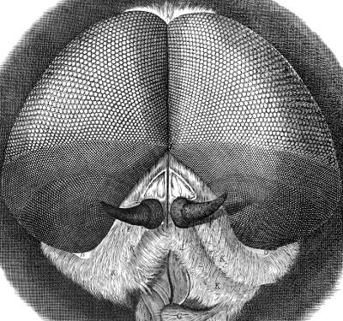
Robert Hooke -early microscope pioneer
1665 Hooke built and Improved upon compound designed a new, screw-operated focusing mechanism.
Previously, people needed to move the specimen to get it in focus.
Added a light source.
First to discover microscope fungi.
Looked at sections of cork – called them "cells".
At the time, Hooke's microscope was one of the best ever produced.

Slide 14
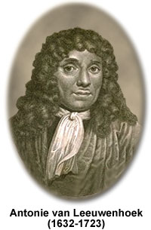
Anton van Leeuwenhoek, 1666
In 1666 he made his own microscope and improved it. Credited with inventing first practical microscope.
It was hand held, single lens
It could magnify up to 250x.
discovered "protozoa" -single-celled organisms he called "animalcules".
First to observe red blood cells, muscle fibers, and sperm.
known as "the Father of Microbiology"

Slide 15
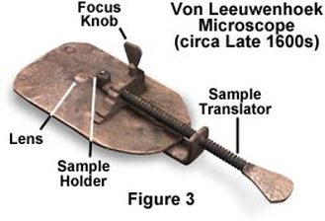
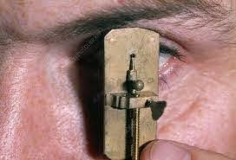
It was quite small

Slide 16
Microscopes
Notes:
Wacky History of the Cell video

Slide 17
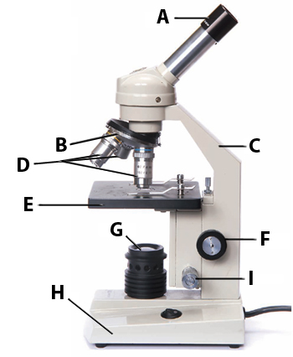
Compound Light Microscope
Two sets of lenses to magnify an image,
(One in eye piece, one in each objective)
Total magnification: 400 - 600x
Do you know all the compound microscope parts?
See pages 12-13

Slide 18
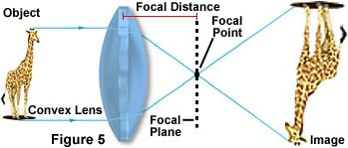
The image you observe is magnified, and inverted (upside down) and reversed (backwards).

Slide 19
Electron Microscope
uses beams of electrons instead of rays of visible light
Magnification up to 10,000,000 x
Notes:
to form highly magnified images of tiny areas materials or biological specimens.
Much higher magnifications and has a greater resolving power than a light microscope, allowing it to see much smaller objects in finer detail.

Slide 20
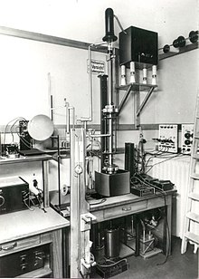
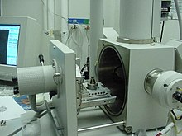
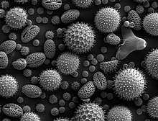
Electron Microscopes
  Scanning electron microscopes (SEM) 2Mx
  Transmission Electron Microscope (TEM) 50 Mx
Water flea (Daphnia)

Slide 21
How the Compound Light Microscope works
Use page 12 of your text book to label the parts and their functions
Do you know all the compound microscope parts?
See pages 12-13

Slide 22
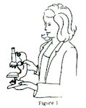
Proper Handling of a Microscope
Always use 2 hands:
  One hand on the arm,
  one hand supporting the base

Slide 23
USING A LIGHT MICROSCOPE
Start with the lowest power objective.
Notes:
Use lowest objective first:
Find your object, get it into focus without cracking slid

Slide 24
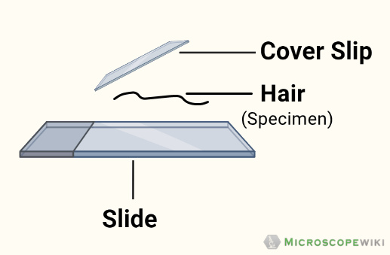
Using a light microscope
Always start with the lowest power objective.
Always put specimen on glass slide, not directly on stage.
Notes:
Use lowest objective first:
Find your object, get it into focus without cracking slid

Slide 25
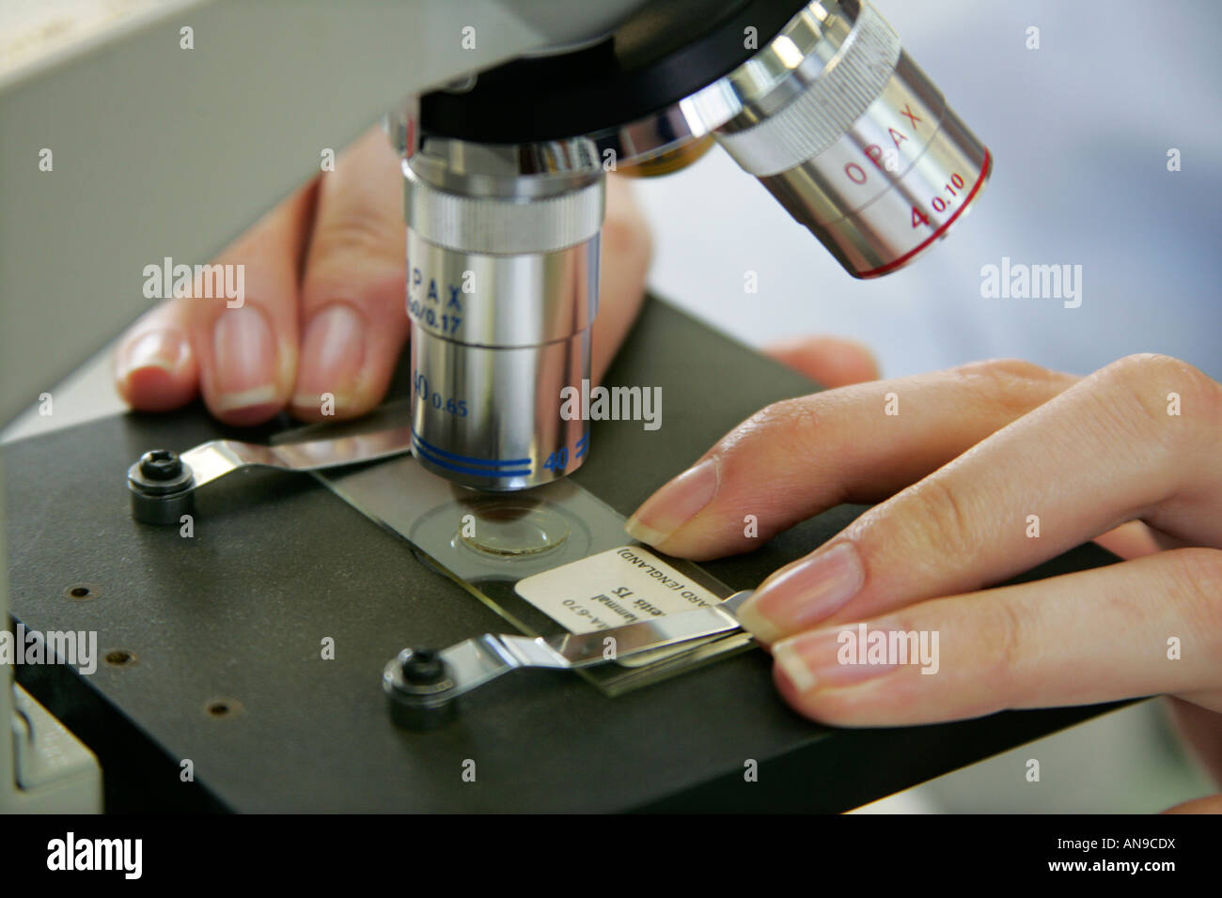
Using a light microscope
Always start with the lowest power objective.
Always put specimen on glass slide, not directly on stage.
Place slide on the stage, secure with clips.
Notes:
Use lowest objective first:
Find your object, get it into focus without cracking slid

Slide 26
Using a light microscope
Always start with the lowest power objective.
Always put specimen on glass slide (with coverslip), not directly on stage. Place slide on the stage, secure with clips.
Turn the coarse focus knob to focus your specimen.
Notes:
Use lowest objective first:
Find your object, get it into focus without cracking slid

Slide 27
Using a light microscope
Always start with the lowest power objective.
Always put specimen on glass slide, (with coverslip) not directly on stage. Place slide on the stage, secure with clips.
Turn the coarse focus knob to focus your specimen.
Only when specimen is centered and in focus, switch to higher objective. Only use fine focus knob. Why?
Notes:
Use lowest objective first:
Find your object, get it into focus without cracking slid

Slide 28
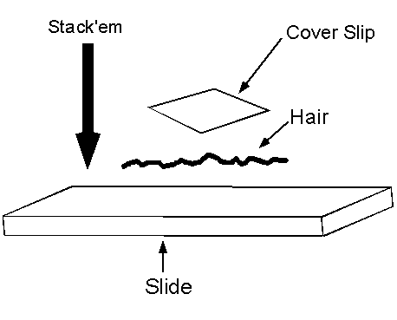
Never put a specimen directly on the stage
If viewing your OWN specimen, use a plane Microscope SLIDE and a COVERSLIP.

Slide 29
Why do we need to start with the lowest objective first?

Slide 30
Why do we need to start with the lowest objective first?
The lowest object makes it is easier to locate the specimen on the slide than if you start with a higher power objective.

Slide 31
Practice Handling
View bits of yarn, feather, colored magazine paper.
Students learn handling, focusing, navigating, switching to higher power, noticing difference of size in Field of View under different magnification.
Notes:
Using letter “e”, bits of yarn, feather, colored magazine paper.
Students learn handling, focusing, navigating, switching to higher power, noticing difference of size in FOV under different magnification.

Slide 32
Magnification and
Field of View

Slide 33
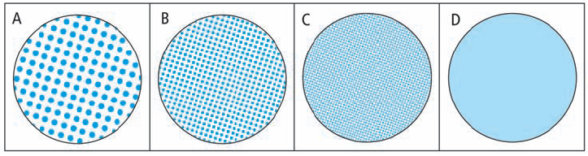
Resolving Power
Resolving power is the ability to distinguish between very small objects that are very close together.
The human eye has a certain resolving power.
You can see the individual dots in diagrams A, B and C.
The human eye does not have the resolving power to see the dots in diagram D.
Can you think of ways to increase resolving power?
Notes:
Magnification is the ability to make small objects seem larger, such as making a microscopic organism visible. Resolution is the ability to distinguish two objects from each other. Light microscopy has limits to both its resolution and itsmagnification.

Slide 34
Magnification
Low power objective magnifies 4x
Med power objective magnifies 10x
High power objective magnifies 40x
Eye piece is usually 10x
Total Magnification = Eyepiece X objective lens
Notes:
Example: High Power = 40 x 10 = 400 x

Slide 35
Calculating Total Magnification
What would the total magnification of a specimen be if you were looking through the medium power lens?

Slide 36
Calculating Total Magnification
What would the total magnification of a specimen be if you were looking through the medium power lens?
Total Magnification = Eye piece X Objective
= 10 X 10
= 100x

Slide 37
Calculating Total Magnification
What would the total magnification of a specimen be if you were looking at it using the lowest power?

Slide 38
Calculating Total Magnification
What would the total magnification of a specimen be if you were looking at it using the lowest power?
Total Magnification = Eye piece X Objective
= 10 X 4
= 40x

Slide 39
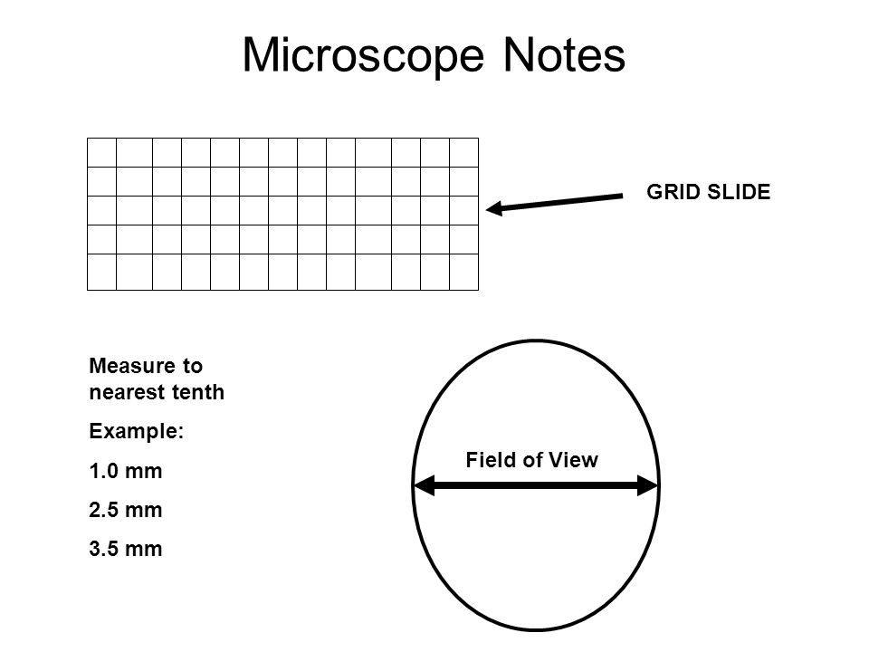
Field of View (FOV)
FOV is the area you see when looking through the microscope.
It is measured by the diameter of a circle (line through the center of a circle)

Slide 40
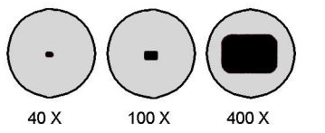
What happens to FOV as you switch to higher Magnification?
Notes:
As the power gets greater, the image gets larger but the field of view gets smaller.

Slide 41
What happens to FOV as you switch to higher Magnification?
field of view gets smaller
Notes:
As the power gets greater, the image gets larger but the field of view gets smaller.

Slide 42
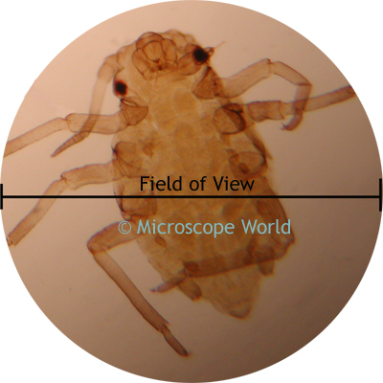
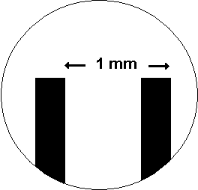
DETERMINING Field of View (FOV)
Your can determine field of view by placing a clear metric ruler on the stage and counting the millimeters from one side to the other.
What is the FOV in the image?

Slide 43
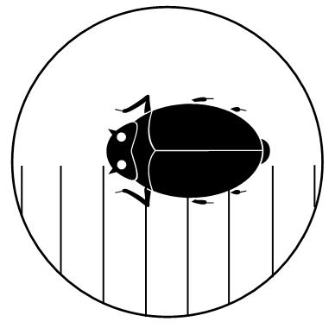
Use FOV to determine approximate size of an object.
If each line represents 1 mm, how big is the bug?
Notes:
For the diagram on the right, If each line represents 1 mm, how big is the bug?

Slide 44
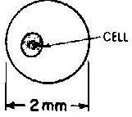
Using FOV to determine approximate size of an object.
If the Field of View is 2mm, how big is the cell?

Slide 45
How big is a micrometer? Add this to your notes
1 mm = 1000um
1 um = 1/1000 of a mm
How many um is 2.3 mm?
How many mm is 560 um?

Slide 46
Practice Conversion:
4 meters is how many cm?
4000 mm equals how many cm?
How many millimeters in 40 cm?
k h d m d c m

Slide 47
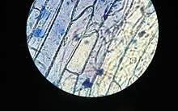

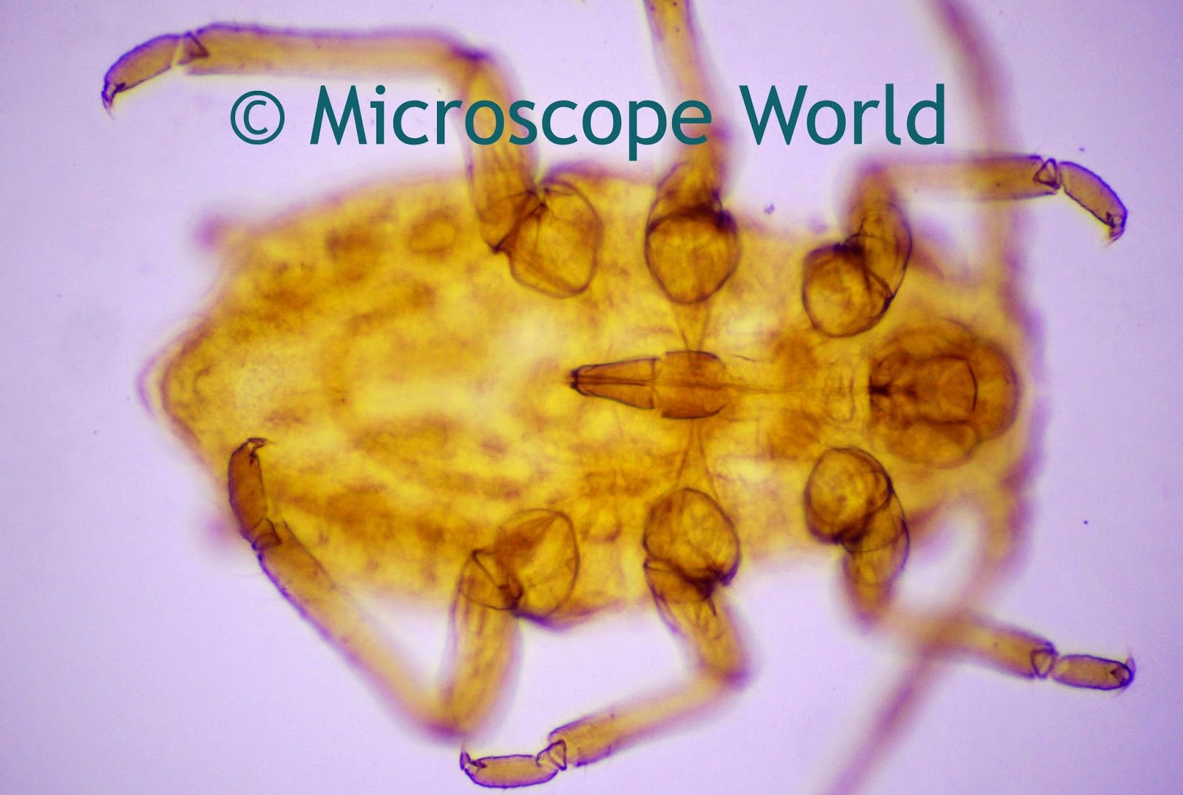
Wet Mount
Uses a drop of water between the slide and coverslip
Prevents the specimens from drying out.
Enables viewing of microscopic aquatic organisms in their “natural” environment.
Notes:
Wet mounts are used to view microscopic organisms that grow in pond water or other liquid media, especially when studying their movement and behaviour.

Slide 48
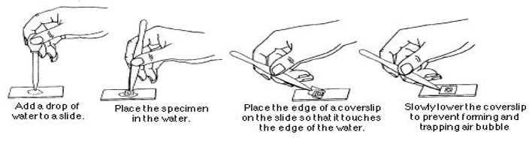
Preparing a Wet Mount Slide

Slide 49
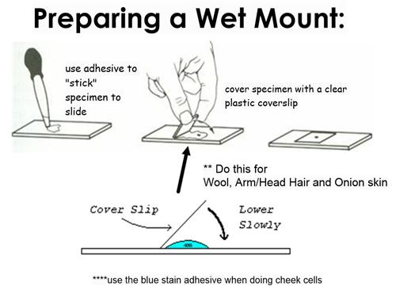

Slide 50
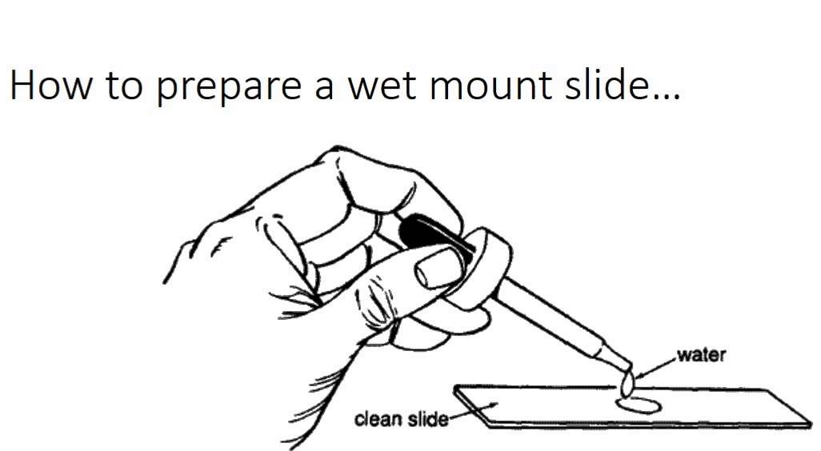
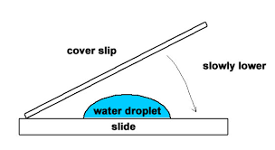
Preparing a Wet Mount of a Specimen
Place specimen on a clean microscope slide.
Using a dropper, place a drop of water on the slide.
Take cover slip, hold at a 45 degree angle to the slide and slowly lower it until the specimen is covered. This prevents bubbles.

Slide 51
HOW TO MAKE A SCIENTIFIC DRAWING

Slide 52
What is this???
putting green?
donut?
cell?
key?
landscape?
bottle opener?
egg?

Slide 53
A Egg Frying
November 17, 2011
Egg white
Egg yolk
1 x

Slide 54
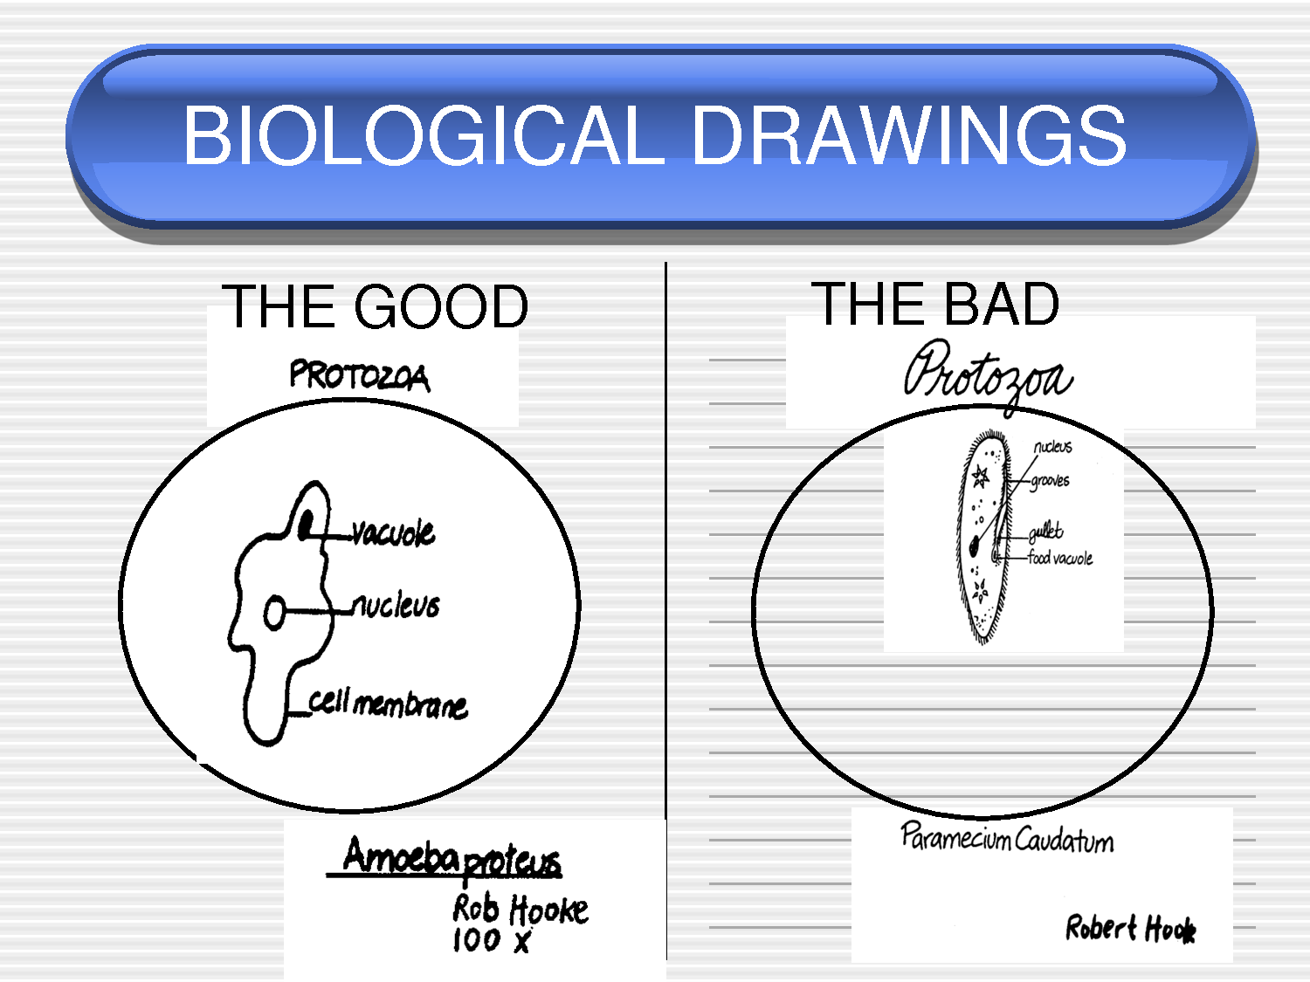

Slide 55
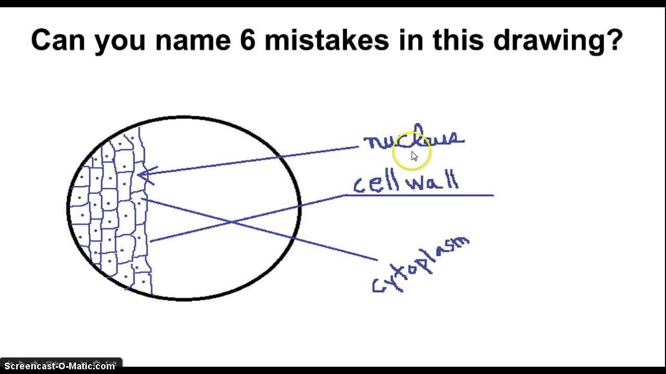

Slide 56
Rules of Scientific Diagrams
Each diagram MUST include:
  Use pencil, not pen
  Title (specimem)
  Magnification
  Stipple, not shading
  Print labels, no cursive writing
  Label line are Straight, do not cross, No arrows

Slide 57
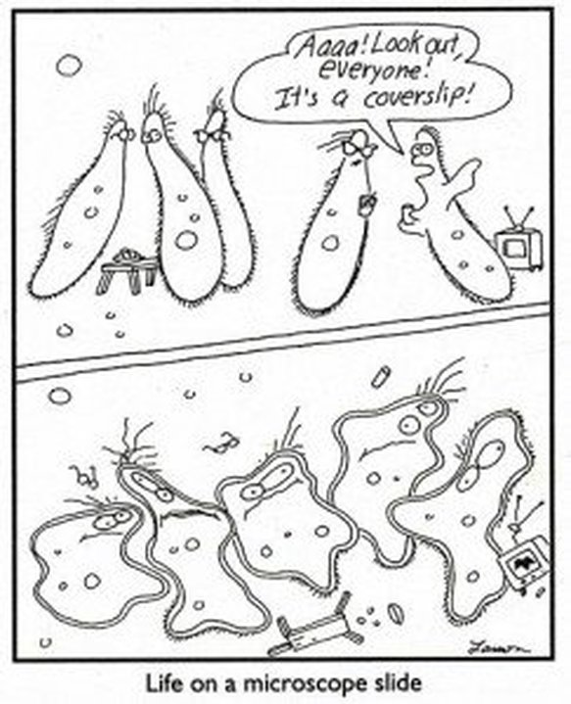

Slide 58
Practice
FOV and Magnification WS
Practice preparing wet mount.
Scientific Drawing

Slide 59
Assignment: Scientific Drawing of Paramecium
Use a microviewer, booklet # 222, Slide #2, of a Paramecium
Use booklet to determine proper labelling.
Follow the guidelines for drawing scientific diagrams
DUE: by end of class
Notes:
Label the following:
Cell wall (the outer part of the cell)
Chloroplasts (the little green things in the cell)
Cytoplasm (the blank space in the cell)

