Slide 1
SEISMOLOGY
THE STUDY OF EARTHQUAKES

Slide 2
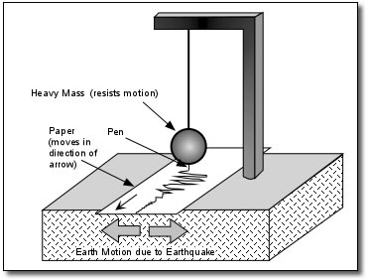
Seismograph
A seismograph is an instrument that records vibrations that are caused by seismic waves.

Slide 3
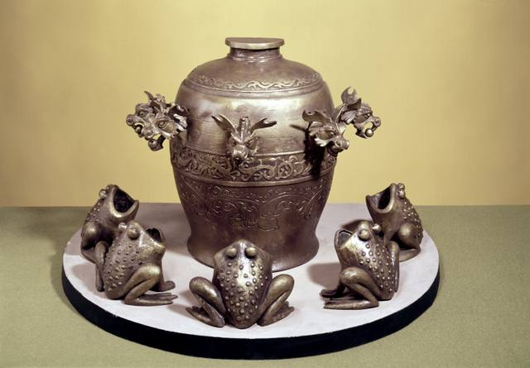

Slide 4
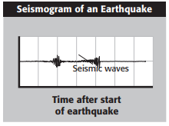
Seismogram
When the waves from an earthquake reach a seismograph, it records them as lines on a chart called a seismogram.

Slide 5
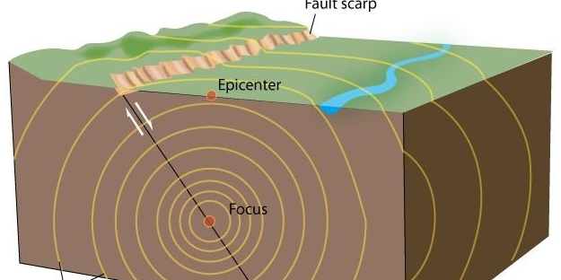
How Does Earthquake Energy Travel?
The released energy of an earthquake travels in the form of seismic waves that radiate out from the focus.

Slide 6
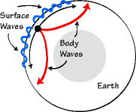
How Does Earthquake Energy Travel?
There are two kinds of seismic waves:
Body waves are seismic waves that travel through the inside (body) of Earth to the surface.
Surface waves are seismic waves that travel through the top part (surface) of Earth’s crust

Slide 7
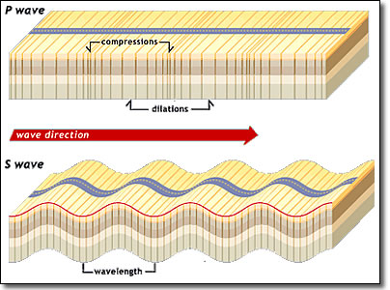
Two Kinds of Body Waves
P Waves
S waves

Slide 8
P Waves:
Primary/Compression/Pressure Waves
Fastest moving waves
can move through solids, liquids, and gases.
Causes ground to compress and stretch in the same direction as the wave.
Notes:
Squeeze and stretch

Slide 9
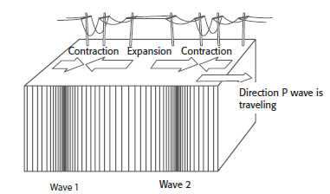

Slide 10
S Waves (Shear, Transverse Waves)
slower than P waves.
move rock from side to side.
can travel only through solids.
Shake the particles perpendicular to the direction of the wave.

Slide 11
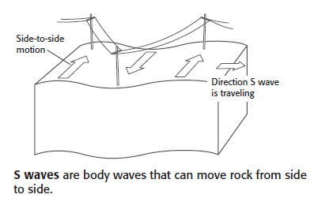

Slide 12
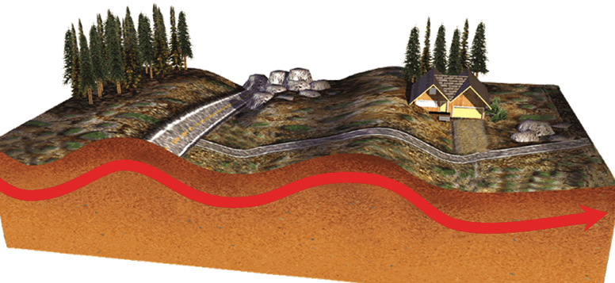
Surface Waves (L waves)
Travel along the surface (top of Earth’s crust).
Slowest (last waves to be felt).
Most damaging
Click here to see a Love wave in action.
Notes:
named after A.E.H. Love, a British mathematician who worked out the mathematical model for this kind of wave in 1911.

Slide 13
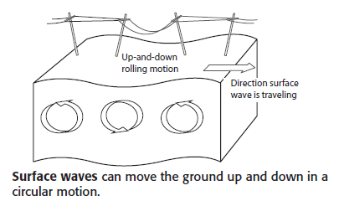

Slide 14
Love Waves – surface waves

Slide 15
Check your understanding
Which kind of seismic wave travels the most slowly?
How are the motions of P waves and S waves different?
What do you think is the reason surface waves usually cause the most damage?

Slide 16
Slinky Activity

Slide 17
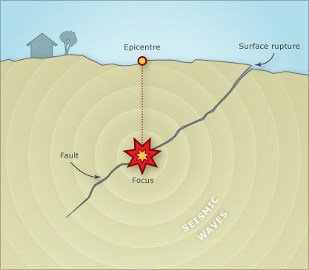

Slide 18
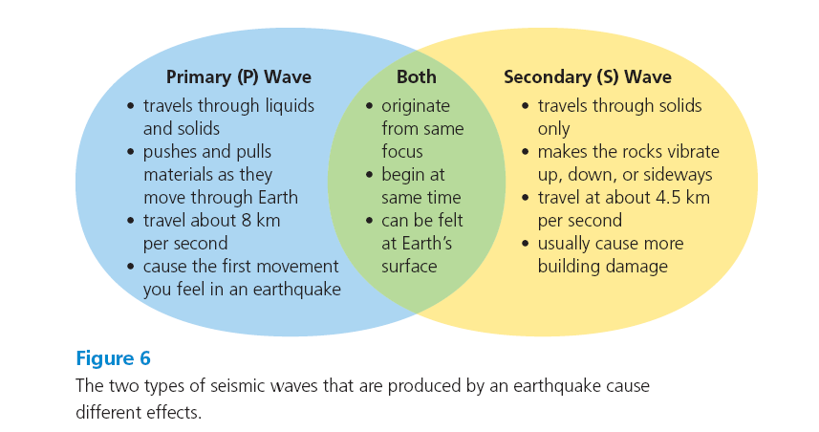

Slide 20
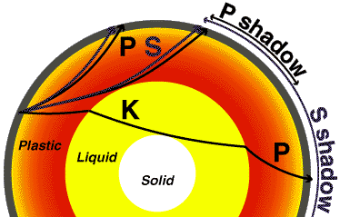

Slide 21
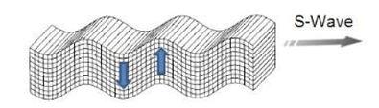
Seismic Waves
P Waves – primary wave
S Waves – secondary wave
Love Waves – surface wave

