Slide 1
Elements: the building blocks of matter. NAMING AND CLASSIFYING

Slide 2
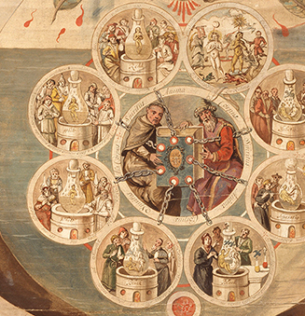
The History of Chemistry
Alchemy - medieval precursor to chemistry based on the idea of transforming of matter, particularly in converting metals into gold.

Slide 3
The History of Chemistry
Alchemists believed what the Greeks had, that all substances in the world were composed of:
Fire
Earth
Air
Water
https://www.youtube.com/watch?v=O-48znAg7VE

Slide 4
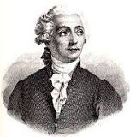
Antoine Lavoisier – the father of chemistry
Scientists believed water was an element.
Lavoisier discovered that water was a compound made of hydrogen and oxygen.
In June 1783, Antoine Lavoisier reacted oxygen with inflammable air, obtaining "water in a very pure state."
He concluded that water was not an element but a compound of oxygen and inflammable air, (hydrogen). To support his claim, Lavoisier decomposed water into oxygen and inflammable air.
In 1777, he was the first to establish that sulfur was an element, not a compound.
He wrote the first extensive list of elements, and helped to reform chemical nomenclature.
In 1778, he named oxygen.
In 1783 he named hydrogen.
Also helped construct the metric system

Slide 5
Beginnings of Modern Chemistry
Early chemists began to recognize the existence of two types of pure substances:
Compounds and elements
And began to test many substances to see if they could be broken down.
If it could not be broken down → they found a new element

Slide 6
How are elements named?
Most have Latin origins: plumbum is Lead
Based on their special properties
Eg. “light giving” (phosphorous)
Eg “water forming” (hydrogen)
E.g. Mercury – hydragyrum "liquid silver"
3. Some named after scientists (einsteinium)
4. Some named after Countries (germanium), cities (berkelium)
Notes:
Mercury gets is name from the planet Mercury which was named after the swift messenger of the Roman gods, Mercury. It was given this name because it flowed swiftly in its liquid form. The symbol Hg comes from the Latin word "hydragyrum" meaning "liquid silver."

Slide 7
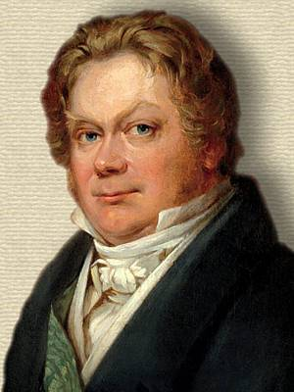
Symbols
Swedish chemist Jons Jakob Berzelius suggested symbolic system to describe all the elements using the letter of either their common name or Latin name.

Slide 8
Symbols
Each element begins with one capital letter
Usually first letter of their common or Latin name:
Carbon = C
Hydrogen = H
Boron = B

Slide 9
Symbols
If there is a second letter, it is lower case :
Helium = He
Calcium = Ca
Lithium = Li

Slide 14
HOW ARE ELEMENTS CLASSIFIED?

Slide 15
Learning Goals
I can identify metals on the periodic table
I can identify non-metals on the periodic table
I can describe properties of metals and non-metal

Slide 16
How are Elements classified?
Elements are classified according to their properties (chemical and physical). They can be classified as either:
Metals
Non-metals
Metalloids

Slide 17
Notes:
Which group is the biggest? Therefore most elements are metals.

Slide 18
Notes:
First 18 elements make up most of earth

Slide 19
Hydrogen is NOT a metal

Slide 20
Metals

Slide 21
Physical Properties of Metals
Solid at room temperature (except mercury)
Shiny - Have metallic luster
Malleable – can be pounded into thin sheets
Ductile – can be drawn into a wire
Good conductors of heat and electricity.
High density (are heavy for their size)
High tensile strength (resist being stretched)
High melting and boiling points.

Slide 22
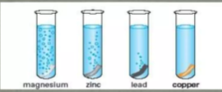
Some metals react with acid, some don’t

Slide 23
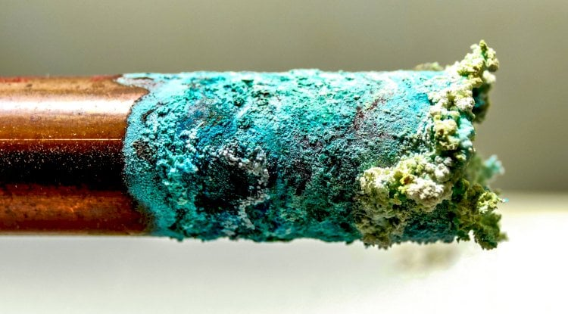
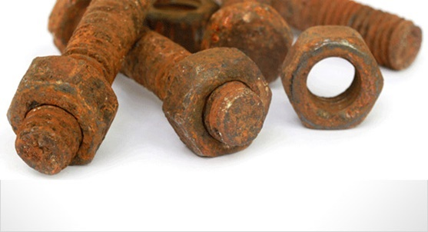
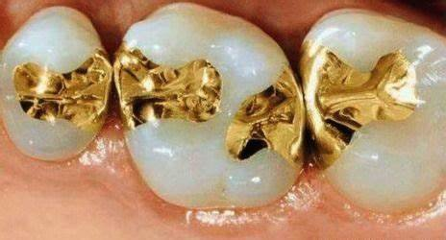
Chemical property of Metals
Some may react with water, resulting in corrosion
E.g. Iron, copper, lead, zinc
However,
Gold and Platinum do NOT corrode easily:

Slide 24
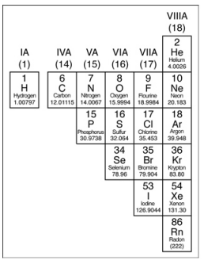
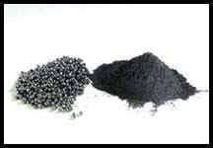
Non metals
Notes:
selenium

Slide 25
Non-Metals
Poor conductors of electricity or heat.
Not malleable or ductile.
Lower densities than metals.
Lower melting and boiling points than metals.
The one exception to this is carbon.
Low luster (dull, not shiny)
Solid non-metals are brittle (break easily)
Many are gas at room temp (hydrogen, oxygen, nitrogen)

Slide 26
Metalloids or Semi-Metals

Slide 27
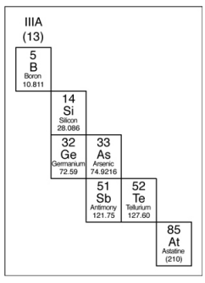
Metalloids or Semi-metals
Have some qualities of both metals and non-metals.
Often look like metals but behave like nonmetals.
They are solids at room temperature
Can be either shiny or dull.
Can conduct heat and electricity better than non-metals but not as well as metals.
Not very ductile or malleable. Brittle – break easily
Examples include: silicon, boron, arsenic.
Notes:
Some are called semiconductors. – conductors under special conditions.
Silicon is the 2nd most abundant element in Earth’s crust (after oxygen)
car grease, cookware, satellite parts, contact lenses, film props and prosthetics

Slide 28
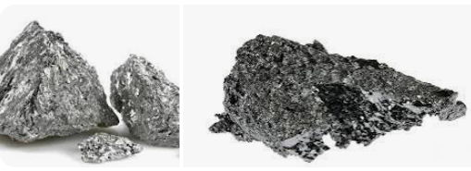
Unique to Metalloids
most useful property of metalloids: they are semiconductors .
Important in electronics.
act as both metals and nonmetals under different conditions.

Slide 29
Uses of Metalloids
Metalloids are semiconductors - important in electronics
Antimony is used as a flame retardant in plastics and other materials.
Boron is used as a bonding agent in magnets and other chemical substances

Slide 30
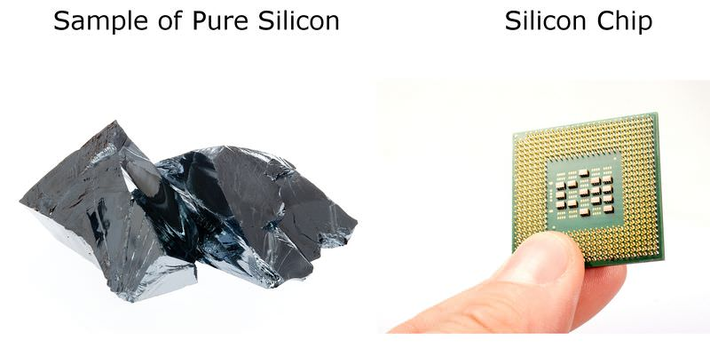
Semiconductor
Silicon is one of the most important materials used to make electronics such as computers and mobile phones
A semiconductor substance lies between the conductor and insulator.
It controls the flow of electric current in electronic equipment.
https://www.youtube.com/watch?v=aKPmQTj9BzA

Slide 31
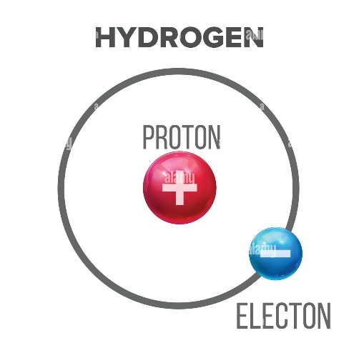
Hydrogen: NOT a METAL!
Usually placed on the left side of PT, but is a non-metal.
Can either lose or gain an electron
Often called a proton
Smallest and lightest element,
Colourless, odorless, tasteless, highly flammable gas
Most abundant (plentiful) element on Earth (Makes up over 90 % of the atoms in the universe).
Notes:
On Earth, most hydrogen is found combined with water.

Slide 32
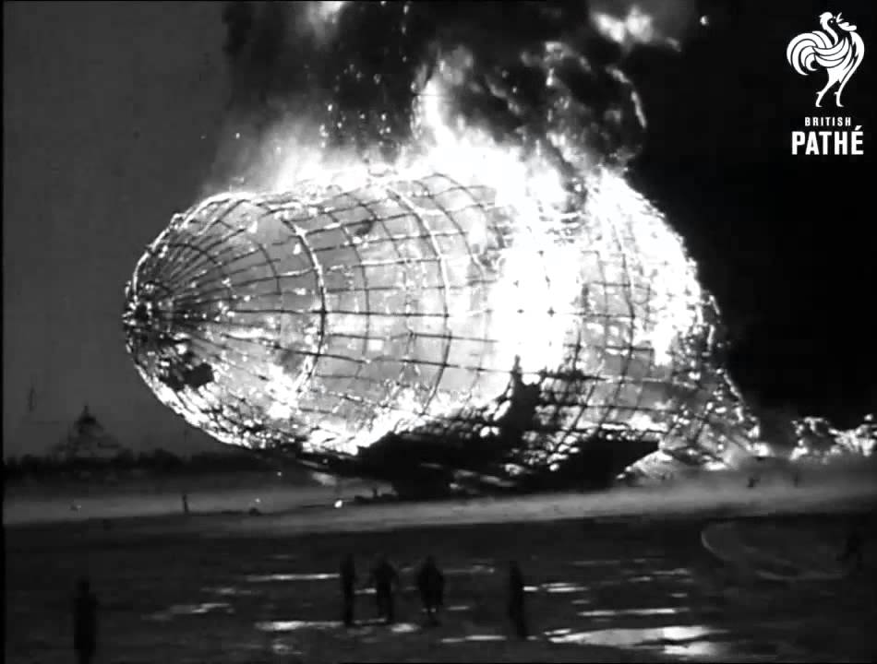
Hindenburg Disaster
The Hindenburg disaster was an airship accident that occurred on May 6, 1937, in Manchester Township, New Jersey, US.
The Hindenburg had been designed to use the inert gas helium, but Germany was unable to acquire the quantities needed to operate a fleet of airships.
Hindenburg disaster was caused by an electrostatic discharge (i.e., a spark) that ignited leaking hydrogen.
of the 97 passengers and crew on board, 62 survived.

Slide 33
Check your Understanding
Where on the periodic table can you find metals? Non-metals? Metalloids?
How do metals and non-metals differ in their properties?
What are some properties of metals that make them good for electrical wiring?

Slide 34
Practice:
Colour in your periodic table
Metals, nonmetals Worksheet –> Go over in class

Slide 35
Homework
Use pages 20-21 of WB to answer p22-23
And ptable.com interactive WS
Element Song ASAP Science:
https://www.youtube.com/watch?v=rz4Dd1I_fX0

Slide 36
Mercury
Aluminum nad mercury
https://www.youtube.com/watch?v=IrdYueB9pY4
Could put these in compounds/reactions
Mercury and penny

