Slide 1
Sexual Reproduction Enhances Genetic Diversity

Slide 2
Vocabulary
Gene Codominance
Allele Homozygous
Trait heterozygous
Genotype Punnett square
Phenotype
Dominance
Incomplete dominance

Slide 3
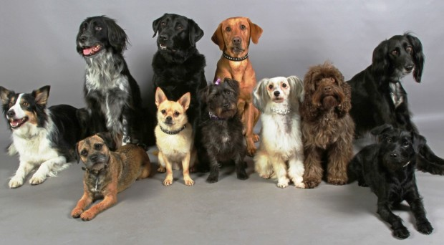
Sexual Reproduction Enhances Genetic Diversity
Genetic diversity is the total number of genetic characteristics in the genetic makeup of a species.
It is distinguished from genetic variability, which describes the tendency of genetic characteristics to vary

Slide 4
Activity: How many different offspring can be produced? p46

Slide 5
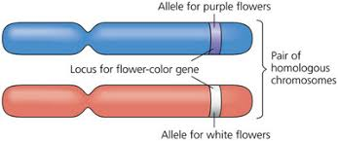
How does Genetic Variation Occur?
Each gamete contributes half of each pair of homologous chromosomes in the zygote:
Sperm (n) + egg (n) = zygote (2n)
Each chromosome has a corresponding gene, and each gene may be slightly different from each other (allele).

Slide 6
Three Sources of Genetic Variability
Independent assortment is the random alignment of homologous chromosomes during meiosis I and of nonidentical sister chromatids during meiosis II.

Slide 7
Crossing over between members of homologous pairs of chromosomes leads to the formation of chromosomes that contain new combinations of the alleles of the genes.

Slide 8
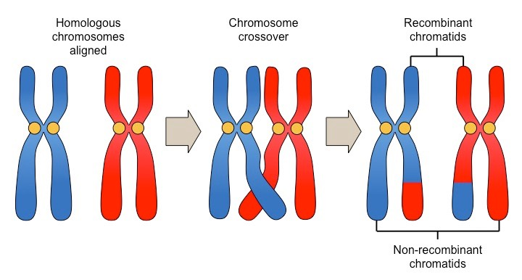
Three Sources of Genetic Variability
Crossing over between homologous chromosomes during prophase I.
Crossing over between members of homologous pairs of chromosomes leads to the formation of chromosomes that contain new combinations of the alleles of the genes.

Slide 9
Three Sources of Genetic Variability
Random fertilization of an ovum by a sperm:
Any sperm can fuse with any ovum
About 64 trillion diploid combinations
Each zygote has a unique identity

Slide 10
Genetic Diversity
Trait Treasure Hunt

Slide 11
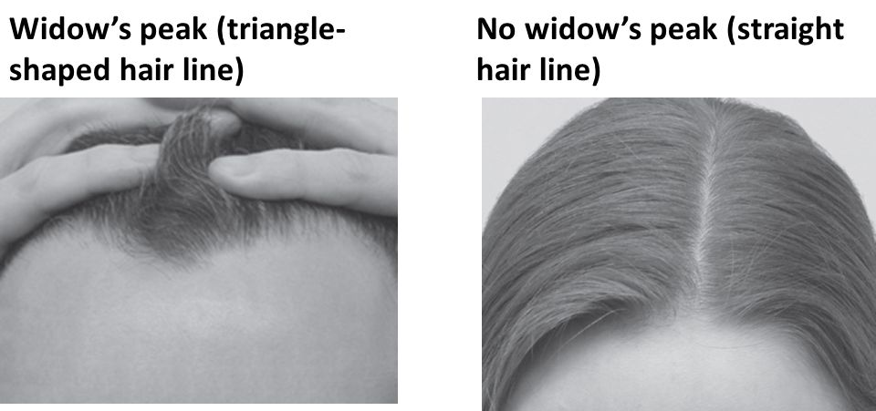
Genetic Diversity
Eg. in humans, homologous chromosomes may contain two different alleles for the gene that controls the shape of the hairline: one chromosome has the allele for a widow’s peak and the another has the allele for a straight hairline.

Slide 12
Dominance
The allele for a widows peak is dominant
A dominant allele will express its trait (the trait will show up in the person’s appearance) if it is present.
The allele for a straight hairline is recessive.
A recessive allele will only be expressed if both chromosomes contain the recessive allele.
If a person has one of each allele, the dominant trait is expressed.

Slide 13
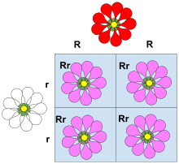
Incomplete Dominance
Incomplete dominance is a form of intermediate inheritance in which one allele for a specific trait is not completely expressed over its paired allele.
This results in a third phenotype in which the expressed physical trait is a combination of the phenotypes of
both alleles.
Example:
When a carnation (flower) has one allele for red flowers and one allele for white flowers, the result is pink flowers

Slide 14
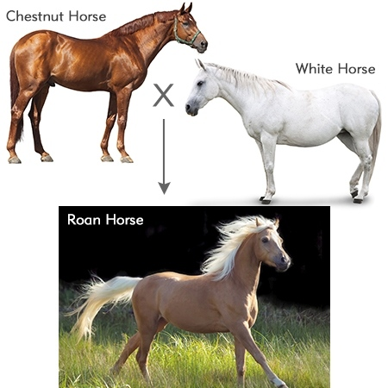
Codominance
Codominance is when both traits are expressed in one individual.
Eg. An animal born with an allele for white hair and an allele for red hair will have a roan-coloured coat, with a mix of white hairs and red hairs.

Slide 15
Punnett Squares
Punnett Square is a diagram used to show the possible combinations of gametes.

Slide 17
You try
If B is the dominant allele for purple,
And b was the recessive allele for white,
What would be the resulting offspring to this cross?

Slide 18
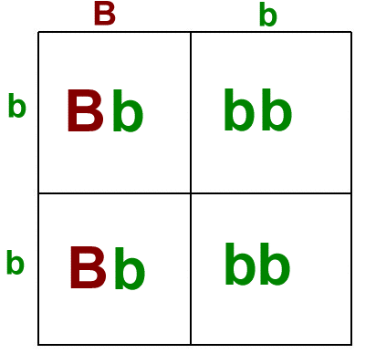
Answer
Half of all progeny (offspring) will be purple
Half will be white

Slide 19
CHAPTER
Sexual Reproduction
3
With a partner, draw a comparison table like the one below on a sheet of paper. In the table, list some advantages and disadvantages of sexual and asexual reproduction.
Read pages 80 and 81 in your textbook. Compare the advantages and disadvantages suggested in the reading with those you and your partner described in your table. Complete your table with any points you may have missed.
 | Advantages | Disadvantages
Sexual Reproduction
Asexual Reproduction

Slide 20
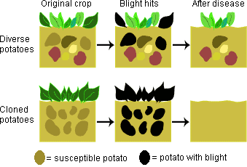
Why is Genetic Diversity Important?
Genetic diversity serves as a way for populations to adapt to changing environments and therefore survive to reproduce, ensuring the continuation of the species.
Notes:
Outbreaks of disease kills large numbers of population but there is always a few who were able to fight it. They survived and reproduced, passing on their ability to fight the disease to their children, strengthening the population.

Slide 21
Advantages and Disadvantages of Sexual Reproduction
Genetic Diversity
An individual needs to find a mate.
Fewer offspring produced
Slower
Most individuals have to grow and develop for 8-10 years before mature enough to reproduce.

Slide 22
Advantages and Disadvantages of Asexual Reproduction
If parent does well, so does offspring because they are genetically identical to parent.
Only one parent necessary - less time and energy spent attracting a mate
Parent can reproduce frequently and reproduce many offspring in relatively short period of time.
No genetic diversity – entire populate susceptible to disease or negative change in habitat.

