Slide 1
FLOW OF NUTRIENTS THROUGH ECOSYSTEMSS
In Ecosystems

Slide 2
Learning Goals
DO –Seek and analyze patterns, trends, and connections in data, including describing relationships between variables (dependent and independent) and identifying inconsistencies
- Construct, analyze and interpret graphs (including interpolation and extrapolation), models and/or diagrams
-Contribute to care for self, others, community, and world through individual or collaborative approaches
- Transfer and apply learning to new situations
KNOW: Matter cycles within biotic and abiotic components of ecosystems
UNDERSTAND: How nutrients are cycled. Effect of living organisms when nutrient cycles disrupted by humans.

Slide 3
What are nutrients?
Nutrients are substances that provides nourishment essential for growth and the maintenance of life
How many can you name?

Slide 4
What are nutrients?
Nutrients are substances that provides nourishment essential for growth and the maintenance of life
Oxygen, Water, Carbon, Nitrogen, Phosphorous, etc

Slide 5
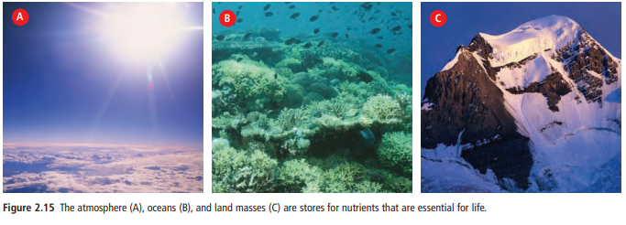
Nutrient Sources and Stores (Sinks)
Nutrients accumulate for short or long periods of time in the atmosphere, oceans, and land.
Scientists refer to these accumulations as stores or sinks.

Slide 6
4 elements make up 95% of the body in most organisms
CARBON
OXYGEN
HYDROGEN
NITROGEN
The same molecules are passed around
again and again within the biosphere in
___________________________
BIOGEOCHEMICAL CYCLES

Slide 7
Five Chemical Elements Necessary for Life:
Carbon, hydrogen, oxygen, nitrogen, and phosphorus determine amount of life possible in an ecosystem
They cycle between living organisms and the atmosphere.
Carbon, hydrogen, and oxygen make up molecules, such as deoxyribonucleic acid (DNA), carbohydrates, and proteins that are found in every living organism.
Nitrogen is found in proteins and DNA.
Phosphorus atoms enter the environment from sedimentary rock.

Slide 8
Nutrients Flow or Cycle
Nutrients cycle throughout the spheres due to Abiotic (river run-off ) and Biotic processes (e.g. decomposition)
Nutrient cycles are nearly in balance: nutrients flowing into the stores are nearly the same as the amounts flowing out of the stores.

Slide 9
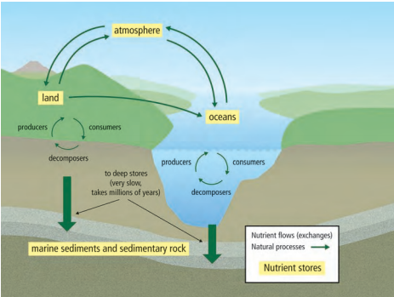
General Nutrient Cycle:
Where are nutrients stored?
What nutrients are flowing?
What patterns do you see?
Infer the way in which nutrients travel from land to oceans.
Identify the state in which nutrients enter the atmosphere (solid, liquid, gas)
Where is the fastest exchange of nutrients taking place?
How might producers contribute to nutrient cycles?
How might human activities might alter a nutrient cycle?

Slide 10
Nutrient Cycles
Explain why the arrows are drawn in different sizes
What conclusion can you make about nutrient stores in marine sediments and sedimentary rocks?
What biotic processes may take place in a nutrient cycle?
What abiotic processes may take place?
Do nutrients leave the biosphere? Explain.

Slide 11
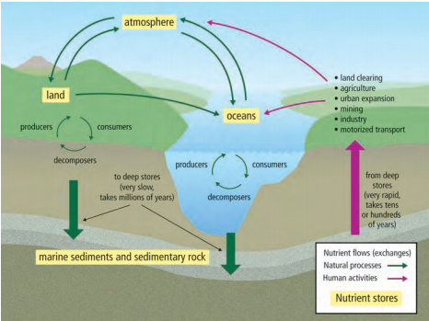
Effect of Human Activities on Nutrient Cycles
Human activities such as land clearing, agriculture, urban expansion, mining, industry, and motorized transportation can affect a nutrient cycle by increasing the amounts of nutrients in the cycle faster than natural biotic and abiotic processes can move them back to the stores.

Slide 12
Effect of Human Activities on Nutrient Cycles
Over time, increased nutrients in the atmosphere, oceans, and land can have significant effects on the environment.

Slide 13
Check your understanding
What is the importance of nutrients?
What is a nutrient store?
Explain the term “nutrient cycle.”
How can human activities affect a nutrient cycle?

Slide 14
Five Chemical Elements Necessary for Life:
Carbon, hydrogen, oxygen, nitrogen, and phosphorus determine amount of life possible in an ecosystem
They cycle between living organisms and the atmosphere.
Carbon, hydrogen, and oxygen make up molecules, such as deoxyribonucleic acid (DNA), carbohydrates, and proteins that are found in every living organism.
Nitrogen is found in proteins and DNA.
Phosphorus atoms enter the environment from sedimentary rock.

Slide 15
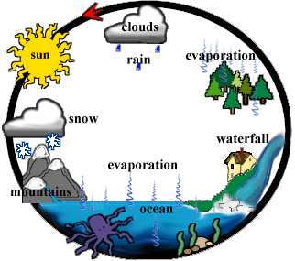
WATER CYCLE = ___________________
HYDROLOGIC CYCLE
http://www.urbanrivers.org/water_cycle.html

Slide 16
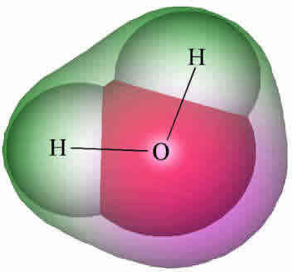
WHY IS WATER IMPORTANT?
Water makes up 60-70% of your body
Water provides Oxygen and Hydrogen
found in all the building blocks of cells. (carbohydrates, proteins,
nucleic acids, lipids)
Water provides protons (H⁺) and
& electrons necessary for
for_______________
photosynthesis
http://www.lsbu.ac.uk/water/molecule.htm

Slide 17
WHY IS WATER IMPORTANT?
SOLVENT
Water is a good _________________
Many molecules dissolve in water so it
provides a place for chemical reactions
to happen in the body.
Water doesn’t change temperature easily so it helps with
________________________
TEMPERATURE REGULATION
http://www.lsbu.ac.uk/water/molecule.htm

Slide 18
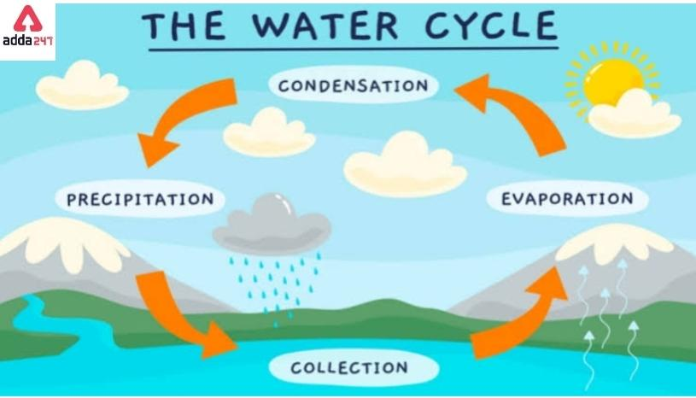
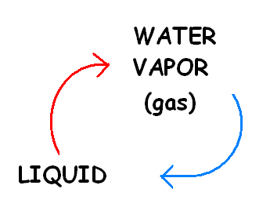
WATER CYCLE
evaporation
condensation
http://www.radio-canada.ca/jeunesse/fd6/000_images/cat/c_buee_c.gif

Slide 19
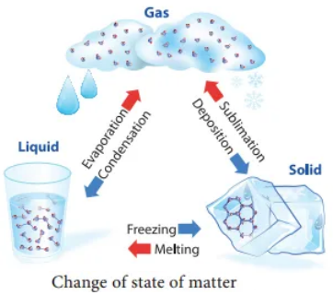
How does Water Cycle?
Evaporation: Liquid → Gas
Condensation: Gas → Liquid

Slide 20
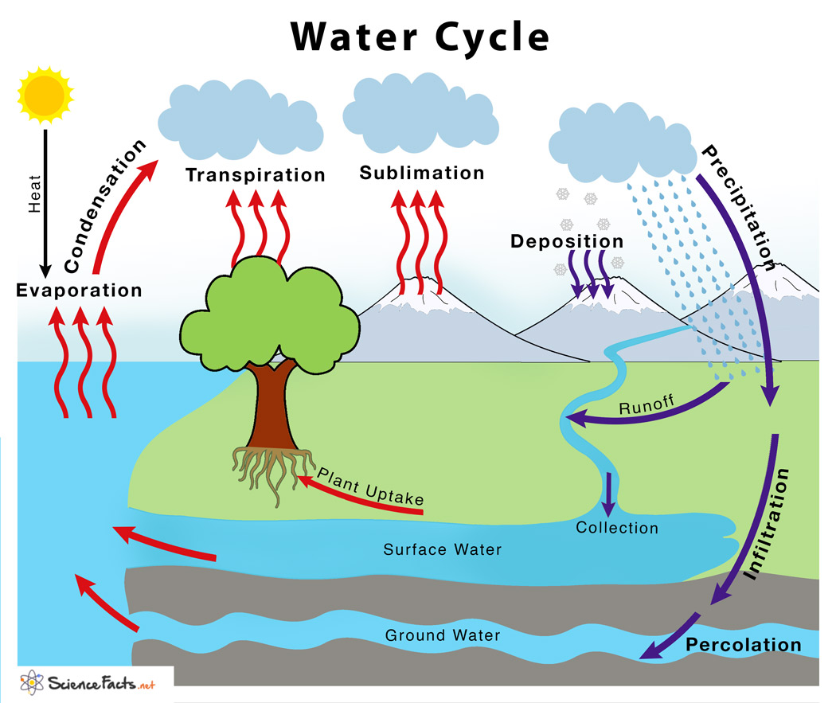

Slide 21
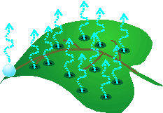
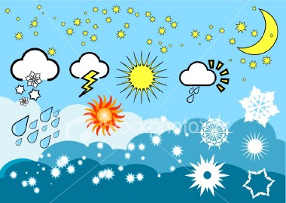
http://www.css.cornell.edu/faculty/hmv1/watrshed/Etrans.htm
The evaporation of water from the surface of plant leaves
= ________________
TRANSPIRATION
The return of water to the surface in the form of
rain, snow, sleet, hail, etc.
= ____________________
PRECIPITATION

Slide 22
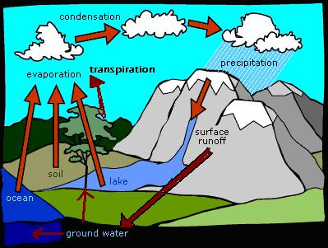
Image edited from: http://www.cotf.edu/ete/modules/msese/earthsysflr/water.html
WATER CYCLE
5.
4.
6.
3.
2.
2.
2.
1.
PH ONLINE LINK
Put in code: cbp-2033 Choose Start

Slide 23
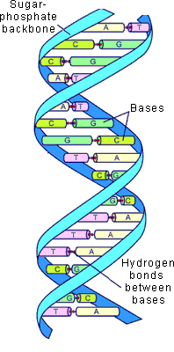
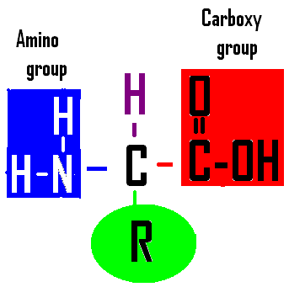
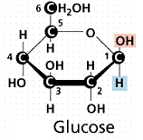
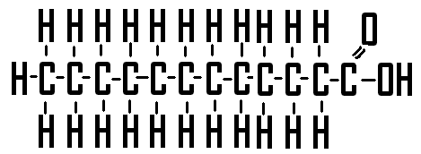
WHY IS CARBON IMPORTANT?
BUILDING BLOCKS
Found in all the _______________ of cells: carbohydrates, proteins,
nucleic acids, lipids
Image by Riedell
http://web.jjay.cuny.edu/~acarpi/NSC/12-dna.htm

Slide 24
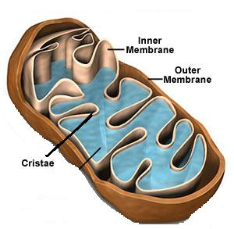
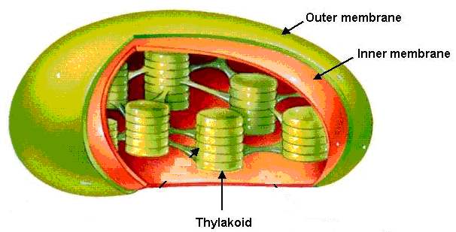
WHY IS CARBON IMPORTANT?
Carbon in CO₂ provides the atoms for
__________ production during __________________...
the fuel that all living things depend on.
GLUCOSE
PHOTOSYNTHESIS
http://www.science.siu.edu/plant-biology/PLB117/JPEGs%20CD/0076.JPG
http://www.biologyclass.net/mitochondria.jpg

Slide 25
4 main CARBON reservoirs
atmosphere
In ____________ as CO₂ gas
In _______ as dissolved CO₂ gas
On _______ in organisms, rocks, soil
__________ as coal & petroleum (fossil fuels) and calcium carbonate in rocks
ocean
land
Underground
CO₂ in
atmosphere
CO₂ in
Ocean
BIOLOGY; Miller and Levine; Prentice Hall; 2006
Notes:
Biosphere, geosphere, atmosphere

Slide 27
Where does CO₂ in atmosphere come from?
CO₂ in
atmosphere
CO₂ in
Ocean
Volcanic activity
________________
______________
_________________
____________ of dead organisms
Human activity (burning fossil fuels)
Cellular respiration
Decomposition
BIOLOGY; Miller and Levine; Prentice Hall; 2006

Slide 28
CARBON CYCLE
CO₂ in atmosphere
photosynthesis
respiration
decomposition
CO₂ in ocean
deposition
Carbon videoclip (2:34min): http://www.youtube.com/watch?v=jNIQ9KTMimQ&feature=related
NASA Carbon (5:39min): http://www.youtube.com/watch?v=HrIr3xDhQ0E
BIOLOGY; Miller and Levine; Prentice Hall; 2006

Slide 29
Where is Carbon Stored?
MOST of the carbon is found in long-terms stores in geosphere (soil and rock) as coal deposits in oil and gas deposits, which formed million of years ago. Coal, oil, and natural gas are fossil fuels that are formed from dead plants and animals. The largest long-term stores of carbon are found in marine sediments and sedimentary rock..
Short-term stores include atmosphere, (in form of CO2 gas) and in all living things (vegetation on land, in plants in oceans, in land-based and marine animals, and in decaying organic matter in soil).
It is also stored, in its dissolved form, in the top layers of the ocean.
Carbon moves between stores via six main processes:
Notes:
Carbon is an essential component of cells and life-sustaining chemical reactions.

Slide 30
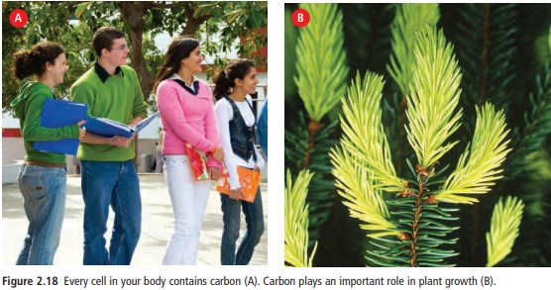
Carbon
All living things contain billions of carbon atoms in their cells.
Carbon is an essential component in the chemical reactions that sustain life, such as cellular respiration.

Slide 31
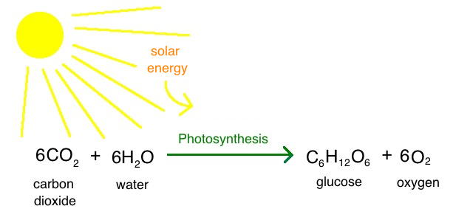
1. Photosynthesis
Converts CO2 gas from atmosphere into chemical energy.

Slide 32
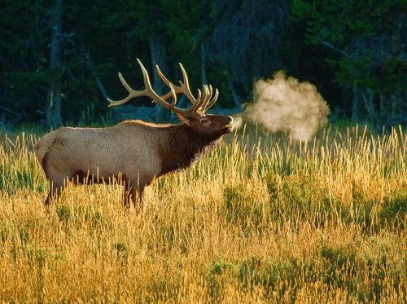
2. Cellular respiration
CO2 is a waste product of cellular respiration when organisms consume nutrients to make energy.

Slide 33
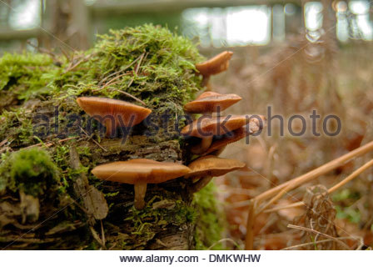
3. Decomposition
Decomposers release carbon and other nutrients into the soil and atmosphere by breaking down dead organisms

Slide 34
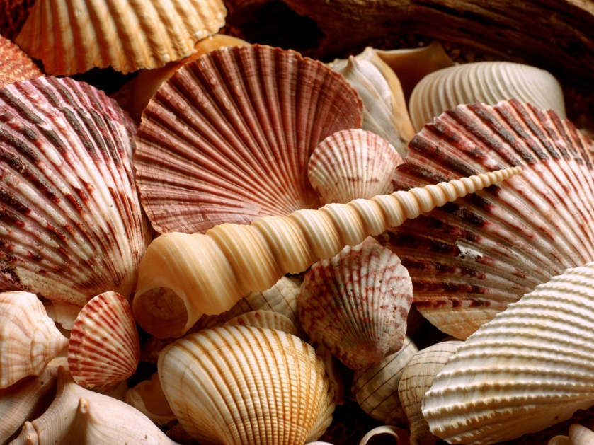
4. Ocean processes
Oceans are HUGE stores of dissolved CO2 gas from atmosphere.
Marine organisms also store carbon in the form of calcium carbonate (CaCO3) in their shells.

Slide 35
5. Volcanic Eruptions

Slide 36
6. Forest Fires

Slide 37
Human Impact on Nutrient Cycles? 10min
https://www.youtube.com/watch?v=2RC3Hsk90t8

Slide 38
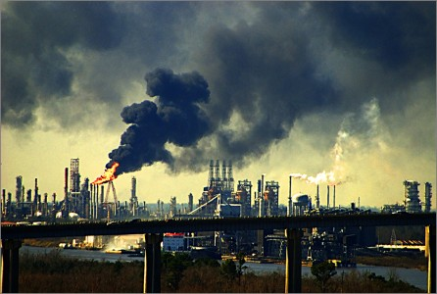
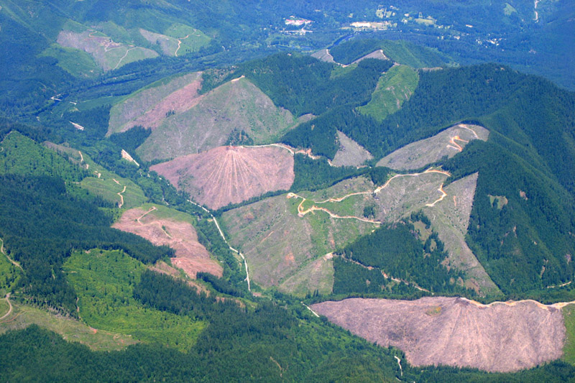
Human Activities affect the Carbon Cycle
Burning Fossil Fuels: Fast release of Carbon from long term stores (geosphere) into atmosphere
Land clearing, agriculture, and urban expansion
Burning plants releases their stored carbon into the atmosphere
Removing plants reduces photosynthesis
Notes:
quickly reintroduces carbon into the cycle that was removed long ago and stored long term. These actions increase levels of carbon dioxide, a greenhouse gas that contributes to global climate change.
Since the Industrial Revolution, around 1850, the amount of carbon dioxide gas in the atmosphere has increased over 30 percent.

Slide 41
Effects of Excess Carbon in the Atmosphere:
Burning fossil fuels releases huge amounts of carbon into the atmosphere at a much faster rate that it is getting stored.
Excess carbon in atmosphere creates Green House Gases, which causes Global Warming.
A Greenhouse gas (GHG) is a gas that traps heat energy from the sun that reflects off the Earth, causing a “Greenhouse Effect” .
The primary greenhouse gases in Earth's atmosphere are water vapor (H2O), carbon dioxide (CO2), methane (CH).

Slide 43
So What? People like warm weather
Warmer Temperatures may cause:
Extreme Weather → more heat waves, droughts, fires → possible fatalities
Sea ice melting → sea level rises → coastal flooding → climate refugees
Warmer Oceans → warmer water absorbs more CO2 → ocean acidification→ coral reef harmed, declining fish populations

Slide 45
Ocean Acidification

Slide 46
Check your Understanding
Why is the carbon cycle important?
How is carbon stored?
How is carbon cycled?
Name several human activities that affect the carbon cycle.

Slide 47
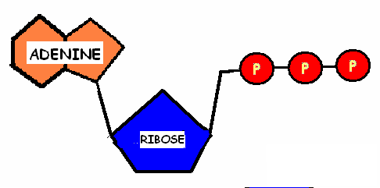
WHY IS NITROGEN IMPORTANT?
Nitrogen is found in every living thing:
Nitrogen makes up nitrogenous bases in DNA and RNA, adenine in ATP, and the amino part of amino acids (building blocks of protein)
Image by Riedell
Image by Riedell
http://web.jjay.cuny.edu/~acarpi/NSC/12-dna.htm

Slide 48
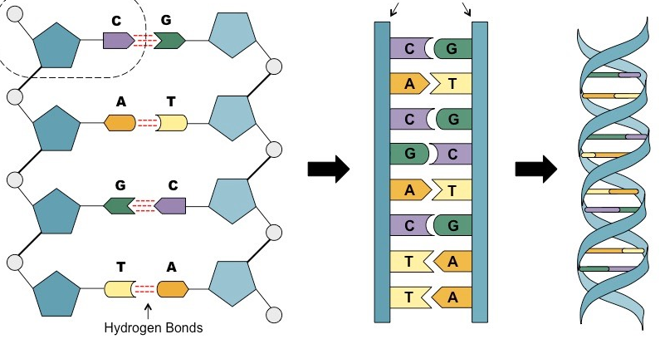
Nitrogen
MOST Nitrogen is stored in the atmosphere as N2 gas (atmosphere is 78% nitrogen)
But nitrogen gas is not usable by most living things.
Notes:
Nitrogen is an important component of DNA and proteins, which are essential for life.
The largest store of nitrogen is the atmosphere (as nitrogen gas, N2)
Other major stores include oceans and organic matter in soil.
In terrestrial (land) ecosystems, living organism, lakes and marches also store nitrogen, but in much smaller amounts.
Other major stores: oceans and organic matter in soil.
In terrestrial (land) ecosystems, living organisms, lakes and marches also store nitrogen, but in much smaller amounts.

Slide 49
79% of the atmosphere is made up of NITROGEN gas (N₂)
The bond in N₂ gas is so strong it can only be broken by:
lightning
Volcanic activity
few special bacteria
Image by Riedell
Image by Riedell
http://web.jjay.cuny.edu/~acarpi/NSC/12-dna.htm
Notes:
Much of the nitrogen cycle involves making nitrogen available to plants and animals.
This is done by bacteria.

Slide 50
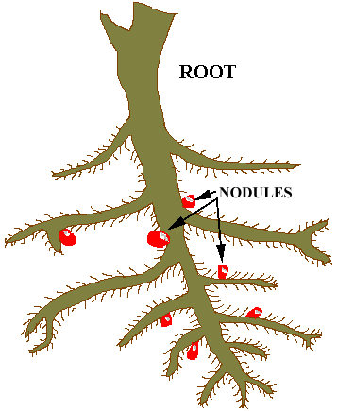
Nitrogen Cycle
Much of the nitrogen cycle involves making nitrogen available to plants and animals.
This is done by bacteria. That “fix” nitrogen gas into a useable form for plants.
This process is called Nitrogen Fixation

Slide 51
in the soil
Bacteria that live ______________
and in symbiotic relationships with
plants called legumes take
nitrogen from the atmosphere and
turn it into ______________, a form
that is usable by plants.
THIS PROCESS
IS CALLED _________________
AMMONIA (NH₃)
NITROGEN FIXATION
http://www.slic2.wsu.edu:82/hurlbert/micro101/images/101nodules21.gif

Slide 52
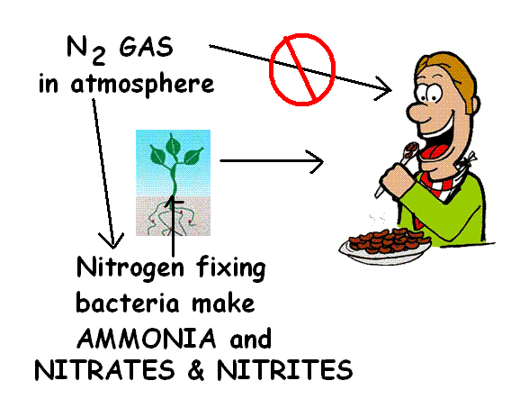
Other bacteria in the soil convert
ammonia into ________________
& _________________
which plants can also use.
The nitrogen we need for proteins,
ATP, and nucleic acids comes from
the ___________
___________
we breathe!
NITRATES (NO₃⁻ )
NITRITES (NO₂⁻)
FOOD WE EAT
NOT THE AIR
Image from: http://www.utdallas.edu/images/departments/biology/misc/gonzalez-image.jpg and http://www.cibike.org/CartoonEating.gif
modified by Riedell

Slide 53
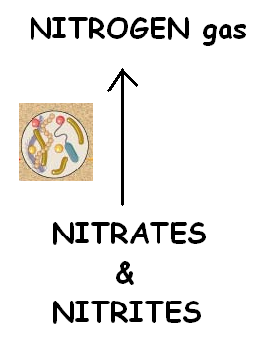
in the soil
Bacteria that live ______________
also carry out the reverse process
___________ → _____________.
THIS PROCESS
IS CALLED _________________
NITRATES
& NITRITES
NITROGEN GAS
DENITRIFICATION

Slide 54
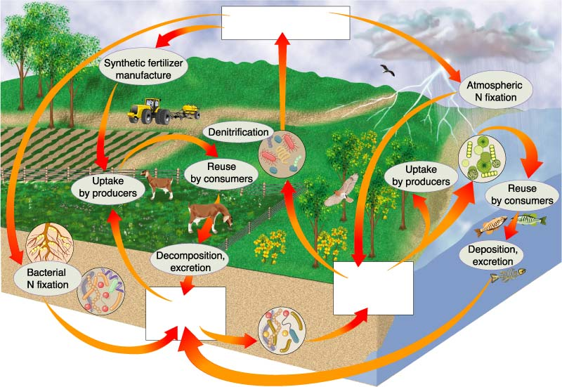
NITROGEN CYCLE
Section 3-3
N₂ in Atmosphere
Atmospheric N fixation
Denitrification
Uptake by producers
Decomposition, excretion
Bacterial N fixation
Nitrates & nitrites
Ammonia
BIOLOGY; Miller and Levine; Prentice Hall; 2006

Slide 55
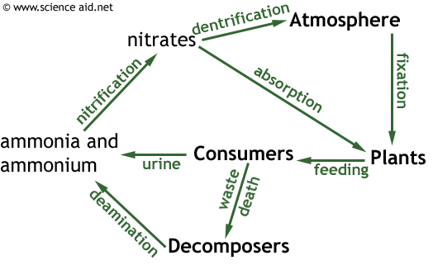
Nitrogen Cycle
Nitrogen Fixation: bacteria in the soil convert nitrogen to Ammonia (NH2)
Nitrification: bacteria convert Ammonia to Nitrite (NO2) to Nitrate (NO3)
Uptake: Plants take up nitrate/nitrite
Ammonification: Decomposers convert nitrogen in dead organisms back to ammonium (NH4+)
Denitrification: Other soil bacteria convert nitrate back into N2 gas to atmosphere

Slide 58
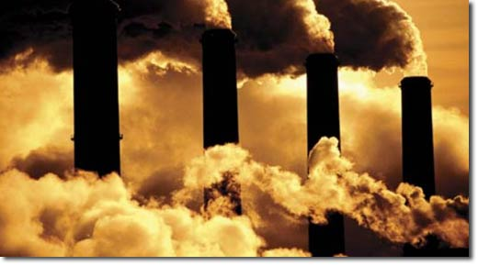
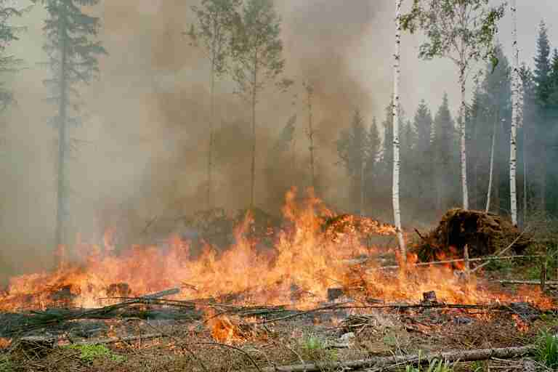
Human Activities Affecting Nitrogen Cycle
Burning fossil fuels
Land-clearing by burning
Both release nitrogen compounds into the atmosphere which combine with water to form nitric acid (HNO₃) which comes down as acid rain.
Notes:
Millions of tonnes of nitrogen are added toteh atmosphere each year in the form of nitrogen oxide (NO) and NO2. as a result of fossil fuel combustion in p

Slide 59
3. Over Fertilization of crops:
Fertilizers contain nitrogen.
Not all fertilizer is used by the plants. Excess fertilizers can be washed or leached from the soil by rain, collects in streams and lakes. This can an algal bloom.
Leaching is the removal of a substance dissolved in soil by water
Notes:
Millions of tonnes of nitrogen are added toteh atmosphere each year in the form of nitrogen oxide (NO) and NO2. as a result of fossil fuel combustion in p

Slide 60
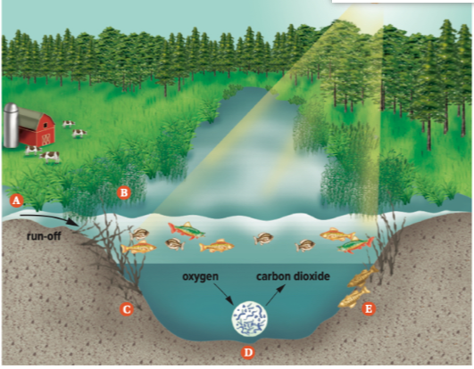
Algal Bloom
A. Rain carries nitrogen from farms, gardens, and lawns into aquatic ecosystems

Slide 61
Algal Bloom
B. Algae and plants at the water’s surface grow quickly. This blocks sunlight from reaching deeper water.

Slide 62
Algal Bloom
C. Deep-water plants get no sunlight. They cannot carry out photosynthesis, so they no longer give off oxygen, and they soon starve to death.

Slide 63
Algal Bloom
D. When the plants die, decomposers have lots of food. The number of decomposers increases quickly. They use up the oxygen in the water as they carry out cellular respiration.

Slide 64
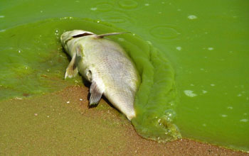
Algal Bloom
E. As oxygen in the waeter is used up, aquatic organism that need the oxygen suffocate and die.

Slide 65
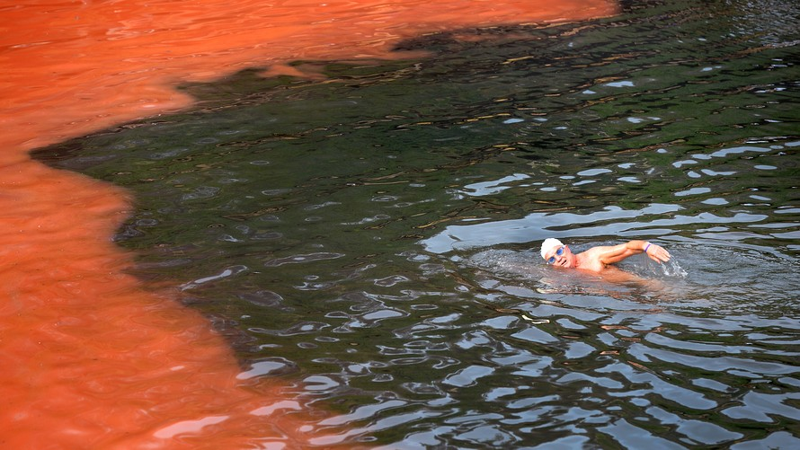
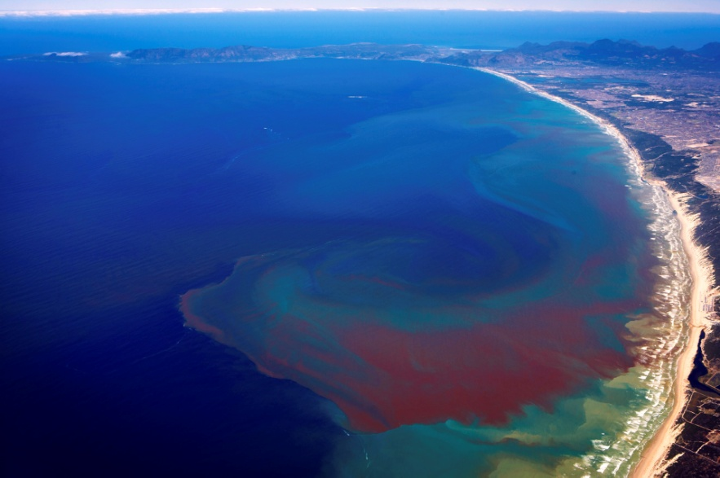
Algal Bloom
Some algae produce neurotoxin that enter the food web to shellfish, seabirds, marine mammals and humans.
Eg. Red Tide
Notes:
Rain carries excess nitrogen from farms, gardens, lawns into aquatic ecosystem
Algae and pants at surface grow quickly, blocking sunlight form reaching deeper water
Deep-water plants get no light, soon die.
When they die, decomposers have lots of food and increase in number, using up all the oxygen.
As oxygen in the water is used up, aquatic organisms that need the oxygen suffocate and die.

Slide 66
Check your Understanding
Why is the nitrogen cycle important?
How is nitrogen stored?
How is nitrogen cycled?
Name several human activities that affect the nitrogen cycle?

Slide 67
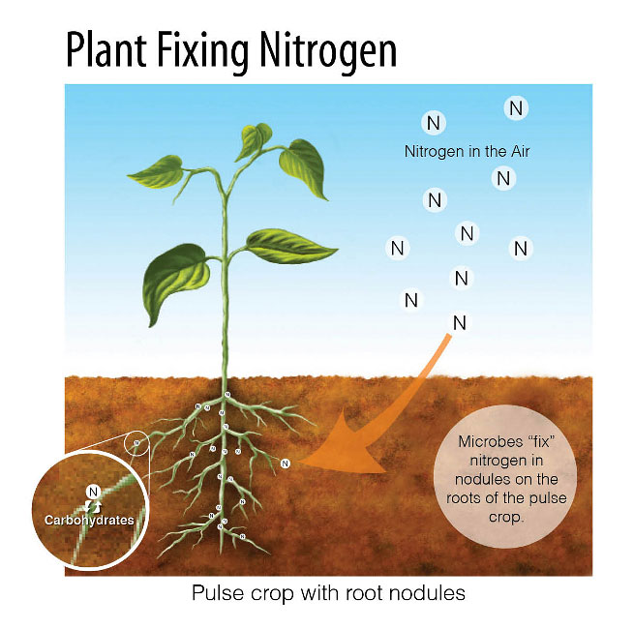
1. Nitrogen Fixation
Nitrogen Fixation is the process by which nitrogen gas (N2) is converted into nitrate (NO3-) and ammonium (NH4+), which are usable by plants.
Soil: Nitrogen fixation occurs mainly in the soil when nitrogen-fixing bacteria convert Nitrogen gas (N2) to forms usable by plants like ammonium (NH4+), Nitrite and Nitrate.
Notes:
Rhizobium lives in the root nodules of legumes (peas, beans, clover, and alfalfa). The plants supply the bacteri a with sugars,
Also cyanobacteria in surface waters of oceans, wetlands, and lakes.
Lightning provides energy for nitrogen to react with oxygen to form these ocmounds.

Slide 68
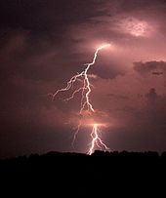
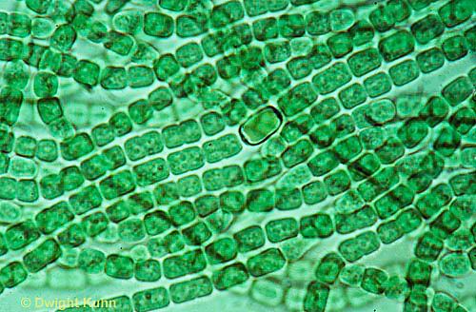
1. Nitrogen Fixation
Water: Cyanobacteria also fix nitrogen into ammonium
Atmosphere: A very small amount of atmospheric nitrogen is fixed by lightning.
Notes:
Rhizobium lives in the root nodules of legumes (peas, beans, clover, and alfalfa). The plants supply the bacteri a with sugars,
Also cyanobacteria in surface waters of oceans, wetlands, and lakes.
Lightning provides energy for nitrogen to react with oxygen to form these ocmounds.

Slide 69
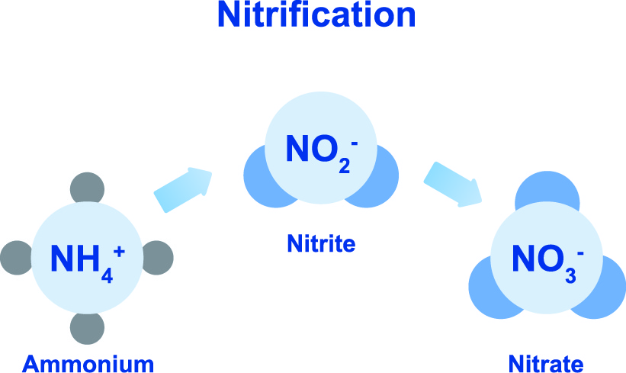
2. Nitrification
Ammonium is converted into nitrite (NO2-) and then nitrate (NO3-) by nitrifying bacteria.

Slide 70
3. Uptake
Once nitrates are made available by the nitrifying bacteria, plants can take up this usable form of nitrogen into their roots and incorporated it into plant proteins
Consumers (herbivores and omnivores) incorporate nitrogen into their tissues by eating the plants.

Slide 71
4. Ammonification
Some types of decomposer bacteria and fungi uptake nitrogen trapped in the proteins and DNA of dead orangisms and convert it back to ammonium (NH4+).

Slide 72
5. Denitrification
Denitrifying bacteria convert nitrate back into atmospheric nitrogen.

Slide 74
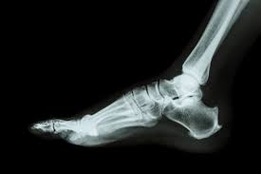
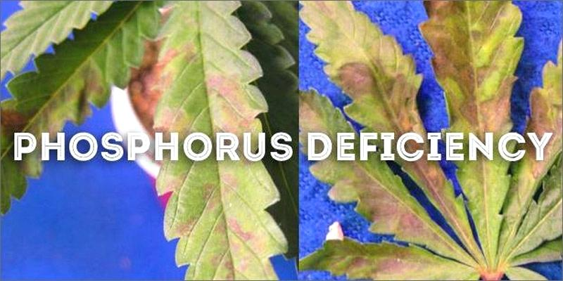
Phosphorous
Important for healthy root, stem and seed development in plants.
Essential element in bones and in the energy molecule, ATP in animals.
Mostly in long-term stores as phosphate (PO4-) in rock and ocean floor sediment.
Notes:
Not found in atmosphere

Slide 75
How does Phosphorous Cycle?
Weathering (breaking down rock into smaller fragments) is the main method of cycling phosphorous.
Uptake - Plant take up phosphorous from the soil by their roots.
Decomposition - bacteria release phosphorous back into the soil by breaking down dead organisms.
Geologic Uplift - a major geological event uncovers buried rock

Slide 77
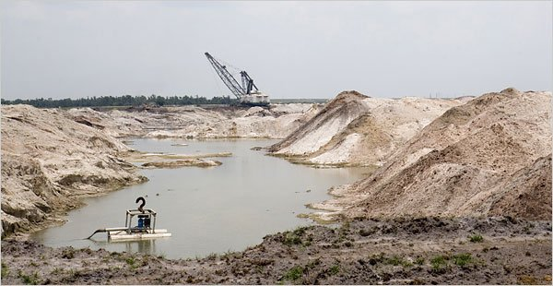
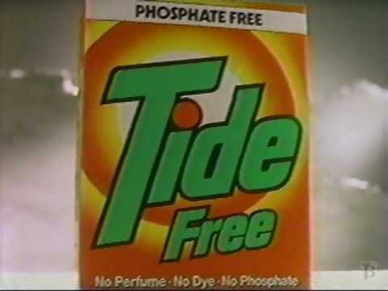
Human Activity and Phosphorous Cycle
Phosphate is used in fertilizers and detergents.
Slash and burn also releases excess phosphorous
Notes:
Just like too much nitrogen in lake water, it can cause fish to die.

Slide 79
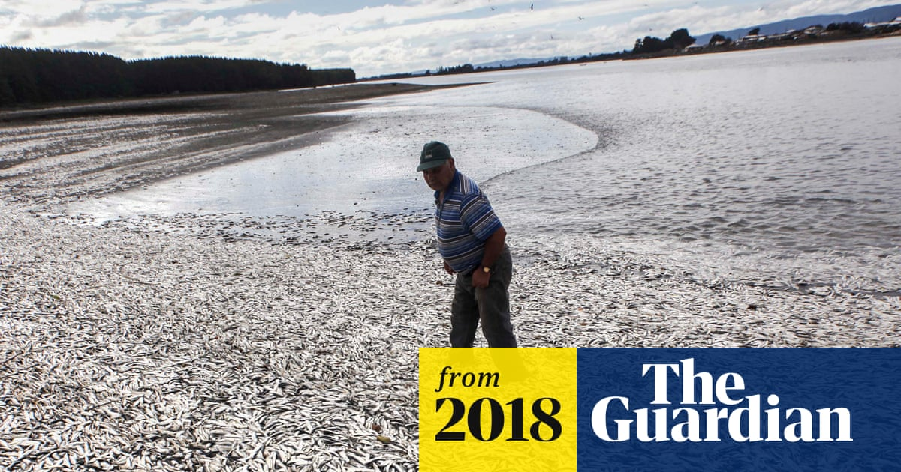
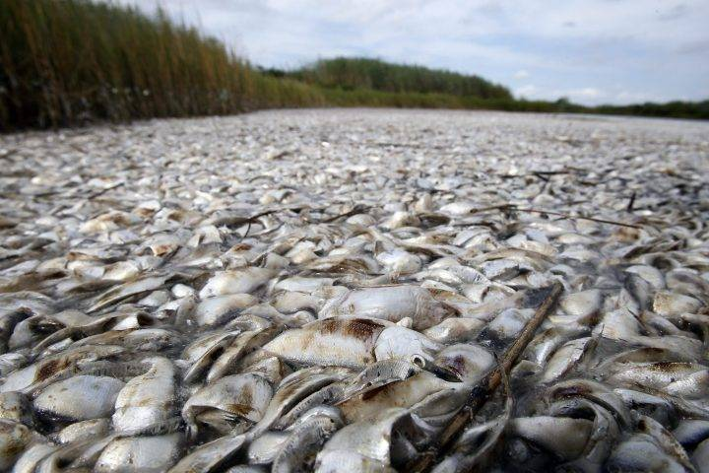
Excess Phosphorous
Also leads to algal blooms and possible dead zones - (low-oxygen) areas in oceans and lakes.

Slide 80
Check your Understanding
Why is the phosphorous cycle important?
How is phosphorous stored?
How is phosphorous cycled?
Name several human activities that affect the phosphorous cycle?

Slide 81
How are human activities harming the environment?
Do you think these practices are sustainable?
How long can we keep doing this?
Are there alternatives?

Slide 82
Extras

Slide 83
Assignment
Research a topic where human activity is disrupting the delicate balance of nature.
Eg. overhunting/fishing, introduction of non-native species, destruction of natural habitats, pollution, burning fossil fuels
Research what is being done to help curb or counteract the actions/effects or offer your own solution
Eg. Bioremediation, banning pesticides, reforestation, fishing caps, greener sources of energy.

Slide 85
Practice
Nutrient Cycle WS
View remainder of PPT for Nitrogen and Phosphorous Cycles and how to destroy a lake.

Slide 86
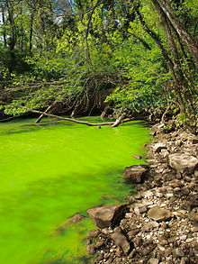
Excess nitrogen in lakes causes Eutrophication:
overly enriched with nutrients causes excessive algae growth (algal bloom).
Notes:
Rain carries excess nitrogen from farms, gardens, lawns into aquatic ecosystem
Algae and pants at surface grow quickly, blocking sunlight form reaching deeper water
Deep-water plants get no light, soon die.
When they die, decomposers have lots of food and increase in number, using up all the oxygen.
As oxygen in the water is used up, aquatic organisms that need the oxygen suffocate and die.

