Slide 1
Outbreaks
Epidemics and Pandemics

Slide 2
Infectious Diseases:
Are communicable. (Diseases that you can catch).
Are contagious (spread from person)
Example: colds, influenza, measles, mumps, tuberculosis, pneumonia, smallpox...
(Noninfectious diseases: Asthma, Cancer, and Arthritis, etc.)

Slide 3
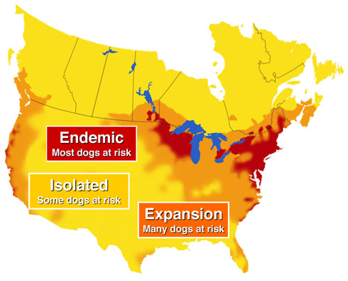
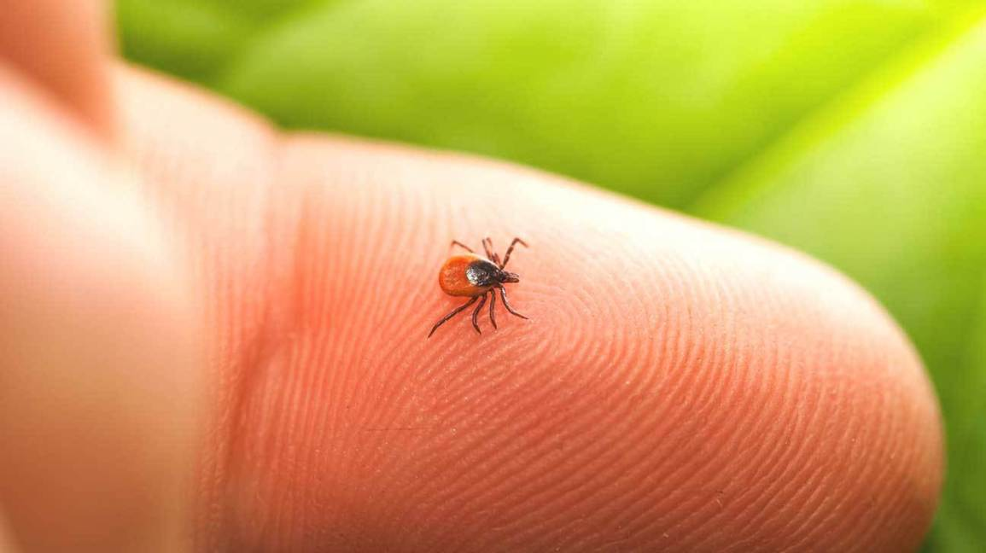
Diseases that are Endemic
Normal level of disease regularly found in a population or in a certain area. Always there.
Low numbers of people get sick.
Eg. Common Cold
Eg. Malaria is a constant worry in parts of Africa.
Eg. Lyme Disease is spread through the bite of a blacklegged tick infected with bacteria Borrelia burgdorferi.
Notes:
Pandemic: IV/AIDS is an example of one of the most destructive global pandemics in history. Spanish influenza killed 40-50 million people in 1918. Asian influenza killed 2 million people in 1957

Slide 4
Outbreaks
An outbreak is a sudden rise in the incidence (occurrence) of a disease.
Ted ed Cholera Outbreak http://ed.ted.com/featured/l2cLflvw

Slide 5
Name some outbreaks

Slide 6
The Spanish flu - 1918
La Pesadilla,
Lasting from January 1918 to December 1920
infected 500 million people – about a quarter of the world's population at the time.
50,000,000 deaths
Strain: HINI

Slide 7
Name some outbreaks
Bird Flu – H5N1, 1997, 100 deaths
SARS – Severe Acute Respiratory Syndrome – 2002-03, killed nearly 800 people globally, started in China
MERS - Middle East respiratory syndrome-related coronavirus - 2012, is a species of coronavirus which infects humans, bats, and camels.
Swine Flu (H1N1) – 2009-2010, causes 203,000 deaths
COVID-19 – same family as SARS (coronavirus), Nov 2019

Slide 8
Bird flu, H5N1
Deadly to most birds. And it's deadly to humans and to other mammals that catch the virus from birds.
Since the first human case in 1997, H5N1 has killed nearly 60% of the people who have been infected. leads to viral pneumonia and multiorgan failure
But does not spread easily from person to person.
About 100 human deaths, non in Western countries

Slide 10
Swine Flu, H1N1, Swine Influenza
June, 2009 flu pandemic or swine flu lasted from early 2009 to late 2010, and the second of the two pandemics involving H1N1 influenza virus (the first of them being the 1918–1920 Spanish flu pandemic), albeit in a new version.
Death toll: up to 203,000 people worldwide—10 times higher than the first estimates

Slide 11
Outbreaks: Epidemic
Epidemic is an outbreak of disease that attacks many people at about the same time within a community. Eg. Whooping Cough Eg. Seasonal flu outbreaks happen each year Eg. Norovirus outbreaks have occurred on cruise ships Eg. Measles in schools

Slide 12
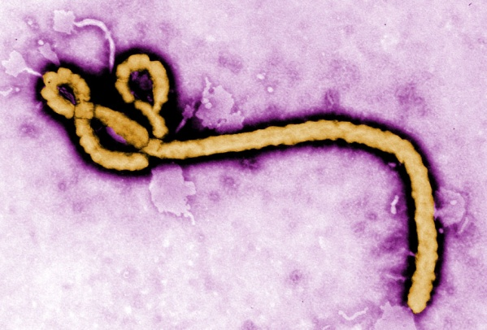
Outbreaks: Pandemic
Epidemic spreads throughout the world. Spreads easily from person. Causes serious illness. Usually a new form of a virus or bacteria. Spanish Flu: The deadliest flue in history SARS, COVID-19 Zika virus Bubonic plague

Slide 13
COVID-19
Pandemic
As of April 10, 2020: 1.6 Million cases in 210 countries
Spreads in droplets which can hang in the air up to 3hrs, remain on some surfaces for hours or even days.
Why are so many people getting sick? It’s a novel virus (new) . Our bodies have not encountered it before so we have no antibodies against it.
Likely originated in bats ,spread to pangolins, then mutated to infect humans

Slide 14
Zoonotic
Some diseases only infect animals
Some diseases only infect humans
A zoonotic disease is one that originates in animals then mutates to infect humans
Eg. Rabies, West Nile, Lyme, Swine Flu, corona viruses

Slide 15
video
What Is A Pandemic And How Do We Control It? 4min
https://www.youtube.com/watch?v=WimZ3oRkbFQ
How pandemics are spread (Ted Ed)
https://ed.ted.com/lessons/how-pandemics-spread#watch

Slide 16
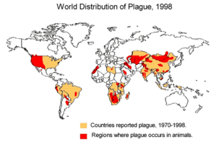
Outbreaks
The Black Death, also known as the Pestilence, the Great Plague or the Plague, or the Black Plague, was one of the most devastating pandemics in human history, resulting in the deaths of an estimated 75 to 200 million people in Eurasia, peaking in Europe from 1347 to 1351
4min
http://www.history.com/topics/black-death/videos/the-black-death-begins
Ted Ed: Ebola
https://www.youtube.com/watch?v=UMMwgvLmN-M

Slide 17
Impacts of outbreaks
Ted Ed Bubonic Plague
https://www.youtube.com/watch?v=ySClB6-OH-Q

Slide 18
Social and Economic Impacts of Epidemics and Pandemics on Human Populations:
1. Death toll
HIV has killed more than 25 million people since it was first identified in 1984. More than 1 million people have died due to diseases such as SARS, HINI, measles and typhoid.

Slide 19
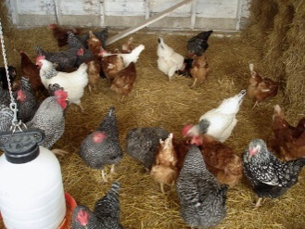
2. Loss of Livestock
In 2015, an outbreak of bird flu forced poultry producers to kill about 50 million chickens and turkeys.
The price of eggs increased and farmers lost millions of dollars.

Slide 20
3. Sick Days
The flu alone results in losses of half a billion dollars each year to the Canadian economy.

Slide 21
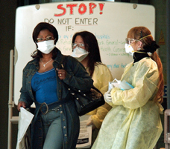
4. Travel Precautions and Panic
Lead governments to restrict travel as well as importation of certain foods.
Lunar New Year celebrations cancelled due to Coronavirus.

Slide 22
Different Populations have Different Immunities
Repeated outbreaks of measles and smallpox in Europe.
Many died in each outbreak, but over time they built up immunity.
In North and South America, people had not been exposed to these same pathogens and therefore had no immunity.
Estimated 70% of the First Nations population died

Slide 23
Natural Immunity in Human Populations
Eg. 10% People in remote part of Peruvian rain forest immune to rabies
Gabon west-central Africa some immune to Ebola
Mary Mallon (1869 –1938) Typhoid Mary, was the first person in the United States identified as an asymptomatic carrier of the pathogen associated with typhoid fever. She was presumed to have infected 51 people, three of whom died, over the course of her career as a cook.

Slide 24
How can we prevent the spread of disease?

Slide 25
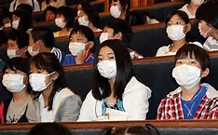
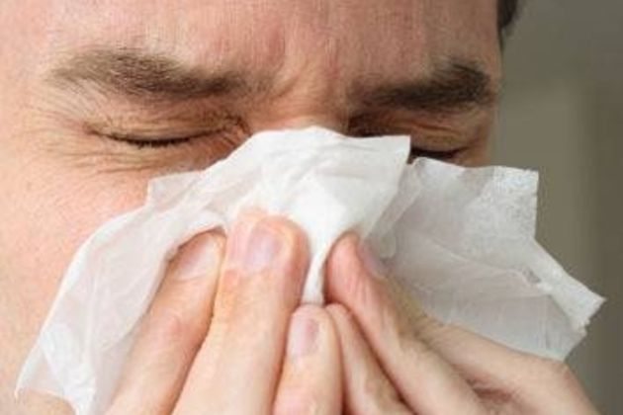
How to prevent the spread of diseases?
Get vaccinated.
Wash hands often with soap and water.
Avoid touching your mouth, nose, or eyes with your hands.
Cover your mouth and nose when you cough or sneeze.
Avoid crowded places.
Wear a face mask when sick. fected person.

Slide 26
Practice
Outbreak WS p40-42
Optional Outbreak Quiz on Teams, April 15, 2020, 11-11:30am

Slide 27
EXTRAS

Slide 28
Assignment: Disease Poster – not this year
List disease that is caused by a pathogen,
How does it spread (vector, air, water)
How you get infected (ingesting, sexual intercourse, breathing in, bites)
Symptoms
When was the last major outbreak and how many people were infected world wide
Outcome – do you overcome the disease or does the disease overcome you? Are there lasting effects?
Is this disease preventable? If so, how?
Socio – Economic Impact

Slide 30
How many people die from a pandemic depends upon:
The number of people who become infected
The severity of disease caused by the virus (its virulence)
The vulnerability of affected populations
The effectiveness of preventive steps

Slide 31
The World Health Organization (WHO) provides an influenza pandemic alert system, with a scale ranging from Phase 1 (a low risk of a flu pandemic) to Phase 6 (a full-blown pandemic):
Phase 1: A virus in animals has caused no known infections in humans.
Phase 2: An animal flu virus has caused infection in humans.
Phase 3: Sporadic cases or small clusters of disease occur in humans. Human-to-human transmission, if any, is insufficient to cause community-level outbreaks.
Phase 4: The risk for a pandemic is greatly increased but not certain.
Phase 5: Spread of disease between humans is occurring in more than one country of one WHO region.
Phase 6: Community-level outbreaks are in at least one additional country in a different WHO region from phase 5. A global pandemic is under way.

Slide 32
Examples of Epidemics:
in 2014, the Ebola virus resulted in 6070 deaths in West Africa.
The Western African Ebola virus epidemic was the most widespread outbreak of Ebola virus disease in history—causing major loss of life and socioeconomic disruption in the region, mainly in Guinea, Liberia, and Sierra Leone. killed about 774 people out of 8,098 that were infected,” IFLScience reported. “It started as an outbreak in Asia and then spread to two dozen countries. Approximately 11,000 people died in the Ebola outbreak that hit West Africa from 2014 to 2016; tens of thousands more who were infected survived.
Zika virus disease is an epidemic which was reported in Brazil in Feb., 2016
Ted Ed: Ebola
https://www.youtube.com/watch?v=UMMwgvLmN-M

Slide 33
Examples of Pandemics:
Spanish flu killed 40-50 million people in 1918
Black Plague
The Franco-Prussian War triggered a smallpox pandemic of 1870–1875 that claimed 500,000 lives
HIV/AIDS - Ongoing- as of 2011 at least 60 million people had been infected by AIDS and 25 million had died.
In 2009, H1N1
Bubonic plague is mainly spread by infected fleas from small animals., yersinia pestis
Black Death 4min
http://www.history.com/topics/black-death/videos/the-black-death-begins

