Slide 1
Outbreaks
Epidemics and Pandemics

Slide 2
Infectious Diseases:
Are communicable. (Diseases that you can catch).
Are contagious (spread from person)
Example: colds, influenza, measles, mumps, tuberculosis, pneumonia, smallpox...
(Noninfectious diseases: Asthma, Cancer, and Arthritis, etc.)

Slide 3
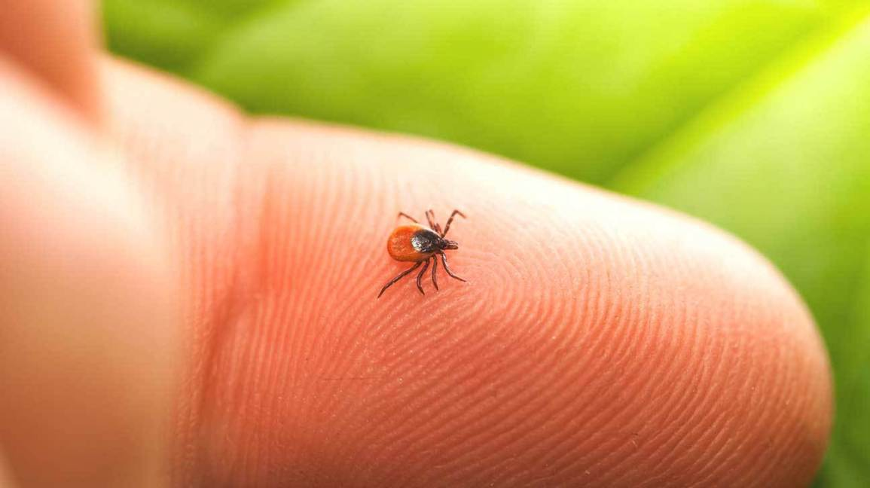
Endemic Diseases:
Normal level of disease regularly found in a population or in a certain area.
Always there
Low numbers of people get sick.
Eg. Common Cold
Eg. Malaria is a constant worry in parts of Africa.
Eg. Lyme Disease is spread through the bite of a blacklegged tick infected with bacteria Borrelia burgdorferi.
Notes:
Pandemic: IV/AIDS is an example of one of the most destructive global pandemics in history. Spanish influenza killed 40-50 million people in 1918. Asian influenza killed 2 million people in 1957

Slide 4
Outbreak
An outbreak is sudden rise in the incidence (occurrence) of a disease usually limited to a defined geographical area
E.g. outbreak of measles in a school
TededCholera Outbreak http://ed.ted.com/featured/l2cLflvw
Notes:
An outbreak is a sudden rise in the incidence (occurrence) of a disease usually limited to a defined geographical area

Slide 5
Epidemic
Notes:
An outbreak is a sudden rise in the incidence (occurrence) of a disease usually limited to a defined geographical area

Slide 6
Epidemic
Epidemic is an outbreak of disease that affects higher than normal levels within a specific population or community. Eg. Whooping Cough Eg. Seasonal flu outbreaks happen each year Eg. Norovirus outbreaks have occurred on cruise ships

Slide 7
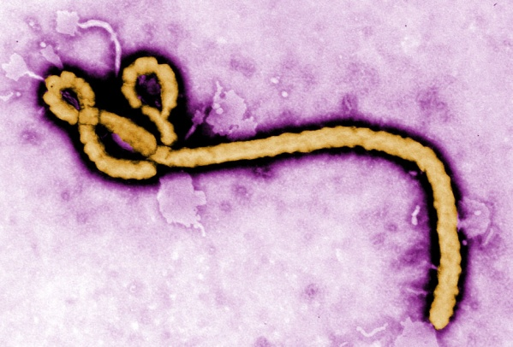
Pandemic
Epidemic spreads to many countries or the world. Spreads easily from person. Causes serious illness. Usually a new form of a virus or bacteria. E.g. Spanish Flu: The deadliest flue in history, SARS, COVID-19
Notes:
Black Plague in late 1340s (50 million killed), Spanish flu 1918 (killed 40-50 million), Small pox 1870–1875 (killed 500,000), HIV/AIDS (25million died).

Slide 8
The Spanish flu - 1918
La Pesadilla,
Lasting from January 1918 to December 1920
infected 500 million people – about a quarter of the world's population at the time.
50,000,000 deaths
Strain: HINI

Slide 9
Name some outbreaks
Bird Flu – H5N1, 1997, 100 deaths
SARS – Severe Acute Respiratory Syndrome – 2002-03, killed nearly 800 people globally, started in China
Swine Flu (H1N1) – 2009-2010, causes 203,000 deaths
MERS - Middle East respiratory syndrome-related coronavirus - 2012, is a species of coronavirus which infects humans, bats, and camels.
COVID-19 – same family as SARS (coronavirus), Nov 2019 - present

Slide 10
Bird flu, H5N1 (1997)
Deadly to most birds. And it's deadly to humans and to other mammals that catch the virus from birds.
Since the first human case in 1997, H5N1 has killed nearly 60% of the people who have been infected. leads to viral pneumonia and multiorgan failure
But does not spread easily from person to person.
About 100 human deaths, non in Western countries

Slide 12
COVID-19
Pandemic
As of Jan 4, 85.7 Million cases in 218 countries
Spreads in droplets which can hang in the air up to 3hrs, remain on some surfaces for hours or even days.
Why are so many people getting sick? It’s a novel virus (new) . Our bodies have not encountered it before so we have no antibodies against it.
Likely originated in bats, spread to pangolins, then mutated to infect humans
Notes:
1,855,050 deaths

Slide 13
How pandemics are spread (Ted Ed)
https://ed.ted.com/lessons/how-pandemics-spread#watch
Notes:
What Is A Pandemic And How Do We Control It? 4min
https://www.youtube.com/watch?v=WimZ3oRkbFQ

Slide 14
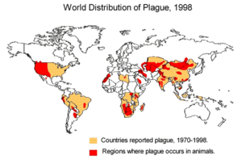
Black Death (Pestilence, Great Plague, the Plague)
One of the most devastating pandemics in human history,
Estimated 75 to 200 million people in Eurasia,
peaking in Europe from 1347 to 1351
4min
http://www.history.com/topics/black-death/videos/the-black-death-begins
Ted Ed: Ebola
https://www.youtube.com/watch?v=UMMwgvLmN-M

Slide 15
Different Populations have Different Immunities
EG. measles and smallpox in Europe brought to North America.
Estimated 70% of the First Nations population died
Notes:
Repeated outbreaks of measles and smallpox in Europe.
Many died in each outbreak, but over time they built up immunity.
In North and South America, people had not been exposed to these same pathogens and therefore had no immunity.
Estimated 70% of the First Nations population died

Slide 16
Natural Immunity in Human Populations
Eg. 10% People in remote part of Peruvian rain forest immune to rabies
Gabon west-central Africa some immune to Ebola

Slide 17
Some people are Asymptomatic – infected but show no symptoms
Mary Mallon (1869 –1938) Typhoid Mary, was the first person in the United States identified as an asymptomatic carrier of the pathogen associated with typhoid fever.
She was presumed to have infected 51 people, three of whom died, over the course of her career as a cook.
Notes:
Persons with typhoid fever carry the bacteria in their bloodstream and intestinal tract. Symptoms include prolonged high fever, fatigue, headache, nausea, abdominal pain, and constipation or diarrhoea. Some patients may have a rash. Severe cases may lead to serious complications or even death.

Slide 18
What affects our immune system?
If you are tired and feeling "run down“ you may be more susceptible to getting sick because you are less likely to be able to fit off infection
Age: Elderly population may weakened immune system
Some people may be Immunocompromised
Some people have a Genetic predisposition
You may have natural Immunity:
If you have been Exposed before
If you have a genetic protection

Slide 19
IMPACTS of OUTBREAKS
Social, Economic, etc

Slide 20
Impacts of COVID
During the height of the pandemic, some places went into “Lockdown” to “flatten the curve”.
How did this impact your
Ability to go to school/mall/restaurant, travel to France
What is the impact on your social life, mental health, ability to learn, ability to go to work

Slide 21
Personal/Social Impacts
What might happen to a 98 year old if they caught COVID?

Slide 22
Personal/Social Impacts
Misinformation:
What about your crazy neighbor who thinks Covid was created in a lab to control the masses?
Or that vaccines are used to implant microchips so we can be tracked.
Or Vaccines will give you COVID!

Slide 23
Social Impacts of Pandemics
People Dying
Isolation from others,
Mental heath
Panic
Travel precautions
Misinformation, Conspiracy Theories

Slide 24
Economic Impact
Loss of revenue for businesses
Due to sick leave
Loss of income for individuals on Sick leave
Notes:
People call in sick for several days from the flu
The flu alone results in losses of half a billion dollars each year to the Canadian economy.

Slide 25
Check your understanding: What type of Impact is the following?
What happened to restaurant owners?
Many people work contract work and get paid by the job. There is no sick pay. No work, no pay.
What happened to the Gig economy (entertainers) during the height of the pandemic?
What about the chicken farmer that has to cull his entire flock? How does that affect the price of eggs?

Slide 26
Black Death: Increase in Social Standing?
Social and economic structure of Europe drastically changed
Millions died
People abandoned their friends and family, fled cities, and shut themselves off from the world.
Funeral rites became perfunctory or stopped altogether, and work ceased being done.
Inflation: price of goods went up because trade decreased
Not enough workers to work the land – lords increased wages to keep workers, empowering peasants
As financial distinctions blurred, fashion of nobility became more extravagant to emphasize social standing
Peasants revolted when aristocracy resisted changes.
Notes:
The economy underwent abrupt and extreme inflation. Since it was so difficult (and dangerous) to procure goods through trade and to produce them, the prices of both goods produced locally and those imported from afar skyrocketed. Because of illness and death workers became exceedingly scarce, so even peasants felt the effects of the new rise in wages. The demand for people to work the land was so high that it threatened the manorial holdings. Serfs were no longer tied to one master; if one left the land, another lord would instantly hire them. The lords had to make changes in order to make the situation more profitable for the peasants and so keep them on their land. In general, wages outpaced prices and the standard of living was subsequently raised.
As a consequence of the beginning of blurring financial distinctions, social distinctions sharpened. The fashions of the nobility became more extravagant in order to emphasize the social standing of the person wearing the clothing. The peasants became slightly more empowered, and revolted when the aristocracy attempted to resist the changes brought about by the plague. In 1358, the peasantry of northern France rioted, and in 1378 disenfranchised guild members revolted. The social and economic structure of Europe was drastically and irretrievably changed.

Slide 27
Practice
Outbreak WB p40-42,
Flu WB p

Slide 28
Extra Slides beyond here

Slide 29
Social Impacts of Pandemics
1. Death toll
HIV has killed more than 25 million people since it was first identified in 1984. More than 1 million people have died due to diseases such as SARS, HINI, measles and typhoid.

Slide 30
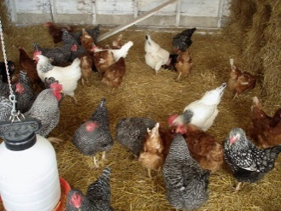
Economic Impact
Loss of revenue for farmers due to Culling livestock
In 2015, an outbreak of bird flu forced poultry producers to kill about 50 million chickens and turkeys.
The price of eggs increased and farmers lost millions of dollars.
Notes:
People call in sick for several days from the flu
The flu alone results in losses of half a billion dollars each year to the Canadian economy.

Slide 31
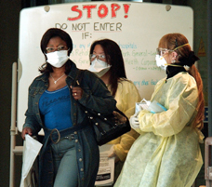
Social: Travel Precautions
as well as certain food imports
Lunar New Year celebrations cancelled due to Coronavirus.

Slide 32
Swine Flu, H1N1, Swine Influenza (2009)
June, 2009 flu pandemic or swine flu lasted from early 2009 to late 2010, and the second of the two pandemics involving H1N1 influenza virus (the first of them being the 1918–1920 Spanish flu pandemic), albeit in a new version.
Death toll: up to 203,000 people worldwide—10 times higher than the first estimates

Slide 33
Zoonosis (animal → human
A zoonotic disease is one that originates in animals then mutates to infect humans.
Eg. Rabies, West Nile, Lyme, Swine Flu, corona viruses
Notes:
Some diseases only infect animals
Some diseases only infect humans

Slide 34
Impacts of outbreaks - extra
Ted Ed Bubonic Plague
https://www.youtube.com/watch?v=ySClB6-OH-Q
What sort of impacts (social, economic, both) did the Bubonic Plague cause?

Slide 35
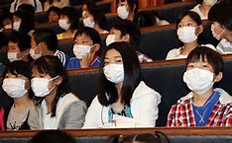
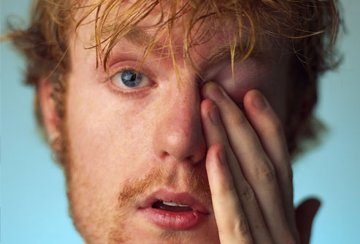
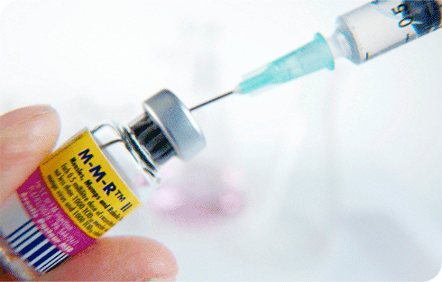
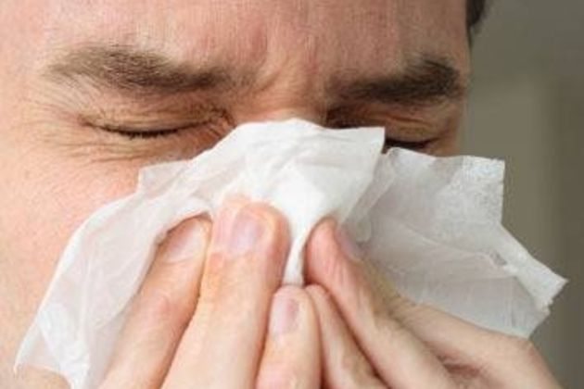
How to prevent the spread of diseases?
Get vaccinated.
Wash hands often with soap and water.
Avoid touching your mouth, nose, or eyes with your hands.
Cover your mouth and nose when you cough or sneeze.
Avoid crowded places.
Wear a face mask when sick. fected person.

Slide 36
Assignment: Disease Poster – not this year
List disease that is caused by a pathogen,
How does it spread (vector, air, water)
How you get infected (ingesting, sexual intercourse, breathing in, bites)
Symptoms
When was the last major outbreak and how many people were infected world wide
Outcome – do you overcome the disease or does the disease overcome you? Are there lasting effects?
Is this disease preventable? If so, how?
Socio – Economic Impact

Slide 38
How many people die from a pandemic depends upon:
The number of people who become infected
The severity of disease caused by the virus (its virulence)
The vulnerability of affected populations
The effectiveness of preventive steps

Slide 39
The World Health Organization (WHO) provides an influenza pandemic alert system, with a scale ranging from Phase 1 (a low risk of a flu pandemic) to Phase 6 (a full-blown pandemic):
Phase 1: A virus in animals has caused no known infections in humans.
Phase 2: An animal flu virus has caused infection in humans.
Phase 3: Sporadic cases or small clusters of disease occur in humans. Human-to-human transmission, if any, is insufficient to cause community-level outbreaks.
Phase 4: The risk for a pandemic is greatly increased but not certain.
Phase 5: Spread of disease between humans is occurring in more than one country of one WHO region.
Phase 6: Community-level outbreaks are in at least one additional country in a different WHO region from phase 5. A global pandemic is under way.

Slide 40
Examples of Epidemics:
in 2014, the Ebola virus resulted in 6070 deaths in West Africa.
The Western African Ebola virus epidemic was the most widespread outbreak of Ebola virus disease in history—causing major loss of life and socioeconomic disruption in the region, mainly in Guinea, Liberia, and Sierra Leone. killed about 774 people out of 8,098 that were infected,” IFLScience reported. “It started as an outbreak in Asia and then spread to two dozen countries. Approximately 11,000 people died in the Ebola outbreak that hit West Africa from 2014 to 2016; tens of thousands more who were infected survived.
Zika virus disease is an epidemic which was reported in Brazil in Feb., 2016
Ted Ed: Ebola
https://www.youtube.com/watch?v=UMMwgvLmN-M

Slide 41
Examples of Pandemics:
Spanish flu killed 40-50 million people in 1918
Black Plague
The Franco-Prussian War triggered a smallpox pandemic of 1870–1875 that claimed 500,000 lives
HIV/AIDS - Ongoing- as of 2011 at least 60 million people had been infected by AIDS and 25 million had died.
In 2009, H1N1
Bubonic plague is mainly spread by infected fleas from small animals., yersinia pestis
Black Death 4min
http://www.history.com/topics/black-death/videos/the-black-death-begins

