Slide 1
Prevention and Treatment
Vaccines, Antibiotics, Antivirals

Slide 2
Amoeba Sisters, 10 min
https://www.youtube.com/watch?v=uVUf_pt7Sh0

Slide 3
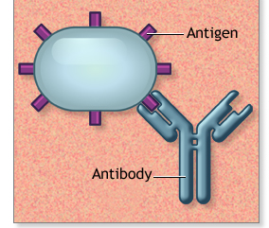
Immune System Review
Antigens are any particle the body perceives as foreign (and therefore a threat) which triggers an immune response (production of antibodies)
Eg. toxins, chemicals, bacteria, viruses, or other substances that come from outside the body
Antibodies – Y shaped proteins produced B cells. Bind to antigens, neutralizing them or marking them for destruction.

Slide 4
What is a Vaccine?
Vaccines are made using killed, weakened or piece of bacteria or viral capsid
(antigens).

Slide 5
Immune Response Triggered
White blood cells recognize the antigen as foreign.
Body (B cells) develops antibodies against the foreign particles (antigens).
Antibodies are “Y” shaped proteins that bind to antigens, neutralizing them or flagging them for destruction.
Other White blood Cells engulf and destroy.

Slide 6
Immunity
Your body remembers the antigen.
If you are ever exposed to it again, antibodies can quickly neutralize the pathogen before it can take hold.

Slide 7
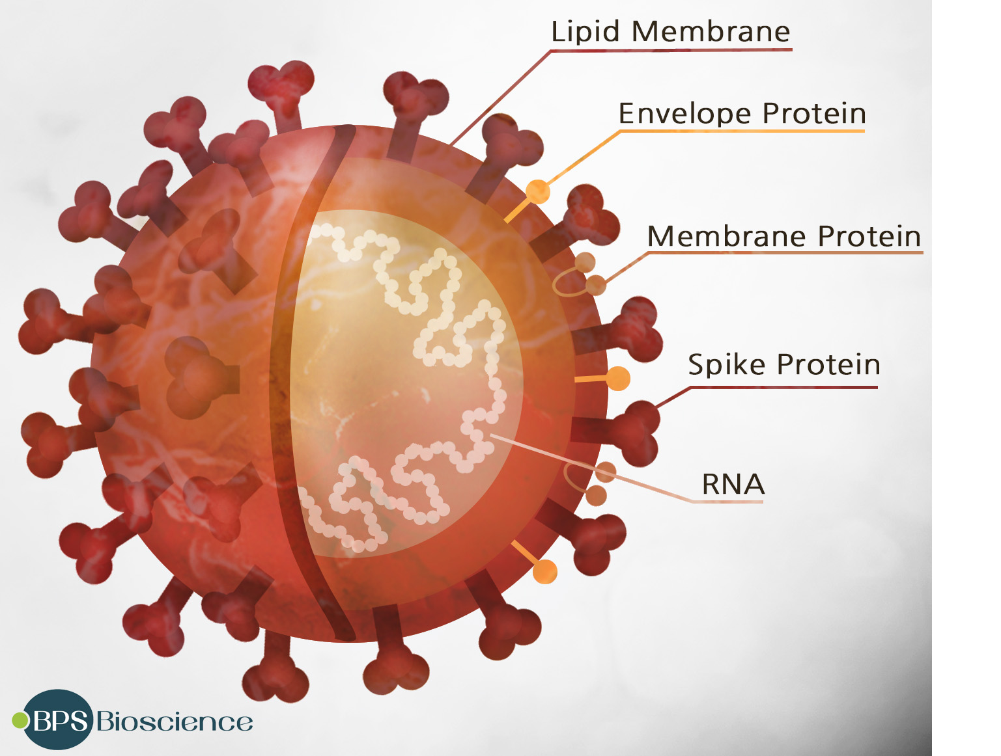
COVID – 19 virus

Slide 8
mRNA vaccines (Pfizer-BioNTech or Moderna)
these vaccines use mRNA created in a lab.
The mRNA uses our cells to produce a harmless piece of the surface spike protein on COVID virus
Our cells display the spike protein piece on their surface.
Our immune system recognizes that the protein as foreign.
Immune system triggered to produce antibodies against spike protein.
Notes:
mRNA vaccines have been studied before for flu, Zika, rabies, and cytomegalovirus (CMV).
Beyond vaccines, cancer research has also used mRNA to trigger the immune system to target specific cancer cells.

Slide 9
Are vaccines safe?
The data is out there
Same technology for centuries.
More than 650 million doses of COVID-19 vaccine have been given in the United States from December 14, 2020, through November 16, 2022.

Slide 10
Background
Variolation by Buddhist Monks in Asia as early as 200 BCE
Lady Montagu
Dairy Maids made the connection
Dr. Edward Jenner
TED Ed 5 min
https://www.youtube.com/watch?v=yqUFy-t4MlQ
https://www.youtube.com/watch?v=E_PKQ_M7AtU
https://www.youtube.com/watch?v=vkEZiHBTXyY
Notes:
Lady Montague - introducing smallpox inoculation to Western medicine after witnessing it during her travels and stay in the Ottoman Empire. Lady Mary's brother had died of smallpox in 1713, and although Lady Mary recovered from the disease in 1715, it left her with a disfigured face. There in March 1717, she witnessed the practice of inoculation against smallpox – variolation –Variolation used live smallpox virus in the pus taken from a mild smallpox blister and introduced it into scratched skin of the arm or leg (the most usual spots) of a previously uninfected person to promote immunity to the disease.^{[37]} Consequently, the inoculate would develop a milder case of smallpox than the one he/she might have contracted. Lady Mary was eager to spare her children, thus, in March 1718 she had her nearly five-year-old son, Edward, inoculated there with the help of Embassy surgeon, On her return to London, she enthusiastically promoted the procedure, but encountered a great deal of resistance from the medical establishmen. In April 1721, when a smallpox epidemic struck England, she had her daughter inoculated by Maitland, the same physician who had inoculated her son at the Embassy in Turkey, and publicised the even

Slide 11
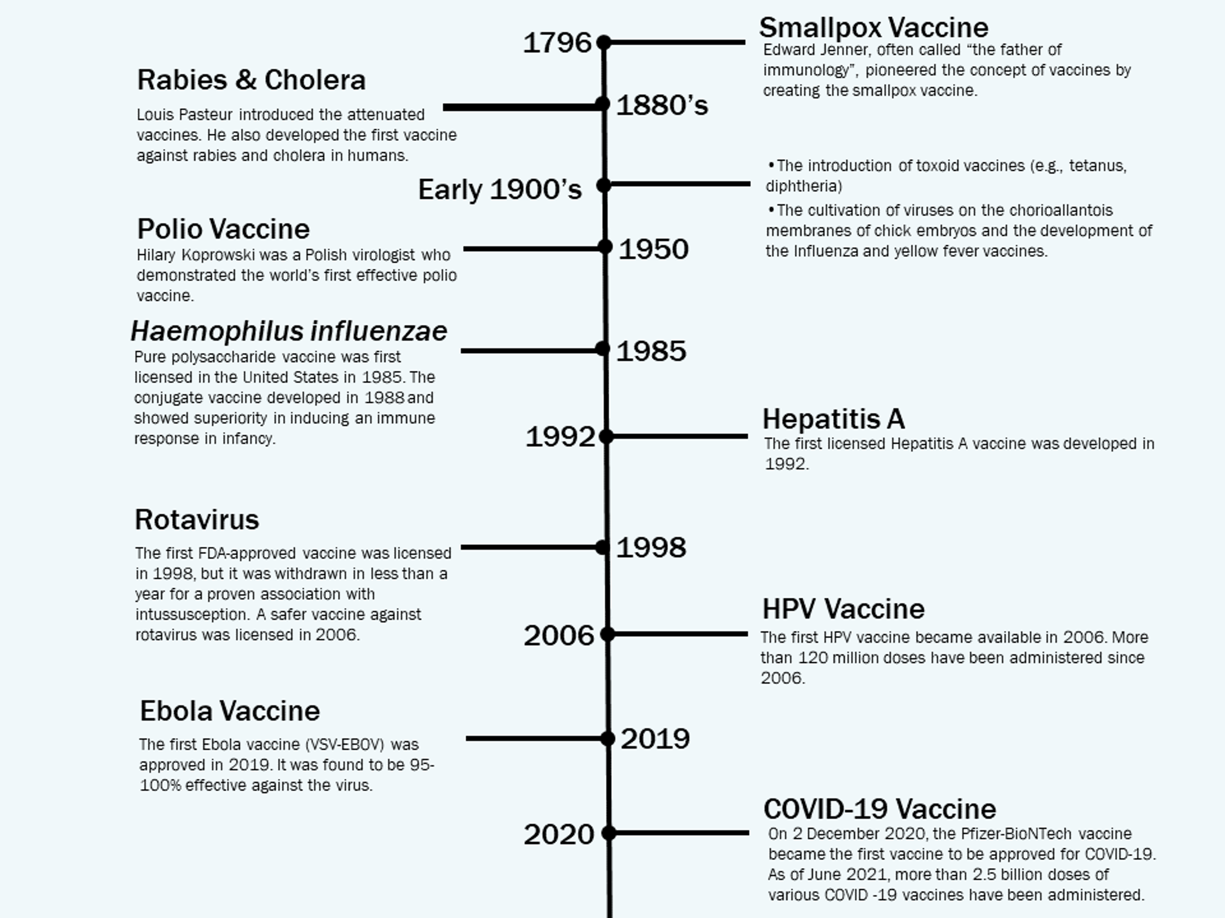

Slide 12
Edward Jenner is considered the founder of vaccinology in the West in 1796, after he inoculated a 13 year-old-boy with vaccinia virus (cowpox), and demonstrated immunity to smallpox.
In 1798, the first smallpox vaccine was developed.

Slide 13
Myths
Will it cause cancer?
Will it give me the virus?
Will it affect my brain?
Tracking?
Allergies
Autism

Slide 14
Booster

Slide 15
Antiviral Medication
usually suppress the virus's ability to infect and multiply in your cells.
Block receptors so viruses can't bind to and enter healthy cells.
Boost the immune system, helping it fight off a viral infection.
Lower the viral load (amount of active virus) in the body.

Slide 16
Examples of vaccines

Slide 17
Why the hesitancy?
mRNA vaccines do not use the live virus that causes COVID-19 so cannot cause COVID-19.
They do not affect or interact with our DNA in any way.
mRNA never enters the nucleus of the cell where our DNA (genetic material) is located, so it cannot change or influence our genes.
The mRNA and the spike protein don’t last long in the body.
Our cells break down mRNA and get rid of it within a few days after vaccination.

Slide 18
Edward Jenner Vaccines
Discovered that milkmaids who contracted cowpox and recovered did not seem to be affected by the much deadlier small pox disease
On the 14 May 1796, a young milkmaid called Sarah Nelmes came to see him with blisters like sores.
He carefully extracted some liquid from her sores
Jenner believed that if he could inject someone with cowpox, the germs from the cowpox would make the body able to defend itself against the dangerous smallpox germs which he would inject later.
Jenner made two small cuts on James's left arm. He then poured the liquid from Sarah's cowpox sores into the open wounds which he bandaged.
James went down with cowpox but was not very ill. Six weeks later when James had recovered, Jenner vaccinated him again, this time with the smallpox virus
Ted Ed https://www.youtube.com/watch?v=yqUFy-t4MlQ

