Slide 1
How Light Behaves when Striking a Very Smooth Surface
THE LAW OF REFLECTION, MIRRORS

Slide 2
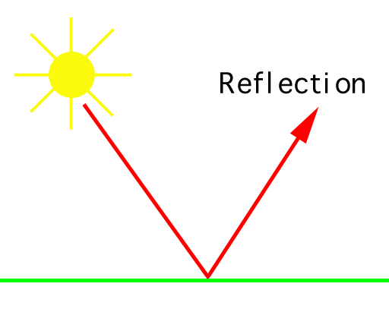
RECALL:
Reflection is when light “bounces off” an object.
When light bounces off a surface, it changes direction.
There are two types of reflection:
Reflection off a smooth surface (like a mirror)
Reflection off a rough surface (like paper).

Slide 3
Light reflects off a very smooth surface, like a mirror, in predictable ways.

Slide 4
Reflection off a Plane (Flat) Mirror
When light strikes a smooth surface, it bounces off at an angle.

Slide 5
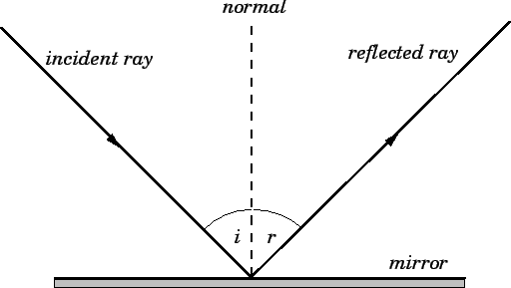
Reflection off a Plane Mirror
Label your diagram
INCIDENT RAY- The incoming light ray that strikes the reflecting material. Use arrow to show direction.
REFLECTED RAY- The light ray that bounces off (reflects) from a reflecting surface. Use arrow to show direction.
NORMAL - An imaginary line drawn perpendicular to a reflecting surface at the point where an incident ray strikes the surface

Slide 6
Reflection off a Plane Mirror
ANGLE OF INCIDENCE- The angle formed between the incident ray and the normal. Label i
ANGLE OF REFLECTIONThe angle formed between the reflected ray and the normal. Label r

Slide 8
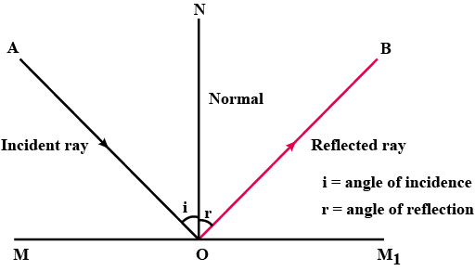

Slide 9
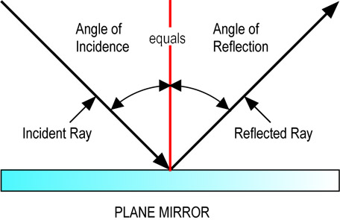
Normal

Slide 10
Measuring Angles with a protractor

Slide 11
Practice measuring angles - Worksheet

Slide 12
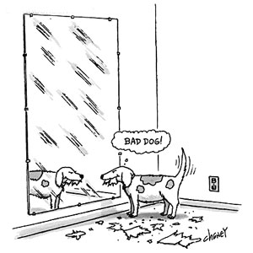
The Law of Reflection
The angle of reflection (r) equals the angle of incidence (i).
The reflected ray and the incident ray are on opposite sides of the normal.
The incident ray, the normal, and the reflected ray lie on the same plane (flat surface).

Slide 13
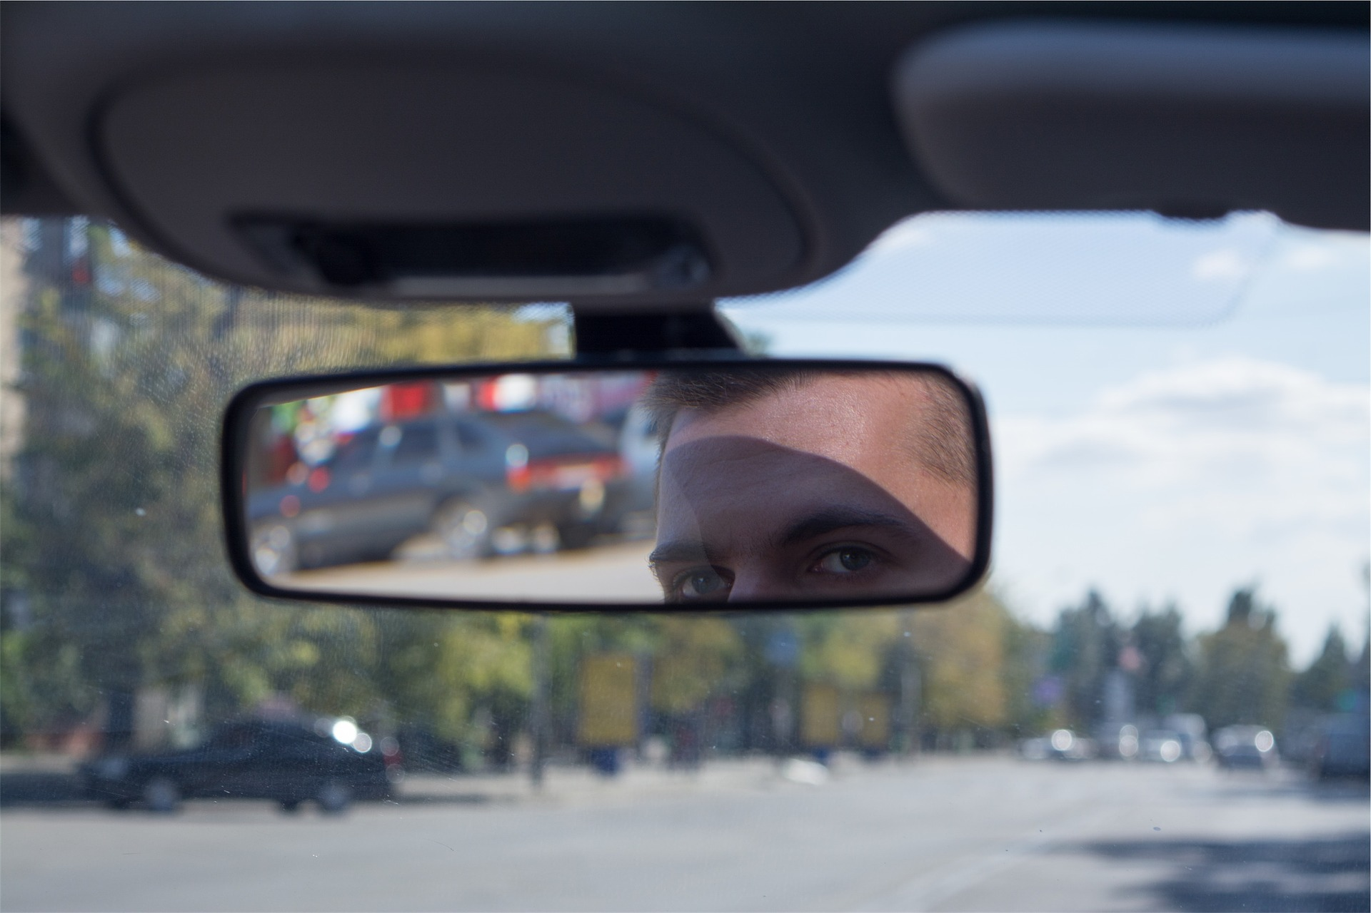
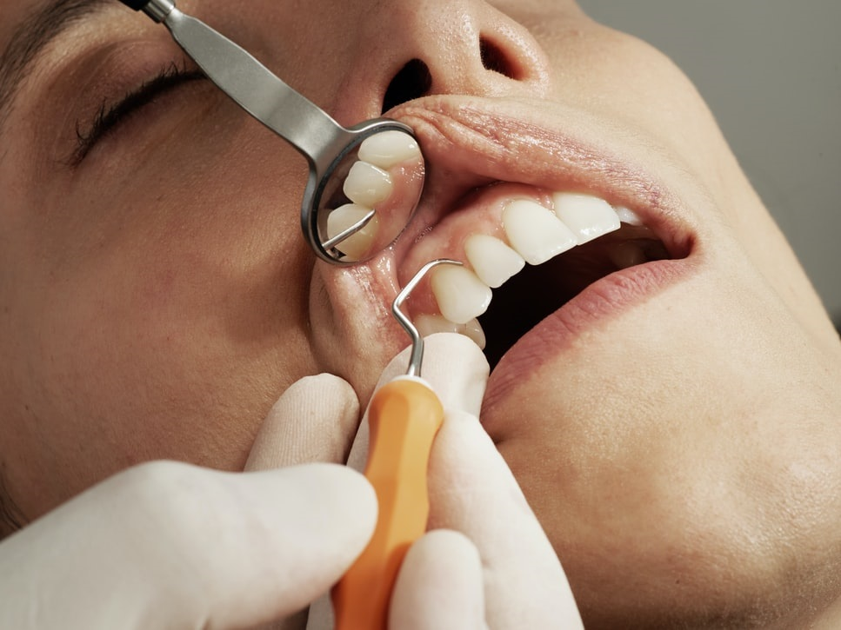
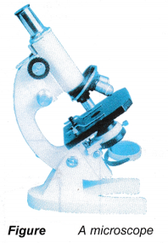
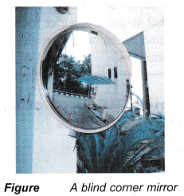
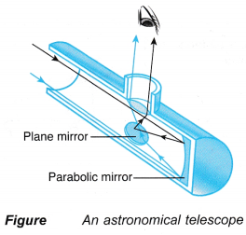
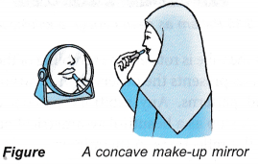
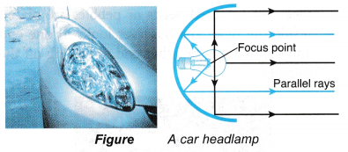
Who Cares? Using Law of Reflection in real life
Rear view mirrors in cars
Microscopes, Telescopes
Flashlights and headlamps
Dental mirrors

Slide 14
Check your understanding
What is the law of Reflection?
Why does a white page not reflect like a mirror?
What is the difference between the incident ray and the reflected ray?
What point does the normal intersect?
What does the angle of incidence always equal?
Can you measure angles correctly with a protractor?

Slide 15
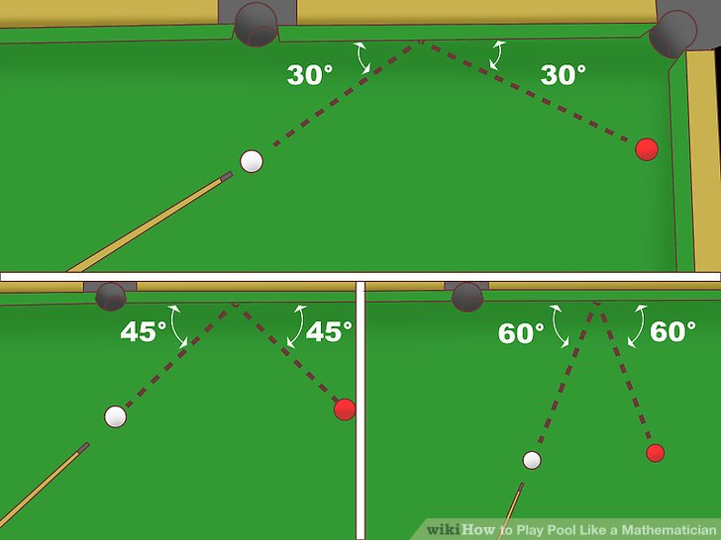
Also works for objects that aren’t light

Slide 16
Practice
Measuring Angles Worksheet
Checking Concepts p181 #1-5
Activity: Proving the Law of Reflection, p178
Plane mirror
Protractor
Light box
Paper, pencil
Notes:
Checking Concepts p181 #1-5

Slide 17
Extra Slides Beyond here.

Slide 18
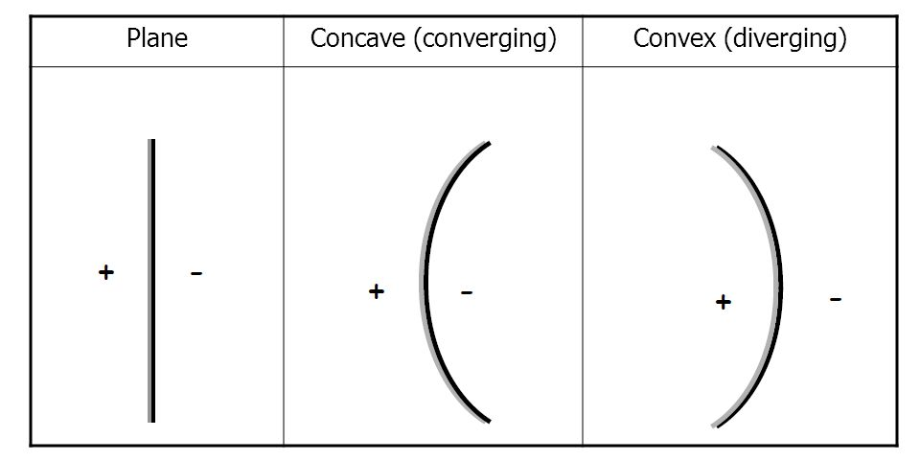
Types of Mirrors:

Slide 19
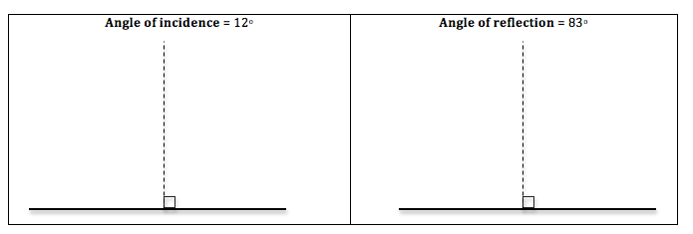
Draw the angles. Label: normal mirror ray of incidence ray of reflection angle of incidence angle of reflection.

Slide 20
The Laws of Reflection
The angle of reflection (r) equals the angle of incidence (i).
The reflected ray and the incident ray are on opposite sides of the normal.
The incident ray, the normal, and the reflected ray lie on the same plane (flat surface).
See page 173

Slide 21
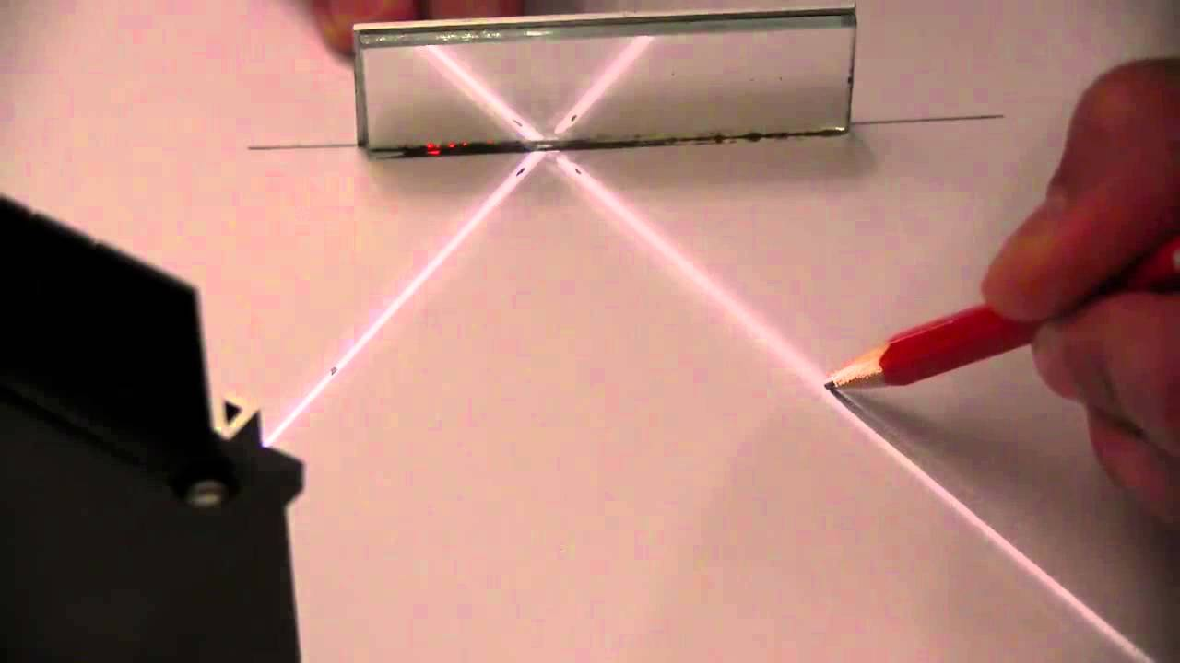
Activity 5-5 p178
Video
https://www.google.com/search?q=demonstrating+law+of+relflection&rlz=1C1OKWM_enCA892CA892&oq=demonstrating+law+of+relflection&aqs=chrome..69i57j33.7217j1j7&sourceid=chrome&ie=UTF-8#kpvalbx=_VcRzXv22C4_x-gSrjZu4BQ26

