Slide 1
Types of Mirrors
Plane, Concave, Convex

Slide 2
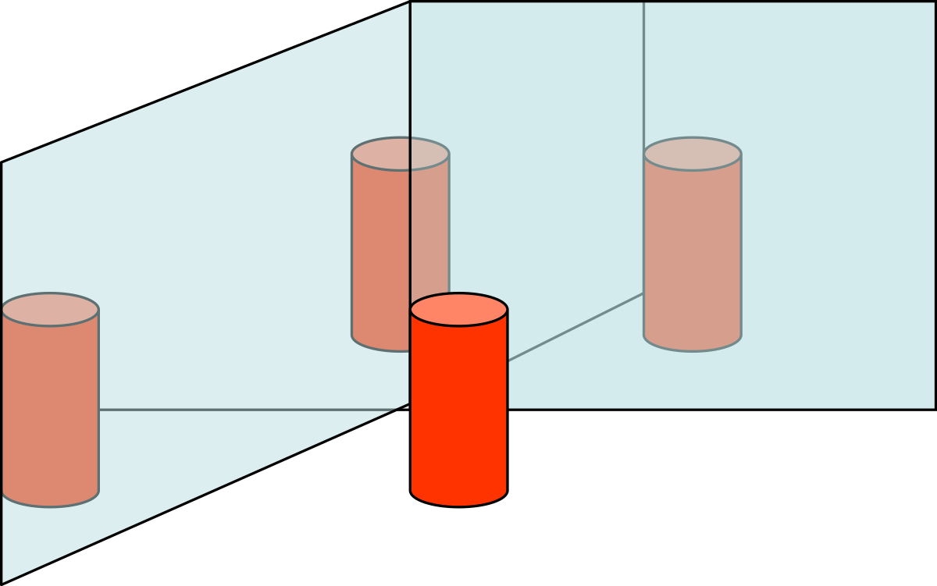
Extension: Find out Activity 5-6 p182
What is the relationship between the number of reflections and the angle between the mirrors?

Slide 3
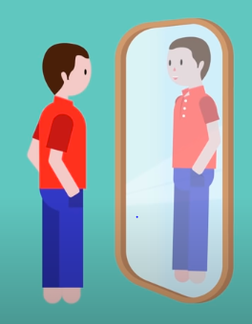
Why do we see our image in a mirror?
Notes:
Due to the reflection of multiple light rays.

Slide 4
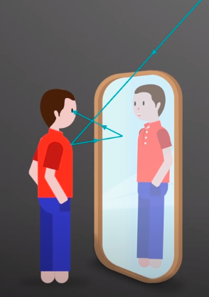
Due to the reflection of multiple light rays.
Light ray can be reflected multiple times.
Is your image a real image or virtual?
Notes:
Light ray can be reflected multiple times. Is your image a real image or virtual?

Slide 5
REFLECTION in Mirrors
The LAW OF REFLECTION applies to ALL mirrors.
Reflected Images can be REAL or VIRTUAL.

Slide 6
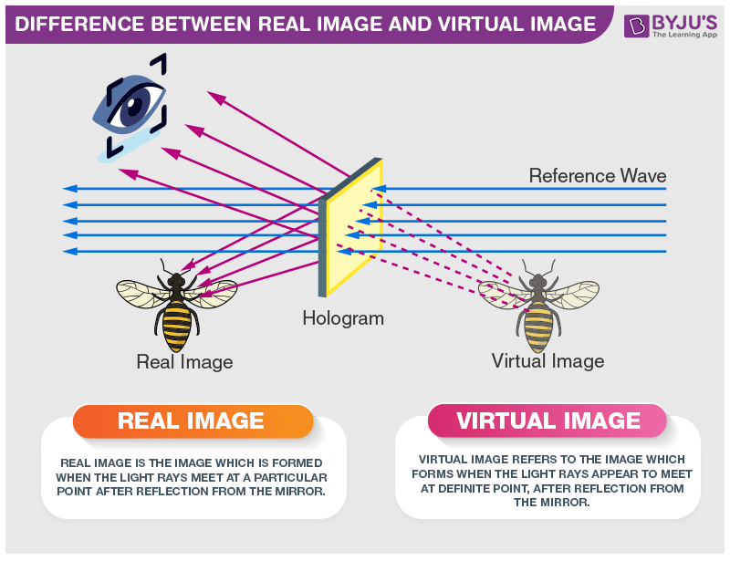
VIRTUAL IMAGE
Forms when reflected rays do not actually meet;
Only the extended rays do.
Images appears behind mirror.
REAL IMAGE
Forms when reflected rays meet. Image is visible in front of mirror

Slide 7
A real image can be caught on a screen.
A real image is always inverted, virtual image is always upright.
A real image is formed when the rays of light after reflection or refraction actually meet at some point whereas a virtual image is formed when the rays of light after reflection or refraction appear to meet at a point.
A real image is formed by the actual intersection of light rays whereas a virtual image is formed by the imaginary intersection of light rays.
A real image can be formed in in a screen but a virtual image can be only seen in the mirror.
A real image is formed by only concave mirror however a virtual image can be formed by concave, convex and plane mirror also.

Slide 8
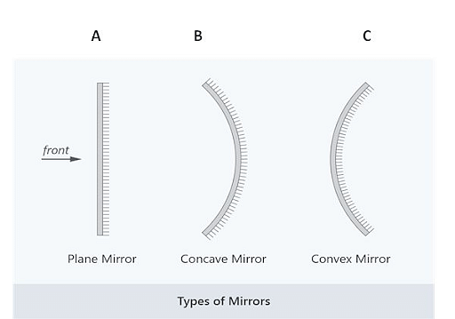
Light Box Activity – Hand in
Types of Mirrors
Notes:
5-7, p187

Slide 9


Try this:
Find a mirror Look into your mirror/camera,
Raise your right hand.
What do you see?
Write a message on a piece of paper,
hold it in front of you and try to read it
in the mirror.
Notes:
OR use your phone camera (The image created by your selfie lens behaves like a mirror).

Slide 10
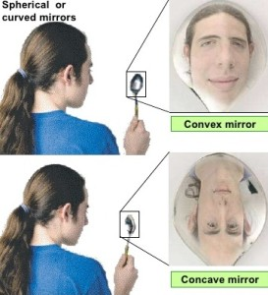
For each mirror:
Describe shape of the mirror
Look into it: Can you see your whole head or just part of it?
Looking at your image, slowly move the mirror away from you to arms length.
Did your image disappear at a certain point as you pulled it away?
Did it reappear?
Was it different?
What general rule can you come up with regarding the reflect images in terms of size and orientation?
Is the image REAL or Virtual?
Where can you find an example of each mirror?
https://www.youtube.com/watch?v=N6n0FAZ_6N8

Slide 11
Complete activity with Ray Boxes
Notes later

Slide 12
PLANE Mirror
DESCRIPTION: smooth and flat
IMAGE:

Slide 13
IMAGE in Plane Mirrors (Flat Mirror)
upright ,
appears to be same distance behind the mirror as the object in front, making image appear to be the same size as object.
Left and right appear to be reversed in a plane mirror.
Image is virtual.
See pages 183 - 184
Notes:
The image formed by a plane mirror is always virtual (meaning that the light rays do not actually come from the image), upright, and of the same shape and size as the object it is reflecting.

Slide 14
Try same for other two mirrors
Concave Convex
Curves inward Curves outward

Slide 15
Concave Mirrors
curves inward.
Light reflecting off converge (come together) and meet at a single point called the focal point.
Image is real
See page 185

Slide 16
Concave Mirrors
The image formed by a concave mirror depends on distance from the focal point .
If object is far, image is upside down and smaller
If object is close, image is upright, larger

Slide 17
A. If object is far, its image is small and inverted (upside down).
B. As the object approaches the focal point, its image is still inverted but gets ever larger.
C. If the object is very close (between the focal point and mirror), then image appears to be larger than the object and is upright.

Slide 18
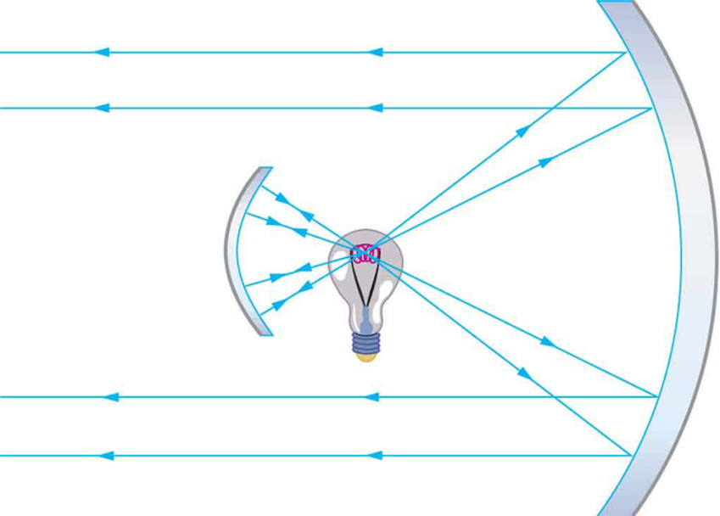
Uses of Concave Mirrors:
If you place a bright light at the focal point, then all the rays bounce off the mirror and are reflected parallel to each other, making an intense focussed beam of light.
Spotlights, flashlights, lighthouses and car headlights use this principle

Slide 19
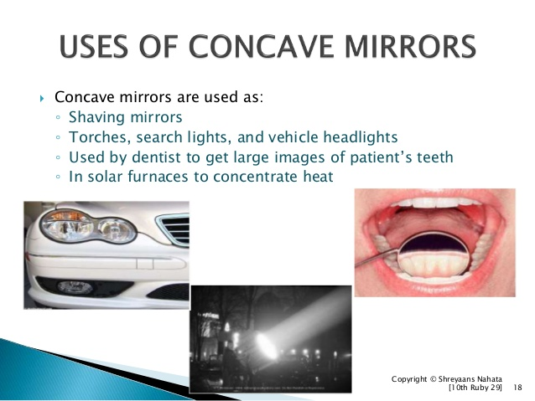

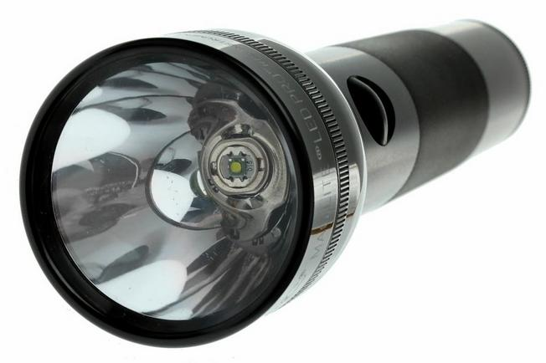
Uses of Concave Mirrors
Dental mirrors
Shaving and Make up mirrors
Used in telescopes
Used as reflectors behind flashlights, car headlights, lighthouses to make intense beam of light.

Slide 20
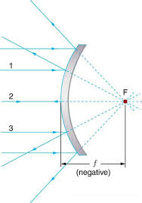
Convex Mirror

Slide 21
Convex Mirror
curves outwards.
Reflected rays diverge (spread apart) and do NOT meet
Incoming parallel rays reflect as if they came from a focal point behind the mirror.
IMAGE: appears upright and smaller, thus seeing more objects
Image is virtual
Notes:
The image produced by a convex mirror is always virtual, and located behind the mirror. When the object is far away from the mirror the image is upright and located at the focal point. As the object approaches the mirror the image also approaches the mirror and grows until its height equals that of the object.

Slide 22
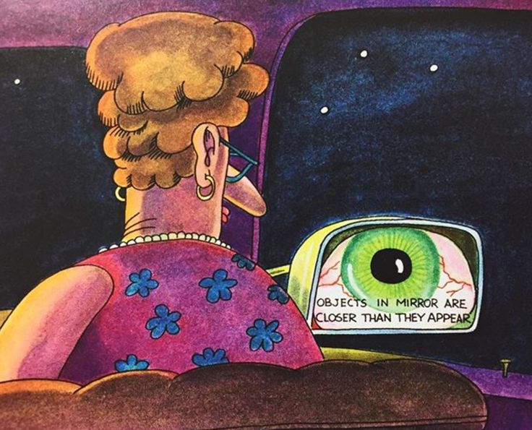
Convex Mirrors USES:
  Security mirrors in stores
  Rearview mirrors in cars

Slide 23
Check your understanding
What size does the image in a plane mirror appear to be?
What distance from the mirror does an image in a plane mirror appear to be?
How is a concave mirror shaped differently from a plane mirror?
What are some uses for concave mirrors?
How is a convex mirror shaped differently from a plane mirror?
What are some uses for convex mirrors?

Slide 24
Extra Slides Beyond Here

Slide 25
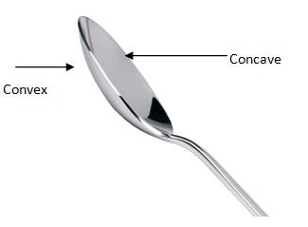
Convex Mirror Activity
Look at your reflection in a Convex Mirror or from the BACK of the spoon.
How is your image different in terms of size and orientation?
Can you see what’s behind you ?
Where would this kind of mirror be handy?

Slide 26
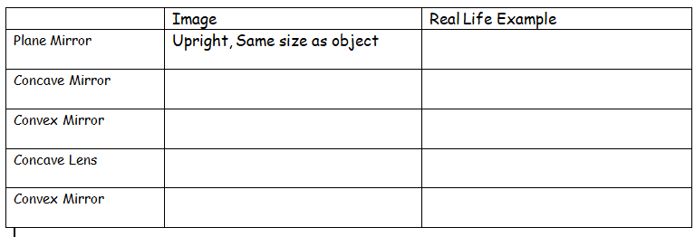
Fill in your chart

Slide 27
More Info: Khan Academy on virtual image
The Virtual Image is an image formed when the outgoing rays from an object always diverge (move apart). A plane mirror forms a virtual image positioned behind the mirror:
https://www.khanacademy.org/science/physics/geometric-optics/mirrors/v/virtual-image

Slide 28
Going Further
Why do mirrors flip images horizontally and not vertically?
https://www.sciencealert.com/how-do-mirrors-work

Slide 29
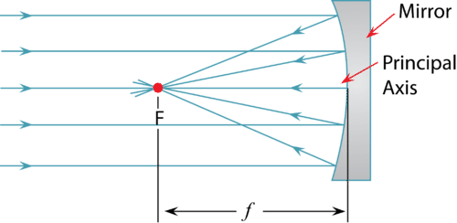
Practice
Mirror WS
Answer Check your Understanding page 189
Questions #1,3,5,6,7

Slide 30
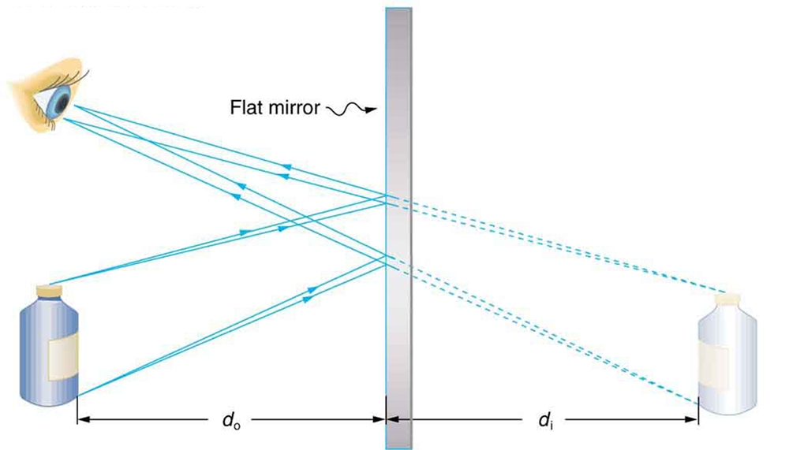

Slide 31
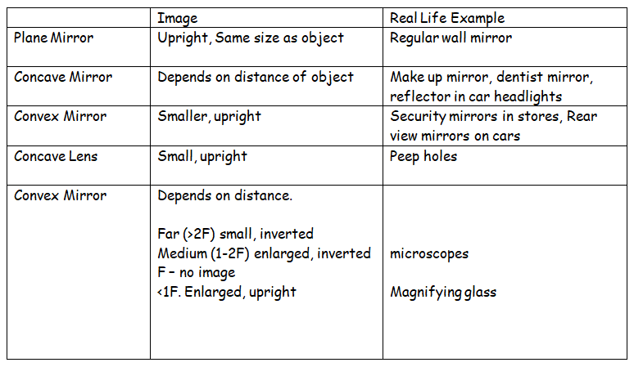

Slide 32
Going further
Images from Concave Mirrors: https://www.youtube.com/watch?v=Hp0PsU6mUGs&t=287s
Uses of concave mirrors: https://www.youtube.com/watch?v=QMElx44Ikss
Images from Convex mirrors: https://www.youtube.com/watch?v=TpN6xuYxwms&t=128s
Uses of Convex mirrors
Real vs Virtual Images: https://www.youtube.com/watch?v=EwBK_cXUTZI

