Slide 1
CLASSIFYING MATTER

Slide 2
Vocabulary
Atom, molecule, compound
Pure substance
Homogeneous,
heterogeneous
Solute, solvent, solution
Colloid
Mechanical mixture
suspension

Slide 3
Matter can be classified by State

Slide 4
Matter can be classified by its composition

Slide 5
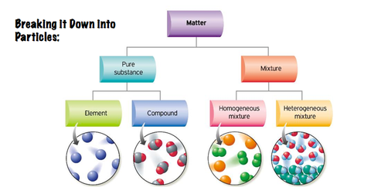

Slide 6
THERE ARE TWO TYPES OF MATTER

Slide 7
PURE SUBSTANCES
Have only ONE TYPE of particle

Slide 8
Pure Substances can be further categorized into ELEMENTS OR COMPOUNDS

Slide 9
ELEMENTS:
contain only ONE type of ATOM
CANNOT be broken down into anything simpler.
Eg: anything on the periodic table: Gold, copper, silver, sulfur, oxygen, helium, etc.

Slide 10
COMPOUNDS
Made up of TWO or MORE different elements chemically bound together

Slide 11
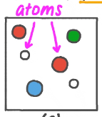
Atoms, Molecules, Compounds
An atom is the smallest unit of an element:
A molecule is a substance composed of two or more atoms bonded together. These atoms may be the same or different:
A compound contains two or more different elements

Slide 13
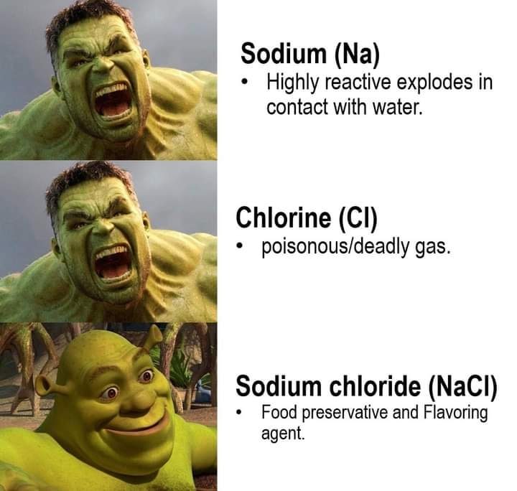
Salt is a compound
Salt is a compound
Chemical formula is NaCl – a combination of sodium (Na) and chlorine (Cl)
They are chemically combined

Slide 14
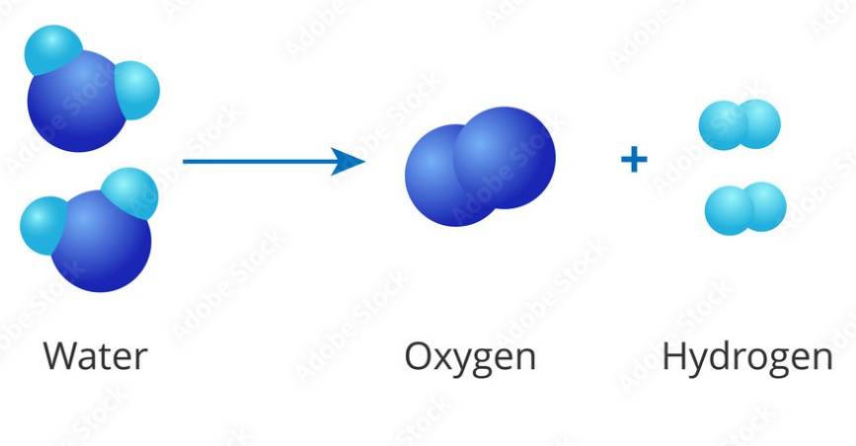
COMPOUNDS
Because compounds are made of different elements, they can be broken down using ENERGY like heat or electricity.
The energy is needed to break the chemical bonds between elements.

Slide 15
What is the difference between elements and compounds?
Elements cannot be broken down into anything simpler by ANY means.
One type of atom.
Compounds can be broken down into simpler units using ENERGY like heat or electricity (to break the chemical bonds between elements).
Eg. Water can be broken down into hydrogen and oxygen from water
video: http://www.youtube.com/watch?v=OTEX38bQ-2w

Slide 17
MIXTURES (are NOT pure substances)
Mixtures contain two or more pure substances NOT chemically bound together.
Can be separated based on their physical properties, without needing energy
Notes:
A mixture is the physical combination (not chemically joined) of two or more substances in which each substance keeps its identity.

Slide 18
Homogeneous Mixtures
“Homo-” means “same”.
Looks same throughout
Properties are same throughout.
The components are indistinguishable from each other (can’t tell them apart) because they are microscopic (too small to see with human eye).
Can be solid, liquid, gas

Slide 19
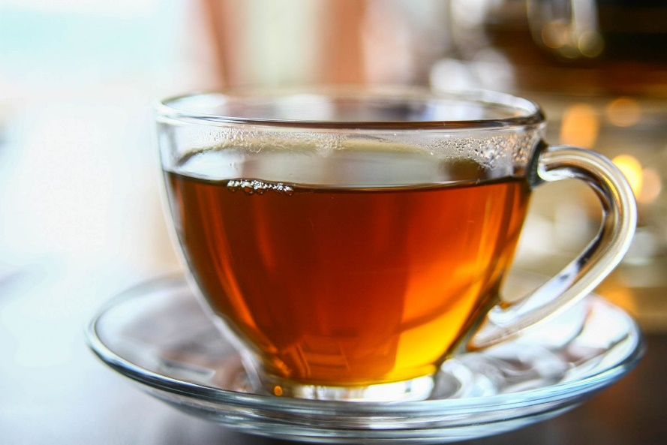
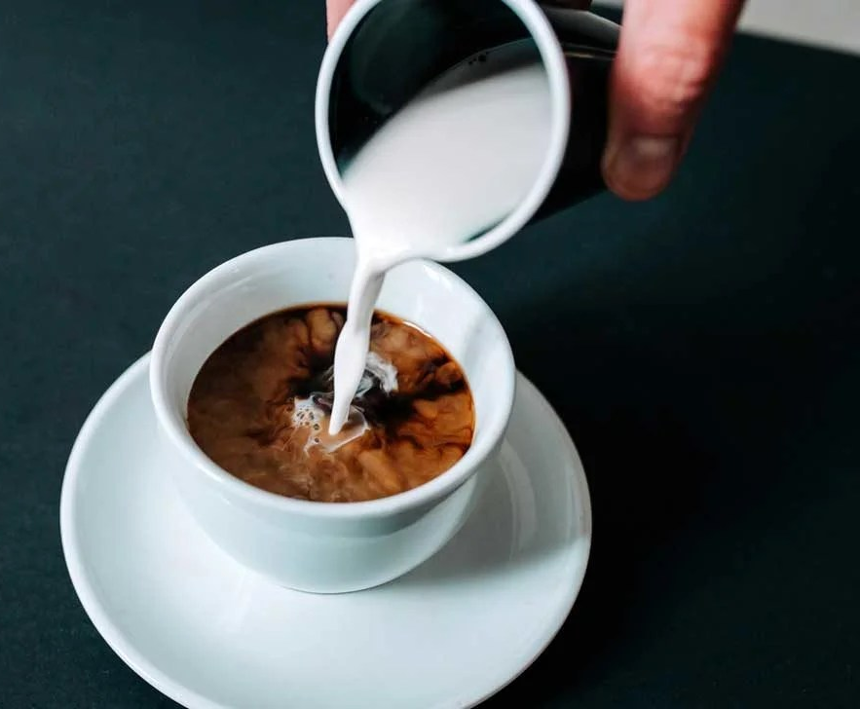
Examples of Homogeneous Mixtures in liquid
Honey and Tea, coffee and cream

Slide 20
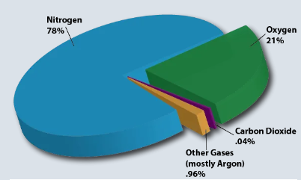
Homogeneous Mixtures in Gas form
Air is a mixture of gasses:
oxygen,
nitrogen,
argon,
carbon dioxide,
etc

Slide 21
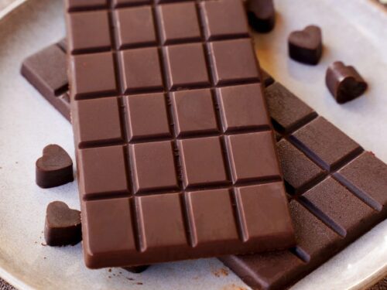
Solid Homogeneous Mixture
Chocolate is a solid mixture.
cacao powder,
cocoa butter,
sugar;

Slide 22
Homogeneous Mixtures: Solutions
Particles DO NOT settle out
Solutions contain particles that are < 2 nm
Eg. Sugar dissolved in water

Slide 23
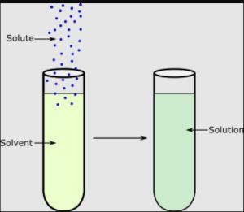
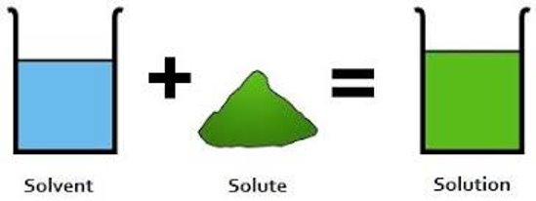
Homogeneous Mixtures: Solutions
Solute + solvent = Solution

Slide 24
Colloids – Moved to Heterogenous

Slide 25
Homogeneous Mixtures

Slide 26
Heterogeneous (Mechanical) Mixtures:
“Hetero” means different
(Looks different, different properties)
Composition NOT uniform
Components can be seen
May have DIFFERENT properties throughout
Ex. Granola, sulfur and iron, sand and marbles, salsa, blood

Slide 27
Heterogeneous Mixtures

Slide 28
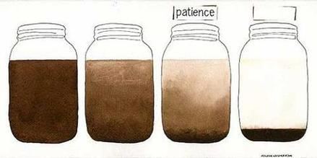
Heterogeneous Mixtures: Suspensions
Particles may settle out over time
Suspensions contain particles >500nm
eg. Muddy water, hot chocolate, oil and water

Slide 29
Hetergenous Mixtures: Colloids
Colloids contain particles are bigger (2-500nm) but still can’t be seen without a microscope,
Appear homogenous but are heterogenous
particles stay suspended (hanging), will not settle out.
Eg. Milk, fog (water molecules in air), smoke, whipped cream, mayonnaise, butter, jelly, colored glass, paper

Slide 30
Properties of Mixtures
1) Components can be separated by physical means (filtration, evaporation, sublimation, distillation)
2) Mixtures show properties of all its constituents (components).
3) Formation of a mixture is a physical change (energy is neither given off nor absorbed).
4) Constituents are present in any portion by mass.
5) Do not have a definite melting point or boiling point.
6) Can be homogeneous or heterogeneous

Slide 32
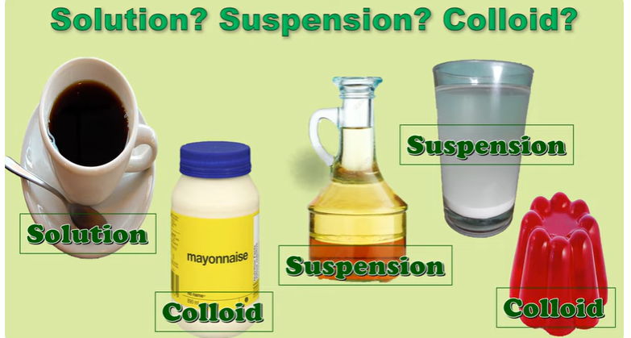

Slide 33
Classify these

Slide 34
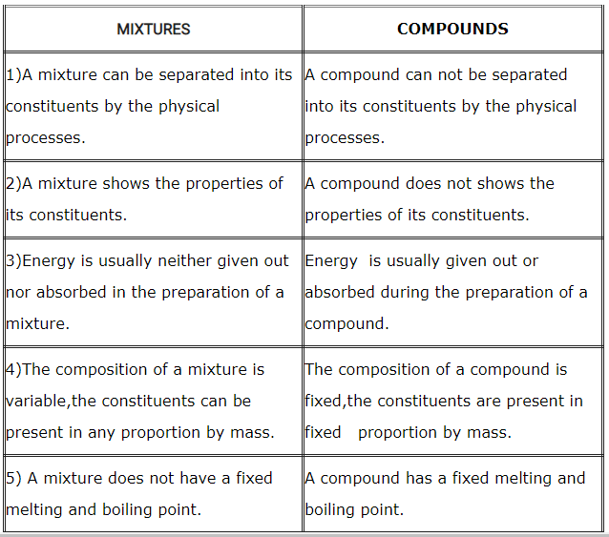
Difference between Compound and Mixture

Slide 35
Types of Mixtures

Slide 37
Extra Slides beyond here
Practice vocabulary

Slide 44
Summary

Slide 45
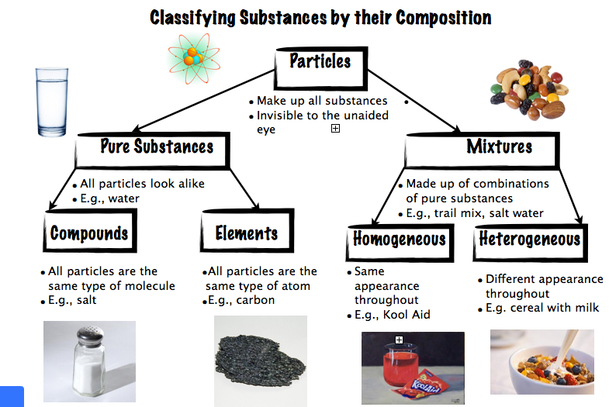

Slide 46
Summary
Pure Substances may be either elements or pure compounds. They may also be solid, liquid, or gas. Some of the elements (such as silver) exist in the solid form. Other elements (mercury) exist as liquids at room temperature. Elements such as helium and radon exist as gases at room temperature. A compound such as water will take the form of a solid, a liquid, or a gas, depending upon the temperature.
Summary
A substance is a pure material with a uniform and definite composition.
A substance cannot be separated into components using physical means.
A substance can be a solid, a liquid, or a gas, depending on the temperature.
Review
Define substance.
Can salt be a substance?
Is aspirin a substance?

Slide 47
Examples of Mixtures
Cement

Slide 48
Examples of Mixtures
Brass is a mixture of copper and zinc.
The substances that make up the mixture are called constituents or components.

Slide 49
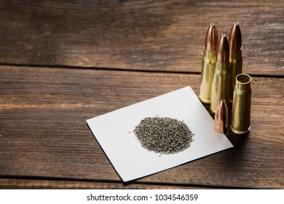
Examples of Mixtures
Gun powder is a mixture of
potassium nitrate, sulphur,
charcoal

