Slide 1
LEWIS DIAGRAMS
Atoms and Ions

Slide 2
Lewis Diagrams:
Shows only the valence electrons and symbol.
Invented by American chemist Gilbert Lewis (1875 – 1946)
Find Nitrogen on periodic table,
How many electrons does it have?
How many valence electrons?

Slide 3
Lewis Diagrams:
Shows only the valence electrons and symbol.
Invented by American chemist Gilbert Lewis (1875 – 1946)
Find Nitrogen on periodic table,
How many electrons does it have? 7
How many valence electrons? 5

Slide 4
Lewis Diagram for Nitrogen:
5 valence electrons:
Dots represent valence electrons
Place dots around in compass points (North, East, South, West),
Single dots until 5th electron, then paired

Slide 5
Draw Lewis Diagrams for these elements
Lithium Sodium Beryllium Carbon Helium Neon

Slide 6
Try these
Lithium Sodium Beryllium Carbon Helium Neon

Slide 7
Lewis Diagrams:
Lewis diagrams are the same (except for the symbols) for elements in the same family because they have the same number of valence electrons

Slide 8
Lewis Diagrams for Cations:
Positive ions (cations): one electron dot is removed from the valence shell for each positive charge of the ion.
Because only valence electrons are shown in Lewis diagrams, the positive ion usually does not have any valence electrons left to show.
Use square brackets and superscript to show charge.
→

Slide 9
Draw Lewis Dot Diagrams for this IONS:
Lithium Beryllium Sodium Magnesium

Slide 10
Lewis Diagrams for Ions:
Negative ions: one electron dot is added to each valence shell for each negative charge of the ion.
Usually means the symbol is surrounded by all 8 dots.
Place square brackets around each ion and superscript to indicate the charge.

Slide 11
Draw Lewis Dot Diagrams for this IONS:
Oxygen Nitrogen Fluorine Chlorine

Slide 12
What do you notice about the valence electrons?
Notice that Mg has no electrons,
Notice that Oxygen has 8 electrons.

Slide 13
What do you notice about the valence electrons?
Notice that Mg has no electrons,
Notice that Oxygen has 8 electrons.
The lack of electrons around Mg means the previous shell is FULL.
Like Bohr Models, Lewis Diagrams for ions will indicate stable octet.

Slide 14
Where do the electrons go/come from?
Sodium metal GIVES an electron to Chlorine:
Now they are both STABLE because their valence shells are full.

Slide 15
When sodium loses an electron, it becomes positive.
When chlorine gains an electron, it becomes negative

Slide 16
The opposite charges attract each other.
This attraction is a chemical bond.
A chemical bond between two ions = ionic bond.
When ions form an ionic bond, they have formed an ionic compound.
E.g. Sodium ion bonded to chlorine ion = sodium chloride (table salt)

Slide 17
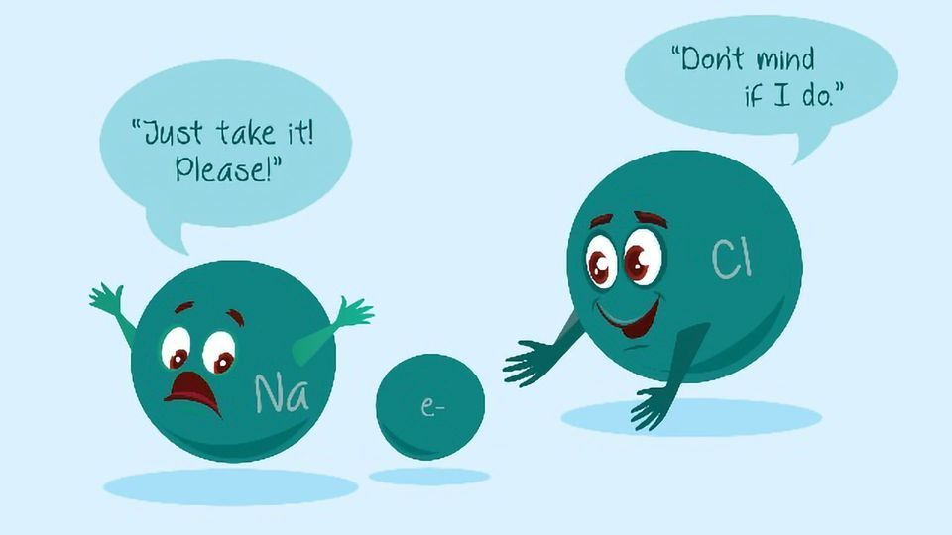

Slide 18
Lewis and Bohr Diagrams of Ionic Compound of Magnesium and Oxygen
Lewis Diagram Bohr Diagram

Slide 19
Lewis Diagrams of Ionic Compound of Magnesium and Oxygen
Lewis Diagram

Slide 20
Bohr Diagrams of Ionic Compound of Magnesium and Oxygen
Bohr Diagram

Slide 21
For each electron given, one must be taken
Do you think an ionic compound could form between barium and bromine? Why?

Slide 22
For each electron given, one must be taken
Do you think an ionic compound could form between barium and bromine? Why?
How many electrons can Barium give (to become ion)?
How many electrons can bromine receive (to be ion)?
Draw the Lewis diagrams for both ions.
For every electron give, one must be received (accepted, taken)

Slide 23
Lewis Diagram for Ionic Compound
For every electron given away, one must be received (accepted, taken)

Slide 24
Try the Bohr Model for compound of calcium and fluorine

Slide 25
Try the Bohr Model for Calcium and Fluorine

Slide 26
Practice
Worksheet

