Slide 1
SEPARATING MATTER

Slide 2
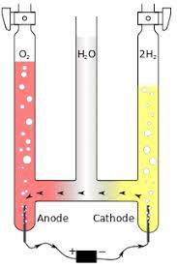
Recall
Compounds can be separated into its constituents using ENERGY (because energy is needed to break the chemical bond). Like heat or electricity
Eg. Electrolysis is the process of separation water into oxygen and hydrogen.

Slide 3
Separating Mixtures
Mixtures are composed of different elements NOT chemically bonded together so they can be separated easily using physical means based on their physical properties.

Slide 5
Separation techniques for mechanical mixtures
filtration,
evaporation,
sublimation and
magnetic separation
Centrifugation.

Slide 6
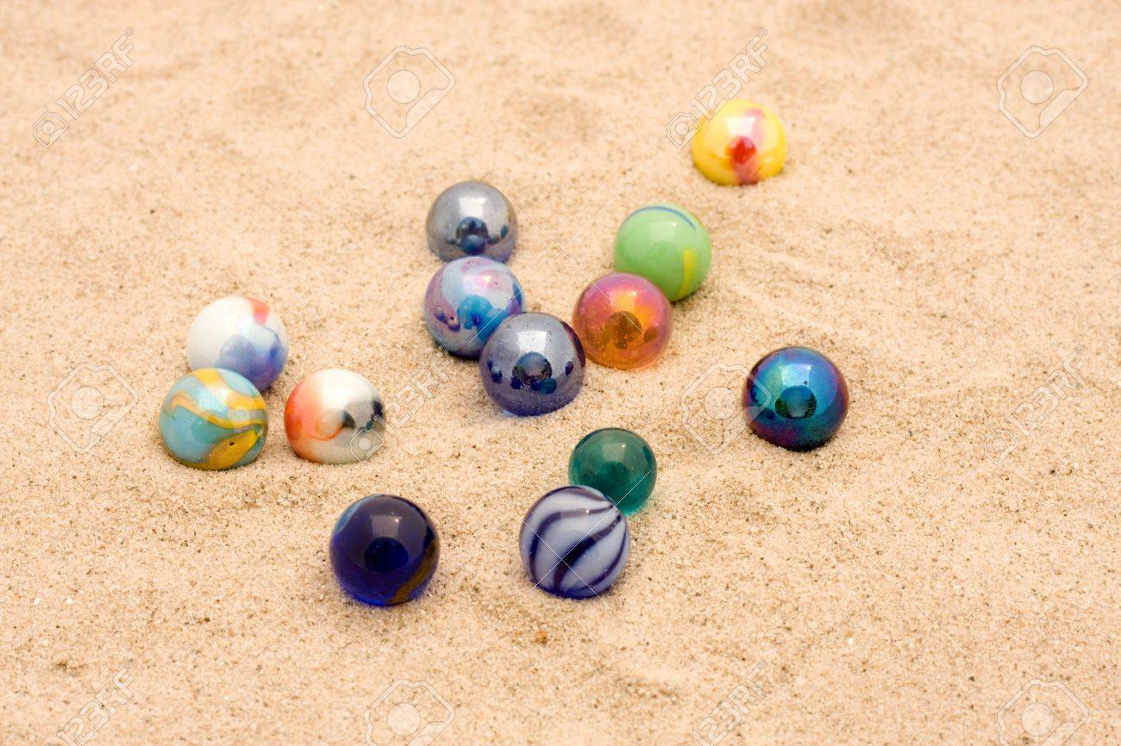
MIXTURES CAN BE SEPARATED BY PHYSICAL MEANS
How would you separate the components of these heterogeneous mixtures?
Sand marbles?

Slide 7
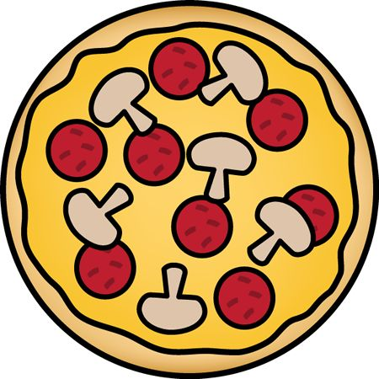
Hand picking

Slide 8
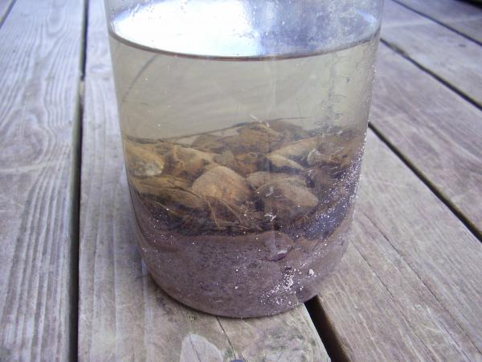
How would you separate the components of these heterogeneous mixtures?
Sand and water?

Slide 9
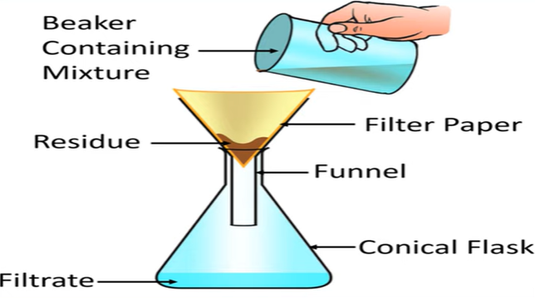
Filtration
Based on solubility
Coffee

Slide 10
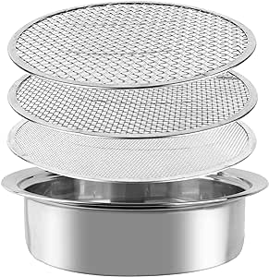
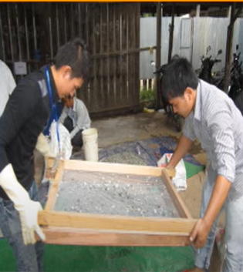
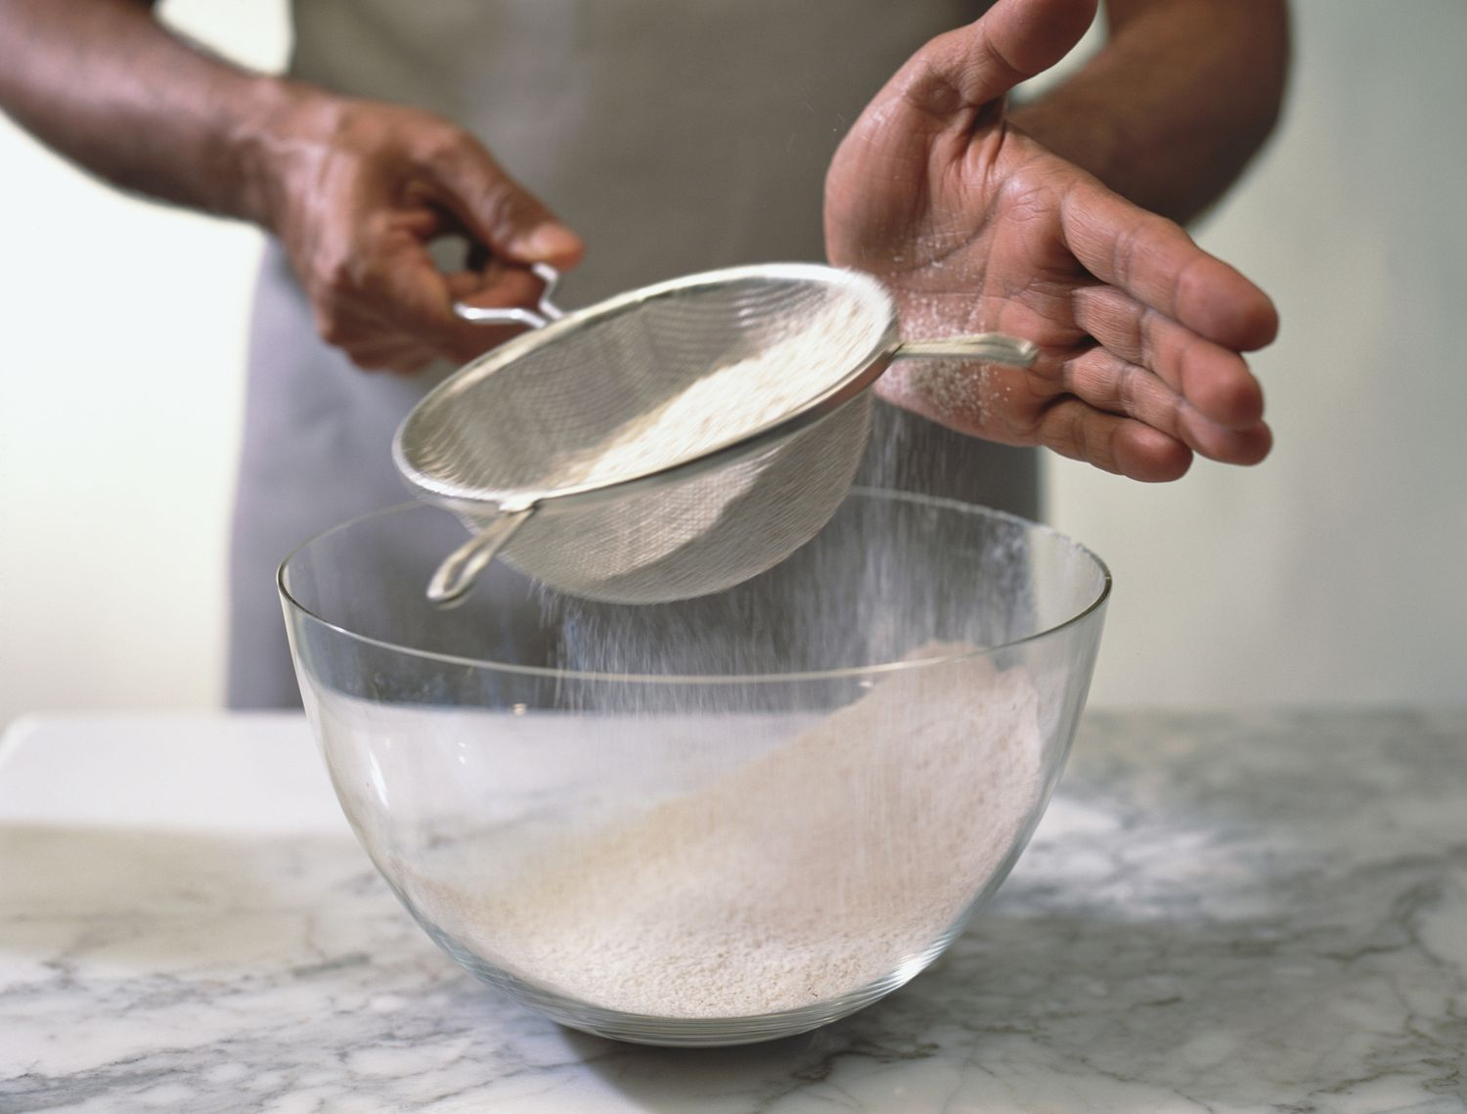
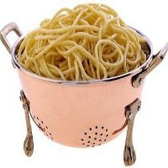
Sifting, Sieving, Straining – like filtering
Baking, Landscaping

Slide 11
Decantation
Different density

Slide 12
Floatation

Slide 13
Using magnets
Magnetism is a physical property of iron but not sand

Slide 14
Centrifugation- for particles too small to filter. Spins at high speeds. Denser particles force to bottom.

Slide 15
Separating homogenous mixtures (solutions)
Dissolved substances

Slide 16
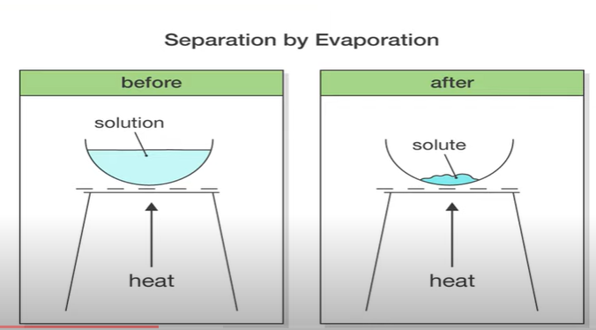
Evaporation
Difference in solubility

Slide 17
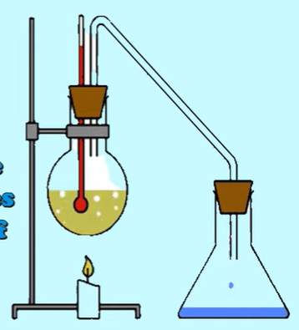
Distillation
The substance with the lowest boiling point will boil first

Slide 18
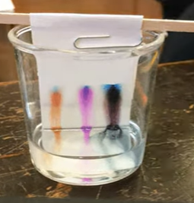
Chromatography
Based on solubilities, size, charge, and/or polarity.
Uses a “medium”: gel or paper
Solvent moves through the medium, carrying the solute with it.
Solutes move at different rates through the medium due to their different solubilities/charge/size/polarity.
Notes:
https://www.youtube.com/watch?v=eHCuJjIBIpY

Slide 19
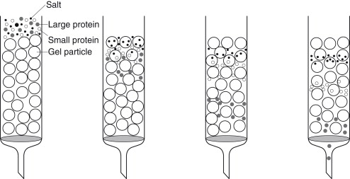
Gel Chromatography
Solutes move at different rates through the medium due to their different size:
(Like filtering)

Slide 20
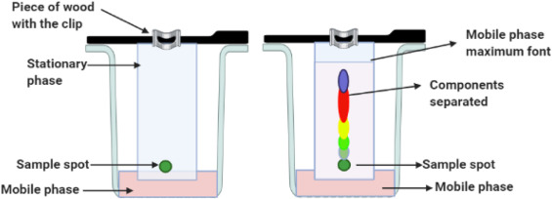
Paper Chromatography
Sample (solute) placed on chromatography paper,
Solvent (water, acetone, etc) moves up paper, carrying sample (solute) with it.
The sample is a mixture
Different components of mixture move up paper at different rates based on their solubilties in the solvent

Slide 21
Practice
Separating Matter WS
Chromatography Lab

Slide 22
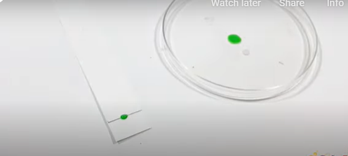
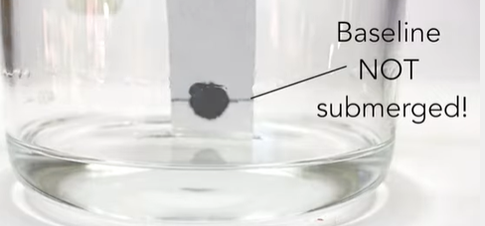
Activity: Candy Chromatography
Be able to discuss what paper chromatography is, Know how to make sense of your results
Provide trouble shooting tips
https://www.sciencebuddies.org/blog/chromatography-science-projects

