Slide 1
Atomic Theory
History of the Atom

Slide 2
History of Atom
Ted Ed https://ed.ted.com/lessons/the-2-400-year-search-for-the-atom-theresa-doud
Crash Course
https://www.youtube.com/watch?v=thnDxFdkzZs
Science classroom https://www.youtube.com/watch?v=IO9WS_HNmyg
Extra video on history of atom
https://www.youtube.com/watch?v=NSAgLvKOPLQ

Slide 3
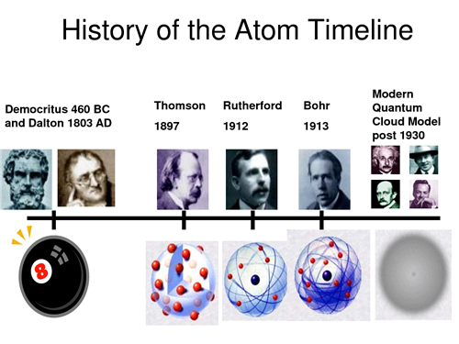
The History of Atomic Theory
Notes:
Early ideas about matter
Greek philosophers believed that matter was made of atomos that were the smallest pieces of matter.
Aristotle believed matter was made of
different combinations of earth, air,
fire, and water.
Alchemists experimented with matter and
tried to turn common metals into gold.
Their activities marked the beginning of
our understanding of matter.

Slide 4
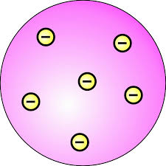
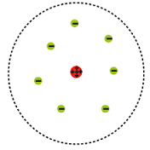
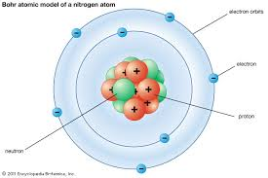
Early Ideas about Matter and Atoms
Researcher | Idea | Model
Ancient Greeks | Atomos- smallest piece of matter | (n/a)
John Dalton (1766-1844) | Particles are small hard spheres that are different for different elements
J. J. Thomson (1856-1940) | Atoms have smaller particles called electrons (= raisin bread model)
Ernest Rutherford (1871-1937) | Electrons move around the nucleus. Nucleus is made up of protons and neutrons
Neils Bohr (1885-1962) | Electrons circle the nucleus in predetermined shells
Notes:
Ancient Greeks: Democritus believed everything was made up of tiny particles in empty space. Atomos. Uncuttable. No proof, just theory
Aristotle disagreed. Didn’t believe empty space could exist. Denial for 2000yr
John Dalton school teacher (1766 - 1844) developed a theory that was a new way of explaining matter. Conducted experiements
He studied gases that make up Earth’s atmosphere.
Based on his studies, he suggested that:
matter is made of small, hard spheres
that are different for different elements
the smallest particle of an element is called an atom

Slide 5
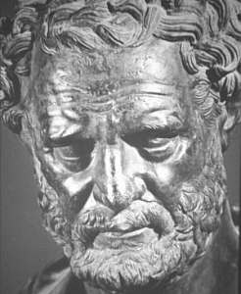
Democritus (460 BC)
Greek philosopher believed everything was made up of tiny particles in empty space.
He called them Atomos, meaning “Uncuttable”.
He did not use experiments to support his ideas, just reason and logic.
Notes:
He pounded up materials in his pestle and mortar until he had reduced them to smaller and smaller particles which he called

Slide 6
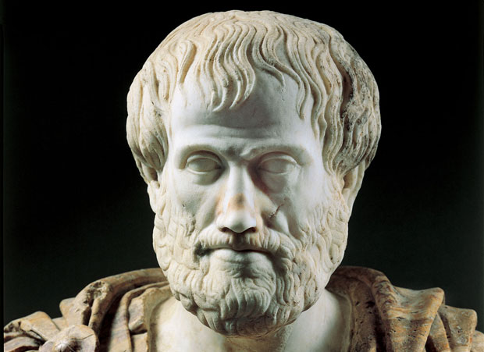
Aristotle
Philosopher Aristotle disagreed because he didn’t believe empty space could exist.
Denial of existence of atoms persisted for 2000yr

Slide 7
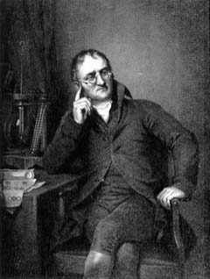
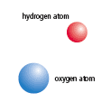
John Dalton (1808)
Suggested that all matter was made up of TINY SPHERES that were able to bounce around with perfect elasticity.
Called them ATOMS

Slide 8

John Dalton (1766-1844)
Developed Atomic Theory
Suggested that:
All matter is made of TINY SPHERES called ATOMS
Atoms cannot be CREATED, DESTROYED, or DIVIDED into smaller particles.
Figure 2.23:
According to Dalton, atoms were solid, indestructible spheres.
Notes:
Introduced his ideas in 1803

Slide 9
John Dalton Developed Atomic Theory
All atoms within the same element are IDENTICAL, but are different from atoms of other elements.
Atoms combine in DEFINITE PROPORTIONS to form Compounds.
Considered the Father of Atomic Theory
Notes:
Introduced his ideas in 1803
John Dalton school teacher (1766 - 1844) developed a theory that was a new way of explaining matter. Conducted experiments
He studied gases that make up Earth’s atmosphere.
Based on his studies, he suggested that:
matter is made of small, hard spheres
that are different for different elements
the smallest particle of an element is called an atom

Slide 10
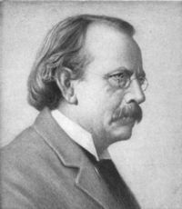
J. J. Thomson (1856 - 1940)
    Found that atoms could sometimes eject a small negative particle, therefore atoms were made of smaller particles.
    Called them ELECTRONS
Notes:
JJ Thompson, British physicist who studied electrical current in cthode ray tubes
Cathode rays were streams of negatively charged particles
All substances produced these particles

Slide 11
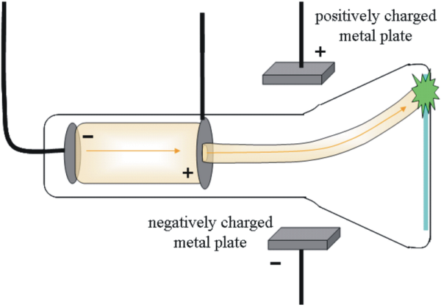
J. J. Thomson (1856 - 1940)
    Studied electric currents in gas discharge tubes (like today’s fluorescent lights).
    From his studies, he determined that the currents were streams of negatively charged particles.
Notes:
JJ Thompson, British physicist who studied electrical current in cthode ray tubes
Cathode rays were streams of negatively charged particles
All substances produced these particles

Slide 12

J. J. Thomson (1856 - 1940)
    atoms were made up of electrons scattered unevenly within an elastic sphere surrounded by a soup of positive charge to balance the electron's charge.
    proposed “RAISIN BUN” model
Notes:
JJ Thompson, British physicist who studied electrical current in cthode ray tubes
Cathode rays were streams of negatively charged particles
All substances produced these particles

Slide 13
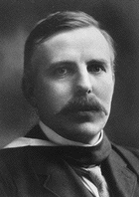
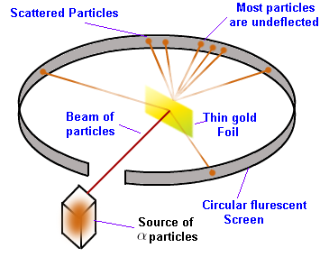
Ernest Rutherford (1910)
Fired Helium nuclei at a piece of gold foil which was only a few atoms thick.
Notes:
Oversaw Geiger and Marsden carrying out his famous experiment.

Slide 14
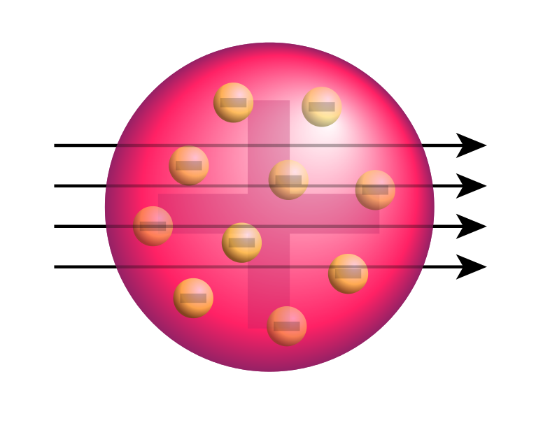

Slide 15
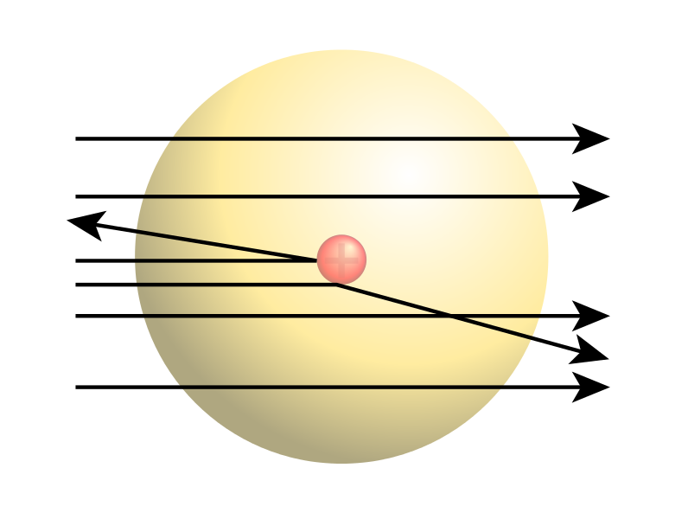

Slide 16
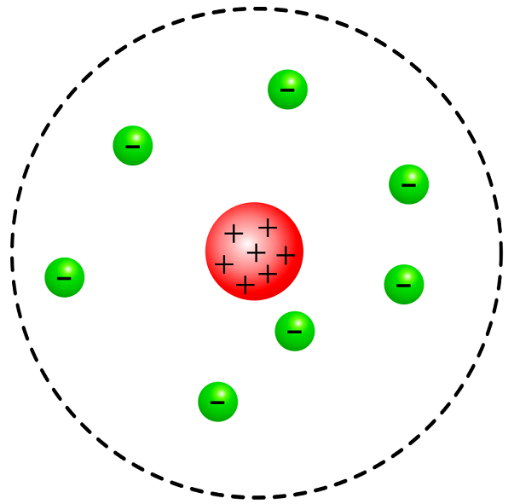

Slide 17
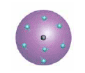
Ernest Rutherford (1871 - 1937)
    Found that although most of them passed through, about 1/10,000 hit.
    He suggested that the deflection of the charged particles was because the atom contained a TINY DENSE NUCLEUS.
Electrons move AROUND THE NUCLEUS.
Nucleus is made up of PROTONS and NEUTRONS.
Notes:
Scientist from New Zealand
Exposed thin sheet of gold to a stream of high speed particles with a positive charge, (alpha particles). The alpha particles cted like tiny bullets. Some particles went through and hit screen on other side., consistent with Thomson’s model (bullet through a muffin) but some rebounded from the foil like a ball bouncing off a wall. Discovered nucleus – tiny dense positively charged center of atom.
According to him, all mass was in nuc

Slide 18
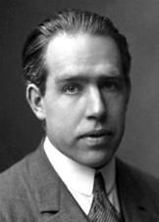
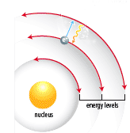
Niels Bohr (1885 - 1962)
    Refined Rutherford’s idea by adding that the electrons were in ORBITS.
    Proposed that electrons surround the nucleus in specific “ENERGY LEVELS” or “SHELLS.”
    Each orbit only able to contain a SET NUMBER of electrons.
Notes:
Danish physicist, student in Rutherford’s lab,
Each gas produced a characteristic spectrum of light as a result, called a line spectrum. Light emitted by the gases was a result of high-energy electrons releasing energy. But electrons of a given gas emitted light only of certain wavelengths. → energy levels
gaseous samples of atoms, which were made to glow by passing an electric current through them.

Slide 19
Dalton’s Atomic Theory
The atom is the smallest particle of an element.
All matter is made of atoms.
Atoms cannot be created or destroyed.
All atoms of the same element are identical in mass and size, but they are different in mass and size from the atoms of other elements.
Compounds are created when atoms of different elements link together in definite proportions.
Notes:
John Dalton school teacher (1766 - 1844) developed a theory that was a new way of explaining matter. Conducted experiments
He studied gases that make up Earth’s atmosphere.
Based on his studies, he suggested that:
matter is made of small, hard spheres
that are different for different elements
the smallest particle of an element is called an atom

Slide 20
The Atom
What is an atom? https://www.youtube.com/watch?v=o-3I1JGW-Ck
Ted Ed: How small is an atom?
https://www.youtube.com/watch?v=yQP4UJhNn0I
Notes:
Ted Ed invisible video
How small is an atom
What is an atom? Monkey see

Slide 21
Review: What is an atom?
Atom: smallest particle of an element that has the properties of the element
Element: Pure substance that cannot be broken down into simpler substances

Slide 22

Structure of the atom
Atoms are made of smaller Subatomic particles (Sub – means below/smaller)
Protons
Electrons
Neutrons
Notes:
Electrons circle the nucleus in special pathways called energy levels or shells.
This region is big (it takes up 99.99% of the atom).
An electron is like a spread-out negative charge that exists in the whole region at once- it is not a fast-moving particle racing around the nucleus.
Protons and Neutrons are composite particles and are made up of Quarks and Gluons

Slide 23
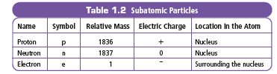
Charge and Mass of Subatomic Particles
Notes:
protons (+) are attracted to electrons (-)
Atoms are neutral: number of electrons equals the number of protons.
e.g. 5 + and 5 – makes 0 charge
protons and neutrons have much more mass than electrons (about 1800 times more!)

Slide 24
Look at your chart
Which particle(s) make up most of the mass of the atom? ________________
Which particle(s) make up most of the mass of the atom? ________________

Slide 25
Which particles make up most of the mass of the atom? Protons and neutrons
Which particle make up most of the mass of the atom? electrons

Slide 26
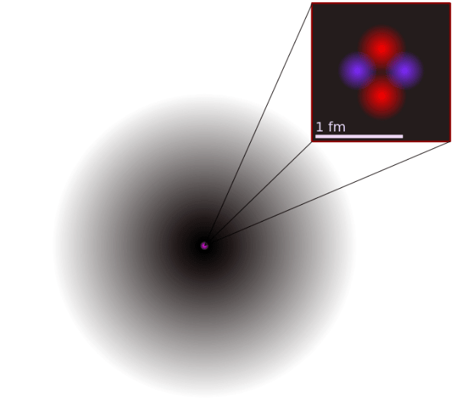
Mass and Volume of an atom
Most of the MASS is in the NUCLEUS (protons and neutrons)
Most of the VOLUME is determined by the ELECTRONS.

Slide 27
Check your Understanding
What are the three subatomic particles?
Compare and contrast the electron and proton in terms of location and charge.
What accounts for an atom`s mass?
What accounts for an atoms volume?

Slide 28
Atoms are Neutral
Neutral → no overall charge
How can this be if it contains positive protons and negative electrons?

Slide 29
Atoms are Neutral
Neutral → no overall charge
How can this be if it contains positive protons and negative electrons?
Positive charges must equal Negative charges
“ + “ = “ – “
Protons = Electrons

Slide 30
So if an atom has 16 protons, how many electrons will it have?

Slide 31
Check your Understanding
What are the three subatomic particles?
Compare and contrast the electron and proton in terms of location and charge.
What accounts for an atom`s mass
What accounts for an atoms volume

Slide 32
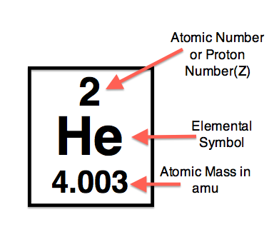

Slide 33
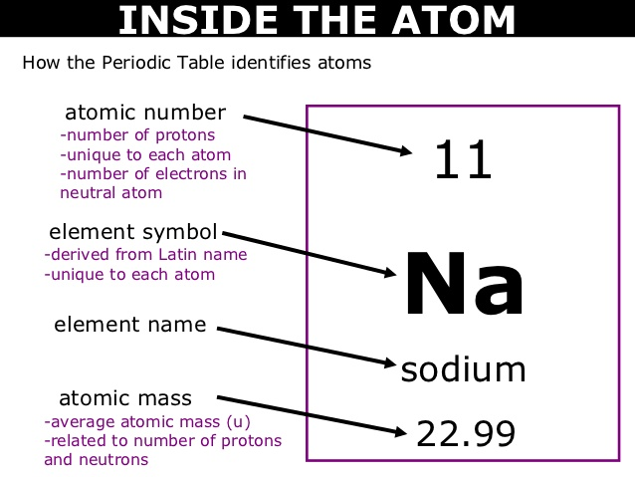

Slide 34
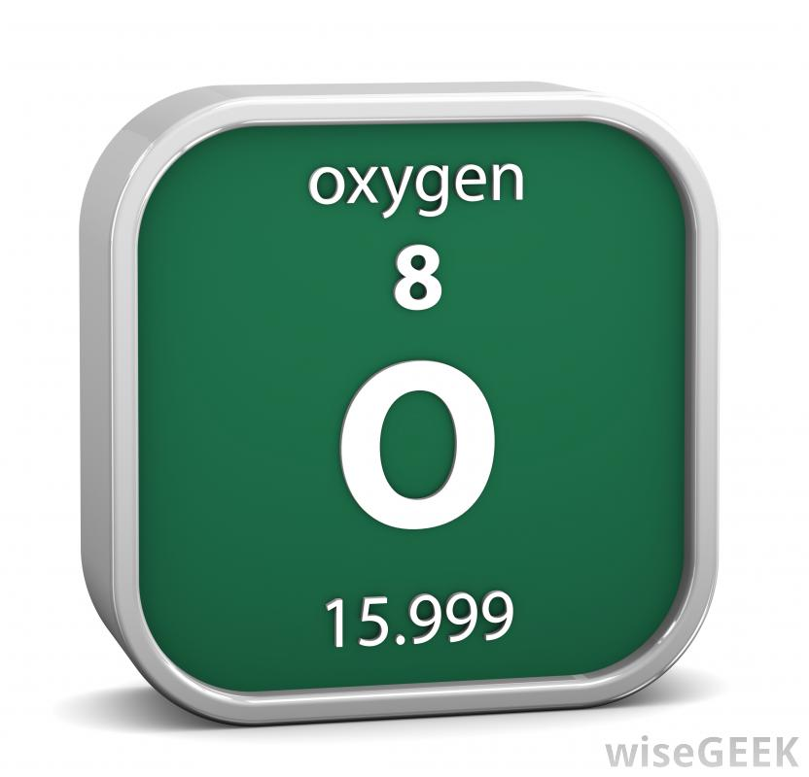
Try this:
What is the atomic number of Oxygen ?
How many protons does it have ?
What is the atomic mass ?
How many neutrons does it have ?

Slide 35
Practice
Element | Symbol | Atomic Number | Mass | Protons | Neutrons | Electrons
Hydrogen
Chromium
Carbon
Barium
Iron

Slide 36
Practice
Element | Symbol | Atomic Number | Mass | Protons | Neutrons | Electrons
Hydrogen | H | 1 | 1 | 1 | 0 | 1
Chromium | Cr | 24 | 52 | 24 | 28 | 24
Carbon | C | 6 | 12 | 6 | 6 | 6
Barium | Ba | 56 | 137 | 56 | 109 | 56
iron | Fe | 26 | 56 | 26 | 30 | 26

Slide 37
Practice
Atomic Theory Worksheet

Slide 38
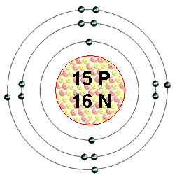
Bohr Model
A Bohr Model is a diagram of the number of electrons in each of the energy level (shell) around the nucleus of an atom.

Slide 39
Bohr Model
Each shell can only hold a CERTAIN NUMBER of electrons:
First shell can only hold a maximum of 2 electrons
2nd shell = 8, 3rd shell = 8, 4th = 18.
The outermost shell is called the VALENCE SHELL.

Slide 40
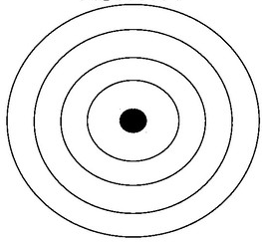
Draw a Bohr Diagram of Nitrogen

Slide 41
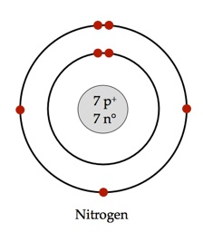
Draw a Bohr Diagram of Nitrogen

Slide 42
Practice: Draw a Bohr Diagram of Potassium

Slide 43
Draw a Bohr Diagram of Phosphorous

Slide 44
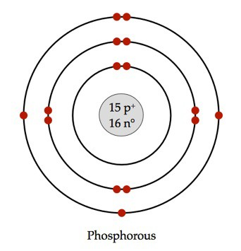
Bohr Model of Phosphorous:

Slide 45
Practice: Draw a Bohr Diagram of Potassium
First find the number of protons by looking at its atomic number (19)
Now you know the number of electrons (19).
Place the electrons in corresponding shells at compass points (North, East, West, South).
Remember that the first shell can only hold 2 electrons, next shell 8, 8, etc

Slide 46
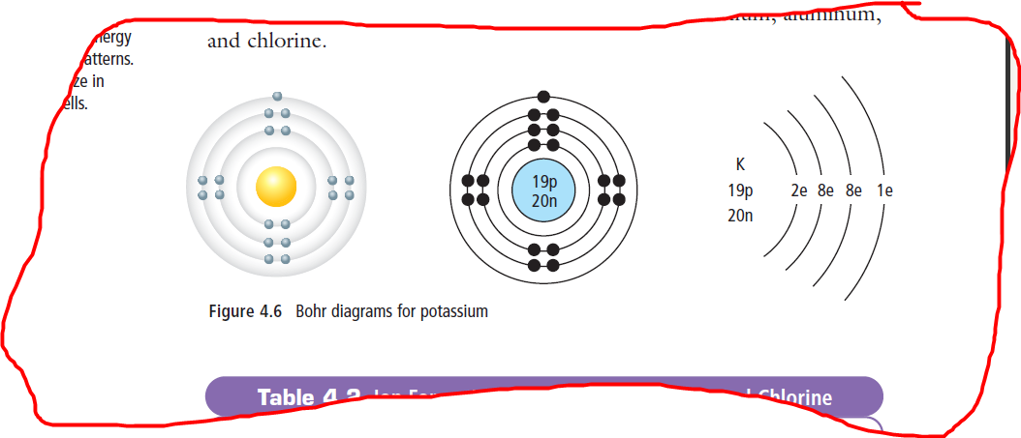
Bohr Model of Potassium

Slide 47
What element is this?
_{18 p}
^{22 n}
Notes:
Argon

Slide 48
What element is this?
_{18 p}
^{22 n}
If you know the number of protons, you know it’s atomic number.
Or count the electrons…
Notes:
Argon

Slide 49
What element is this?
_{18 p}
^{22 n}
It has 2 + 8 + 8 = 18 electrons, and therefore 18 protons.
The element with atomic number of 18 is Argon.
Notes:
Argon

Slide 50
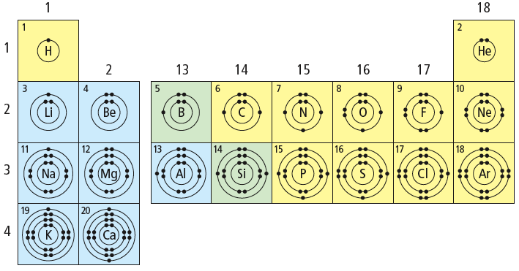
What patterns do you notice?

Slide 51
Patterns of Electron Arrangement in the Periodic Table
Have a look at the three Bohr models you drew.
What relationship can you find between number of OCCUPIED SHELLS and the ROW that it is found on the periodic table?

Slide 52
Patterns of Electron Arrangement in the Periodic Table
Have a look at the three Bohr models you drew.
What relationship can you find between number of OCCUPIED SHELLS and the ROW that it is found on the periodic table?
ROW = # of OCCUPIED SHELLS

Slide 53
Patterns of Electron Arrangement in the Periodic Table
Look at the Alkali Metals (Group 1).
What relationship can you find between number of VALENCE ELECTRONS and the COLUMN that it is found on the periodic table?

Slide 54
What patterns do you notice?

Slide 55
Patterns of Electron Arrangement in the Periodic Table
Look at the Alkali Metals (Group 1).
What relationship can you find between number of VALENCE ELECTRONS and the COLUMN that it is found on the periodic table?
GROUP/COLUMN # = #VALENCE ELECTRONS

Slide 56
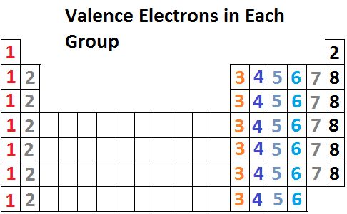
Group number determines the number of valence electrons

Slide 57
What about Argon?
_{18 p}
^{22 n}
It has 3 electron shells, so it is in period 3
It has 8 electrons in the outer (valence) shell, therefore it is a noble gas.
Notes:
Argon

Slide 58
Patterns in the Periodic Table regarding electron arrangement
Elements in same family (group) have same number of valence electrons
Period (Row) = the number of occupied shells.

Slide 59
Homework
Bohr WS
Notes:
Read p14-15 of handout, complete atomic history chart in notes.

