Slide 1
INTRODUCED Species

Slide 2
What is an invasive species?
Ted Ed, 5 min
https://sciencelessonsthatrock.com/invasive-species-teaching-resources-html/

Slide 3
Terms
Native species naturally live in an area.
Introduced species (aka foreign species, non-native species, exotic species or alien species).
they have been introduced accidentally or on purpose

Slide 4
Invasive Species
Invasive species: are introduced species that often take advantage of their new habitat.
They may have no predators, are aggressive competitors, & reproduce fast.
Cause harm to a native species

Slide 5
Harm
Invasive species cause harm to native species by:
Competition for resources (food, water, habitat, etc)
Predation
Disease/infection
Habitat alteration
Parasitism

Slide 6
Biodiversity
Biodiversity is a term we use to describe the variety of life on Earth.
It refers to the wide variety of ecosystems and living organisms: animals, plants, their habitats and their genes
Invasive species threaten biodiversity
Notes:
Our food and energy security strongly depend on biodiversity and so does our vulnerability to natural hazards such as fires and flooding. Biodiversity loss has negative effects on our health and it largely limits our freedom of choice. Most of the medicines that we are using were derived from plants or flora and animals or fauna in our biodiverse world.

Slide 7
Why is Biodiversity important?
Our food and energy security strongly depend on biodiversity
Low biodiversity makes us more e vulnerable to natural hazards such as fires, flooding, drought, disease.
Biodiversity loss has negative effects on our health and it largely limits our freedom of choice.
Most of the medicines that we are using were derived from plants or flora and animals or fauna in our biodiverse world.

Slide 8
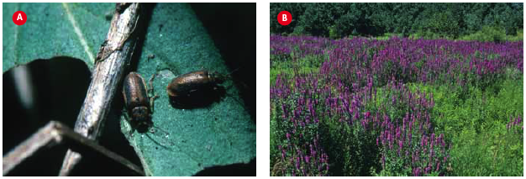
Invasive Species
Eg. Purple Loosestrife, negatively impacts native species, and often reduces biodiversity as a result.
The European leaf-feeding beetle (left), and the Purple Loosestrife.

Slide 9
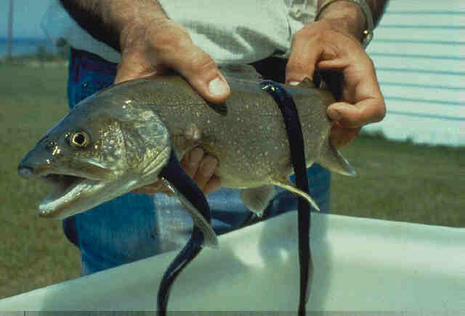
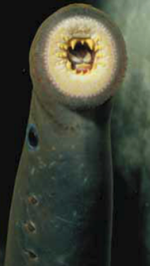
E.g. Sea Lamprey Parasite on other fish
The sea lamprey arrived in the Great Lakes via the canals and St. Lawrence Seaway over 50 years ago, making its way around Niagara Falls that at one time protected the Great Lakes from many east coast species.
Cause millions of dollars of damage to Great Lakes fisheries each year.

Slide 10
European Chafer Beatle grubs

Slide 11
European Starling
50 breeding pairs of the European Starling were brought to BC in the late 1800’s. It now out-competes western bluebirds for nesting habitat.
The American Bullfrog was brought to BC in the 1930’s by restaurants for their legs. It has since taken over the habitats of native frogs.

Slide 12
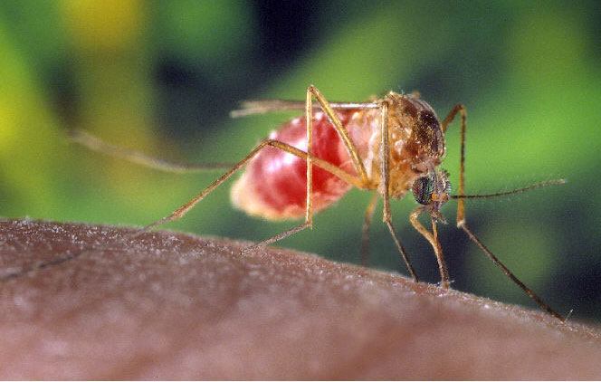
The Norway rat escaped from early European explorer and fur-trading ships. On Queen Charlotte Islands, they have caused a decline in ground-nesting sea birds, such as ancient murrelets and puffins, by eating their eggs and young.
West Nile virus was recently introduced to the United States in 1999, when it started causing deaths in birds and illness in humans in New York City. It is a vector borne disease, carried by the mosquito.
Notes:
Disease & Parasitism: by weakening certain species, a micro-organism invading an ecosystem can drastically alter the entire ecosystem and the niches within it.

Slide 13
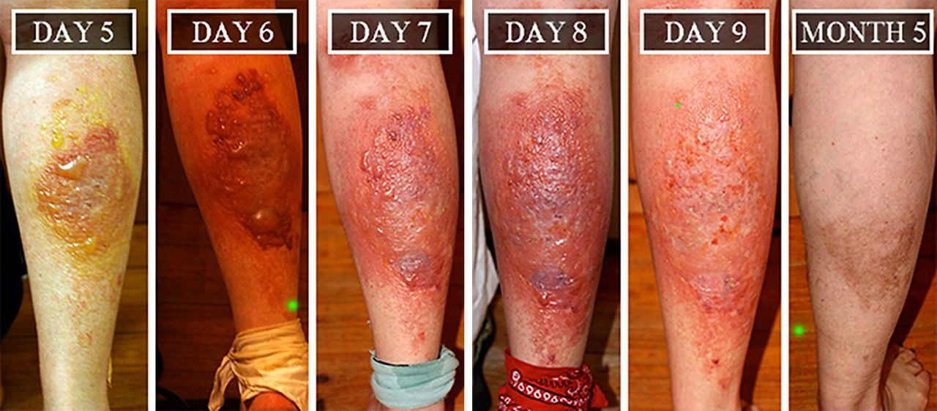
Impact of Invasive Species
Decreased biodiversity

Slide 14
Habitat Alteration: some invasive species can change the physical structure of the ecosystem by digging, burrowing, blocking sunlight or changing the chemistry of the ecosystem.
Eurasian Milfoil was first identified in Okanagan Lake in 1970. It forms wide, dense mats at lake surfaces, cutting off sunlight to organisms below and interfering with recreational activities. It can grow from plant fragments, which are often spread by boats.

Slide 16
Impact of Invasive species
Decreased biodiversity
Possible extinction of native species
Notes:
They eat tiny food particles that they filter out of the water, which can reduce available food for larval fish and other animals, and cause aquatic vegetation to grow as a result of increased water clarity. Zebra mussels can also attach to and smother native mussels.

Slide 17
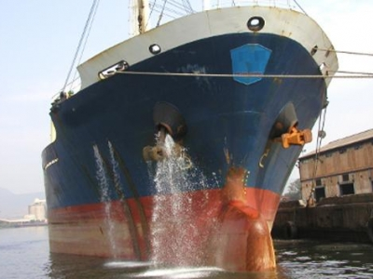
Ship Ballast

Slide 18
What can be done?
Don’t bring it in the first place
Stricter guidelines
Audits, Monitoring
Report
Remove
Rehome

Slide 19
WHAT CAN YOU DO?
Do not release alien plants or animals (including pets and live bait) into the wild.
Do not bring fruit, vegetables, plants, or animals with you across borders.
Before taking a recreational trip, inspect and clean fishing equipment, boats, trailers, recreational vehicles, and other items that may harbour hitch-hiking invaders.
Do not transport over long distances firewood or other wood with bark attached.
Reference: Hinterlands Who’s Who: Issues and Topics: Invasive and Alien Species in Canada, http://www.hww.ca/hww2.asp?id=220

Slide 20
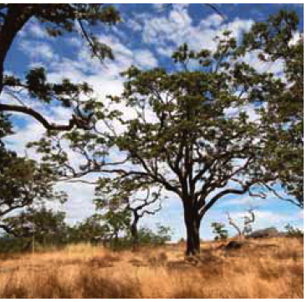
Saving an Ecosystem Under Siege
It often takes human intervention to save established ecosystems.
The Garry Oak Ecosystem Recovery
Team (GOERT) is trying to save
several areas of the Garry Oak
ecosystem in BC because Garry
Oak trees are a keystone species and
they may be better suited to survive in the future than Douglas fir forests.
Scotch broom, English ivy and other plant species are its biggest threats.
Take the Section 3.3 Quiz

Slide 21
Assignment
Invasive species poster

Slide 22
Introduced species and biodiversity, 10min
https://www.youtube.com/watch?v=J-ftiWffNTc
Assignment:

