Slide 1
Photosynthesis
Chapter 6 p113-122

Slide 2
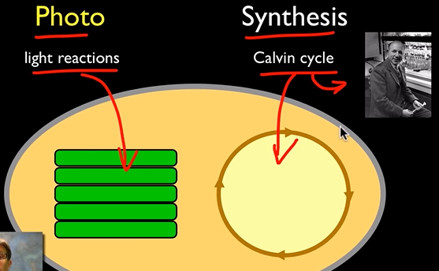
What is photosynthesis?
The process that converts light energy from the sun into chemical energy stored in glucose as food for the cell.
Formula: 6H₂O + 6CO₂ + ENERGY → C₆H₁₂O₆ + 6O₂
_{4 min:}
_{https://youtu.be/SnnmmKApT-c}
Ameoba: https://www.youtube.com/watch?v=CMiPYHNNg28

Slide 3
What organisms perform photosynthesis?
Performed by autotrophs – organisms that can make their own food (also called producers)
Eg. Plants, algae, some bacteria, Leaf Sheep slug
Heterotrophs – organisms that get their energy from the food (other organisms ) they consume. (also called consumers)
Photosynthesis occurs in the chloroplasts of the cell.

Slide 4
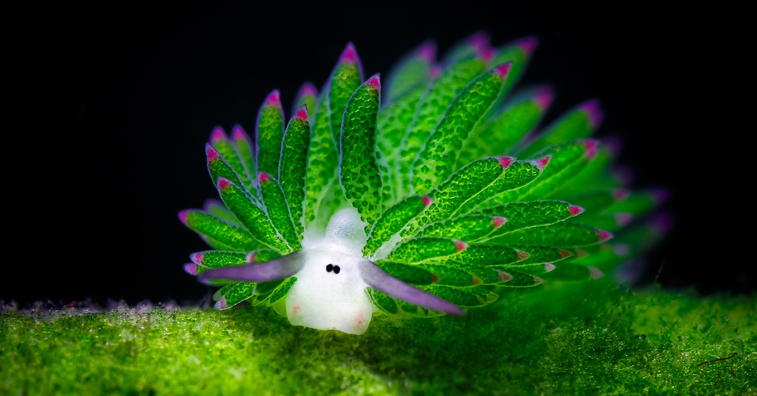
Leaf Sheep slug
Sea slug that eats so much algae that incorporates chloroplasts into its own tissues

Slide 5
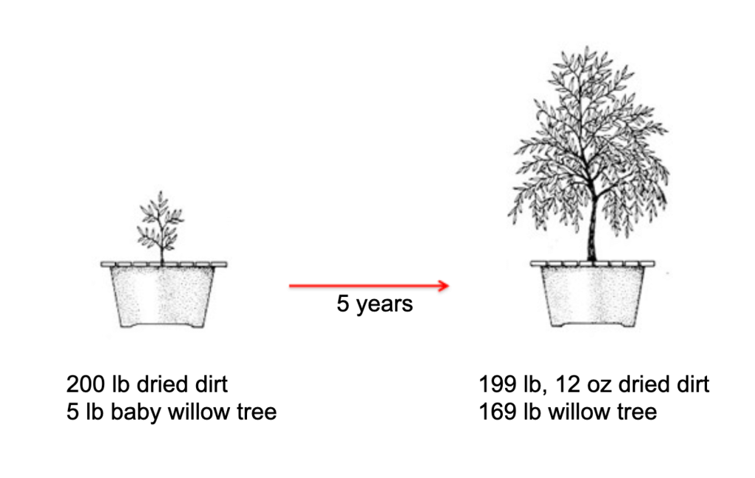
How do we know about photosynthesis?
Dutch physician Jan Van Helmont
placed a 5-pound (2.2kg) willow in an earthen pot containing 200 lb (90kg) of dried soil, and over a five-year period he added nothing to the pot but rainwater or distilled water.
After 5 yr tree weighed about 74 kg more than it did when it started.
plant growth cannot only be due to minerals from the soil. He thought that the extra plant material had come from the water alone.
Notes:
Dutch physician Jan Van Helmont
placed a 5-pound (2.2kg) willow in an earthen pot containing 200 lb (90kg) of dried soil, and over a five-year period he added nothing to the pot but rainwater or distilled water.
After 5 yr tree weighed about 74 kg (165 lb) more than it did when it started.
As the weight of the soil had hardly changed, van Helmont concluded that plant growth cannot only be due to minerals from the soil. He thought that the extra plant material had come from the water alone.

Slide 6
Joseph Priestly, 1772
Plants produce oxygen
Notes:
Several centuries later, Joseph Priestley (1733 - 1804) carried out an experiment that showed that plants produce oxygen. He put a mint plant in a closed container with a burning candle. The candle flame used up the oxygen and went out. After 27 days, Priestley was able to re-light the candle. This showed that plants produce a gas that allows fuels to burn. This gas is oxygen.

Slide 7
Jan Ingenhousz and Jean Senebier
Jan Ingenhousz and Jean Senebier found that the effect observed by Priestley only occurred in the day time (in light).
Concluded that “Light is necessary for plants to produce oxygen”.
Notes:
There are many pigments in plants, and all accept and reflect some parts of rainbow. To identify the culprit, Thomas Engelmann ran an experiment (Figure 3.1.23.1.2) using a crystal prism. He found that Spirogyra algae produce oxygen mostly in the blue and red parts of the spectrum. This was a huge find. It tells that the key photosynthetic pigment should accept blue and red rays, and thus reflect green rays. Blue-green chlorophyll best fits this description.

Slide 8
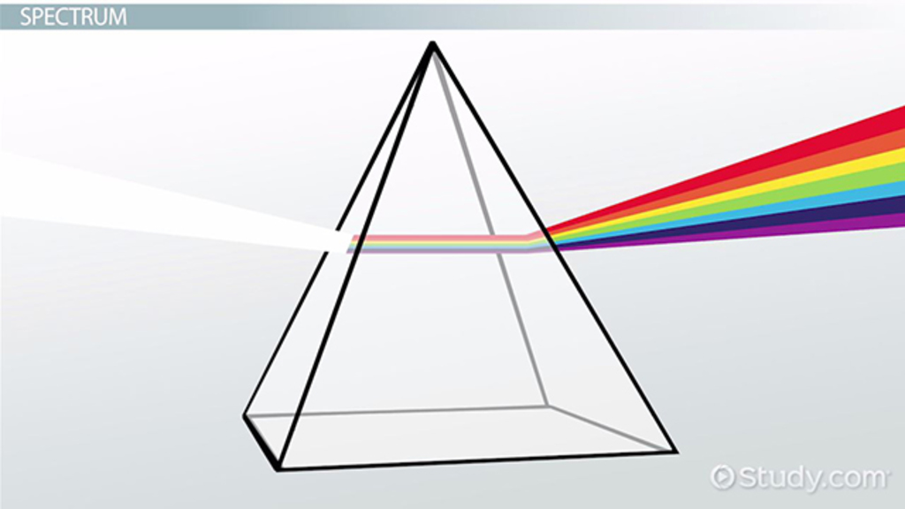
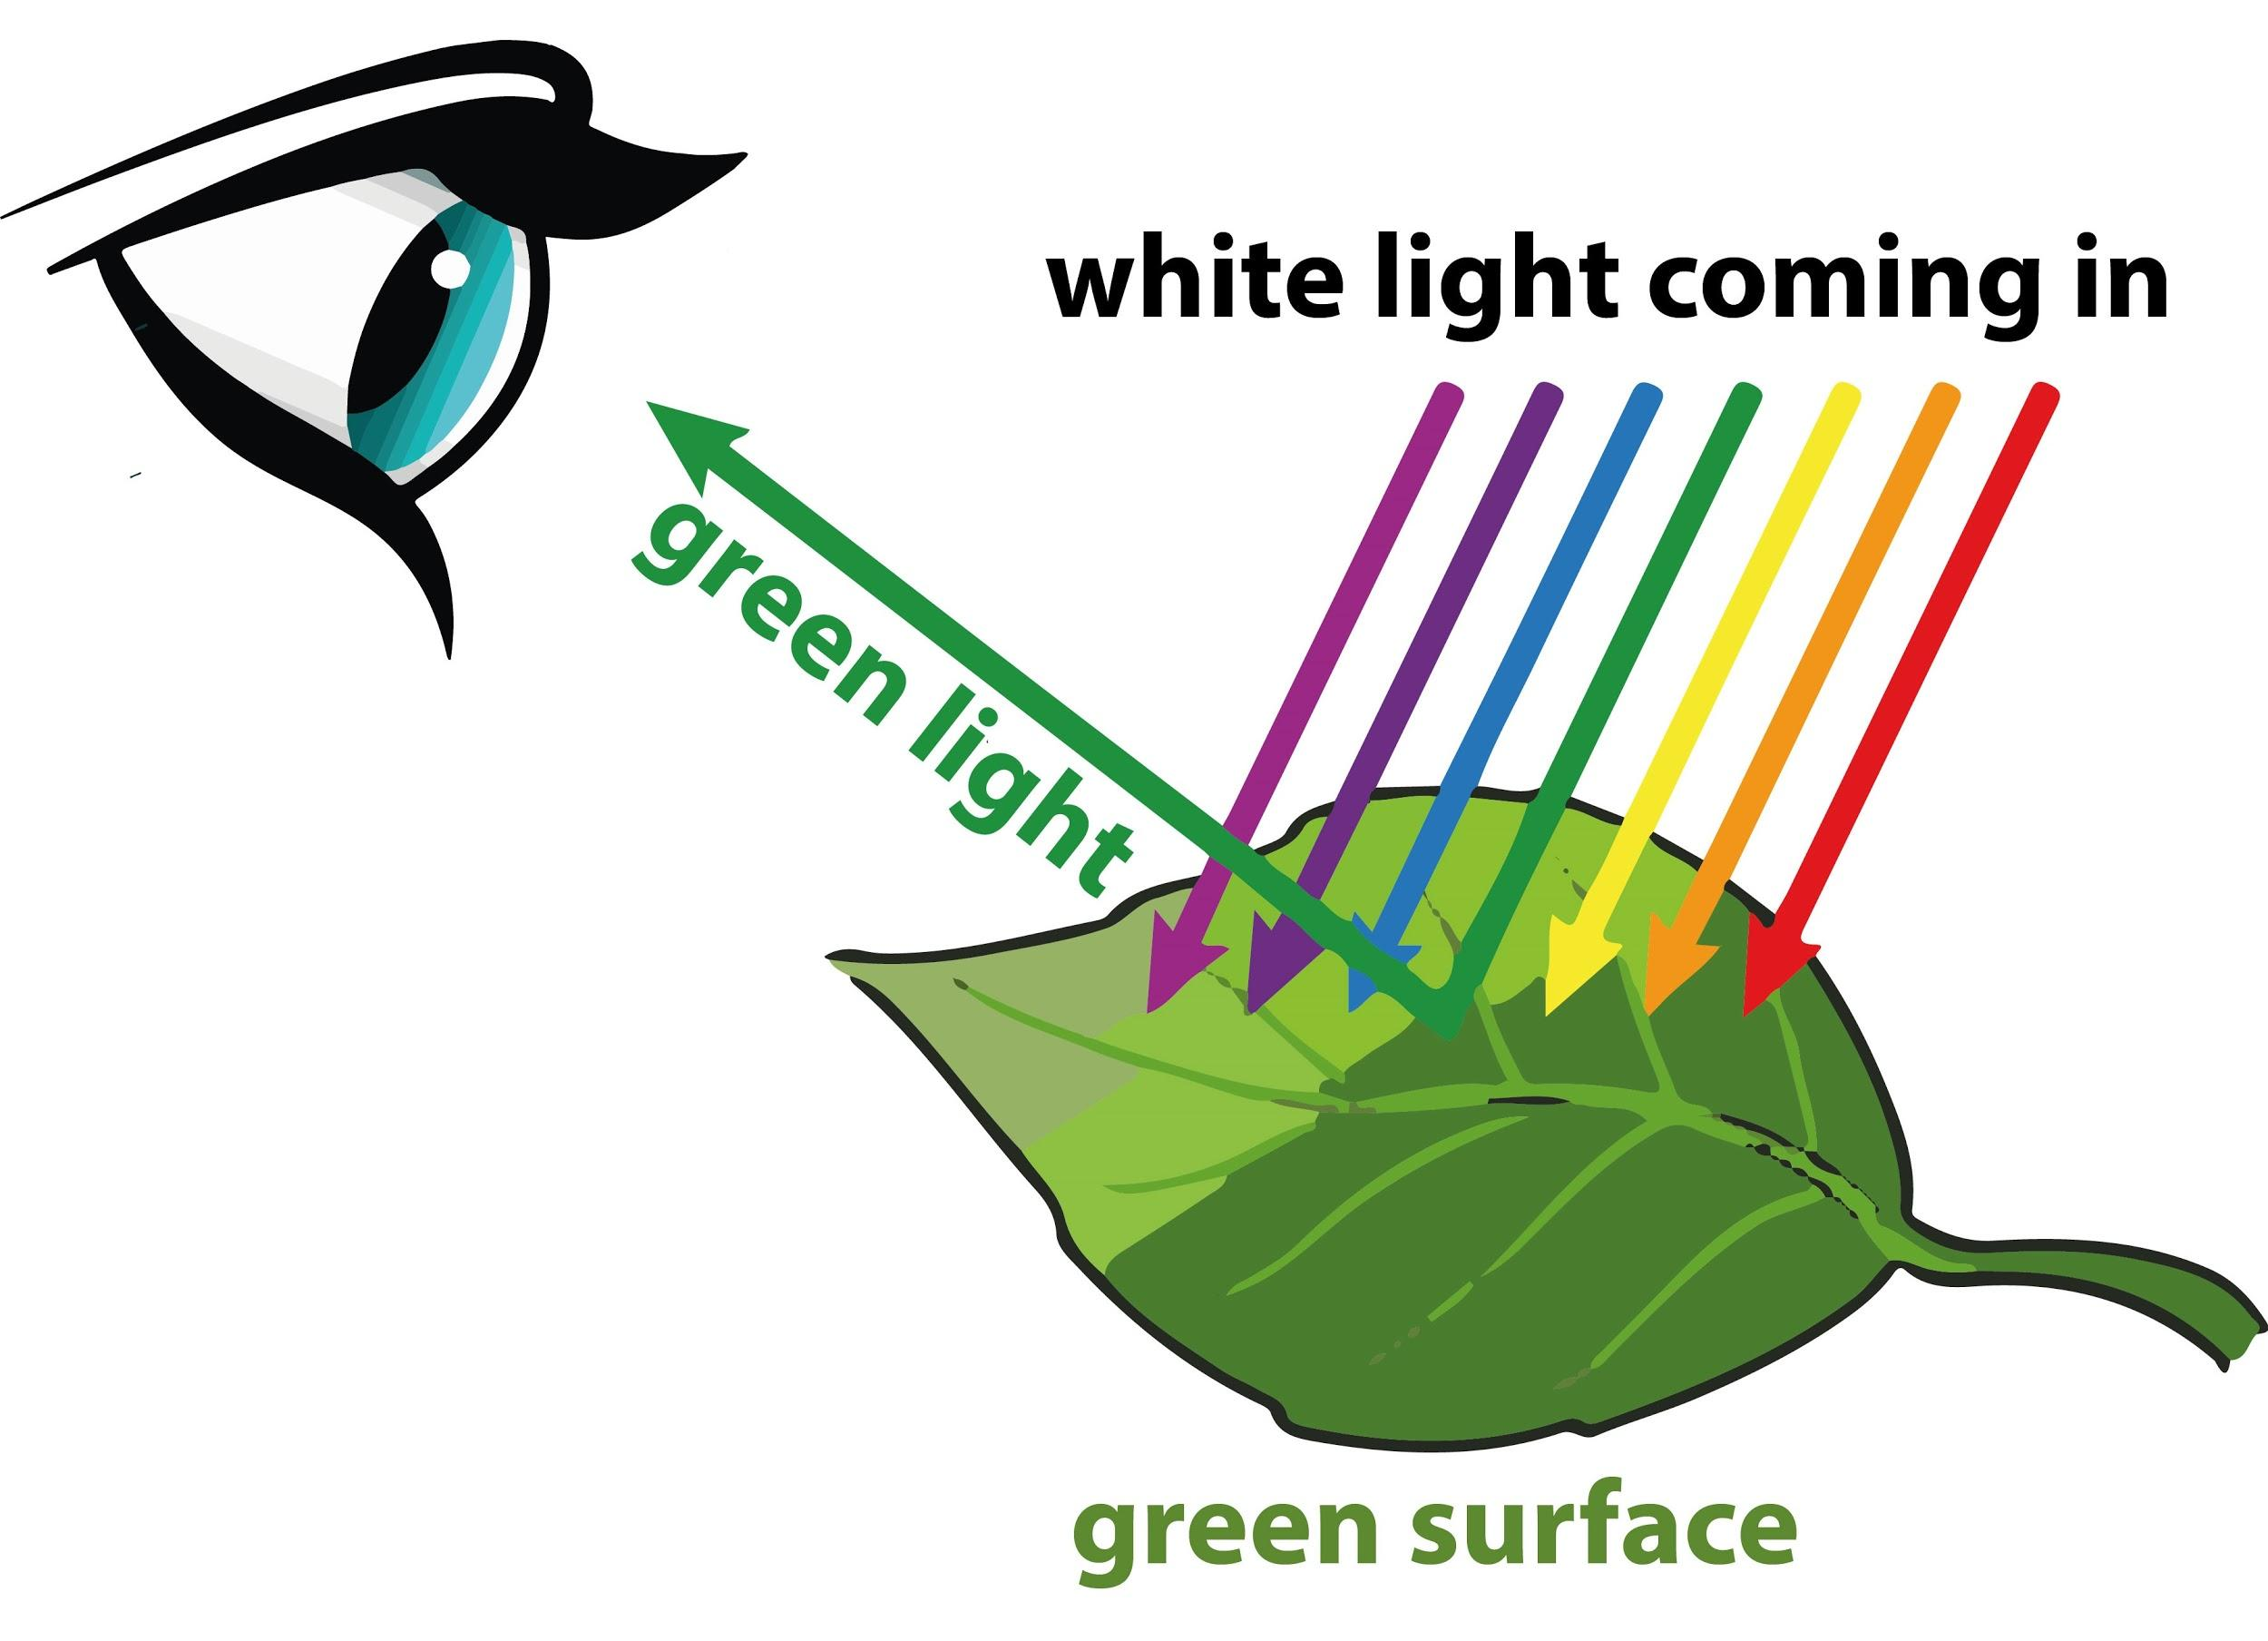
Why do plants look green?
Recall: White light is all colours
The colour we see is the wavelength that is REFLECTED back to us. All other colours are absorbed.
Chlorophyll is the green pigment in plants.

Slide 10
Stages of Photosynthesis:
Photosynthesis Explained, 18 min
https://www.youtube.com/watch?v=fTXh7A7Uc2M
Light Dependent Reaction
requires light
Light Independent Reaction (Calvin Cycle)
doesn’t directly require light

Slide 11
Light Dependent Reaction
Step 1:
In thylakoid membrane, a pigment called chlorophyll in PS II absorbs sunlight.
(PSII is called Photosystem II, made of chlorophyll and protein)

Slide 12
Light Dependent Reaction
Energy from sun is transferred to electrons in the chlorophyll, causing them to be excited.
These high energy electrons are passed along a series of electron carriers called the Electron Transport Chain (ETC)

Slide 13
electrons leaving PS II are replenished by electrons from water. (Water is split)
Remaining H+ from the water build up in thylakoids
Remaining oxygen from the split water is released.

Slide 14
Electrons are passed along ETC to Chlorophyll in PS I (which also absorbs sunlight)
At the end of the ETchain, the energy from the electrons is stored in chemical bonds in NADPH and ATP

Slide 15
Electrons help bond NAP+ and H+ to create NADPH, (to be used later)
Meanwhile, H+ accumulates, creating concentration gradient.

Slide 16
Notes:
Regulated by enzymes

Slide 17
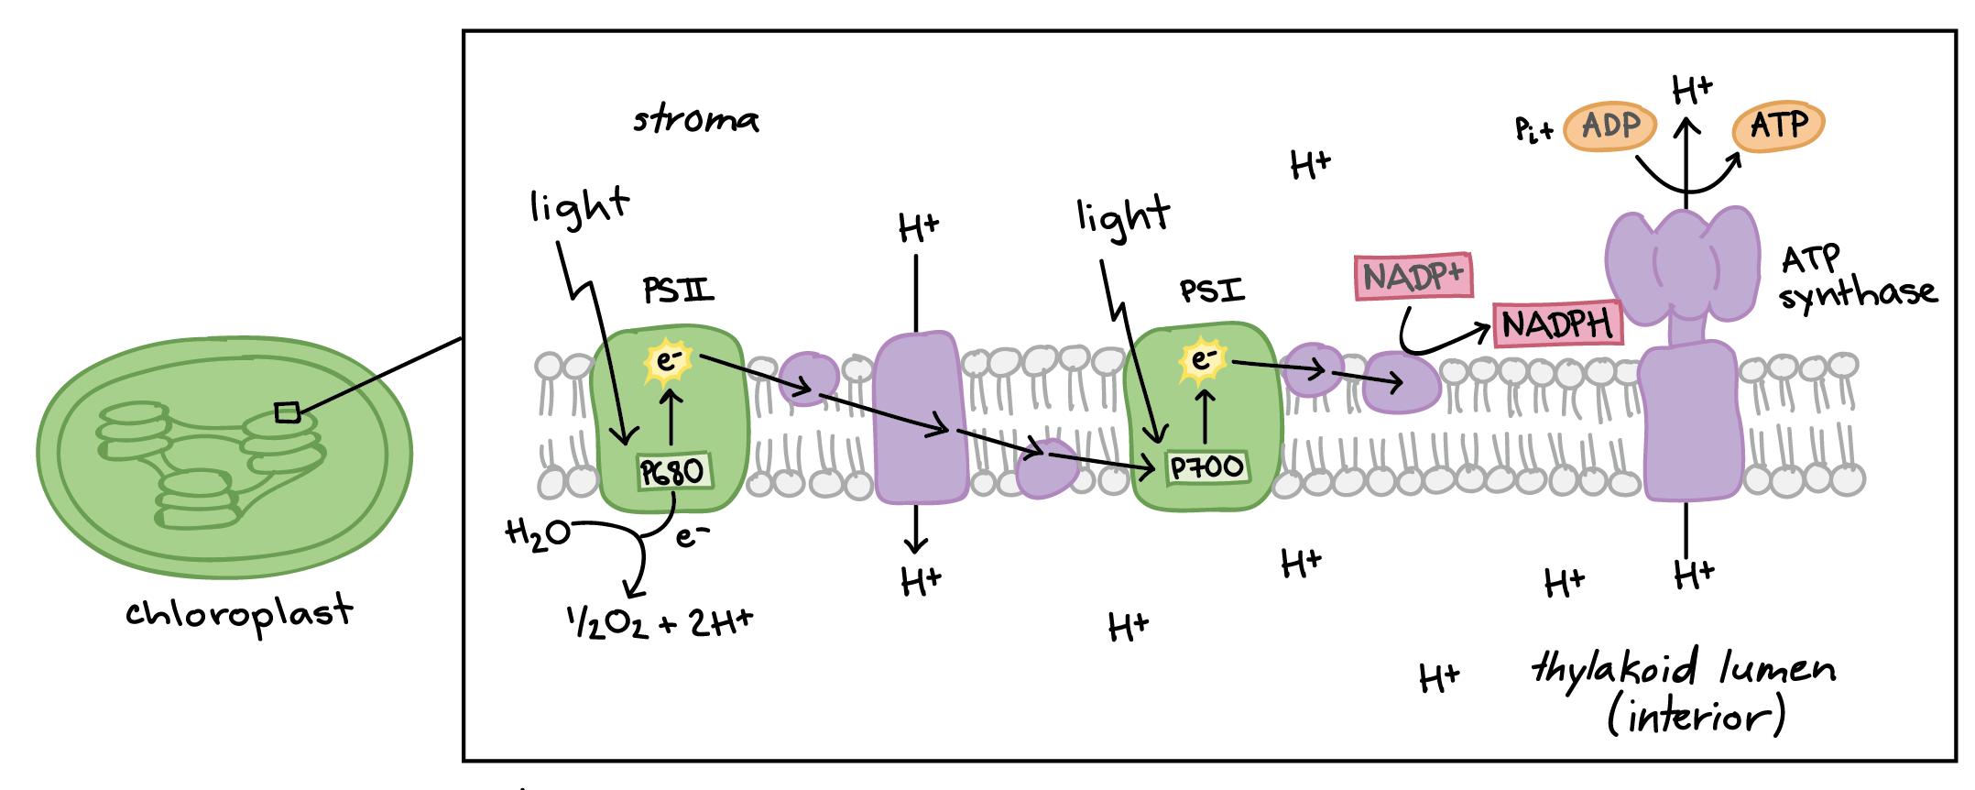
Notes:
electrons are removed from water and passed through PSII and PSI before ending up in NADPH. This process requires light to be absorbed twice, once in each photosystem, and it makes ATP . In fact, it's called photophosphorylation because it involves using light energy (photo) to make ATP from ADP (phosphorylation).

Slide 18
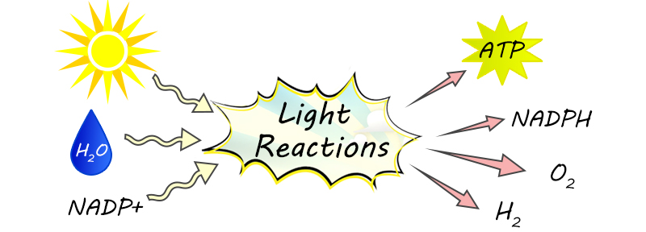
Summary of Products
Reactants: Light, water, NADP+
Products: Oxygen, NADPH, ATP
No glucose yet

Slide 19
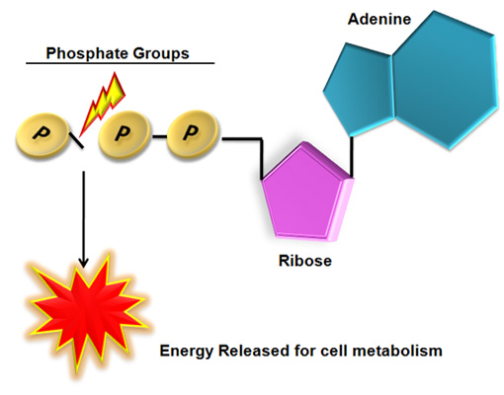
Why do we care about ATP?
ATP stores energy
ATP is Adenine triphosphate
Energy is stored in the chemical bonds
When energy is needed, the ATP molecule splits off one of its three phosphates, becoming ADP (Adenosine di-phosphate) + phosphate.
Much energy is released.

Slide 20
Like a battery

Slide 21
Light Independent Reaction: Calvin Cycle
Does not directly need light but it does use products (ATP and NADPH) that were made in the Light Reactions.
Happens in the stroma
Inorganic carbon in CO2 is used to make organic glucose.
One turn of Calvin cycle fixes only one carbon (from CO2).
six turns of the cycle is required for the synthesis of one glucose by Calvin cycle. (Glucose is a six carbon molecule)
Ted Ed 6 min https://youtu.be/0UzMaoaXKaM

Slide 22
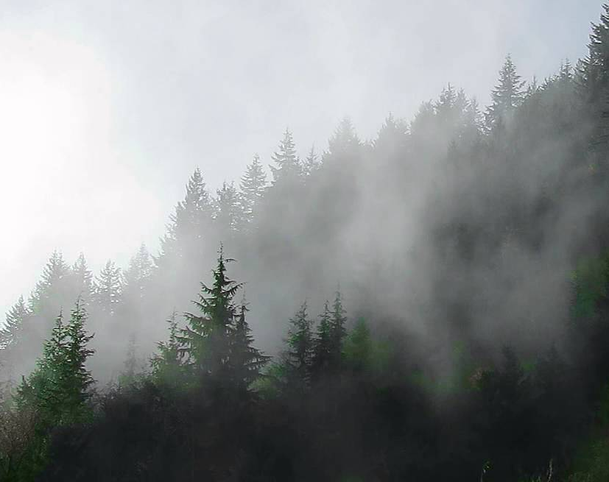
Light Independent Reaction Calvin Cycle
Calvin cycle uses ATP (from the light dependent reaction) to convert CO₂ (from the air) into sugar (glucose)
Overall conversion: 6 CO₂ molecules get converted into a single 6-carbon sugar molecule (glucose)
Happens in the stroma of chloroplast

Slide 23
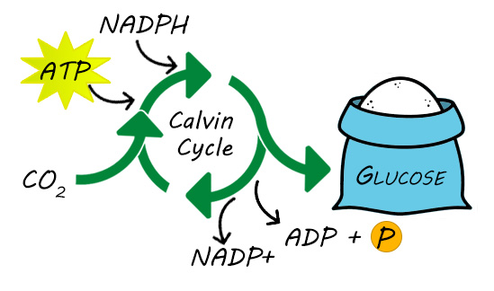
Summary
c

Slide 24
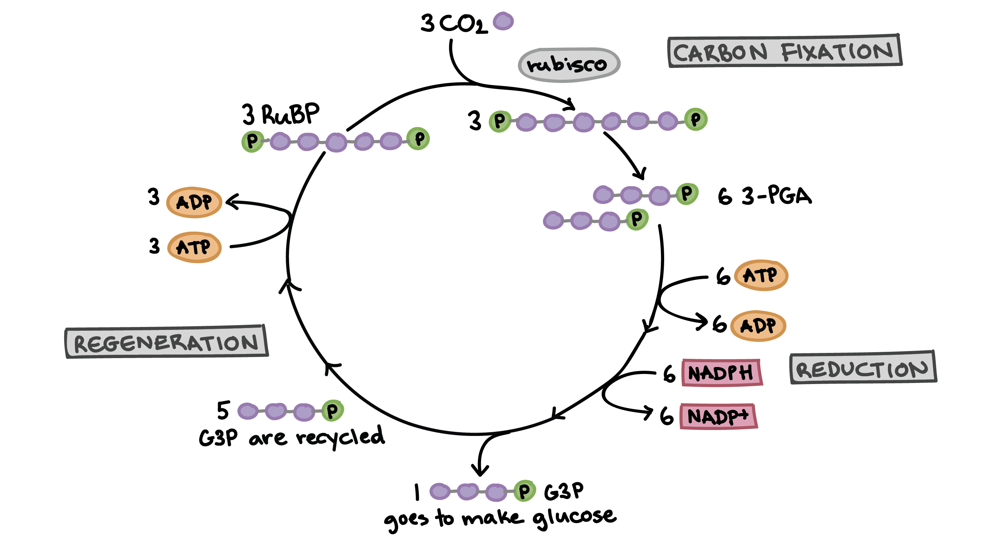
Calvin Cycle
Notes:
In fixation, the first stage of the Calvin cycle, light-independent reactions are initiated; CO₂ is fixed from an inorganic to an organic molecule. In the second stage, ATP and NADPH are used to reduce 3-PGA into G3P; then ATP and NADPH are converted to ADP and NADP⁺, respectively

Slide 25
Notes:
Light hits chlorophyll (PSII) in the thylakoid membrane. This excites electrons, these high energy electrons are passed along an ETC (carried by electron carriers) to …make energy storing NADPH and ATP.
During this process, water is taken in, split, H+ used as pump, Oxygen given off, e’s taken to replenish those moving down ETC.
End result: Oxygen, NADPH, ATP are created
No glucose yet

Slide 26
Calvin Cycle (figure 6-13, p121)
Things to think about:
What enters and exits the cycle?
Where do these materials come from?
What makes the cycle able to restart?
TED Ed 6 min
https://youtu.be/0UzMaoaXKaM
Notes:
Each cycle also creates the starting material (RuBP) for the whole process to start again from the beginning.

Slide 27
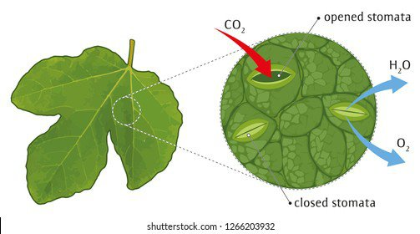
How do plants exchange gases?
Gasses are exchanged through holes called stomata.
Each of the stoma is surrounded by two guard cells that control the opening and closing

Slide 28
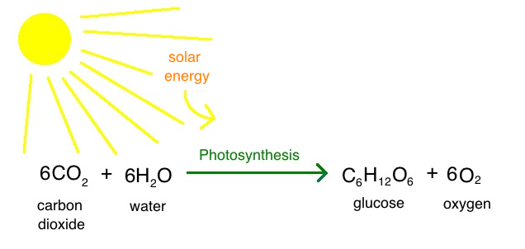
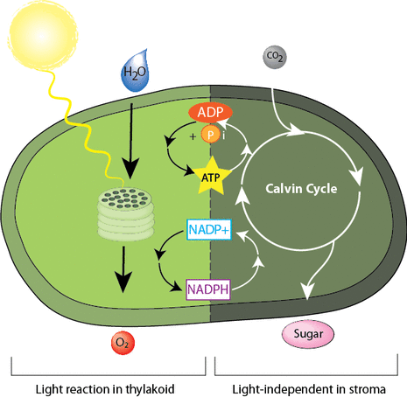
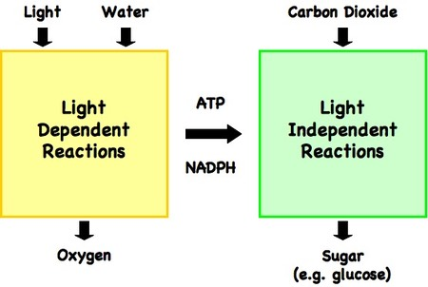
Reactions of Photosynthesis

Slide 29
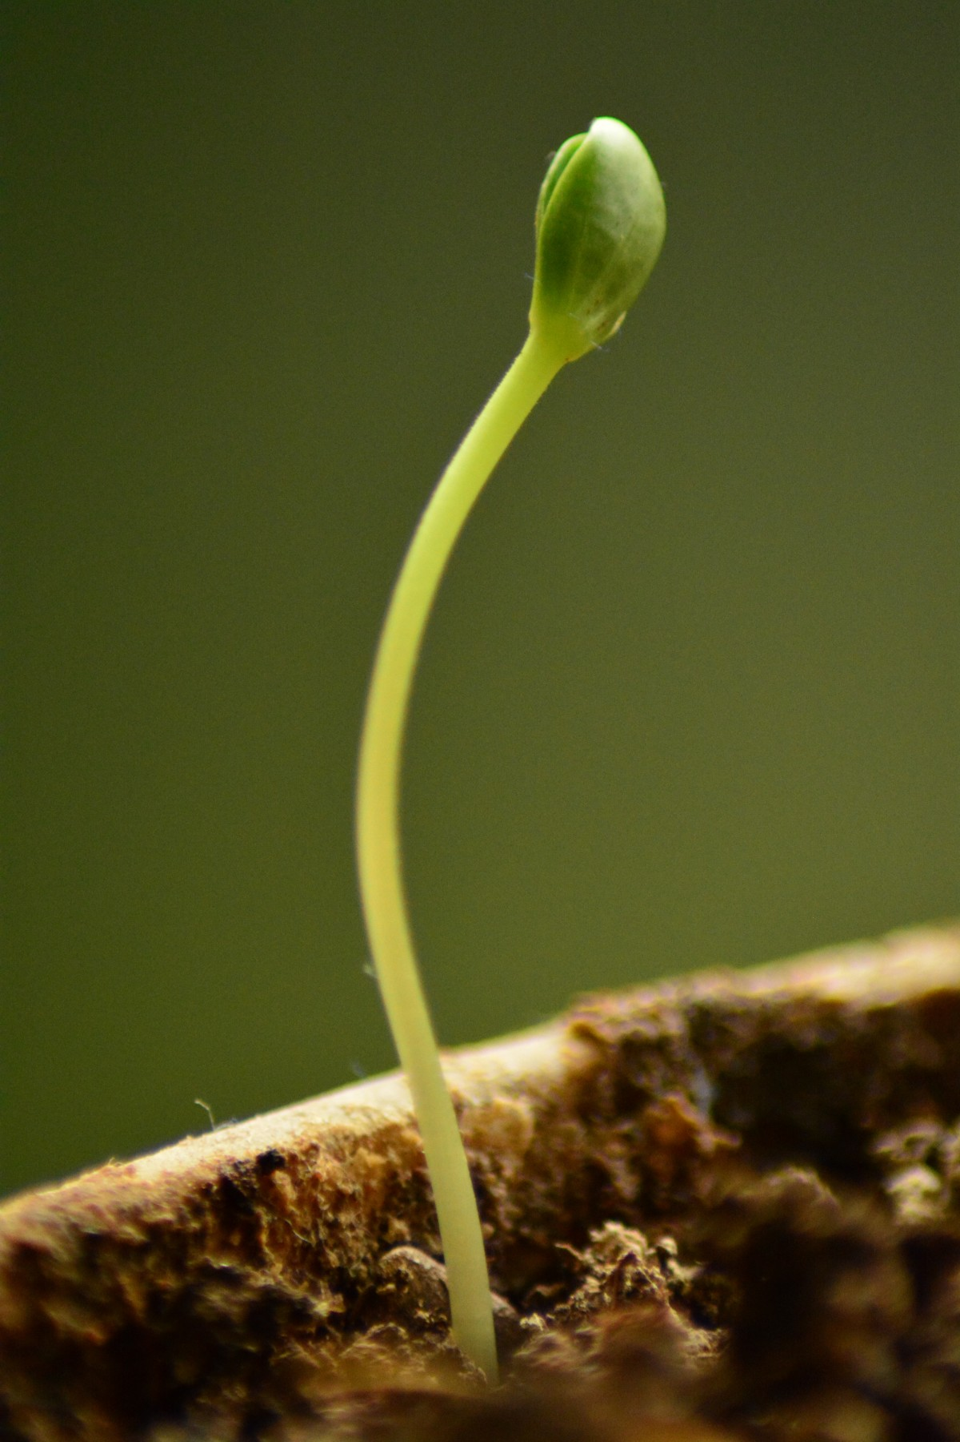
What’s next?
Plant now uses glucose:
for cellular respiration
to build complex macromolecules
cellulose or starch

Slide 30
Chemical Energy
Energy is found in many forms: light, thermal, mechanical, kinetic
Energy is stored within the bonds of chemical compounds
As you break these bonds, chemical energy is released

Slide 31
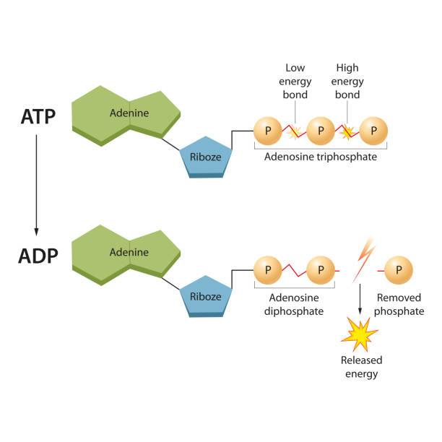
ATP
Adenosine triphosphate (ATP): source of energy that powers cellular work (currency of cell)
ATP + H₂O→ ADP + P + energy
Energy is stored in the phosphate bonds
Energy is released when the phosphate bonds are broken
Notes:
Atp acts like $$$ that the cell uses to do stuff
ATP is the energy currency of organisms. Everything cellular process requires ATP. You can use it up right away or store and save it for later
Hydrlysis of atp into adp releases energy

Slide 32
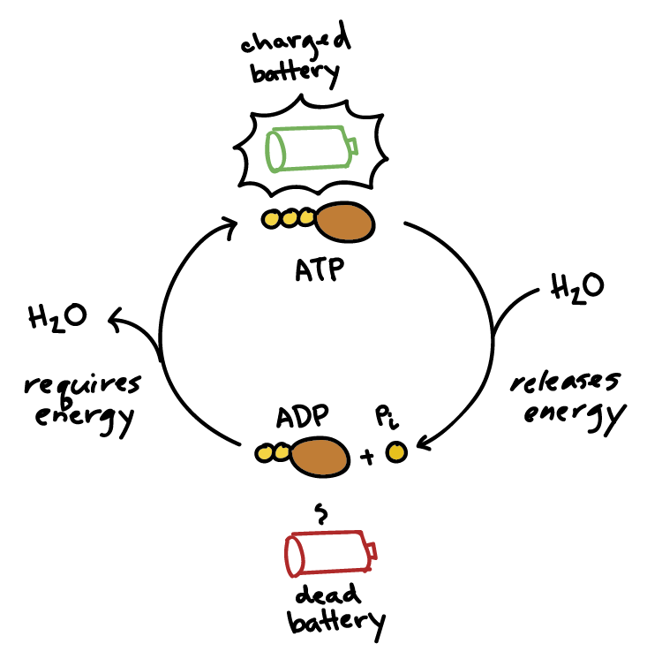
ATP powers cellular work
Storing Energy:
Cells store energy by adding a phosphate to ADP (adenosine diphosphate) to produce ATP (adenosine triphosphate)
Notes:
ATP is like having a fully charged battery, ready to power the machinery of the cell

Slide 33
Practice
Read text book pages 113-127
Answer Reading Check WS
Extra slide beyond here

Slide 34
Does not require light
Occurs in the stroma.
5C molecule RuBP bonds with CO₂ from the air to make a short lived 6 carbon molecule

Slide 35
6 C molecule broken down using energy from ATP and NADPH (from Light reaction)
6 C molecule is broken down using energy from ATP and NADPH that were made in Light Dep Reaction.
Regulated by enzymes.
Notes:
Carbon dioxide enters the cycle and is fixed by Rubisco to a 5-carbon sugar called ribulose biphosphate (RuBP), which is immediately broken down to form two 3-carbon molecules of phosphoglycerate (PGA).
arbon dioxide diffuses into the stroma of chloroplasts and combines with a five-carbon sugar, ribulose1,5-biphosphate (RuBP). The enzyme that catalyzes this reaction is referred to as RuBisCo, a large molecule that may be the most abundant organic molecule on the Earth.

Slide 36
6 C molecule broken into two 3C molecules
Leftover ADP and NADP+ will be recycled in next Light Dependent reaction

Slide 37
Others help keep cycle going by recombining to make more 5 carbon molecules

Slide 38
Process restarts

Slide 39
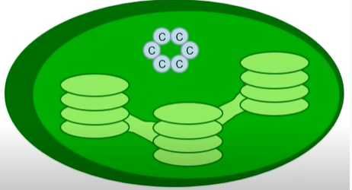

Slide 40
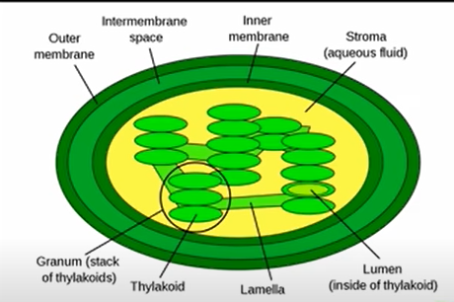
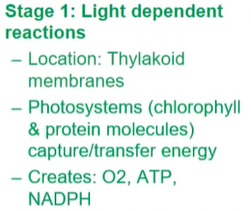
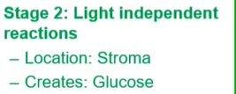
Photosynthesis Summary

Slide 43
Calvin Cycle – Second stage
In the second stage, ATP and NADPH use their stored energy to convert a 3C compound 3-PGA into another 3C compound (G3P) – reduction
then ATP and NADPH are converted to ADP and NADP⁺, respectively.
Notes:
ATP and NADPH use their stored energy to convert the three-carbon compound, 3-PGA, into another three-carbon compound called G3P. This type of reaction is called a reduction reaction, because it involves the gain of electrons. A reduction is the gain of an electron by an atom or molecule.

