Slide 2
Why are Noble gases so stable?
Noble gases have FILLED valence shells
STABLE OCTECT = 8 electrons in the outermost shell.
This makes them very STABLE.
They do not need to gain or lose electrons to fill these outer shells .

Slide 3
How do atoms become more stable?
Atoms want to look like Nobel Gases because they are very stable.
Atoms will attempt to obtain a STABLE OCTECT (8 electrons in their valence shell)
They do this by GAINING or LOSING electrons in their valence shell.
Example: Sodium has 1 valence electron

Slide 4
How does an atom become more stable?
To become more stable, this sodium atom will LOSE that outer electron.

Slide 5
What happens to sodium’s charge if it loses an electron?

Slide 6
What happens to an atom’s charge if it gains or loses electrons?
It becomes POSITIVE.
An atom that has gained a charge is called an ION.
A positive ion is called a CATION.
A negative ion is called an ANION.

Slide 7
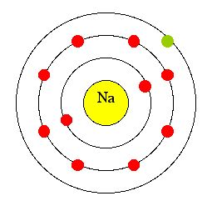
Why would an atom become an ion?
Elements are more stable when their valence shell is full (like the noble gases).
When this is achieved it is called a stable octet.

Slide 8
How do atoms for ions?
An ion is an atom with an electric charge because it has gained or lost electrons from its valence shell.
An atom that loses one or more electrons → positive ion (cation)
An atom that gains one or more electrons → negative ion (anion)

Slide 9
Atoms, Ions & Bohr Models
In a NEUTRAL ATOM:
The number of PROTONS = the number of ELECTRONS
In an ION:
You can calculate the # of electrons by taking
#PROTONS – ION CHARGE (use the charge indicated in the upper right corner of each element on you periodic table)

Slide 10
Example: Magnesium Atom
In a Neutral atom:
# protons _______
# neutrons _______
# electrons ______

Slide 11
Magnesium Ion
In an ion:
# protons _______
# neutrons _______
# electrons ______
(we got this by # protons – ion charge = 12- (+2) = 10

Slide 12
Another Example: Nitrogen
In a neutral atom:
# protons _______
# neutrons _______
# electrons ______
In an ION
# protons _______
# neutrons _______
# electrons ______
( we got this by #protons – ion charge = 7 – (-3) = 10

Slide 13
Quick Review
Find Sodium on the Periodic Table:
What is sodium’s atomic number?
How may protons does sodium have?
How many neutrons does sodium have?
How many electrons does sodium have?
If you have an ION of sodium, what is it’s charge?
How many electrons in an ION of sodium?

Slide 14
Quick Review
Find Sodium on the Periodic Table:
What is sodium’s atomic number? 11
How may protons does sodium have? 11
How many neutrons does sodium have? 12
How many electrons does sodium have? 11
If you have an ION of sodium, what is it’s charge? +1
How many electrons in an ION of sodium? 10

Slide 15
Patterns of the Periodic Table and Ions
What is the charge of the ions of the ALKALI METALS?
What is the charge of the ions of the ALKALI EARTH METALS?
What about the Transitions Metals?
Metals tend to LOSE electrons
Metals tend to become positive ions (CATIONS).

Slide 16
Patterns on the other side
What is the charge of the ions of the HALOGENS (Group 17)?
Group 16?
Non-metals tend to GAIN electrons, forming NEGATIVE IONS (anions).

Slide 17
Representing Ions
Charge of an ion is shown with SUPERSCRIPT:
+ or – to the right of the symbol:

Slide 18
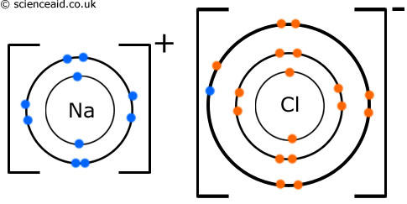
Bohr Model of an Ion
Once an atom has lost or gained electrons, it has an overall CHARGE.
The Bohr Model indicates the charge with a
“ + or – ” and brackets.
Notes:
Note

Slide 19
Practice: Draw the Bohr model for an aluminium atom and ion.
aluminum-27 atom | aluminium-27 ion

Slide 20
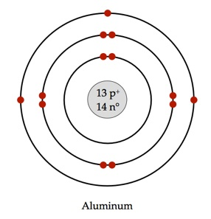
Practice: Draw the Bohr model for an aluminium atom and ion.
aluminum-27 atom | aluminium-27 ion

Slide 21
Practice
Page 223 Probe 9, # 5,7,8,11, 13 Challenge #15

