Slide 1
FOSSIL FUELS

Slide 2
Fossil Fuels

Slide 3
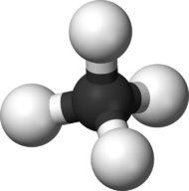
Fossil Fuels
Fossil fuels are compounds of carbon and Hydrogen, called hydrocarbons
Formed from remains of plants and animals that thrived long ago.
https://www.youtube.com/watch?v=zaXBVYr9Ij0

Slide 4
Why do we want Fossil Fuels
The solar energy stored in fossil fuels is a rich source of energy.
But because they take so long to form, they are non-renewable.
https://youtu.be/_8VqWKZIPrM

Slide 5
Coal
Coal 101 https://www.youtube.com/watch?v=iN6LvH_4Q3g

Slide 6
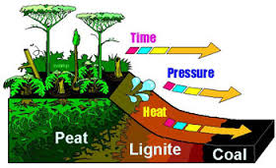
Coal
Organic sedimentary rock formed from plant material buried in swamp water
Solid, mostly carbon – hydrogen and oxygen get driven away over time
Coal is used to:
generate electricity
make steel
- supply raw material for
chemicals

Slide 7
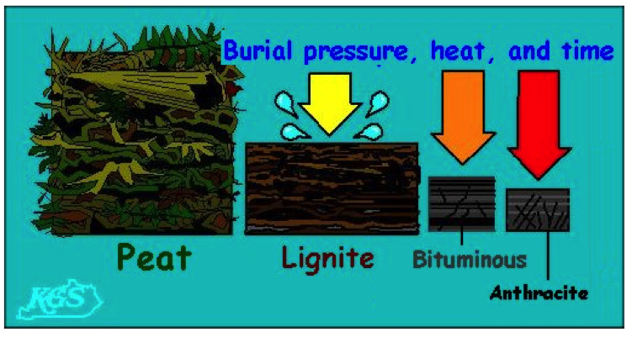
Types of Coal
Peat - Compressed mass of plant remains
Lignite - Compressed and aged peat (soft, brown coal)
Bituminous coal - Soft coal (approx. 85% carbon); takes millions of years to form
Anthracite - Hard coal (90-95% carbon); formed by regional metamorphism

Slide 10
Why do we mine coal?
Abundant
Accessible
Relatively Cheap
Coal provides up to 40% of the world’s electricity.
Notes:
The higher the grade of coal, the cleaner it burns and the more versatile it is.

Slide 11
Petroleum and Natural Gas
sedimentary material of organic origin
liquid and gaseous hydrocarbon (H and C compounds)

Slide 12
Oil (Petroleum or Crude)
Oil 101
https://www.youtube.com/watch?v=UPAqfTNiais
Notes:
Crude oil is a hydrocarbon fossil fuel formed from dead marine organisms.
Millions of years ago, huge numbers of microscopic animals and plants - plankton - died and fell to the bottom of the sea. Their remains were covered by mud.
As the mud sediment was buried by more sediment, it started to change into rock as the temperature and pressure increased. The plant and animal remains were ‘cooked’ by this process, and slowly changed into crude oil.

Slide 13
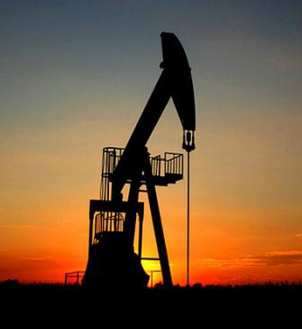
Types of Oil
Conventional Oil – Crude/Petroleum
liquid at atmospheric temperature and pressure, and therefore flows without additional stimulation.
extracted from the ground using traditional drilling methods.
Unconventional Oil – heavy crude, high viscosity, mixed with sand

Slide 14
Why do we extract Oil?
Transportation
Plastics and other petrochemicals

Slide 18
What problems are associated with Oil?
Land disturbance
Large contributor to greenhouse gases

Slide 19
Oil Sands 101: Bitumen
Oil Sands 101
https://www.youtube.com/watch?v=AuSJSRL4sjA

Slide 20
Largest reservoirs of Bitumen
Northern Alberta and Saskatchewan
Venezuela

Slide 21
What problems are associated with oil sands?
Water use
Tailings ponds
Land disturbance
More expense to extract than conventional oil
More carbon intensive than conventional oil

Slide 22
H2Oil Animation: Oil Sands animation
https://vimeo.com/7408834

Slide 23
Natural Gas 101
https://www.youtube.com/watch?v=-njmj0diWu8

Slide 24
Petroleum and natural gas is used for:
Fuel for transportation (gasoline, diesel, jet fuel)
Heating (kerosene, fuel oil, natural gas)
Asphalt
Raw material for plastics, fertilizers, dyes and medicines

Slide 25
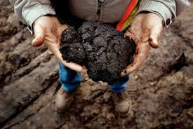
Tar Sands
Consist of sand deposits with pore spaces filled with bitumen (“tar”)
Bitumen is a dried residue of petroleum

Slide 26
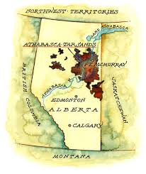
Tar Sands
Only recently been utilized, as new technologies and higher oil prices make it economic to extract.
Large deposits found in the Athabasca region (in northern Alberta).

Slide 27
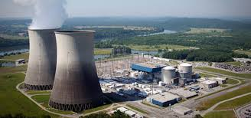
Uranium
not a fossil fuel, but non-renewable
used in nuclear reactors to generate electricity
fission creates nuclear waste which must be stored away from living things for millions of years.

Slide 28
Mining
Mining - process of extracting useful minerals from the surface of the Earth, including the seas.
Surface Mining - when resource is near surface. Eg. Quarries and Open Pit Mines
Sub-surface Mining – under ground mines, wells

Slide 29
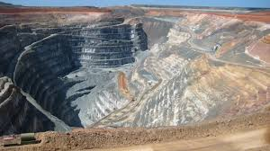
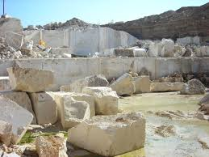
SURFACE MINES
Open Pit Mines, Quarries, Strip Mines, Mountain top removal

Slide 30
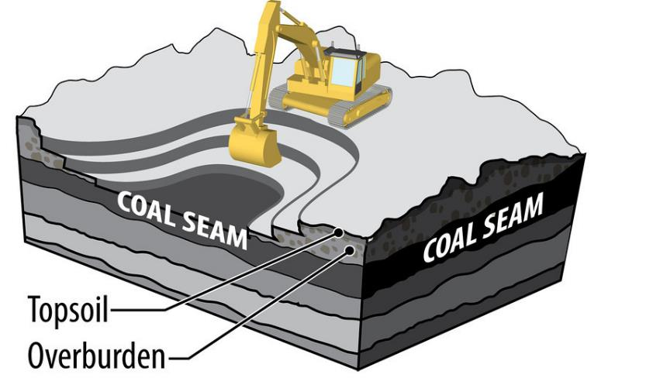
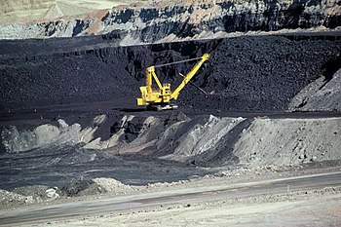
Surface Mining: Open-pit or Strip Mines
Underground Mines
Surface Mines

Slide 31
OVERBURNDEN
Surface mining requires removal of huge amounts of overburden.
overburden is the rock, soil, and ecosystem that lies above the resource to be mined.

Slide 32
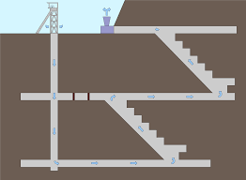
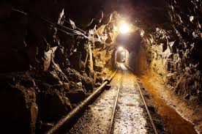
UNDERGROUND MINES

Slide 33
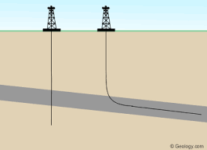
UNDERGROUND MINES
Wells: Ore is a liquid or gas and is pumped out of the ground

Slide 34
Reclamation
Process of restoring land that has been mined to a natural or economically usable state.

Slide 35
Reclamation

Slide 36
What are the issues surrounding Mining?
Pollution – air, ground, water
Acid Rain
Toxic Waste
Nuclear Waste
Land formations
Conservation

Slide 37
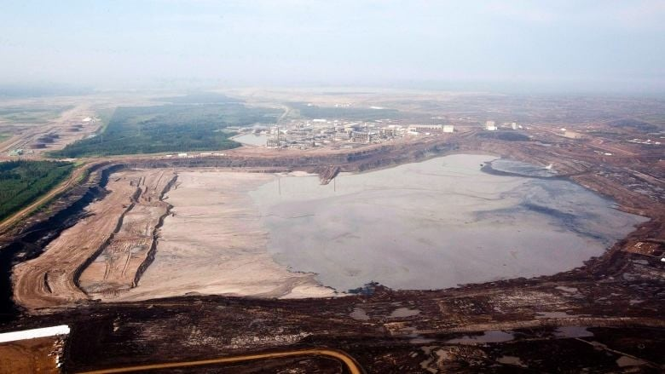
Tailings Ponds
Studies have suggested the ponds leak water containing tailings from oilsands production into the Athabasca River.
The ponds are estimated to hold 1.3 trillion litres of contaminated water.

Slide 38
Miner’s health
Coal miners have suffered a number of respiratory health impacts such as silicosis and black lung (pneumoconiosis)

Slide 39
The canary in the coal mine

