Slide 1
6-3 Cellular Respiration
Releasing Energy from Glucose

Slide 2
Learning Goals
Discuss the process of glycolysis
Describe respiration
Explain how breathing is related to respiration
Relate fermentation to glycolysis
Compare lactic acid fermentation and alcoholic fermentation

Slide 3
What is Cellular Respiration?
Cellular Respiration is the process that releases energy by breaking down glucose in the presence of oxygen
Takes place in the mitochondria of animals, plants, and fungi, algae and protists.
Regulated by enzymes
Glucose + Oxygen → Carbon Dioxide + Water + Adenosine Tri-Phosphate
C₆H₁₂O₆ + 6O₂ → 6CO₂ + 6H₂O + ATP

Slide 4
Chemical Energy
Energy is found in many forms: light, thermal, mechanical, kinetic
Energy is stored within the bonds of chemical compounds
As you break these bonds, chemical energy is released

Slide 5
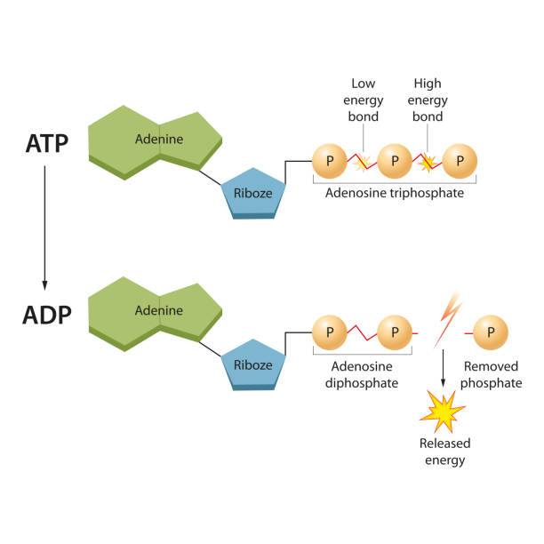
ATP
ADENOSINE TRIPHOSPHATE (ATP): source of energy that powers cellular work (currency of cell)
ATP + H₂O→ ADP + P + energy
Energy is stored in the phosphate bonds
Energy is released when the phosphate bonds are broken
Notes:
Atp acts like $$$ that the cell uses to do stuff
ATP is the energy currency of organisms. Everything cellular process requires ATP. You can use it up right away or store and save it for later
Hydrlysis of atp into adp releases energy

Slide 6
Energy is RELEASED when last P removed

Slide 7
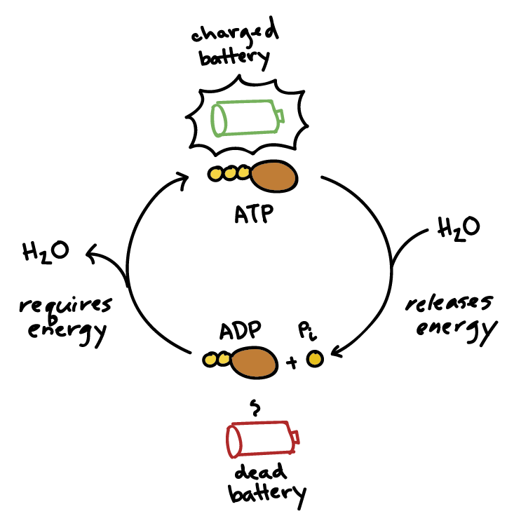
ATP powers cellular work
Cells STORE energy by adding a phosphate to ADP (adenosine diphosphate) to produce ATP (adenosine triphosphate)
Notes:
ATP is like having a fully charged battery, ready to power the machinery of the cell

Slide 8
How does the cell break down the food to release ATP?
Cellular Respiration

Slide 9
Recall: Plant vs Animal
Plants break down the glucose they MADE to produce ATP
Animals break down the glucose they CONSUMED to produce ATP

Slide 10
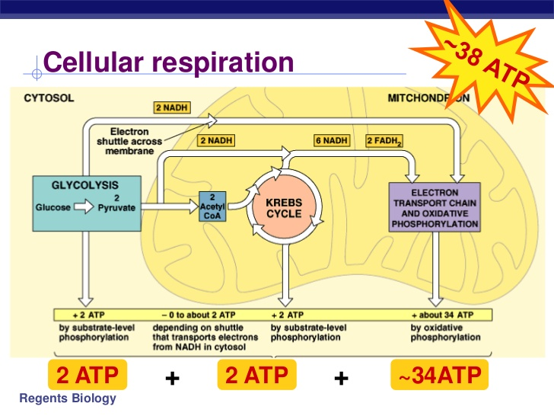
Cellular Respiration
Completed in 4 stages:
Glycolysis
Preparatory step
Krebs Cycle
Electron Transport Chain
Notes:
First complex sugars are broken down into simple sugars (monosaccharides): glucose
Glycolysis - the breakdown of sugar occurs here
Preparatory reaction - in this step the sugar is processed as it is brought into the mitochondria
Citric acid cycle (also known as the Kreb cycle) - here energy is added to the molecules
Electron Transport chain (ETC) - a series of biochemical reactions that produce energy

Slide 11
1. Glycolysis (breaking down of glucose)
Glycolysis is the breaking down of glucose.
Occurs in cytoplasm, (outside mitochondria)
Breaks glucose molecule in half
Yields 4 ATP but requires 2 ATP to start glycolysis there fore net gain of 2 ATP
Can be completed without oxygen

Slide 12
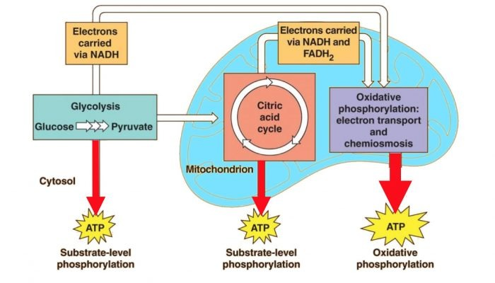
Preparatory Reaction
sugar is processed as it is brought into the mitochondria
The preparatory reaction is a process that oxidizes pyruvate produced by the reactions of glycolysis to form acetyl coA, which then enters the Krebs cycle. In addition to acetyl coA, two molecules of carbon dioxide are also released.

Slide 13
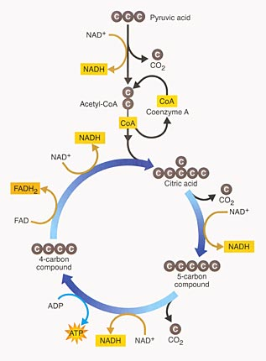
2. Krebs Cycle (or Citric Acid Cycle)
Completed within the mitochondrial matrix
Produces CO₂
Yields a net gain of 2 ATP
Done in the presence of oxygen
Doesn’t use oxygen but shuts down when oxygen is not present (runs out of NAD and FAD)
Notes:
Doesn’t use oxygen but shuts down when oxygen is not present (runs out of NAD and FAD)

Slide 14
Electron Transport Chain
Completed in the mitochondria membrane
Uses high energy electrons from Krebs cycle to convert ADP→ ATP
Yields a net gain of approx. 34 ATP
Only completed in presence of oxygen,
Oxygen is the final electron acceptor in the electron transport chain.
Notes:
Oxygen sits at the end of the electron transport chain, where it accepts electrons and picks up protons to form water.
https://www.youtube.com/watch?v=LQmTKxI4Wn4&ab_channel=HarvardX

Slide 15
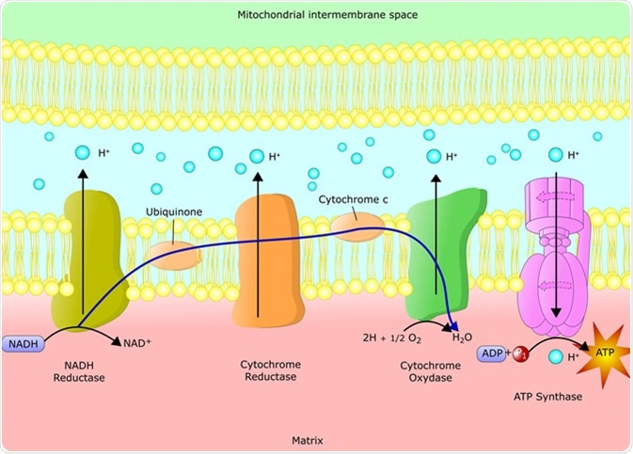
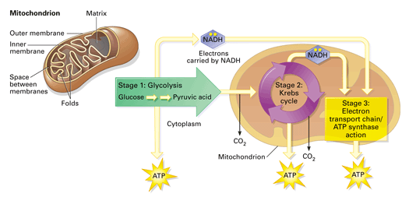

Slide 16
Role of Cellular Respiration
Active transport
Liver cells (1000-2000 mitochondria per liver cell)
Kidney (for extracting the urine)
Active movement
Muscles
Sperm cells (50-75 mitochondria per sperm)

Slide 17
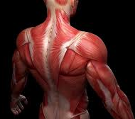
Do some cells have more mitochondria than others?
Human body: areas of a lot of active transport and active movement have more mitochondria in their cells.
Liver is constantly working - so much active transport as liver is filtering the blood
Kidney is extracting urine for excretion
Muscles,
sperm-mitochondria encapsulated in the fagella of sperm
Notes:
In unicell-only one mito
But in humans we have a lot

Slide 18
Aerobic vs. Anaerobic Respiration
https://www.youtube.com/watch?v=WsqP1O7388g&ab_channel=FreeAnimatedEducation

Slide 19
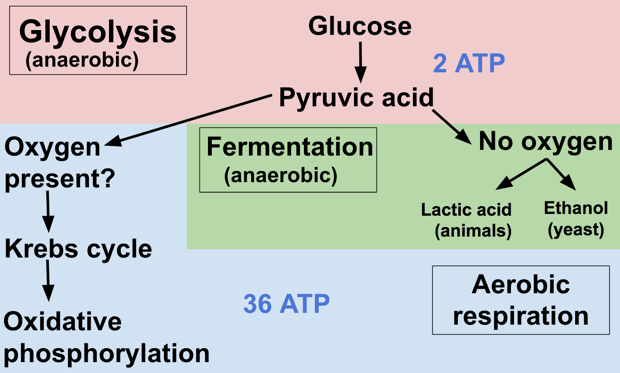
Aerobic vs. Anaerobic Respiration
Electron Transport Chain

Slide 20
Does Lactic Acid Really Cause Muscle Pain?
https://www.youtube.com/watch?v=cdphJJcR-Og&ab_channel=SciShow
Notes:
https://www.youtube.com/watch?v=rLsimrBoYXc

Slide 21
Why do our muscles get tired?
Ted Ed 5 min
https://www.youtube.com/watch?v=rLsimrBoYXc

Slide 22
FERMENTATION
Chapter 6-4, p130

Slide 23
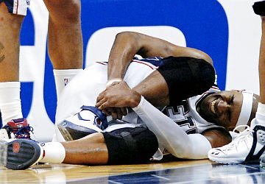
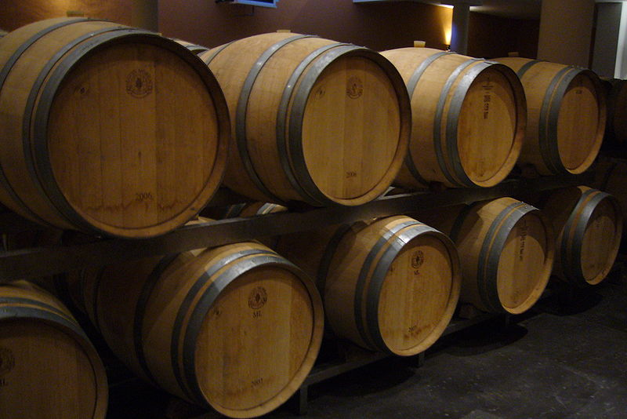
Fermentation:
It is a way for cells to produce ATP when oxygen is not available.
Is called an anaerobic process (does NOT require oxygen)
Not as efficient, only 2 ATP produced.

Slide 24
When would this happen?
Eg. When your muscles are forced to work without enough oxygen.

Slide 25
2 types of Fermentation
Lactic Acid Fermentation - produces lactic acid
Eg: in muscles; during rapid exercise
Alcoholic Fermentation - produces alcohol & CO₂
Eg: in yeast; to rise dough

Slide 26
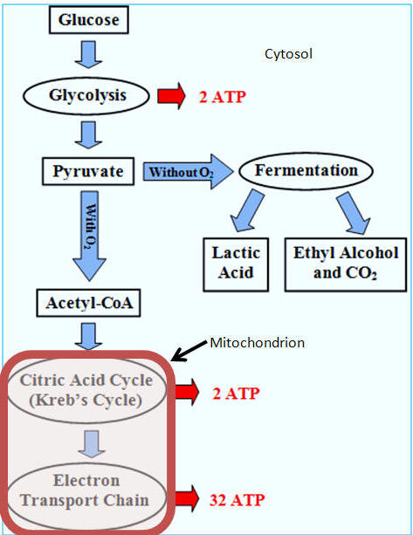

Slide 28
Learning Goals
How are fermentation and glycolysis related?
How do lactic acid fermentation and alcoholic fermentation compare?

Slide 29
Practice
Read pages 130 – 131 of text book.
Complete Fermentation Worksheet
ASSESSMENT:
Design an experiment
Quiz: Photosynthesis, Cellular Respiration, Fermentation

Slide 30
Follow Up Questions
How do photosynthesis and cellular respiration work together?
How are chloroplasts and mitochondria similar? How are they different? Use a Venn diagram.
Why would a heart cell have more mitochondria than a skin cell?
A plant is made up of many different parts (stem, leaves, petals, reproductive structures). What part of the plant would likely have more chloroplasts? Explain.
What side effects would you expect from a person with a mitochondria disease (cells can’t produce enough energy)?
Compare the process of aerobic vs anaerobic respiration.

Slide 31
Check out the Amoeba Sisters!
Cellular Respiration (UPDATED) https://www.youtube.com/watch?v=eJ9Zjc-jdys
Photosynthesis (UPDATED) 8 min https://www.youtube.com/watch?v=CMiPYHNNg28
What is ATP? https://www.youtube.com/watch?v=YbdkbCU20_M
Fermentation: https://www.youtube.com/watch?v=YbdkbCU20_M

