Slide 2
What is a compound?
A Compound is a pure substance made up of two or more different types of atoms chemically joined in fixed proportions.
Eg: water, sugar, salt
H₂O, C₁₂H₂₂O₁₁, NaCl
Notes:
In chemistry, the law of definite proportions, sometimes called Proust's law or the law of definite composition, or law of constant composition states that a given chemical compound always contains its component elements in fixed ratio .

Slide 3
How do compounds form?
Compound form when elements EXCHANGE or SHARE electrons.
Elements that tend to gain electrons are ATTRACTED to those that tend to lose electrons
Notes:
Elements that tend to gain electrons are ATTRACTED to those that tend to lose electrons

Slide 4
How do compounds form?
This attraction becomes the CHEMICAL BOND between the atoms, forming a COMPOUND

Slide 5
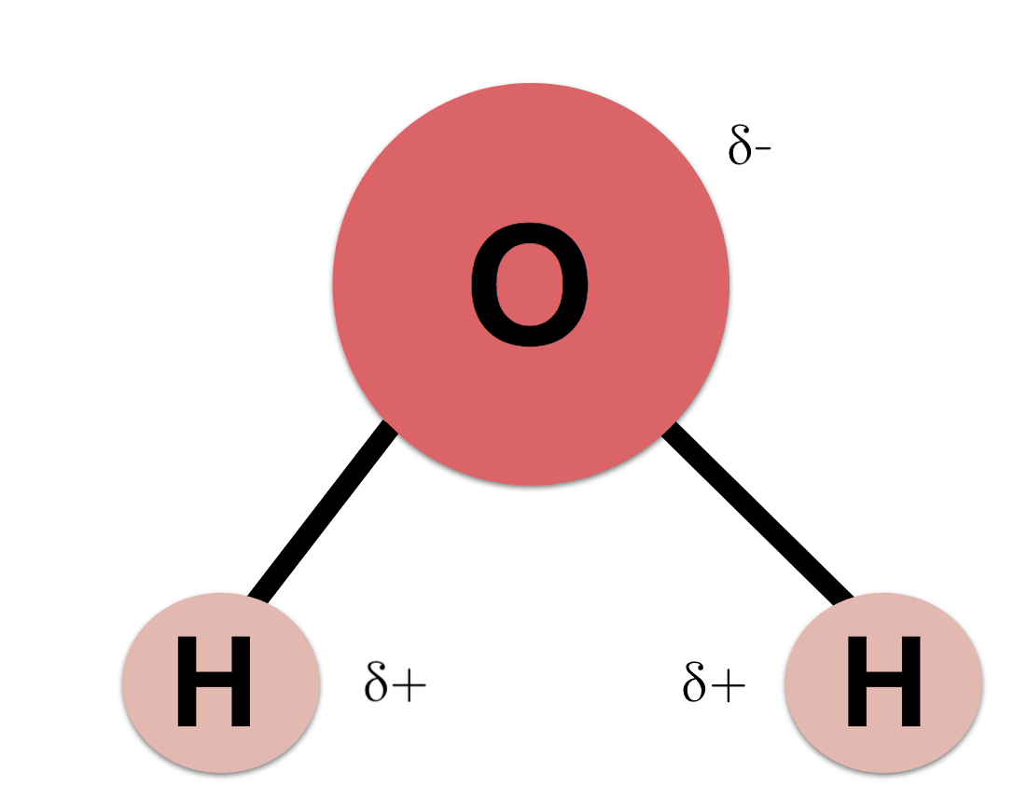
Law of definite proportions
LAW OF DEFINITE PROPORTIONS states that elements in compounds exist in FIXED RATIOs
Water is always H₂O (two Hydrogen bonded one Oxygen)

Slide 6
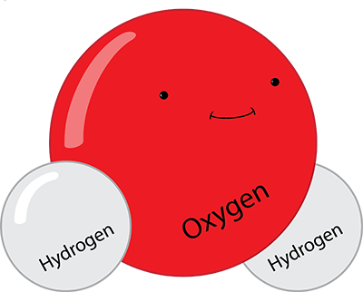
The CHEMICAL FORMULA:
A chemical formula shows elements in a compound and their ratio. Eg NaCl
Elements shown using their SYMBOLS
Proportion (ratio) of each element shown using SUBSCRIPTs
If there is no subscript, it is a single (just one) atom.
H₂O

Slide 8
Formula | Elements | Proportions of Particles
CuS | copper and sulfur | 1 copper ion to 1 sulfur ion
Ag₂S
MgF₂
Al₂O₃

Slide 9
Formula | Elements | Proportions of Particles
CuS | copper and sulfur | 1 copper ion to 1 sulfur ion
Ag₂S | silver and sulfur | 2 silver to 1 sulfur
MgF₂ | Magnesium and Fluorine | 1 Magnesium to 2 Fluorine
Al₂O₃ | Aluminum and Oxygen | 2 Aluminum and 3 Oxygen

Slide 10
ORDER of elements is important!
Always write the metal first!
NaCl
MgCl
CaF₂

Slide 11
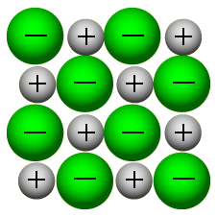
Ionic Compounds
Recall:
The chemical bond between two or more ions is called an ionic bond.
A compound formed between two or more ions is called an ionic compound.
Ionic compounds form when electrons are transferred (given or taken) between two or more ions.

Slide 14
Ionic Compounds
Eg Na + and Cl –

Slide 16
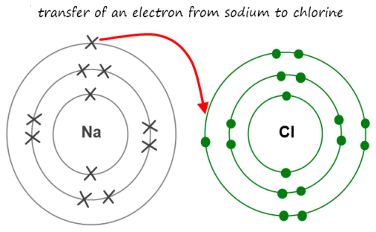
Ionic Compounds
Ionic compounds ALWAYS involve a METAL and a NON-METAL.
Metal element LOSES one or more electrons to the non-metal element.

Slide 17
Binary Ionic Compounds
Simple Binary Ionic Compounds contain just TWO elements
Involves of a Metal and Non-metal
Ionic bonds are very strong
The stability of the full valence shell is what drives the formation of compounds.

Slide 19
Why do compounds form?
Take a look at the Periodic Table.
Notice that may of the elements have one or more charges listed in the upper right corner.
Look at the groups (vertical columns). What patterns do you notice?
What ions are formed by the atoms of elements from Groups 1,2, 16, 17, and 18? Make generalizations.

Slide 20
Homework
Ionic Compound WS
Vocabulary
CYU p237 #3 (b,d,e,f), 4,5, 7

Slide 21
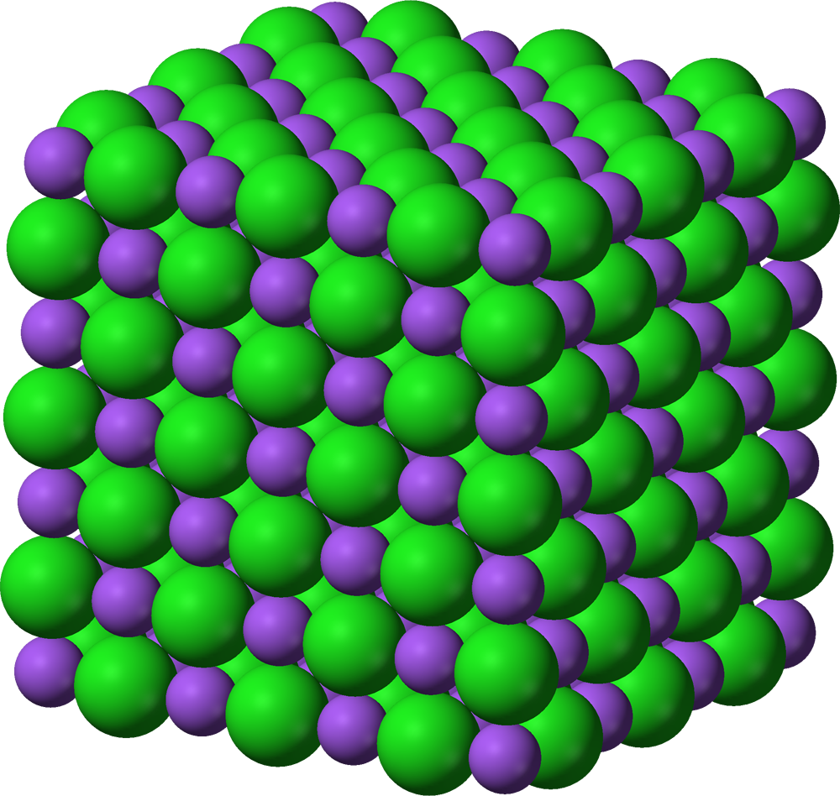
Ionic compounds
Ionic compounds are made up of charged particles (ions), but the positive charges and the negative charges balance, so ionic compounds are neutral.
A repeating pattern of positive and negative ions in a compound is called an ionic lattice.
Notes:
Recall that atoms are neutral
Elements prefer
Why? Bc metals tend to lose electrons, non-metals tend to gain

