Slide 1
Measuring Earthquakes
Magnitude and Intensity

Slide 2
How are Earthquakes Measured?
Magnitude is a measure of the amount of energy released at the source of the earthquake. Determined from measurements on seismographs.
Intensity measures the strength of shaking produced by the earthquake at a certain location. Describes how much people felt and the damage it caused.
.

Slide 3
An earthquake can have many different intensity numbers, even though it has only one magnitude.
How can this be?

Slide 4
An earthquake can have many different intensity numbers, even though it has only one magnitude.
Amount of damage depends on where earthquake occurs.
Eg. desert vs city

Slide 5
Richter Scale measures Magnitude
The Richter Scale is a standardized scale (from 1-10) of earthquake magnitude . The higher the number, the stronger the earthquake.
It is based on the amplitude of the largest seismic wave recorded.
Accounts for the decrease in wave amplitude with increased distance.
Magnitudes less than 2.0 are not felt by humans
When the Richter magnitude of an earthquake goes up by one unit, the amount of ground shaking caused by the earthquake goes up 10 times.
Eg. Magnitude 5.0 is 10 times stronger than a Magnitude 4.

Slide 6
Charles Ritcher 1935
Amount of damage depends on where earthquake occurs.
Eg. desert vs city

Slide 7
Measuring the size of earthquakes
Intensity scales
Modified Mercalli Intensity Scale was developed using California buildings as its standard
The drawback of intensity scales is that destruction may not be a true measure of the earthquakes actual severity
i.e. moderate earthquake causing severe damage in Armenia in 1988 because of poor building construction
also the 1985 earthquake in Mexico City caused massive damage because of the soft sediment under the city

Slide 8
What is the largest earthquake recorded?
1960 Valdivia Earthquake occurred on May 22, 1960 near Valdivia, in southern Chile.
Assigned a magnitude of 9.5 by the United States Geological Survey.
Referred to as the "Great Chilean Earthquake" or the "1960 Valdivia Earthquake.

Slide 9
Earthquake destruction
Amount of structural damage caused by earthquakes depends on:
Intensity and duration of the vibrations
Type of material building are one (sand vs rock) liquefaction
Design of the structure

Slide 10
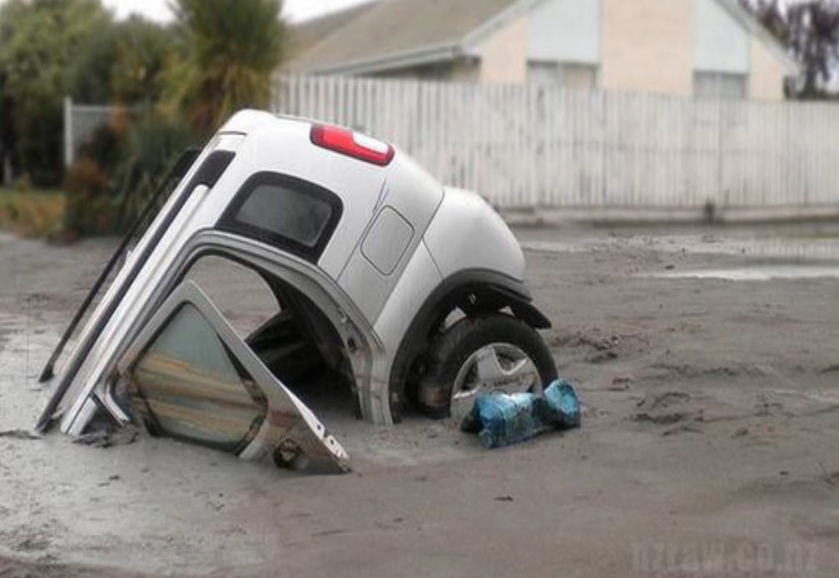
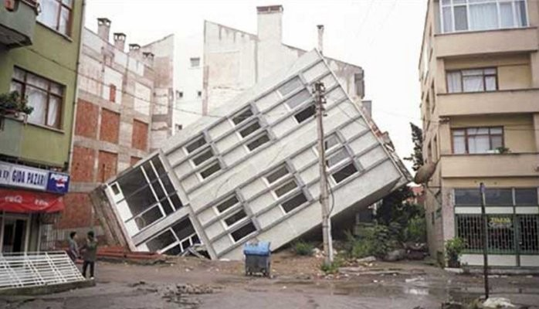
Liquefaction
Liquefaction is a process by which water-saturated sediment temporarily loses strength and acts as a fluid (during an earthquake).

Slide 11
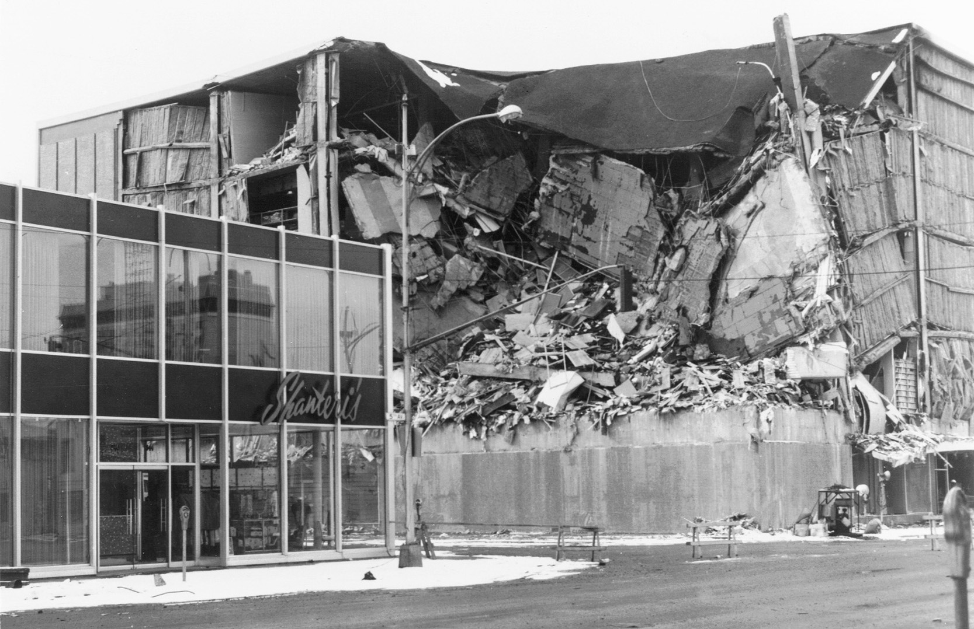
Damage caused by the 1964 Anchorage, Alaska earthquake

Slide 12
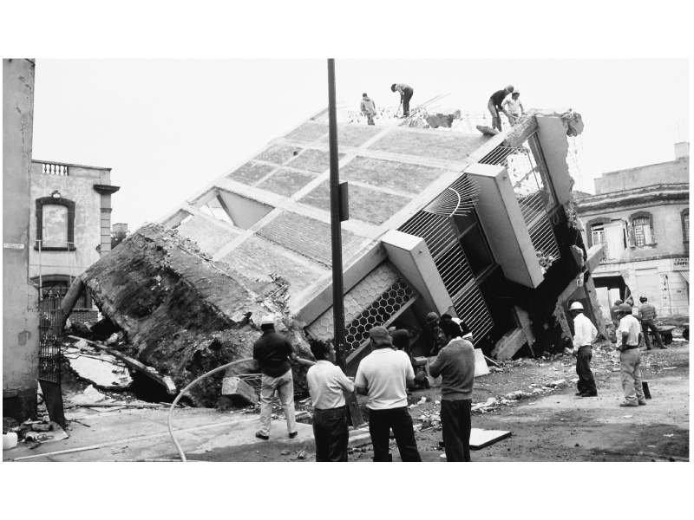
Liquefaction from the 1985 Mexico Earthquake

Slide 13
Homework
Complete and Turn in Earthquake WS

Slide 14
EXTRAS for next year…

Slide 15
Tsunamis, or seismic sea waves
Destructive waves that are often inappropriately called “tidal waves”
Result from vertical displacement along a fault located on the ocean floor or a large undersea landslide triggered by an earthquake.
In the open ocean height is usually less than 1 meter
In shallower coastal waters the water piles up to heights that occasionally exceed 30 meters
Can be very destructive

Slide 16
Formation of a tsunami

Slide 17
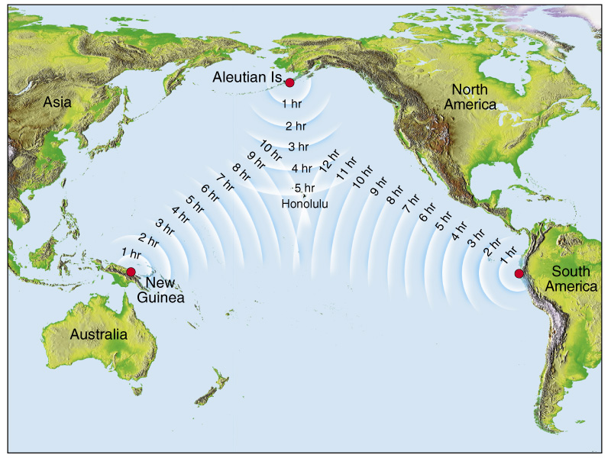
Tsunami Warning System

Slide 18
The Big One
“The Big One” is a hypothetical magnitude-9.0 earthquake that could happen along the Cascadia Subduction Zone, a 1,000 km fault line that runs from northern Vancouver Island to Northern California.

Slide 19
The Big One
The fault is a boundary between two tectonic plates: the Juan de Fuca tectonic plate and the North American plate (that we live on).
The Juan de Fuca plate is shoved beneath the North American plate.
But it’s become stuck for three centuries now, building up stress. When the rocks slip past each other along the fault, it will cause a “megathrust” earthquake.

Slide 20
Megathrust Earthquake

Slide 21
The Last Big One
The last destructive earthquake like this happened on Jan. 27, 1700, and experts say it is “inevitable” that another one will hit the coast.

Slide 22
Take Home Assignment
Read The Great Shaking and the Great Drowning and turn in the questions through Teams.

Slide 23
Cascadia Megathrust Earthquake
Seismologists estimate a 12% probability of a Cascadia Megathrust occurring in the next 50 years.
Estimate 10 000 deaths and 26 000 injuries.
Tofino would have a 20min warning
15-20m high waves

Slide 25
The Big One

Slide 26
Video
CBC: The big one is coming 2:33 min http://www.cbc.ca/player/play/2557297694
http://www.cbc.ca/player/play/953399875854
http://www.cbc.ca/player/play/1616113742
14min

Slide 27
Will You Be Prepared?
Brainstorm: What do you need?
Notes:
Cell Phone towers knocked out

Slide 28
Assignment 2021
Prepare an Earthquake Readiness Kit that fits into a shoe box
Include List of items in your kit
1 page summary explaining why you need them
Plan for family if separated (discuss with family)
Where will you keep your kit?
Decorate your box

Slide 29
Science of Tsunamis
https://www.youtube.com/watch?v=Wx9vPv-T51I

Slide 30
Earthquake Readiness Kit
https://www.cdc.gov/disasters/earthquakes/supplies.html

Slide 31
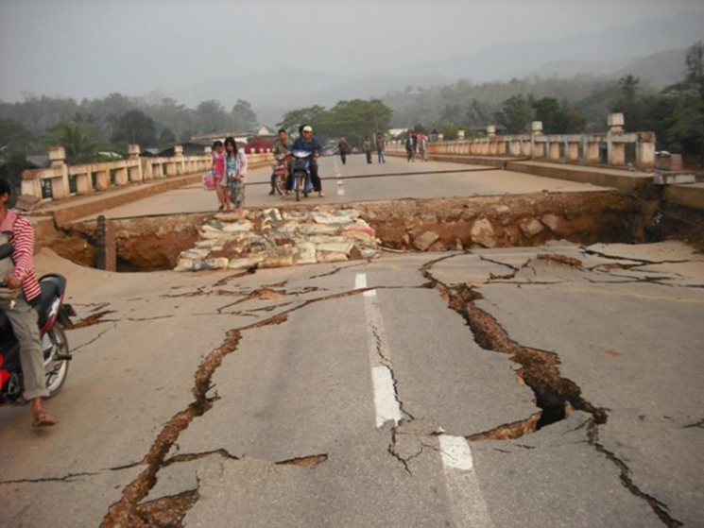
Earthquake Hazards
1. Ground shaking
The result of the waves set in motion by the earthquake
Some vibrations move up and down while others move side to side
Most buildings can withstand large up-and-down vibrations, but not side-to-side (cause collapse)

Slide 32
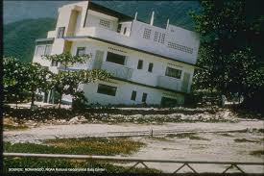
2. Liquifaction
Vibrations cause groundwater to rise, turning solid ground into a liquid-like material.
Buildings built on solid rock experience little damage; buildings located on bog muds or soft fill suffer severe damage

Slide 33
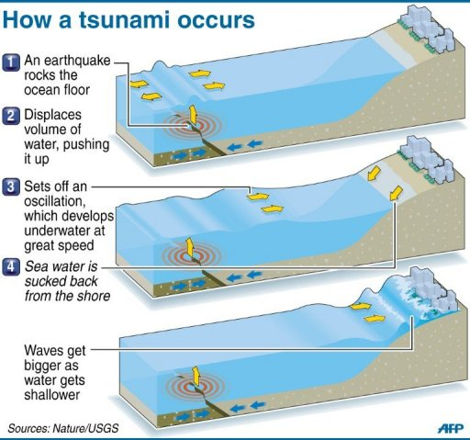
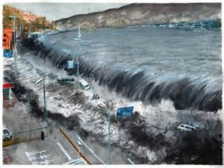
3. Tsunamis
Large ocean waves produced when earthquakes occur under water.
Caused by a large displacement in the water column
Notes:
https://www.youtube.com/watch?v=j9JDzBTwiig
The term tsunami, meaning "harbour wave" in literal translation, comes from the Japanese 津波, composed of the two kanji 津 (tsu) meaning "harbour" and 波 (nami), meaning "wave".

Slide 34
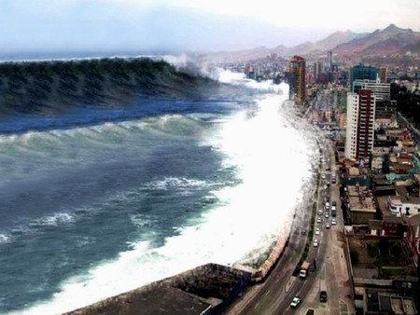
Tsunami’s
A tsunami is a large sea wave generated by an underwater earthquake, volcano, or landslide.
Eg. In 2004 Sumatra earthquake ruptured the sea floor, creating a tsunami
Notes:
he Boxing Day tsunami in 2004 is believed to be the deadliest tsunami in history, killing more than 230,000 people across 14 countries. It began at 7:59am local time on December 26, 2004, when a 9.1-magnitude quake struck off the northern tip of Sumatra in Indonesia
thought to have had the energy of 23,000 Hiroshima-type atomic bombs. The epicenter of the 9.0 magnitude quake was located in the Indian Ocean near the west coast of Sumatra.

Slide 35
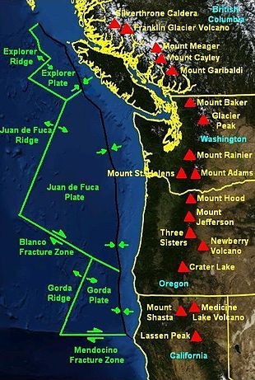
Cascadia Subduction Zone (CSZ)
a 1,000 km long fault that stretches from Northern Vancouver Island to northern California.
It separates the Juan de Fuca and North America plates

Slide 36
Can earthquakes be predicted
Long-range forecasts
Give the probability of a certain magnitude earthquake occurring on a time scale of 30 to 100 years, or more
Using historical records or paleoseismology
Are important because they provide information used to
Develop the Uniform Building Code
Assist in land-use planning

Slide 37
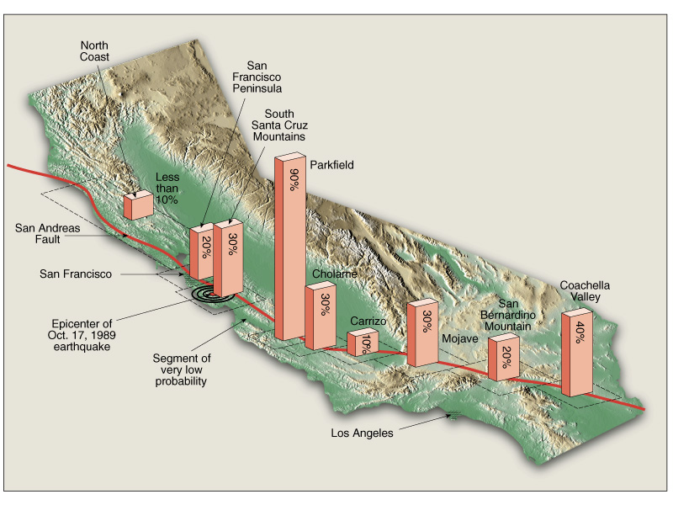
Earthquake Probability between 1988 - 2018

