Slide 1
Microbes
Microscopic Organisms

Slide 2
Microbes Intro Video
https://www.youtube.com/watch?v=XuZQUEFD52I

Slide 3
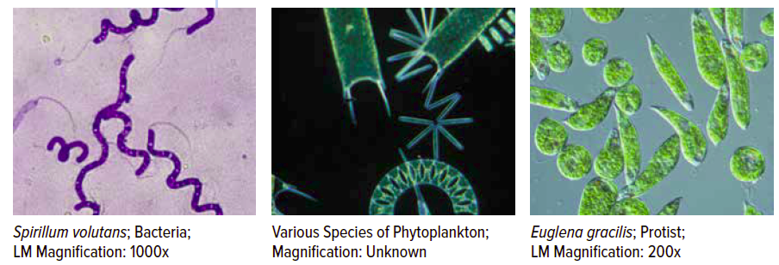
What are Microbes? Micro-organisms
Microbes are very tiny living things
Smaller than 1mm
Can only be seen with a microscope
Eg: bacteria, yeast, paramecium in pond water.

Slide 4
Where can microbes be found?
They are amazingly diverse and can exist in a wide range of habitats from hot springs to the icy wastes of Antarctica. ​
In the soil
In fresh or salt water
In the air
In and on our bodies

Slide 5
What are the different types of microbes?
There are four types of microorganisms:
Bacteria
Fungi
Viruses
Protists

Slide 6
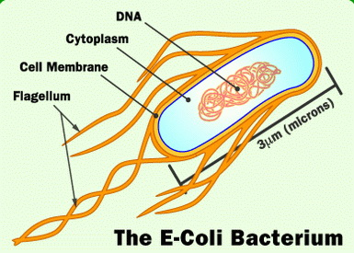
Bacteria (Singular: bacterium)
Bacteria are unicellular microbes that reproduce by splitting in two.
There are more than 5,000 known species of bacteria, with new ones constantly being discovered.
Examples E.coli, Salmonella, Bacillus.

Slide 7
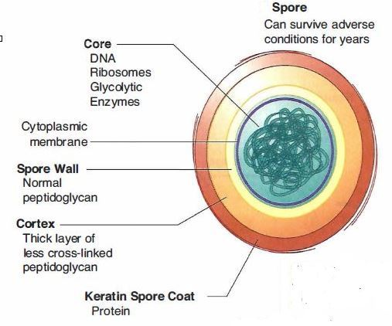
Where can they live? Bacteria
Bacteria prefer moist conditions and can live in a wide range of temperatures.
Most cannot grow in acid conditions.
In the right conditions they can multiply very fast, producing millions of cells in a few hours.
Some bacteria form spores which are resistant to drying and heating. When conditions become favourable again, they germinate and an active cell is released.

Slide 8
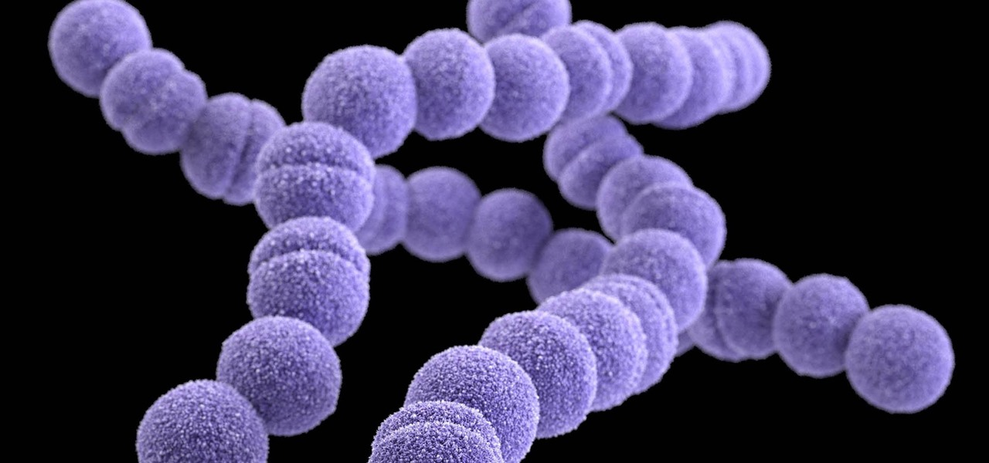
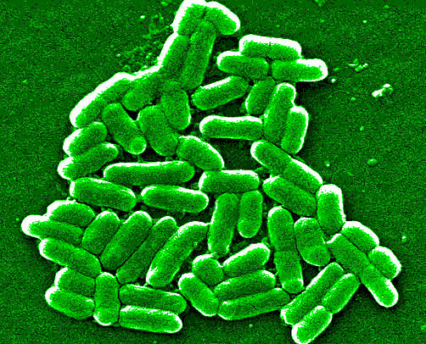
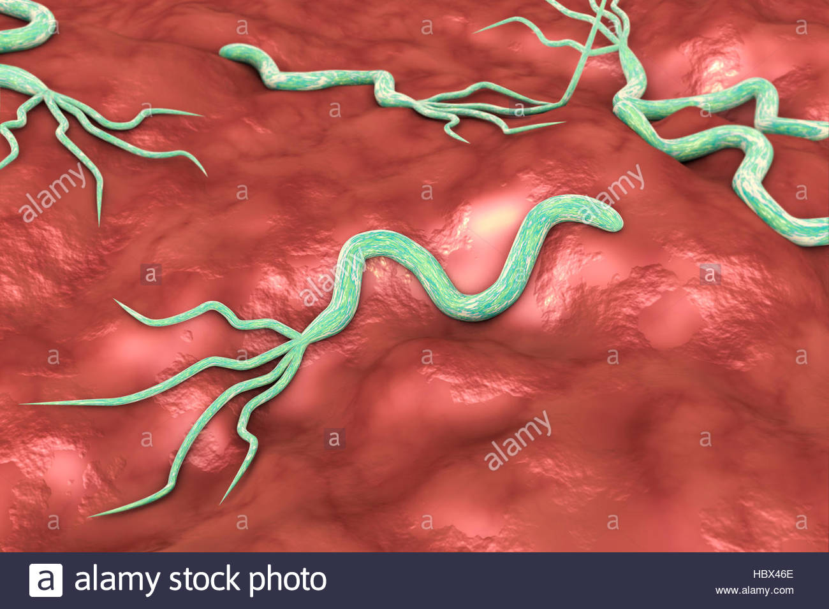
Bacteria are classified by their shape
Spheres (Cocci) Rods (Bacilli) Spirals (Sprilla)
Streptococcus pyogenes E. coli H. pylori
(Strep throat)
They can be found as single cells, in pairs, chains or clusters.

Slide 9
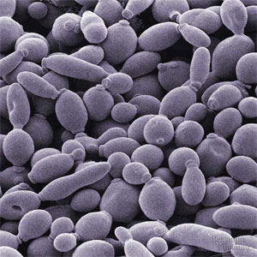
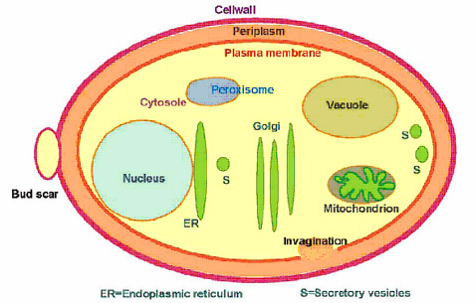
Fungi (Singular: Fungus)
Mushrooms and toadstools are fungi, but these are made of lots of cells, so they are not microbes.
Yeasts are unicellular, eukaryotic fungi, so they are microbes.

Slide 10
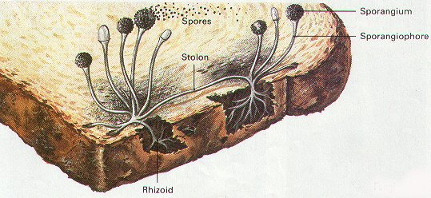
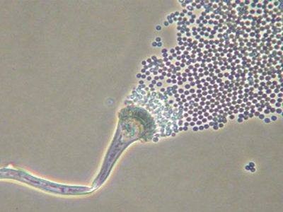
Moulds are also a type of Fungi
Molds are filamentous (thread-like) eukaryotic fungi that decompose (break down) dead organic material such as leaves, wood and plants.
These fungi produce airborne spores.
Examples of moulds are: Penicillium, Mucor, Aspergillus.

Slide 11
Protists
Protists are a classification of organisms that are primarily microscopic and unicellular.
They include unicelluar algae and protozoans.

Slide 12
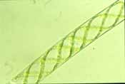
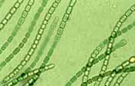
Algae (Singular: Alga)
Contain chlorophyll and carry out photosynthesis and usually live in aquatic environments
Many algae are macroscopic e.g. seaweed so these are not microbes.
Microscopic algae are single celled - e.g. diatoms
Can be either in colonies e.g. Volvox
or appear in filaments e.g. Spirogyra.

Slide 13
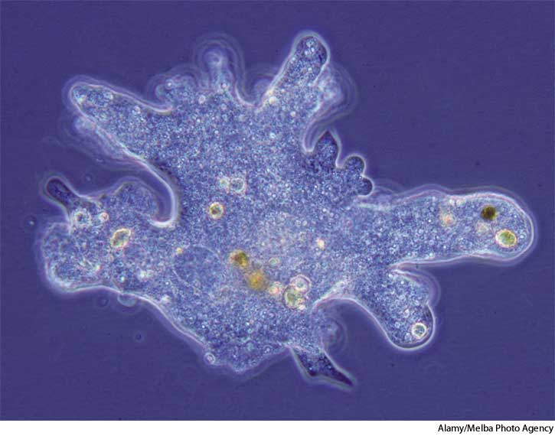
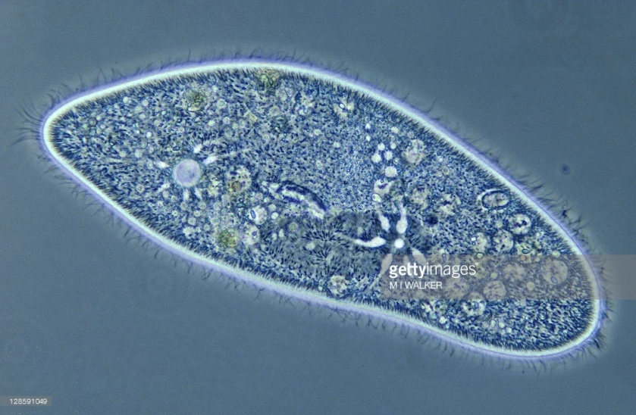
Protozoa (Singular: protozoan)
can be found in Protozoa are single celled eukaryotic organisms lacking cell wall
aquatic environments or in the soil.
Amoeba has a very fluid shape and simple internal organization with few specialised organelles
Paramecium has a fixed shape, complex internal organisation and many specialised organelles.
Many protozoa are parasitic in other animals, including humans.

Slide 14
Eg. Giardia (Beaver Fever)

Slide 15
Viruses (Singular: virus)
Viruses are not living but are still considered microbes
can only be seen under an electron microscope
have no cellular structure
Examples: measles, chicken pox, influenza (flu) and AIDS.

Slide 16
Check your understanding
Explain why a microscope is needed to see micro-organisms.
Suggest some roles you think micro-organisms play in our environment.

Slide 17
What do microbes do?
Some microbes are beneficial, some are harmful but most are completely harmless.

Slide 18
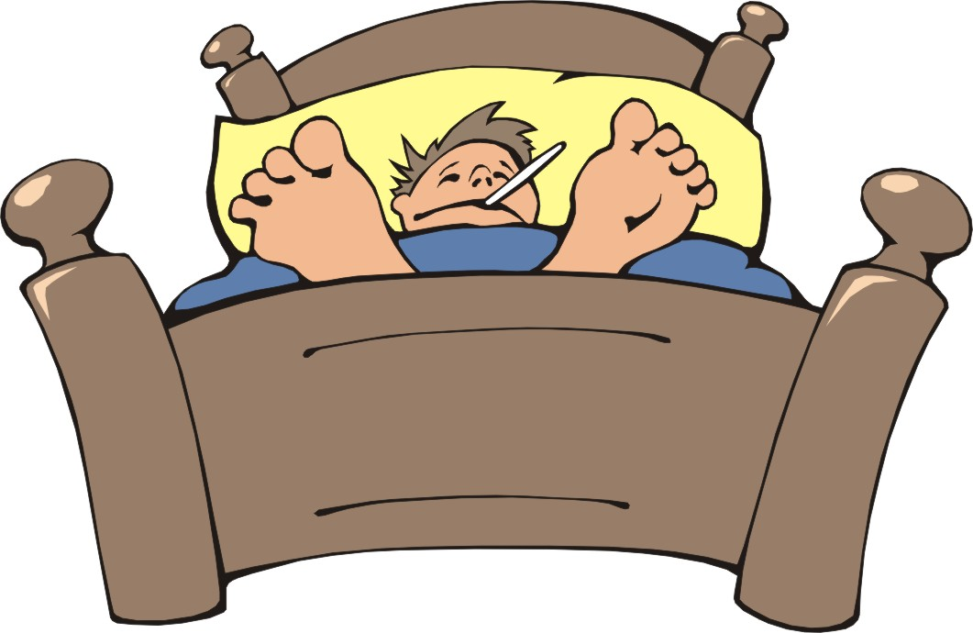
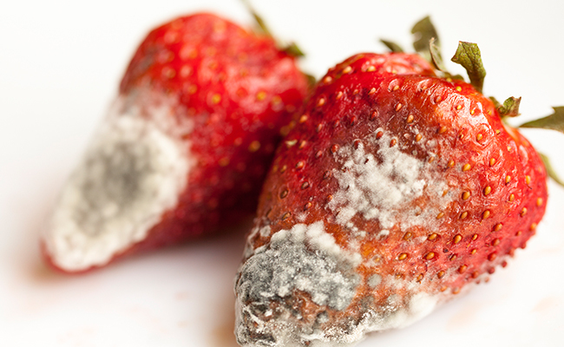
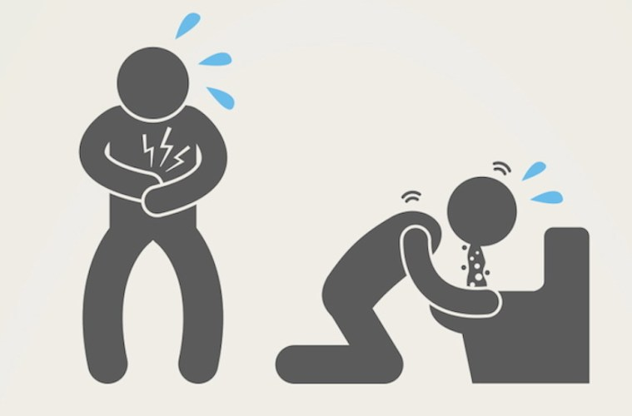
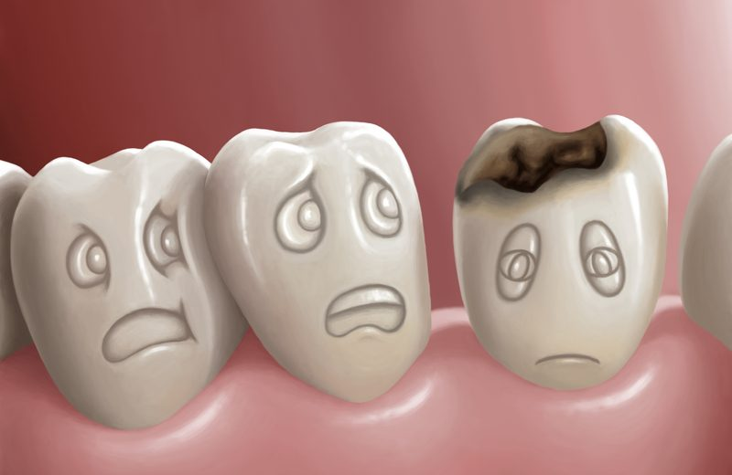
Harmful Microbes
Some cause diseases like ‘flu and malaria,
Some spoil our food
Some cause food poisoning
Some cause cavities

Slide 19
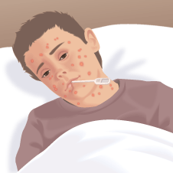
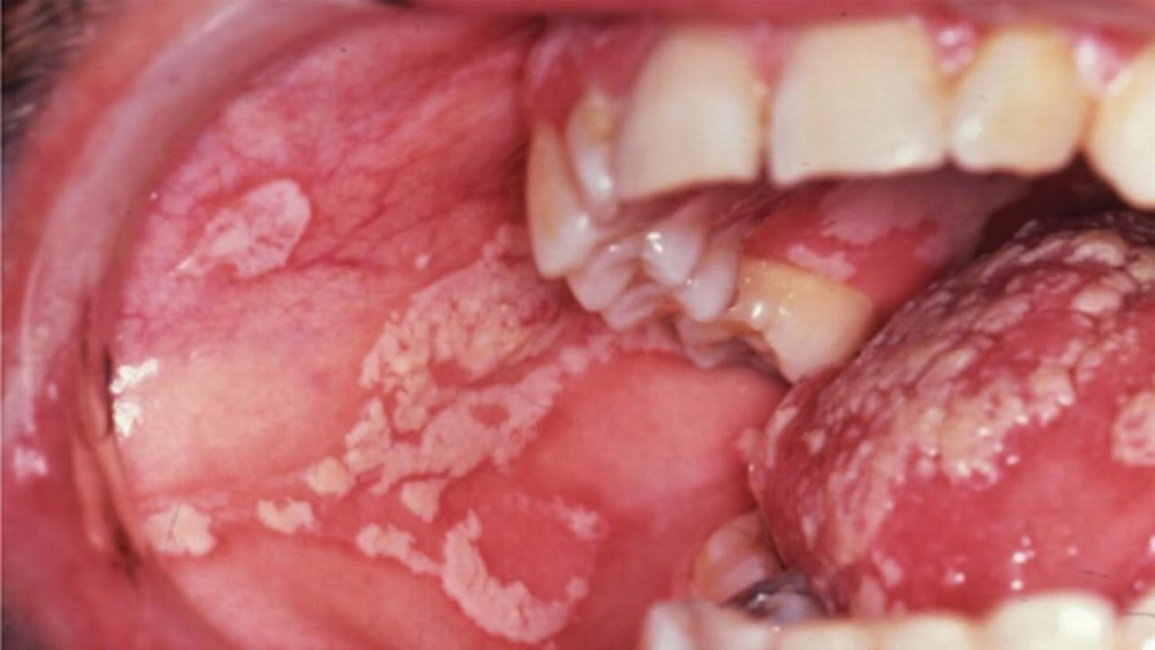
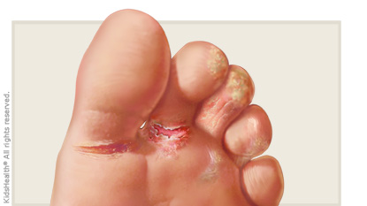
Microbes can cause disease
Microorganisms that cause diseases are called pathogens (are said to be pathogenic).
Diseases can be caused by
Viruses: mumps, measles, chickenpox, Ebola, and rubella. small pox, measles, influenza, HIV,
Bacteria: tuberculosis (TB), whooping cough, Salmonella, Listeria and E. coli
Yeast: Athlete's foot, thrush
Protozoa: Beaver Fever

Slide 20
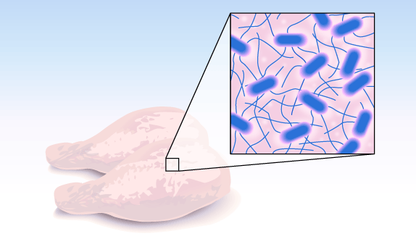
Microbes can cause Food Poisoning
Uncooked foods (especially meat) can contain bacteria.
The bacteria are killed when the food is cooked properly.
But if you eat food that has not been cooked properly, the bacteria may survive and make you feel very ill.
Salmonella, E. coli, Listeria
Notes:
There are at least a million cases of microbial food poisoning in the UK each year - though the vast majority go unreported. Most people suffer from a foodborne illness at some time in their lives. The symptoms of vomiting, diarrhoea, abdominal pain and fever are thoroughly unpleasant. But the estimated costs of medical care and lost working time are also worrying - at about £1 billion a year.How can anything as small as microbes cause all this trouble? Food poisoning organisms present a hidden danger in our food, but it is possible to defeat them. Most food-borne illness is preventable.

Slide 21
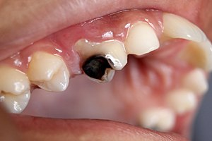
Microbes can cause Cavities
Bacteria left in your mouth by not brushing your teeth properly can cause a tooth infection.
Bacteria left in your mouth could also cause an infection in your ear
https://ed.ted.com/lessons/what-causes-cavities-mel-rosenberg#review
Notes:
Watch Ted Ed: what causes cavities
https://ed.ted.com/lessons/what-causes-cavities-mel-rosenberg#review

Slide 22
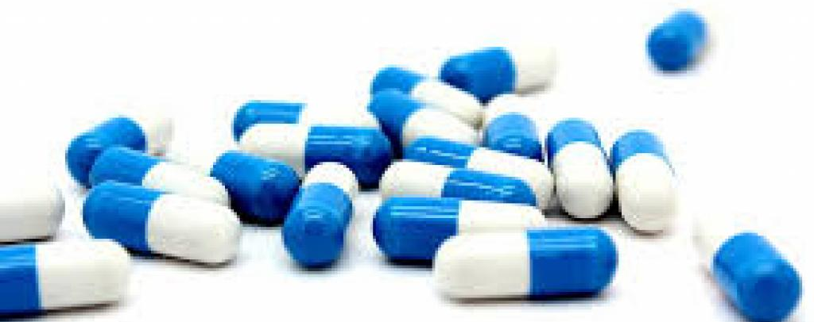
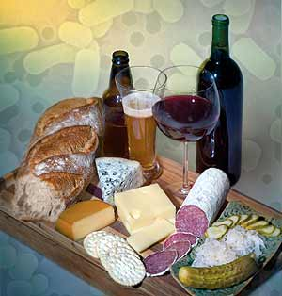
Beneficial Microbes
production of food
production of medicines
production of enzymes
Probiotics help us digest our food.
Some cycle nutrients in the ecosystems by decomposing
Water treatment Plants
Bioremediation

Slide 23
Microbes are used to Produce Food
Yeast makes bread dough rise.
Yeast ferments sugar into alcohol to make wine and beer.

Slide 24
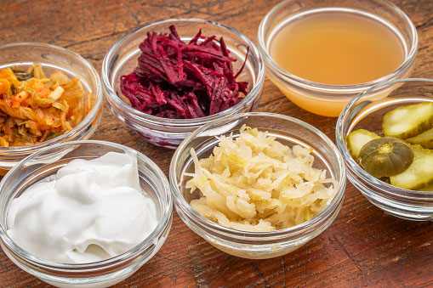
Microbes are used to Produce Food
Bacteria ferments cabbage into sauerkraut or kimchi.
Bacteria is added to milk to make yogurt, cheese, and sour cream.
The bacteria turn the sugar in the milk into acid. The acid makes the milk go thick and stops any harmful bacteria growing.

Slide 25
V

Slide 26
Microbes in our digestive system
Gut microbiota (gut bacteria) is the microbe population living in our intestine.
Our gut microbiota contains tens of trillions of microorganisms, including at least 1000 different species of known bacteria.
Each of us has a unique composition (mixture) of microbiota
https://www.youtube.com/watch?v=VzPD009qTN4

Slide 27
Probiotics
Probiotics are live microorganisms that promote a healthy digestive tract and a healthy immune system.
These are also commonly known as friendly, good, or healthy bacteria.
Notes:
Probiotics are live microorganisms that promote a healthy digestive tract and a healthy immune system. These are also commonly known as friendly, good, or healthy bacteria.

Slide 28
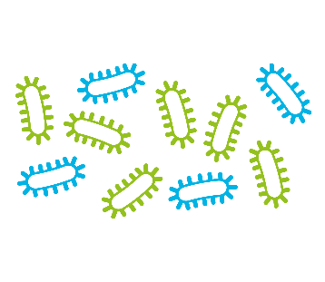
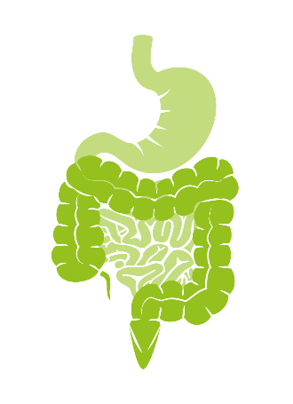
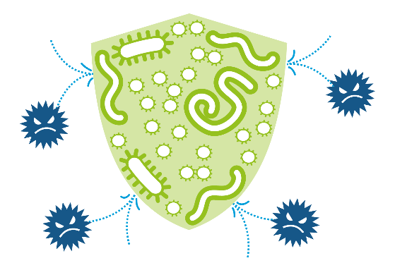
Why do we have gut microbiota?
they help keep your gut and our immune system healthy
they help the body digest certain foods that the stomach and small intestine can’t.
they help with the production of vitamins B and K.
They help defend against aggression from other microbes

Slide 29
Our microbiome
https://www.youtube.com/watch?v=VzPD009qTN4
You are your microbes
https://www.youtube.com/watch?v=1X8p0vhsWRE

Slide 30
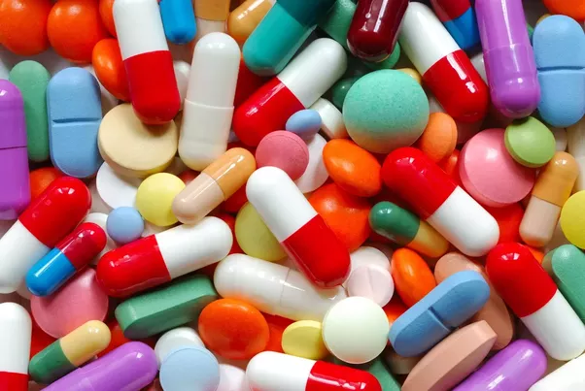
Microbes in Medicine
Microbes such as bacteria and fungi can be used to produce medicines, vaccines and to develop disease testing techniques.
Vaccines are either killed or weakened parts of a disease-causing bacteria or virus. Vaccines prevent us from getting the disease.
Antibiotics -In 1928, Alexander Fleming first identified a mold, Penicillium, growing in one of his unwashed culture plates where other bacteria could not grow.
Insulin is produced either in yeast or E. coli.

Slide 31
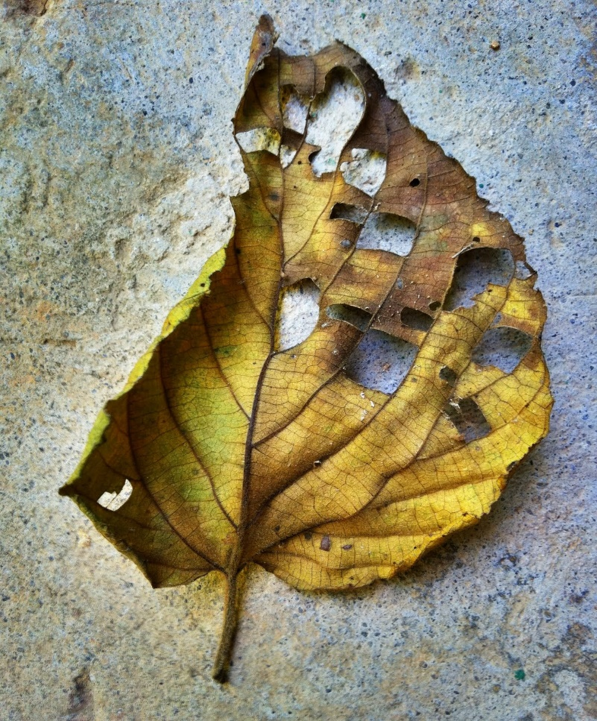
Decomposers
Decomposers break down dead plant and animal material, releasing their nutrients, such as carbon and nitrogen, back into the environment for living organisms to use.
Some decomposers are macroscopic (mushrooms, insects)
Microscopic decomposers are mostly bacteria and fungi.
Decomposers are very important for any ecosystem. If they weren't in the ecosystem, the plants would not get essential nutrients, and dead matter and waste would pile up.

Slide 32
Nutrient Cycle
Nutrients are chemical elements all living things need to grow and live Eg. Oxygen, water, food (Carbon, Nitrogen) CO₂
The Nutrient Cycle describes how nutrients move from the environment into living things, and recycled back again.
Notes:
Around a quarter of the world’s food supply is lost to spoilage by microbes and insects. So what can we do to outwit the microbes and ensure that we consume the food before they do? Over the years man has developed many ways of preserving foods and today’s food technologists have refined the techniques and come up with new ones.
. . . with benefitsWe should remember that spoilage is not necessarily a bad thing. It shows us that a food has not been made or kept in the best conditions, alerting us to the possible presence of pathogenic microbes.
Also decomposition returns the chemicals in food back to the environment, to be used again in the life cycles of Earth.

Slide 33
What affects the rate of decomposition?
Notes:
Fridge, cover, first nations salt, brine

Slide 34
What affects the rate of decomposition?
Temperature
Type of materials that is decomposing
Oxygen
Water
Notes:
Fridge, cover, first nations salt, brine

Slide 35
Decomposers also spoil our food.
How can we prevent/slow down the rate of decomposition of our food?

Slide 36
Ways to prevent/slow down decomposition in our food
Canning – vegetables – the sealed can is heated to kill bacteria, when it cools, no more bacteria can enter
Cooling – food is kept at a low temperature (4C) so bacteria cannot reproduce (they are not killed).
Freezing bacteria cannot reproduce
Drying – fruit, flour, soups, pasta
Adding salt or sugar – jam, chips, meat
Added vinegar – too acidic for bacteria enzymes to work.

Slide 37
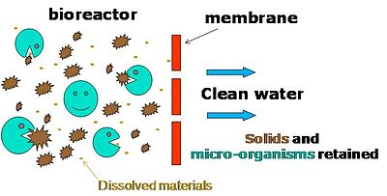
Industrial Use: Water Treatment Plants
Microbes are used to clean-up sewage and other wastes
More than 300 species of bacteria are used in water treatment plants to decompose wastes.

Slide 38
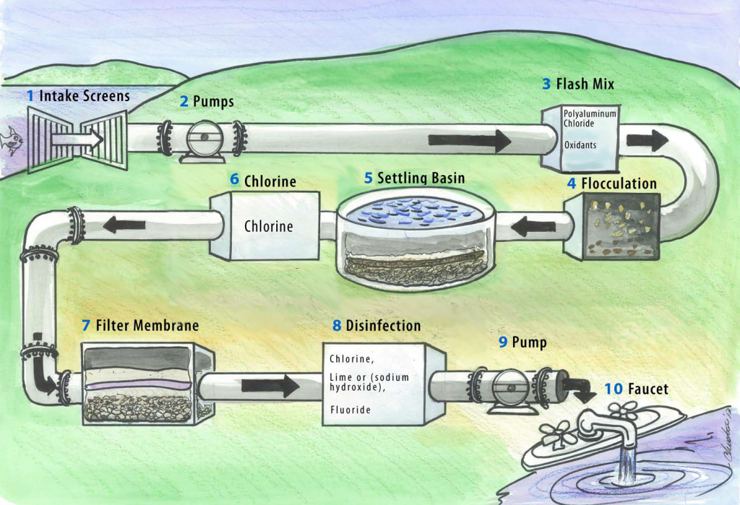
Where can microbes be found?
They are amazingly diverse and can exist in a wide range of habitats from hot springs to the icy wastes of Antarctica.
In the air,
In water
In soil
On and in our bodies

Slide 39
Industrial Use: Bioremediation
Bioremediation is the use of microorganisms to remove pollutants from soil or water such as:
Agricultural chemicals (pesticides and fertilizers that leach from soil into water
Toxic metals removed from water
Oil spills

Slide 40
Disaster Recovery (Bioremediation): using bacteria to eat up oil spills

Slide 41
How can we genetically modify an organism
https://www.youtube.com/watch?v=7TmcXYp8xu4

Slide 42
How is this done?
Genetic Engineering is the manipulating of an organism’s genetic material to produce a desired trait or characteristic.
Microbes are used to genetically engineer certain crops so that they are better protected against insects or disease.
BT corn
Gene from bacteria (B. t.) is inserted into corn, enabling it to produce a protein that will kill the pest that tries to eat it.

Slide 44
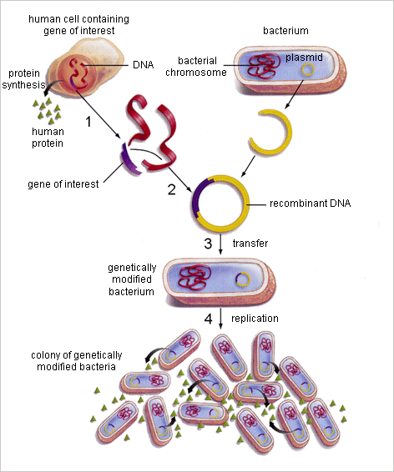
How can organisms be genetically modified?
A piece of DNA (that codes for a trait) from an organism can be inserted into another organism’s DNA (usually bacteria).
Bacteria reproduce in large numbers with the new DNA.
The genetically modified DNA can be inserted into other organisms so they will produce a desired trait (striped flower petals, sweeter apples, faster growing corn, pest-resistant crops, etc)

Slide 45
Microbe Research Project
Research one microbe and discuss how it is important to us in one of the following:
Food production (beer, wine, bread, cheese, yogurt, fermented foods)
Production of vaccines or other medicines
Importance of gut bacteria
Food spoilage and how to prevent it.
Causing disease.
Food poisoning
Cavities
Decomposers in the Nutrient cycle,
Sewage Plant: cleaning up water
Bioremediation: Cleaning up chemical spills,
Notes:
They play a key role in nutrient cycling in the environment
They are used to help make food and beverages
They are an important part of our digestive system
They are used in Biotechnology: eg Genetic Engineering, bioremediation
They can be used in medicine to make antibiotics
They can be Pathogenic – cause disease

Slide 46
Microbe Research Project (10pt)
Title, name, partner, date, block (1pt)
Description of organism:
Type – eg. bacteria, virus, yeast (1pt)
Scientific and Common Name the organism (1pt)
Labeled Image/drawing of organism (1pt)
At least two characteristics describing microbe (shape, reproduction, where normally found) (2pt)
How is it harmful or beneficial? How is it used or what does it do?(3 pt)
Cite your work. Wikipedia does not count. (1pt)
Project must be in your own words. No cut and paste. Can be poster, power point, comic strip or written report.

Slide 47
Some Microbes are Harmful: | Beneficial
Some cause diseases like ‘flu and malaria, Some spoil our food Some cause food poisoning Some cause cavities | production of food production of medicines production of enzymes in our digestive system Some cycle nutrients in the ecosystems.

Slide 48
Check your understanding
Read textbook section about Microbes and fill in the chart in your notes about positive and negative interactions between humans and microbes.
Make a T-chart to list the positive and negative interactions between humans and microbes.
Some medicines people take to treat an infection also kill bacteria that are naturally found in the intestines. Why is this a concern?

Slide 49
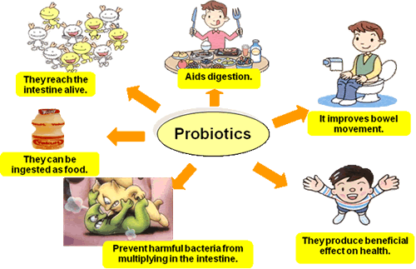
Notes:
Probiotics are live microorganisms that promote a healthy digestive tract and a healthy immune system. These are also commonly known as friendly, good, or healthy bacteria.

Slide 51
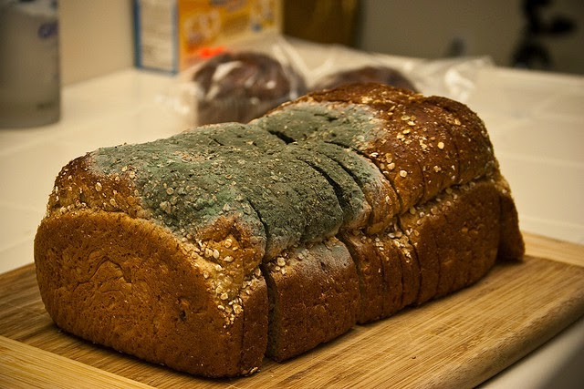
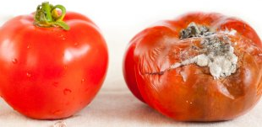
Microbes cause Food Spoilage
Bacteria, Yeast and Mould can grow on food and make it spoil. It can make you ill if you eat it.

Slide 52
Factor | Effect | Explanation
Temperature | High temperatures prevent decay, low temperatures slow decay | High temperatures destroy enzymes and proteins, killing the organisms responsible for decay. Low temperatures slow the rate of reaction of enzymes and will prevent growth and reproduction.
Oxygen | Lack of oxygen will slow or prevent most forms of decay | Oxygen is needed for respiration by organisms. Some bacteria can survive without oxygen, such as those used in biogas generators.
Water | Lack of water will slow or prevent decay | Water is needed for transport and to support reactions inside organisms. Decay organisms need water to digest their food.

