Slide 1
Measuring Matter
Mass and Volume

Slide 2
Question
Which weighs more, a kilogram of feathers or kilogram of bricks? Justify your answer.

Slide 3
MASS
Definition: The amount of matter a substance is made of.
Units: grams (g) or kilograms (kg).
1000g = 1 kg
1000mg = 1 g
Mass is different than WEIGHT

Slide 4
WEIGHT
Weight is the force of gravity pulling on an object
Weight is measured in NEWTONS (N)
Weight is LOWER on the moon since the moon’s gravitational pull is 1/6 of Earth’s

Slide 5
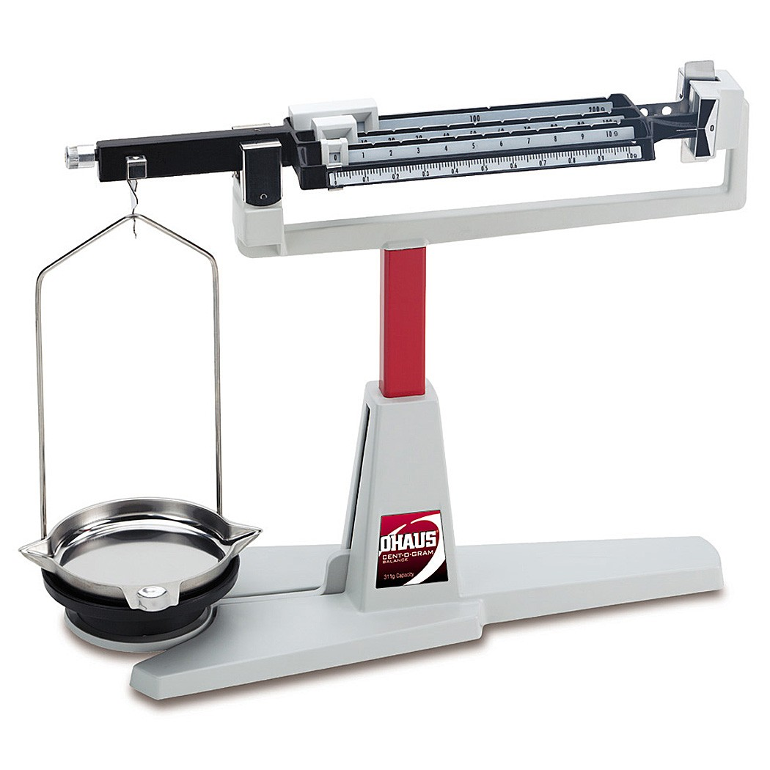
Equipment: TRIPLE BEAM BALANCE
Label your diagram

Slide 7
Using the Triple Beam Balance
Place on a flat surface
Check if ZEROed. Adjust if necessary.
Place solid object on pan
Start with biggest rider: slide until bar touches bottom, then move back one notch
Then move next rider, etc
Never put wet objects directly on pan

Slide 8
MEASURING MASS :
When measuring mass of solids, it can be placed directly on the pan:

Slide 9
Reading Mass: What is the mass of the rock?

Slide 10
Reading the Mass

Slide 11
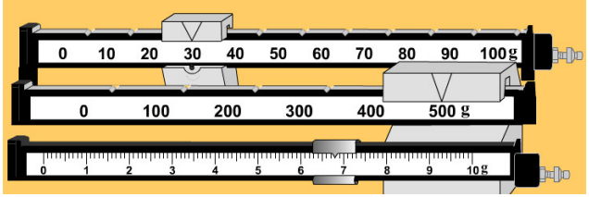
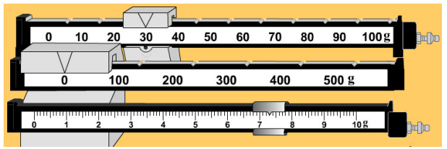
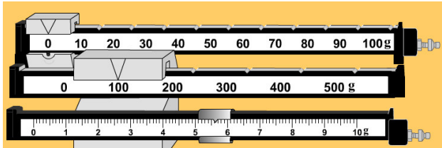
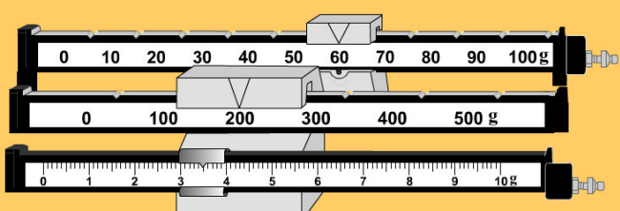

Slide 12
MASS OF LIQUIDS
When measuring mass of liquids, the liquid needs to be in a container and you will need to subtract the container's mass
Notes:
If liquid and container weigh…. Empty container weighs… what is the mass of the liquid?

Slide 13
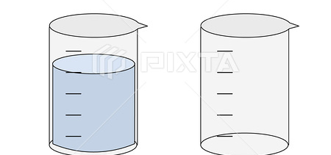
Example
A beaker full of liquid has a mass of 420 g
The beaker alone has a mass of 80 g
What is the mass of the liquid?

Slide 14
Example
A beaker full of liquid has a mass of 420 g
The beaker alone has a mass of 80 g
What is the mass of the liquid?
420g – 80 g = 340 g

Slide 15
Check your understanding
What is the Definition of Mass?
What Units are used when measuring mass?
What Equipment is used to measure mass?
Describe how is mass different than weight.
Which weighs more, a kilogram of feathers or a kilogram of lead?

Slide 16
Before Starting:
Proper handling: two hands, one stabilizing the pan
Flat surface
Zero using adjustment knob
Using:
Start with heaviest rider: slide until too heavy, then back one. Must be in groove.
Continue with next heaviest rider.
Each beaker is different
Review measuring liquids
Review metric conversion

