Slide 2
POLYATOMIC IONS

Slide 3
Polyatomic Ions
A polyatomic ion is a group of atoms together in groups (like a package of atoms) and have a charge like an ion.
Most polyatomic ions are negative and they behave like a single unit in a compound.
The most common positive polyatomic ion is: NH ⁴⁺
It behaves like a METALS in a compound.

Slide 4
Naming Compounds with Polyatomic ions
When naming, use the given name of the package:
Step 1: Name the cation (unchanged)
Step 2: Name the anion (polyatomic ion)
Eg. CaCO3

Slide 5
Naming Compounds with Polyatomic ions
When naming, use the given name of the package:
Step 1: Name the cation (unchanged)
Step 2: Name the anion (polyatomic ion)
Eg. CaCO3 Calcium Carbonate

Slide 6
Try these
NaNO₃
K₂ CrO ₄
KOH
LiNO ₂

Slide 7
Try these
NaNO₃ Sodium nitrate
K₂ CrO ₄ Potassium chromate
KOH Potassium hydroxide
LiNO ₂ Lithium nitrite

Slide 8
POLYATOMIC IONS
Use brackets around the whole polyatomic group if more than one is needed, and the subscript OUTSIDE of the bracket.
The subscript refers to everything inside the brackets.
Example: Al₂(CO₃)₃

Slide 9
POLYATOMIC IONS
Example: Al₂(CO₃)₃
How many Oxygen in this formula?

Slide 10
POLYATOMIC IONS
Example: Al₂(CO₃)₃
How many Oxygen in this formula?
3 x 3 = 9 Oxygen
How many Aluminum?

Slide 11
POLYATOMIC IONS
Example: Al₂(CO₃)₃
How many Oxygen in this formula?
3 x 3 = 9 Oxygen
How many Aluminum? TWO
THREE carbon

Slide 12
More Practice
MgSO₄
Ca(NO₃)₂
Li₂SO₃
Au₂CO₃

Slide 13
Practice
MgSO₄ Magnesium Sulfate
Ca(NO₃)₂ Calcium Nitrate
Li₂SO₃ Lithium Sulfite
Au₂CO₃ Gold Carbonate

Slide 14
One positive Polyatomic Ion
NH₄ + Ammonium ion
NH₄ Cl
Step 1: Name the cation first → in this case, keep the name of the polyatomic ion.
Step 2: Name the anion (change the ending to –ide).

Slide 15
One positive Polyatomic Ion
NH₄ Cl
Ammonium Chloride

Slide 16
Writing Formulas using the Cross Over Method

Slide 17
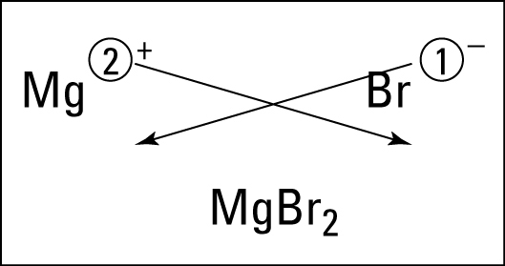
The Cross-over Method
The ions must combine in a ratio that gives an overall neutral charge.
Magnesium bromide:

Slide 18
Practice
Magnesium chloride | Barium sulphide
Sodium oxide | Calcium nitride
Potassium fluoride | Beryllium phosphide

Slide 19
Practice
Magnesium chloride MgCl | Barium sulphide BaS
Sodium oxide Na2O | Calcium nitride Ca₃N₂
Potassium fluoride KF | Beryllium phosphide Be₃P₂

Slide 20
Write the formulas of the polyatomic compounds using the crossover method
Ammonium chloride | Magnesium hydroxide | Calcium chlorate
Calcium sulphate | Potassium nitrite | Lithium nitrate

Slide 21
Write the formulas of the polyatomic compounds using the crossover method
Ammonium chloride NH₄Cl | Magnesium hydroxide Mg(OH)₂ | Calcium chlorate Ca(ClO₃)₂
Calcium sulphate CaSO₄ | Potassium nitrite KNO₂ | Lithium nitrate LiNO₃

Slide 22
Homework
Read text p238-241
Answer CYU p 244 #1, 6, 10 a,b,d,e, 11 bcdf, 12abcd
WB page 46

