Slide 1
CARTOGRAPHY: The science or practice of drawing maps

Slide 2
What are maps?
A map is a representation of an area used to show physical features, exact locations and distances.
the study and making of maps is called cartography.
LAND FORMS eg. mountains, lakes, rivers, etc
MAN MADE STRUCTURES eg. cities, roads, mines

Slide 3
MAKING MAPS: Map Projections
Maps are tricky: Earth is round but paper is flat.
Mapmakers use three different map projections:
Mercator
Gnomonic
Polyconic

Slide 4
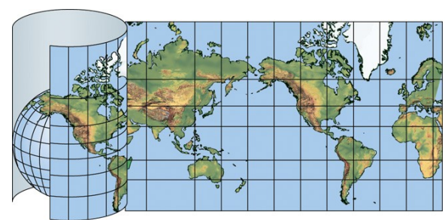
Mercator Projection
Shows the whole world (except extreme polar regions)
used for navigation charts, shows true direction as straight lines
BUT distorts (enlarges) areas farther from equator.
Notes:
The Mercator projection exaggerates areas far from the equator. Examples: Greenland appears the same size as Africa, when in reality Africa's area is 14 times greater. Mercator projection distorts the size of objects as the latitude increases from the Equator to the poles, where the scale becomes infinite. So, for example, Greenland and Antarctica appear much larger relative to land masses near the equator than they actually are

Slide 5
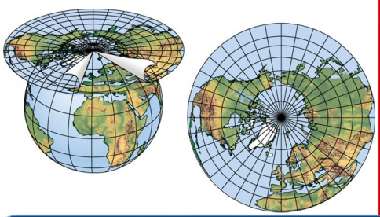
Gnomonic Projection
Can only show one hemisphere at a time
Correctly shows shortest route between two points
Used in seismic work because seismic waves tend to travel along great circles.
Used by navy in plotting direction since radio signals travel along great circles.
Notes:
As if a SHEET OF PAPER was laid on a point on Earth’s surface

Slide 6
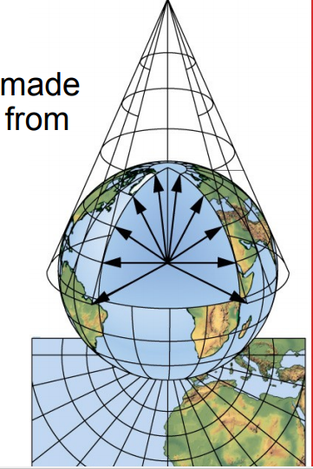
Polyconic Projection
Projects points and lines from a globe onto a cone.
Cone touches the globe at a particular line of latitude along which there is very little distortion in the areas or shapes.
More ACCURATE
Best for making TOPOGRAPHIC maps
Not good for large areas.

Slide 7
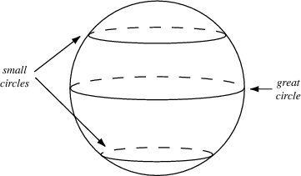
GREAT CIRCLES
Great Circle is any circle that passes through the CENTER
All other circles are small circles.
Great Circles show the shortest route between two points.
Used in airplane travel.

Slide 8
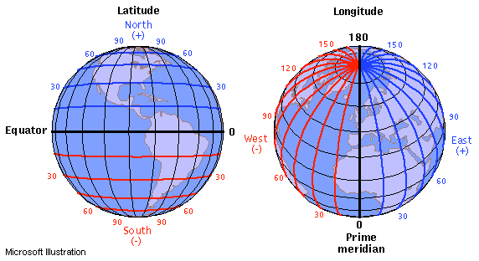
Latitude and Longitude
Show distances and location
Both measured in degrees
Earth is a sphere. There are 360 degrees in a circle,
Any line drawn around the Earth, then, is a circle.
Degrees are divided into minutes(‘) and seconds (“)

Slide 9
Latitude and Longitude
Degrees are subdivided into minutes and seconds
One degree is divided into 60 minutes (60’)
One minute is divided into 60 seconds (60”)

Slide 10
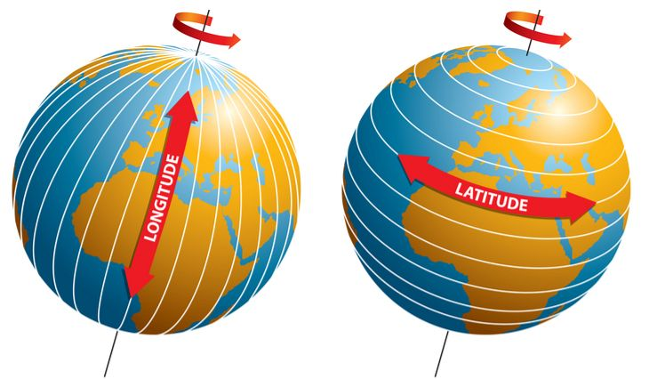
Latitude
Indicates distance North and South
Also called PARALLELS (horizontal lines running East to West)
Never intersect

Slide 11
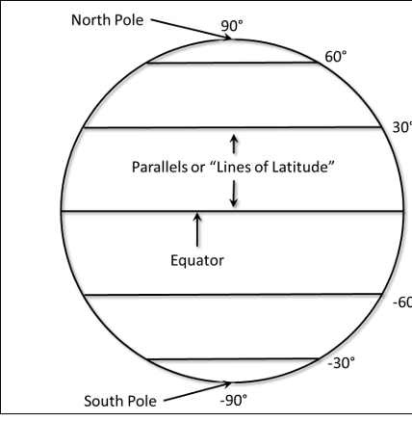
Latitude
Equator is main reference line of latitude (0 °)
Each parallel measures one degree north or south of the equator.
Poles are at 90 °
Eg. North Pole is 90 ° N
Eg. South Pole is 90 ° S

Slide 12
Latitude
Degrees are divided into minutes(‘) and seconds (“)
1° = 60 min
1 min = 1/60 degree
1° = 112km
111.699 km

Slide 13
What is the distance in km of 15 degrees?

Slide 14
If one degree = 112 km, then 5 degrees = 560km

Slide 15
What is the distance in km from equator to North Pole?

Slide 16
North Pole is at 90 °. One degree is 112km Distance is ~ 10,000km

Slide 18
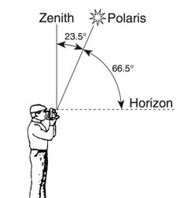
Finding your Latitude
The altitude (angle) of Polaris (North Star over North Pole) is equal to your latitude

Slide 19
LONGITUDE
Measure distance East and West
Also called MERIDIANS
Measured in degrees
PRIME MERIDIAN (0 ° longitude) is the starting line for the world-wide longitude system, at Greenwich, England. Separates the eastern hemisphere from the western
Halfway around the world, at 180 ° longitude, is the International Date Line.

Slide 20
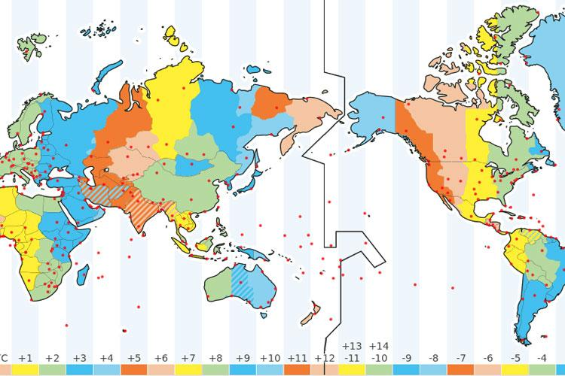
International Date Line
180 ° East or West of Prime Meridian

Slide 21
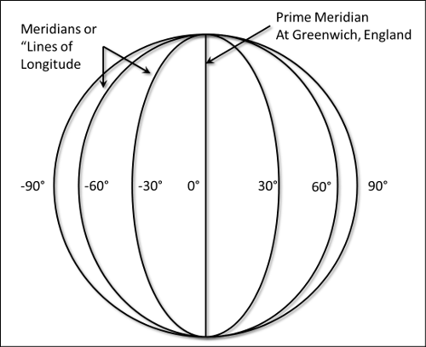
LONGITUDE
No set km for distance, because lines converge at poles.
Example: a city at 30° East near the equator would be farther away from prime meridian than a city at 30° East closer to the pole.

Slide 23
Combine latitude and Longitude to get a coordinate

Slide 24
Latitude and Longitude
Be sure to include direction for both latitude and longitude.
Example Burnaby is located at:
49° 16’ 2" N
122° 58' 8" W

Slide 25
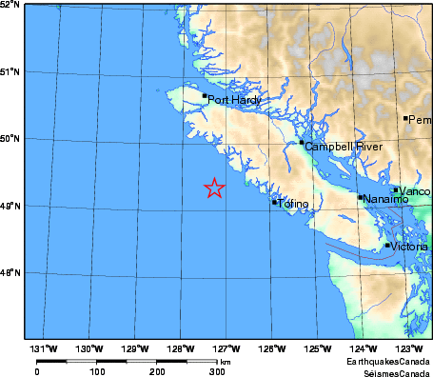
What is the location of Tofino?
sd

Slide 26
49° N, 125° W
sd

Slide 27
Time Zones
Earth’s rotation is the basis for local time​
The Earth rotates 360º in 24 hours​
Earth rotates on an imaginary axis at 15º per hour​
Earth is divided into 24 (15º) time zones

Slide 29
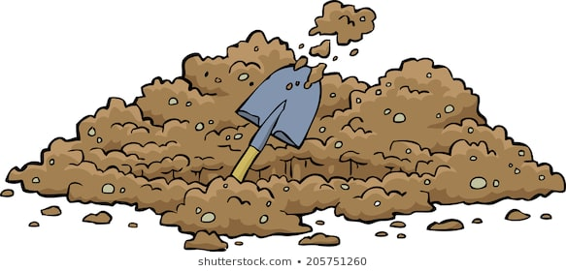
If you could dig all the way through, what would you hit?

Slide 30
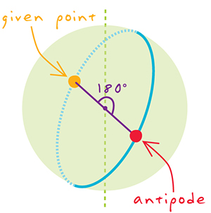
Antipode – direct opposite of something else
Opposite point on Earth from a location
Antipode calculator: https://www.antipodesmap.com/

Slide 31
Calculating Antipode
Latitude: Change North to South
Eg. 49° N becomes 49° S
180 – longitude = antipode
Eg. 123° becomes (180-123) = 57°

Slide 32
PRACTICE READING LATITUDE AND LONGITUDE
In class: Complete Latitude and Longitude WS
Read pages ...109-112 textbook

