Slide 1
Sexual Reproduction
Vocabulary:
Gamete Alleles Somatic Cells
Haploid Diversity Meiosis
Diploid Dominant Homologous
Fertilization Recessive Chromosomes
Notes:
Aphids, slime molds, sea anemones, some species of starfish (by fragmentation), and many plants are examples.

Slide 2
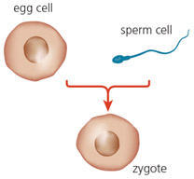
Sexual Reproduction Fast Facts
Requires TWO parents
Offspring are genetically different from each other and parents.
Requires specialized cells called gametes.
Gametes formed by process called meiosis.
Gametes combine to form a zygote during fertilization.
Notes:
Sperm cell reach a jelly-like coating surrounding the egg cell and release substances that digest a path through the coating. This helps sperm cells get closer to eth cell membrane fo the egg.
The head of one sperm cell eventually enters the egg cell, where the sperm nucleus fuses with teh egg nucleus.

Slide 3
Chromosome Conundrum
How many chromosomes do you have?
Where did they come from? How many chromosomes do your parents have?
Why don’t you have double?

Slide 4
Somatic Cells: Body Cells
Somatic Cells are body cells (skin, muscle, bone, etc)
Reproduce by mitosis
Each cell contains a double set of chromosomes (diploid number, 2n)
Humans have 23 pairs of chromosomes (46 total)
2n = 46 in humans

Slide 5
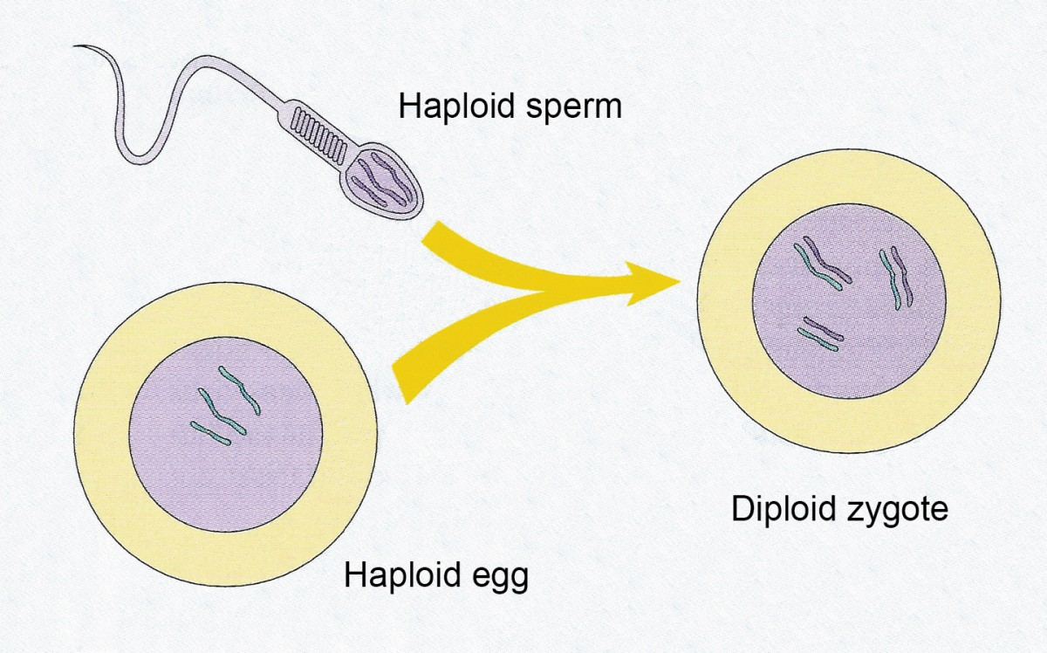
Gametes: Sex Cells
Required for sexual reproduction
Created by process called meiosis
Contain only a single set of chromosomes, (haploid number, n)
male gametes = sperm
female gametes = eggs or ova (ovum)
n = 23 in humans
Notes:
Gametes are sex cells required for sexual reproduction

Slide 6
Each parent contributes one chromosome of each pair to its gametes.
Because gametes will combine their chromosomes, each must contain only half the number of chromosomes.
This ensures the correct number of chromosomes in each offspring and from one generation to the next.
Notes:
ce

Slide 7
FORMS OF SEXUAL REPODUCTION

Slide 8
Forms of Sexual Reproduction
CONjUGATION – some genetic material is transferred from one unicellular organism to another.
Eg. some bacteria
Temporary fusion of cells.
May be a factor that helps some bacteria become resistant to antibiotics

Slide 9
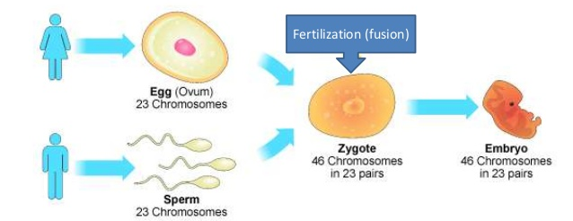
SYNGAMY is when the nuclei of the male and female gametes fuse together to produce a single cell called a zygote during the process of fertilization.
Notes:
Sperm cells have long tails “flagella”.
Egg cells are much bigger and lack flagella. What does the presence or absence of flagella say about the cells motility?

Slide 10
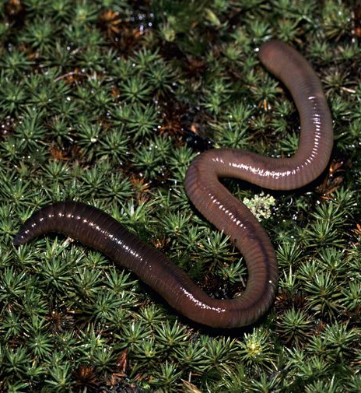
Hermaphrodites
HERMAPHRODITES are organisms that produce both male and female sex cells within the same individual.
occur in plants and some animals that are attached to one location and/or rarely come in contact with other individuals of their species.
Eg. Many Aquatic Organisms ( Sponges, barnacles), Earthworms, flowers
Notes:
Although autogamy is similar to asexual reproduction, in that there is no input of genetic diversity from a partner, the recombination of chromosomes from the male and female gametes results in offspring with slightly altered genetic information, which can therefore look phenotypically different from their parents. Most plants and earthworms reproduce by autogamy. It is sometimes possible for hermaphrodites to reproduce with other hermaphrodites. In this case, genetic diversity does increase within the population.

Slide 11
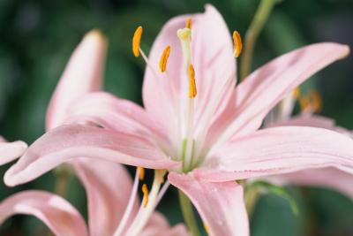
Is Autogamy (self-fertilization) the same as Asexual reproduction?
Notes:
It is possible for hermaphrodites to reproduce with other hermaphrodites. In this case, genetic diversity does increase within the population.

Slide 12
Is Autogamy (self-fertilization) the same as Asexual reproduction?
Similarity: No partner, No input of genetic diversity.
Difference: the recombination of chromosomes from the male and female gametes results in slightly genetically different offspring
Notes:
It is possible for hermaphrodites to reproduce with other hermaphrodites. In this case, genetic diversity does increase within the population.

Slide 13
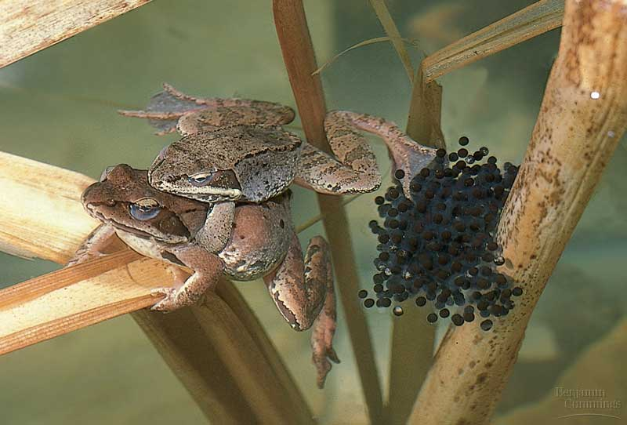
External Fertilization
gametes meet outside of the parents
The female deposits unfertilized eggs and males release sperm over the eggs.
Common in aquatic organism: fish and amphibians
https://www.youtube.com/watch?v=q50Yphp1gzI
Notes:
fertilization (the exceptions are aquatic mammals, sharks, and some other special types of fish).
External fertilization usually occurs among organisms living in aquatic environments. Land animals generally have specialized organs for internal fertilization.

Slide 14
Advantages of External Fertilization
Energy Efficient: Requires very little effort as the sperm and egg can randomly meet
Low Parental Burden: Female does not have to physically carry the developing offspring
Many Offspring: More genetic variation
Notes:
Chickens lay eggs – is this external or internal?

Slide 15
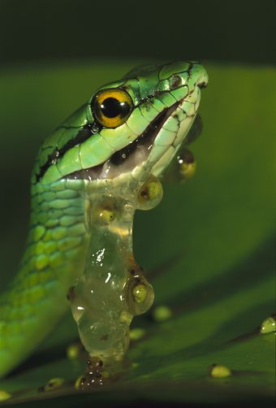
Disadvantages of External Fertilization
Requires aquatic environment for sperm to swim No guarantee gametes will meet
Gametes and zygotes vulnerable
Requires large numbers of gametes to ensure some survival.

Slide 16
Internal Fertilization
Gametes meet inside female’s body
Requires specialized structures to ensure gametes meet
Occurs in mammals, reptiles, birds, and some types of fish
Notes:
All land dwellers need to fertilize this way because sperm still prefer swimming
Need specialized structures. Penis

Slide 17
Advantages of Internal Fertilization
Better chance gametes will meet, greater change of fertilization
Controlled environment: wet environment, temperature regulation, protection from predators
More stringent mate selection
Video of sneaky fish:
https://www.youtube.com/watch?v=RzTy0fAwBFk

Slide 18
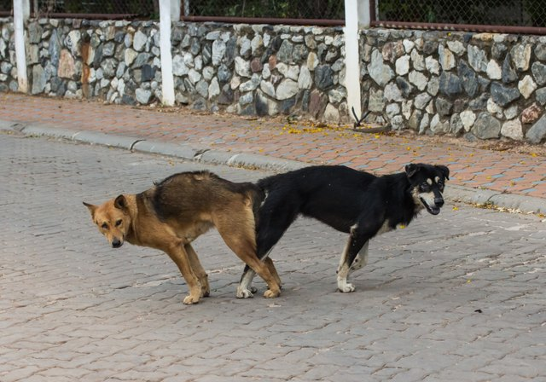
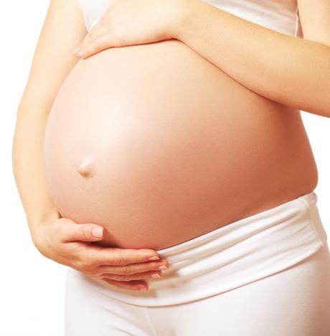
Disadvantages of Internal Fertilization
Mating can be risky, partners vulnerable during intimate contact
Need to find a mate: Complex courtship and mating behaviours can be energy intensive.
Limited amount of offspring being produced at any given time.
Parents must care for young through out gestation
Specialized structures are required to ensure the meeting of gametes
https://www.youtube.com/watch?v=W7QZnwKqopo
Bird of paradise

Slide 19
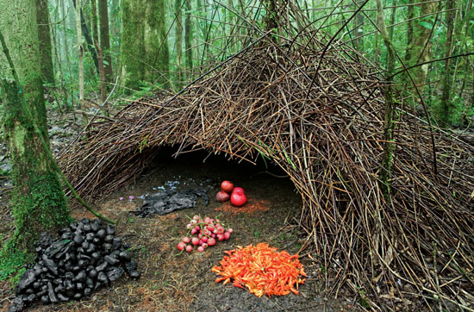
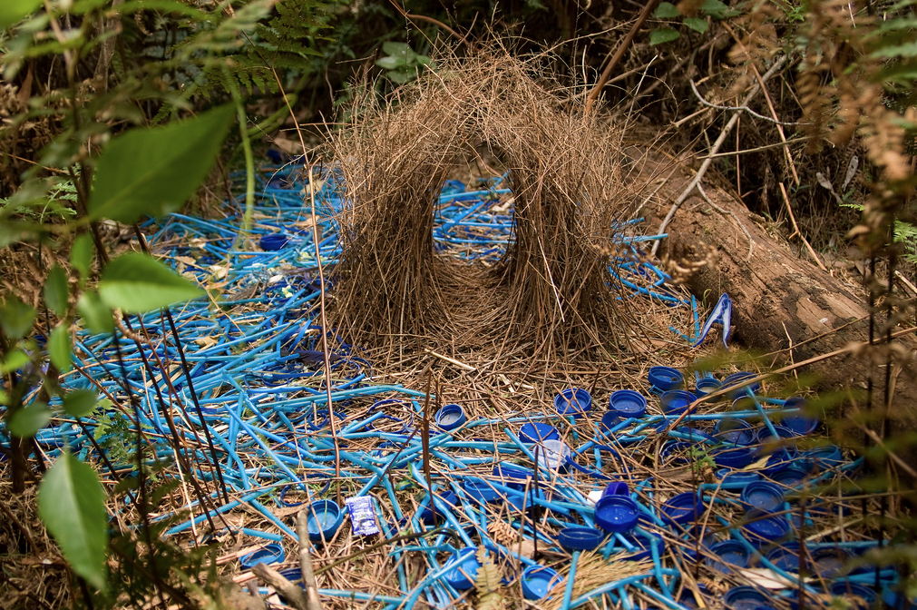
Bower Bird
Bower Bird video https://www.youtube.com/watch?v=GPbWJPsBPdA

Slide 20
Puffer Fish
https://www.youtube.com/watch?v=VQr8xDk_UaY

Slide 21
Advantages and Disadvantages
Greater Genetic Diversity

Slide 22
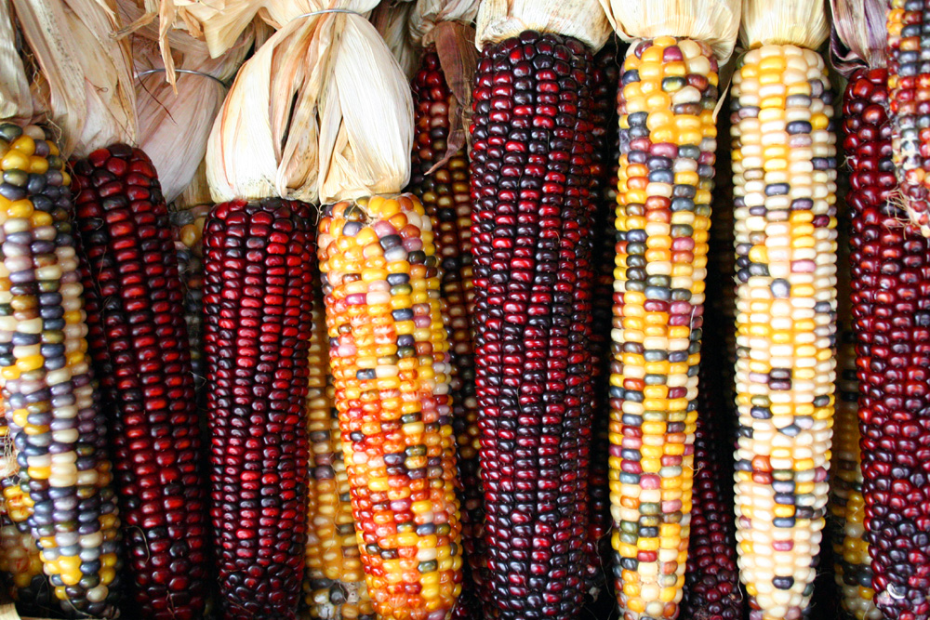
Advantages of Sexual Reproduction
Greater Genetic Diversity

Slide 23
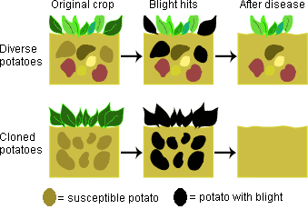
Why is Genetic Diversity Important?
Genetic diversity allows populations to adapt to changing environments and therefore survive to reproduce, ensuring the continuation of the species.
Notes:
Outbreaks of disease kills large numbers of population but there is always a few who were able to fight it. They survived and reproduced, passing on their ability to fight the disease to their children, strengthening the population.
natural selection

Slide 24
Advantages and Disadvantages
Greater Genetic Diversity
Time and Energy intensive- finding a mate, courtship

Slide 25
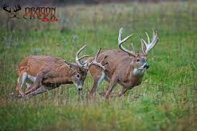
Risky Behaviour

Slide 26
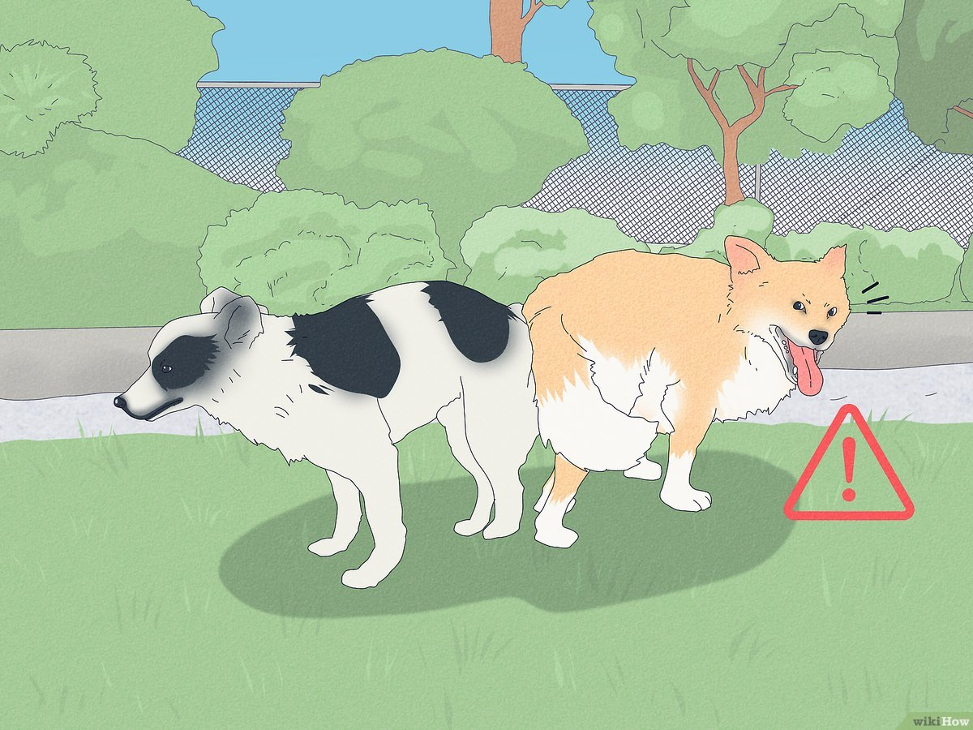
Risky Behaviour

Slide 27
Advantages and Disadvantages
Greater Genetic Diversity
Time and Energy intensive- finding a mate, courtship
Fewer offspring produced

Slide 28
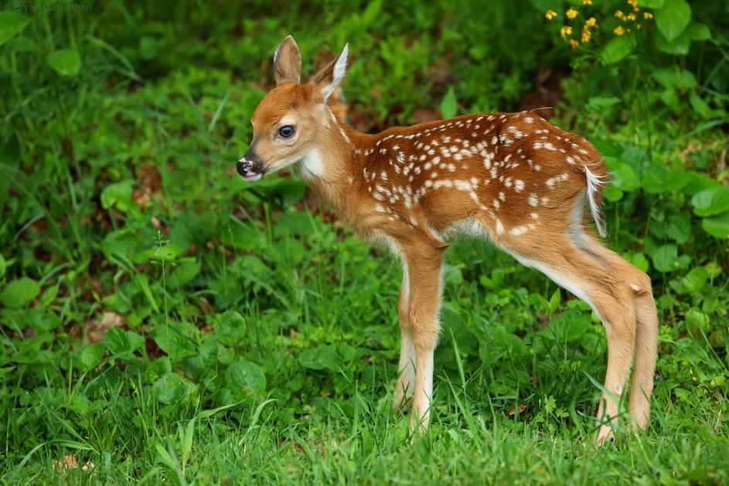
Advantages and Disadvantages
Greater Genetic Diversity
Time and Energy intensive- finding a mate, courtship
Fewer offspring produced
Slower - longer time for offspring to mature

Slide 29
Advantages and Disadvantages
Greater Genetic Diversity
Time and Energy intensive- finding a mate, courtship
Fewer offspring produced
Slower - longer time for offspring to mature

Slide 30
Strange Animal Behaviour
https://www.youtube.com/watch?v=R6R-Hm0enGg

Slide 31
Practice
Strange Animal Behaviour
https://www.youtube.com/watch?v=R6R-Hm0enGg
HW: Read 83-84, 86,
HW: Answer CYU p87 #2,3,5,9-11,14

Slide 32
Practice

Slide 33
Allogamy – Cross Fertilization
Allogamy is the fertilization of an egg from one individual with the sperm of another .
Occurs in most complex animals and some plants
Eg. Conifers such as pine and fir trees have separate male and female cones on the same plant.
Some species have separate male and female flowers on the same plant
Poplar trees have separate sexes on separate plants.

Slide 34
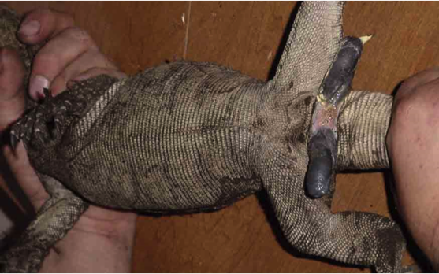
Weirdness
Most male reptiles have two sex organs called hemipenes.
They are housed internally and are everted when needed.
In many snakes, the hemipenes possesses spines or hooks, in order to anchor the male within the female.

