Slide 1
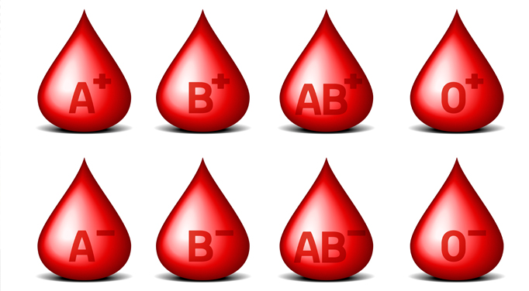
Blood Type

Slide 2
ABO System
Four possible blood types: A, B, AB, O
Due to antigens on the surface of RBC’s
If the same antigen and antibody are present, agglutination (clumping) of RBCs will occur, causing death
Blood recipients may only receive donated blood for which they have no antibodies in their plasma.

Slide 3
ABO system:
blood group A has A antigens on the red blood cells with anti-B antibodies in the plasma.
blood group B has B antigens with anti-A antibodies in the plasma.
blood group O has no antigens, but both anti-A and anti-B antibodies in the plasma

Slide 4
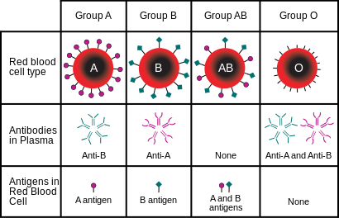

Slide 5
Rh System
Another antigen found on RBCs
People that have the Rh antigen on their RBC’s are Rh positive.
Those without are Rh negative
If you are blood type AB from the ABO system and do not have the Rh antigen you’re blood type is AB-
Therefore there are eight blood types when the 2 systems are combined
Rh negative individuals do not normally make antibodies to the Rh factor, unless they are exposed to the Rh factor

Slide 6
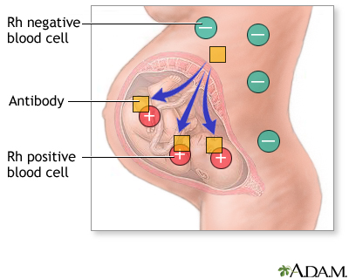
Rh factor and Pregnancy
If the mother is Rh – and the father is Rh+, the child may be Rh+
During gestation, it is normal that a few RBC from the child will leak into mother’s system, causing
Her to produce Rh antibodies
If mother becomes pregnant
With another Rh + baby, mother’s
Rh antibodies may cross the
placenta and destroy baby’s
RBCs. Called Fetal Erythroblastosis
Or hemolytic disease of the
newborn

Slide 7
Can this be prevented?
Give Rh- women an Rh immune globin injection called RhoGAM just after the birth of any RH+ child.
Injection will destroy any RBC’s left over from the baby, before the mother’s immune system has a chance to start producing anti-Rh antibodies
The injection won’t work if the woman has already started to produce her own antibodies.

