Slide 1
5.1 Energy Transformations and
Metabolism
UNIT A
Chapter 5: Metabolism: Energy and Enzymes
Section 5.1
Cellular metabolism is the sum of all chemical reactions of the cell.
Catabolism refers to reactions that break down large molecules (products) into smaller molecules (reactants)
Anabolism refers to reactions that make large molecules (products) from smaller molecules (reactants)
A + B C + D
reactants
products
TO PREVIOUS SLIDE
Notes:
metabolism the sum of all the chemical reactions that occur in a cell
catabolism: the breaking down of molecules
anabolism: the building up (synthesis) of molecules
reactants: in a chemical reaction, the substances that participate in a reaction
products: in a chemical reaction, the substances that form as a result of a reaction

Slide 2
Energy and Reactions
UNIT A
Chapter 5: Metabolism: Energy and Enzymes
Section 5.1
Free energy is the amount of energy available after a chemical reaction has occurred.
The change in free energy of a reaction (ΔG) =
free energy of products − free energy of reactants
− ΔG: products have less energy than reactants, and the reaction will occur in the direction indicated.
exergonic reactions: spontaneous and release energy (exothermic)
endergonic reactions: require energy input (endothermic)
Many cell reactions use energy from exergonic reactions.
TO PREVIOUS SLIDE
Notes:
free energy: the amount of energy available after a chemical reaction has occured
exergonic reactions: reactions that are spontaneous and release energy
endergonic reactions: reactions that require an input of energy to occur

Slide 3
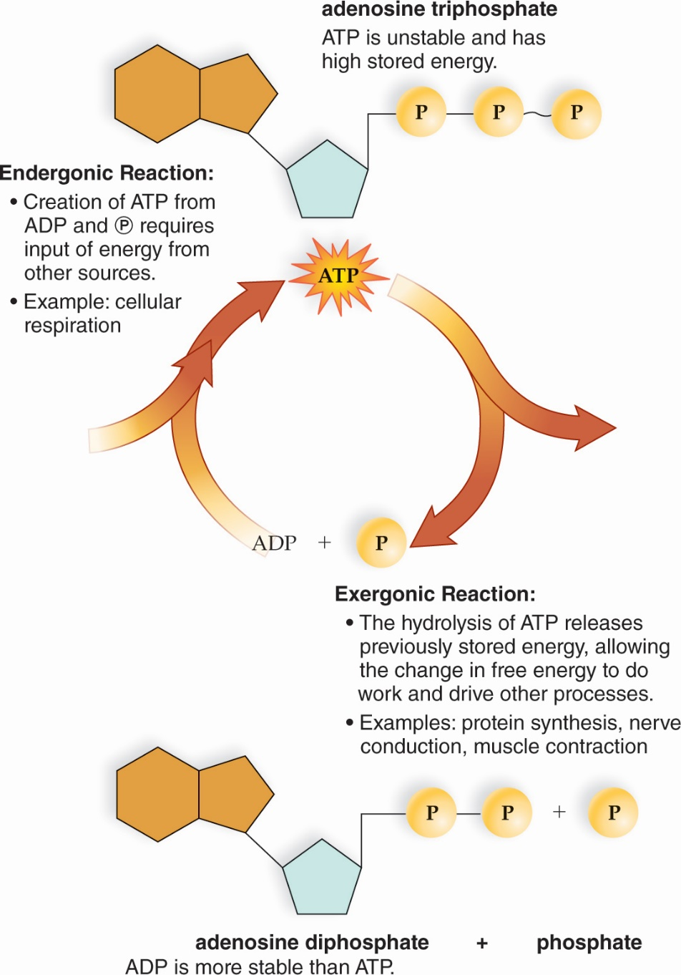
ATP: Energy for Cells
UNIT A
Chapter 5: Metabolism: Energy and Enzymes
Section 5.1
ATP is the energy currency of cells.
ATP is made from ADP and inorganic phosphate
Energy is released when the bond on the terminal phosphate of ATP is broken. This energy is used for endergonic reactions in the cell.
Figure 5.1 The ATP cycle.
TO PREVIOUS SLIDE
Notes:
Caption text
Figure 5.1 The ATP cycle. In cells, ATP carries energy between exergonic reactions and endergonic reactions. When a phosphate group is removed by hydrolysis, ATP releases the appropriate amount of energy for most metabolic reactions.
ATP (adenosine triphosphate): the common energy currency of cells; supplies energy for chemical work, transport work, and mechanical work by being converted to ADP plus a phosphate group
ADP (adenosine diphosphate): a nucleotide that can accept another phosphate group and become ATP

Slide 4
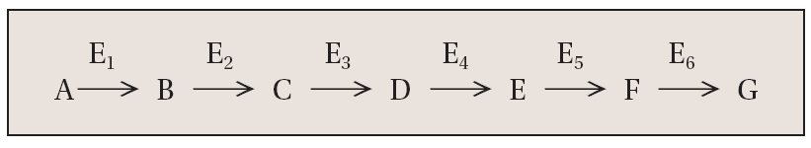
5.2 Enzymes and Metabolic Pathways
UNIT A
Chapter 5: Metabolism: Energy and Enzymes
Section 5.2
Many chemical reactions in the cell are linked in metabolic pathways.
The product of one reaction is the reactant for the next reaction in the pathway. These pathways may be linear (with a final product) or cyclical (reactant is regenerated)
Specific enzymes are proteins that catalyze each step. The reactants are called enzyme substrates
A is a substrate for the enzyme E₁ to produce product B. B is a substrate for E₂ to produce C. This process continues until the final product G.
TO PREVIOUS SLIDE
Notes:
metabolic pathway: a series of linked reactions that begin with a particular reactant and terminate with an end product
enzymes: types of proteins that function as catalysts to speed up chemical reactions
substrates: reactants in an enzymatic reaction

Slide 5
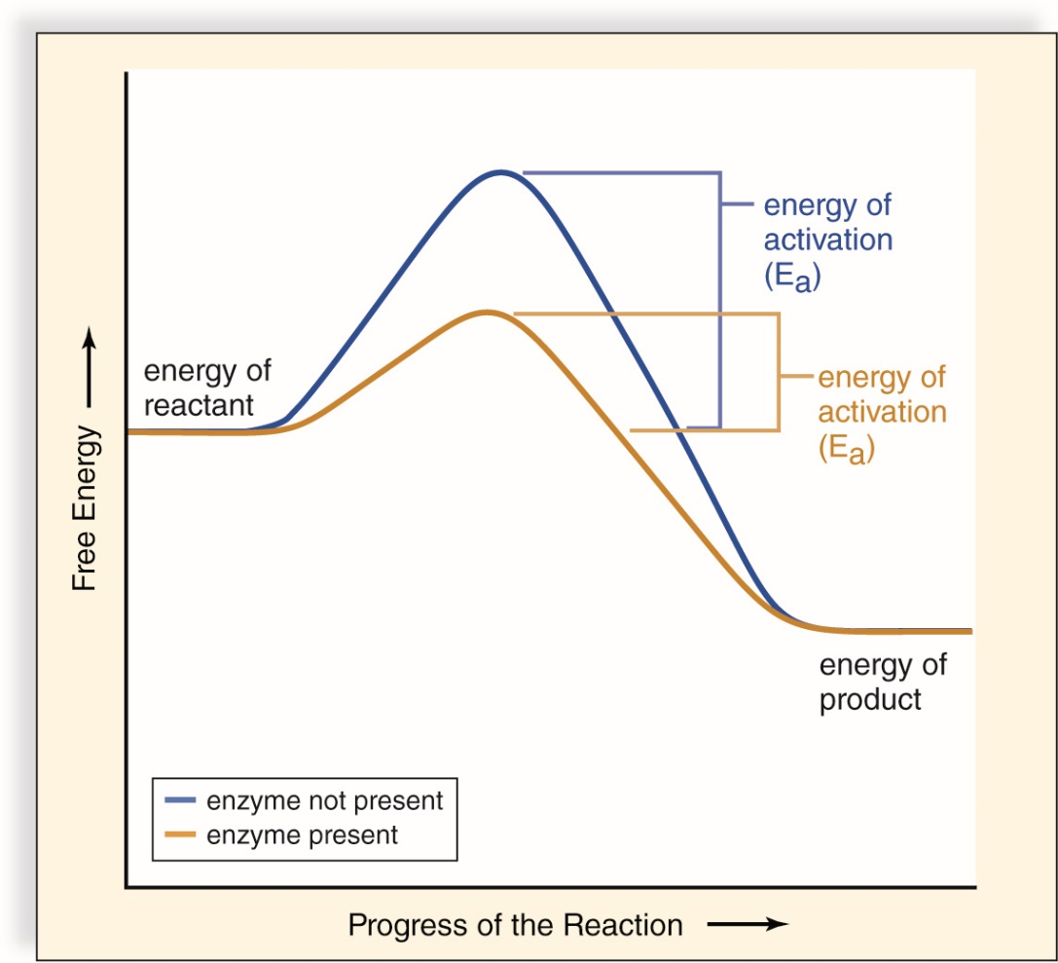
Energy of Activation
UNIT A
Chapter 5: Metabolism: Energy and Enzymes
Section 5.2
For chemical reactions, energy must be added for reactants to react. This is the energy of activation, E_{a}.
Even if ΔG is negative, E_{a} must be overcome
Enzymes speed up the rate of a reaction by lowering the E_{a} barrier
TO PREVIOUS SLIDE
Figure 5.2 Energy of activation (E_{a}).
Notes:
Caption text
Figure 5.2 Energy of activation (E_{a}). Enzymes speed the rate of reactions because they lower the amount of energy required for the reactants to react.
energy of activation (E_{a}): the energy that must be added to cause molecules to react with one another

Slide 6
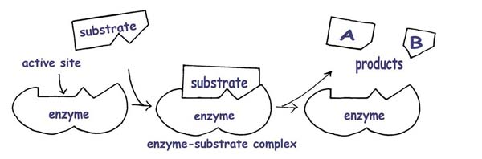
Enzymes: LOWER the ACTIVATION ENERGY
Enzymes do this by bringing the substrate molecules
together and holding them long enough for the reaction to
take place.

Slide 7
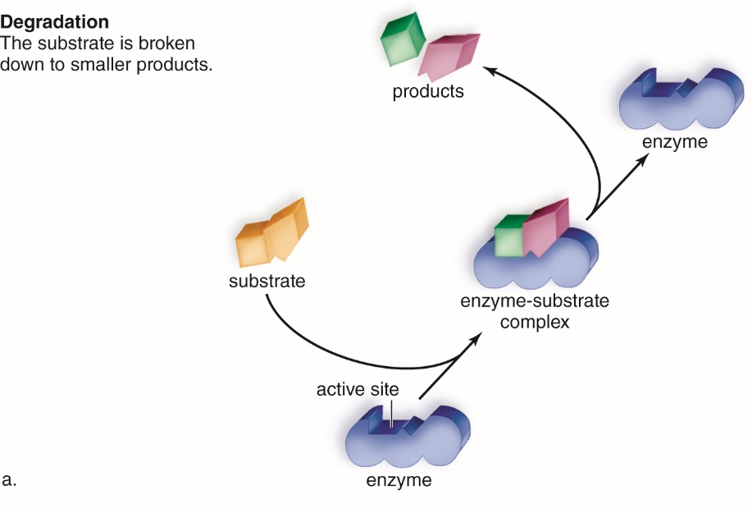

How Enzymes Function
UNIT A
Chapter 5: Metabolism: Energy and Enzymes
Section 5.2
In enzyme-catalyzed reactions, the active site of the enzyme interacts with the substrate(s) to form an enzyme-substrate complex. After the reaction, product is released and the enzyme can bind another substrate.
TO PREVIOUS SLIDE
Figure 5.3 Enzymatic action.
Notes:
Caption text
Figure 5.3 Enzymatic action. An enzyme has an active site where the substrates and enzyme fit together in such a way that the substrates react. Following the reaction, the products are released, and the enzyme is free to act again. a. The enzymatic reaction can result in the degradation of a substrate into multiple products (catabolism) or, b. the synthesis of a product from multiple substrates (anabolism).
active site: a small part of an enzyme that forms a complex with a substrate(s)

Slide 8
How do Enzymes Work? The Lock and Key Theory vs. the Induced Fit Theory
Because the molecules in question are so small and the reaction happen so fast, we’ve never clearly seen how enzymes work.
We do, however, have a good model. The original model, called the “Lock and Key Theory” has more recently been superseded by a slightly more sophisticated model called the “Induced Fit Theory.”

Slide 9
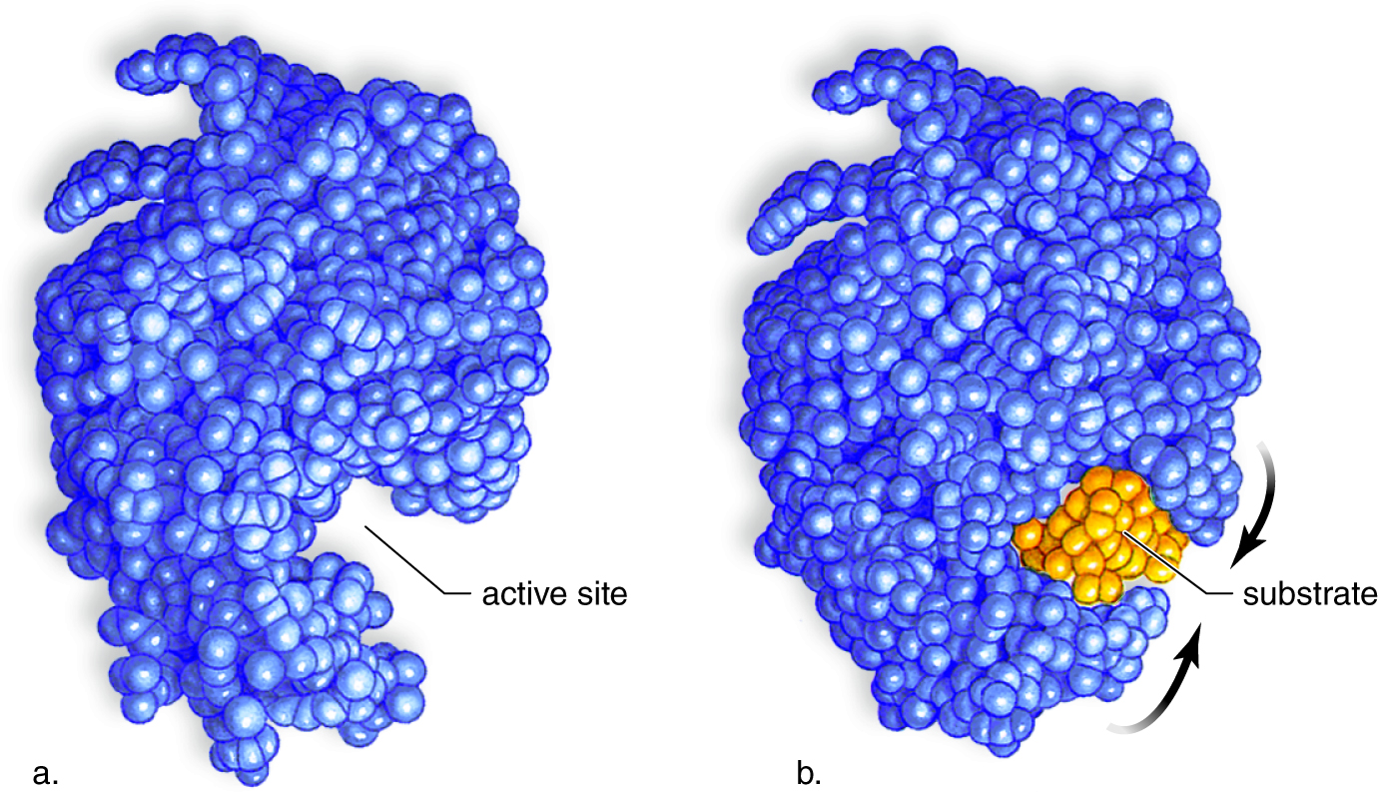
Induced-Fit Model
UNIT A
Chapter 5: Metabolism: Energy and Enzymes
Section 5.2
When a substrate binds to an enzyme, the active site undergoes a slight change in shape, called the induced-fit model, to form the enzyme-substrate complex.
Figure 5.4 Induced fit model.
TO PREVIOUS SLIDE
Notes:
Caption text
Figure 5.4 Induced fit model. These computer-generated images show an enzyme called lysozyme that hydrolyzes its substrate, a polysaccharide that makes up bacterial cell walls. a. Shape of enzyme when no substrate is bound to it. b. After the substrate binds, the shape of the enzyme changes so that hydrolysis can better proceed.
Induced-fit model: when the enzyme undergoes a slight change in shape in order to accommodate the substrate

Slide 10
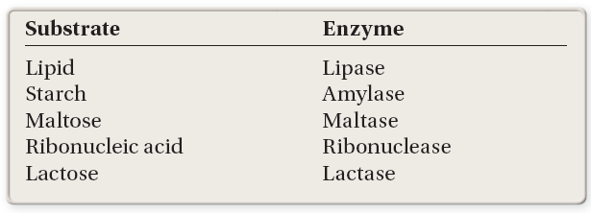
Enzyme Names
UNIT A
Chapter 5: Metabolism: Energy and Enzymes
Section 5.2
Because enzymes form complexes with specific substrates, they are often named by adding the suffix –ase to the name of the substrate.
TO PREVIOUS SLIDE

Slide 11
Factors Affecting Enzymatic Speed
UNIT A
Chapter 5: Metabolism: Energy and Enzymes
Section 5.2
Several factors can regulate the activity of an enzyme. These include
the amount of substrate(s) present for the reaction
environmental conditions, such as temperature and pH
enzyme activation
enzyme inhibition
presence of cofactors
TO PREVIOUS SLIDE

Slide 12
Substrate Concentration
UNIT A
Chapter 5: Metabolism: Energy and Enzymes
Section 5.2
Generally, enzyme activity increases as substrate concentration increases because
there are more collisions between the enzyme and substrate molecules
more substrate molecules are available to fill more active sites of enzymes
However, a maximum rate exists. Once all active sites on an enzyme are filled with substrate, the reaction cannot go any faster.
TO PREVIOUS SLIDE

Slide 13
if the concentration (abbr. = “[ ]”) of substrate increases, enzymatic activity (reaction rate): increases .
The rate of product formation will usually increase too. However, after a certain [ ], the rate won’t increase anymore, as all the enzymes are “saturated” with substrates and can’t work any faster. When this happens the rate levels out.
if the concentration of substrate decreases, the rate of product formation will : decrease.

Slide 14
Concentration of Enzyme
This is what limits the overall rate of reaction. Providing there is adequate substrate (and their is typically millions more substrate molecules than enzyme molecules), enzyme activity increases as enzyme concentration increases.
In other words, if [enzyme] increases, rate of product formation increases. If amount of enzyme decreases, the rate of product formation decreases.
The rate will only level off if you run out of substrate, which is usually not the case.

Slide 15
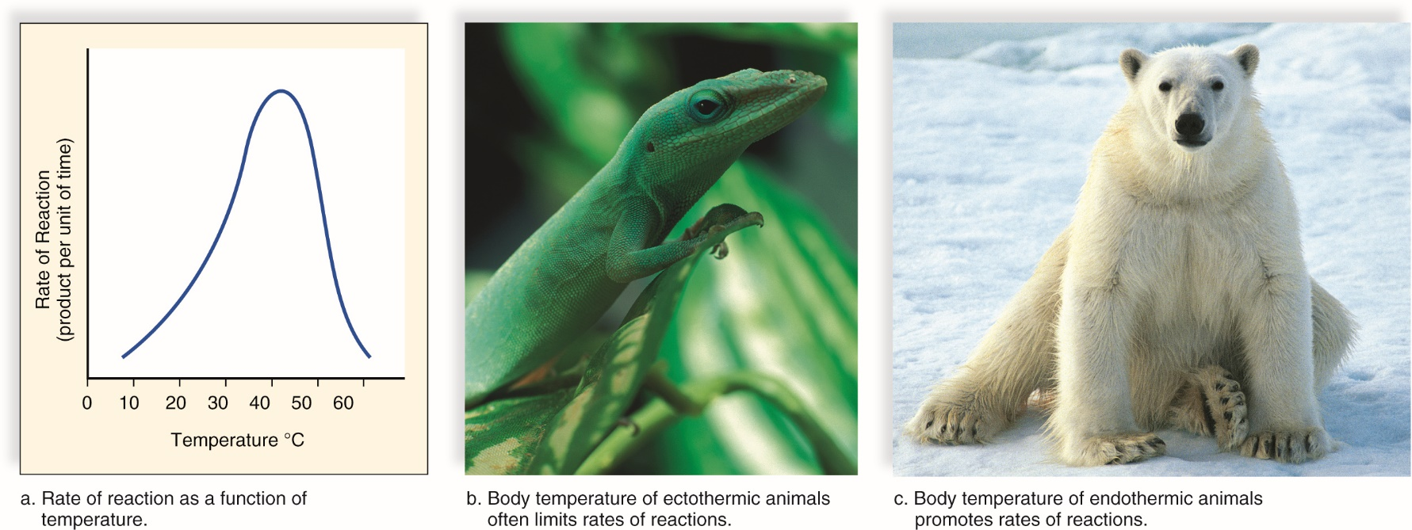
Temperature and pH
UNIT A
Chapter 5: Metabolism: Energy and Enzymes
Section 5.2
As temperature increases, enzyme activity also increases because there are more effective collisions between enzyme and substrate.
Above a certain temperature (45C) the enzyme will no longer be active because it is denatured and cannot bind substrate.
TO PREVIOUS SLIDE
Figure 5.5 The effect of temperature on rate of reaction.
Notes:
Caption text
Figure 5.5 The effect of temperature on rate of reaction. a. Usually, the rate of an enzymatic reaction doubles with every 10°C rise in temperature. This enzymatic reaction is maximum at about 40°C. Then it decreases until the reaction stops altogether, because the enzyme has become denatured. b. The body temperature of ectothermic animals, which require an environmental source of heat, often limits rates of reactions. c. The body temperature of endothermic animals, which generate heat through their own metabolism, promotes rates of reaction.
denatured: describes a protein that has had an irreversible change in its shape; occurs when proteins are exposed to extremes in heat and pH

Slide 16
decreasing temperature will: slow the rate of reaction. The lower the temperature, the lower the rate of reaction. Very low temperatures don’t normally denature the enzyme, however.

Slide 17
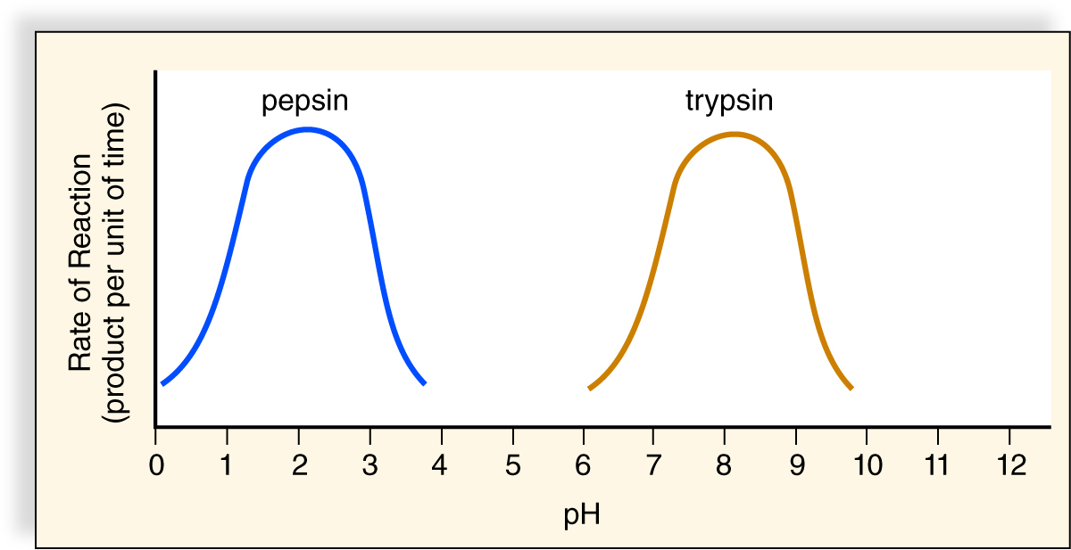
Temperature and pH
UNIT A
Chapter 5: Metabolism: Energy and Enzymes
Section 5.2
Every enzyme has an ideal pH where its activity is greatest.
The protein is in a configuration that makes it most active.
Changes in pH can disrupt normal interactions such as hydrogen bonding, causing a change in enzyme shape and a decrease in activity. Extreme pH changes can cause denaturation.
TO PREVIOUS SLIDE
Figure 5.6 The effect of temperature on rate of reaction.
Notes:
Caption text
Figure 5.6 The effect of temperature on rate of reaction. The preferred pH for pepsin, an enzyme that acts in the stomach, is about 2, while the preferred pH for trypsin, an enzyme that acts in the small intestine, is about 8. At the preferred pH, an enzyme maintains its shape so that it can bind with its substrates.

Slide 18
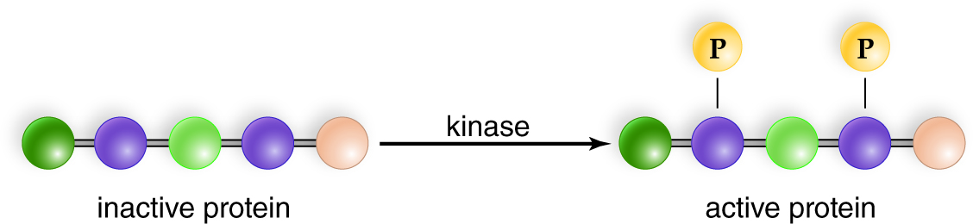
Enzyme Activation
UNIT A
Chapter 5: Metabolism: Energy and Enzymes
Section 5.2
  Some enzymes do not need to be always active in the cell and can exist in an inactive form. When the cell signals a need for the enzyme, the inactive form is changed to an active form. There are different ways this can occur:
  interaction with another protein or molecule
  removal of part of the protein
  addition or removal of one or more phosphate groups; kinase enzymes add phosphates to proteins
TO PREVIOUS SLIDE

Slide 19
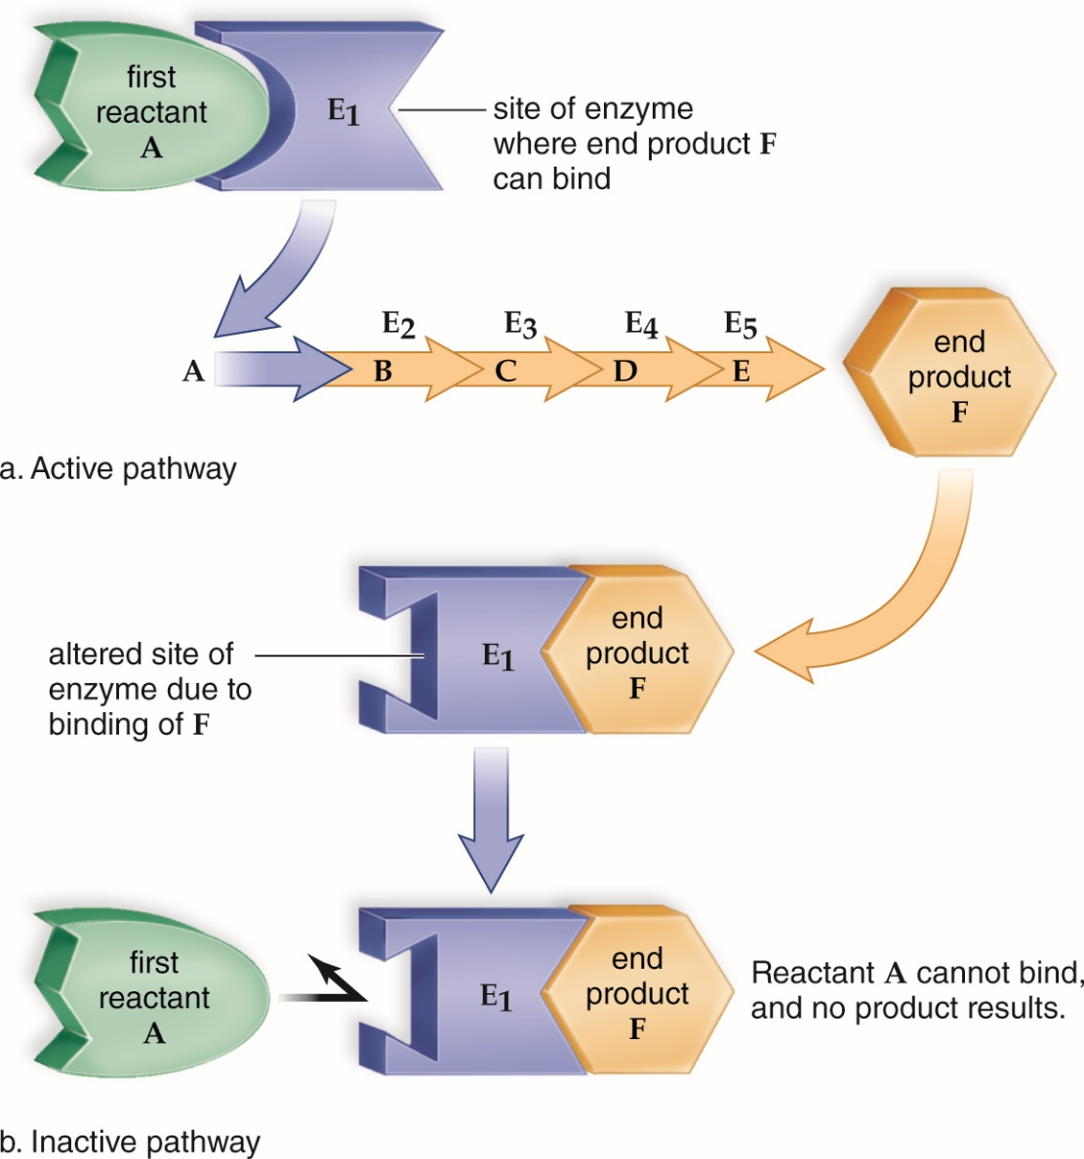
Enzyme Inhibition
UNIT A
Chapter 5: Metabolism: Energy and Enzymes
Section 5.2
Enzyme inhibition decreases the activity of the enzyme by no longer allowing substrate(s) to bind to the active site.
An important type of inhibition is feedback inhibition: reaction product binds the enzyme, causing a change in enzyme conformation and inactivation.
TO PREVIOUS SLIDE
Figure 5.7 Feedback inhibition.
Notes:
Caption text
Figure 5.7 Feedback inhibition. a. In an active pathway, the first reactant (A) is able to bind to the active site of enzyme E1. b. Feedback inhibition occurs when the end product (F) of the metabolic pathway binds to the first enzyme of the pathway—at a site other than the active site. This binding causes the active site to change its shape. Now reactant A is unable to bind to the enzyme’s active site, and the whole pathway shuts down.
enzyme inhibition: occurs when the substrate is unable to bind to the active site of an enzyme

Slide 20
Competitive Inhibition:
a molecule that looks like the substrate can compete for space at the active site (the place where the substrate binds to enzyme).
This will slow down the reaction rate. The inhibitor binding to E can be reversible or irreversible.
Obviously, the more inhibitors are added, the lower the rate of reaction, and the less product is going to be made.
The more substrate is added, the less effect the c.inhibitor has on the reaction rate

Slide 21
Non-competitive Inhibition:
in this case, the inhibitor binds to another place on enzyme (not the active site). The inhibitor may look completely different from the substrate.
The inhibitor may look completely different from the substrate.
When the inhibitor binds, it causes the enzyme to change shape at the active site so S cannot bind.
Amount of substrate does not affect inhibitor
Usually heavy metals (i.e. Mercury: Hg2+, Lead: Pb2+)

Slide 22
Examples of Inhibition:
Reversible inhibition is often used as a normal way of slowing down metabolic pathways (e.g. an intermediate or final product may be a reversible inhibitor of another enzyme in the pathway e.g. threonine).
Inhibitors can also be chemicals introduced into a system from the outside, and can act as medicines or poisons. e.g. penicillin is a medicine that kills bacteria. It works by binding irreversibly to the enzyme that makes bacterial cell walls.
HCN (hydrogen cyanide) is a lethal irreversible inhibitor of enzyme action in human.
Lead (Pb⁺⁺) and other heavy metals (like mercury (Hg⁺⁺) and cadmium) are non-competitive inhibitors that cause poisoning when they bind irreversibly to enzymes and make them denature.

Slide 23
Competative Inhibition Examples:
Antifreeze/Enthylene glycol: Competatively binds to alcohol dehydrogenase (products are poisonous) in liver. To treat, often a patient is given ethanol the normal substrate for the enzyme.
Feedback Inhibition:
  a product of an enzymatic pathway competitively inhibits the beginning of the pathway.

Slide 24
Enzyme Cofactors
UNIT A
Chapter 5: Metabolism: Energy and Enzymes
Section 5.2
  Many enzymes need an inorganic ion or organic nonprotein molecule to function properly.
  The inorganic ions are called cofactors and include metals such as iron and zinc.
  The organic non-proteins are called coenzymes and may contribute atoms to the reaction. Vitamins are small organic molecules required in our diet that are often components of coenzymes (for example, the vitamin niacin is part of the coenzyme NAD).
TO PREVIOUS SLIDE
Notes:
cofactors: inorganic ion helpers required by enzymes to function properly
coenzymes: organic, nonprotein molecule helpers required by enzymes to function properly
vitamins: relatively small organic molecules that are required in trace amounts in diets for synthesis of coenzymes that affect health and fitness

Slide 25
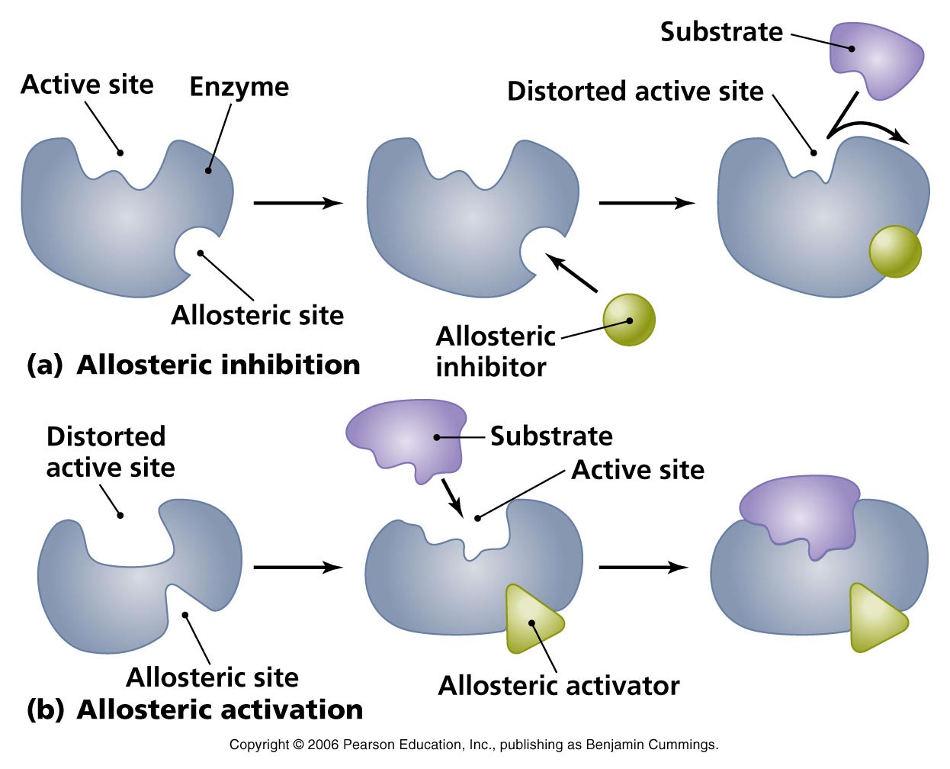

Slide 26
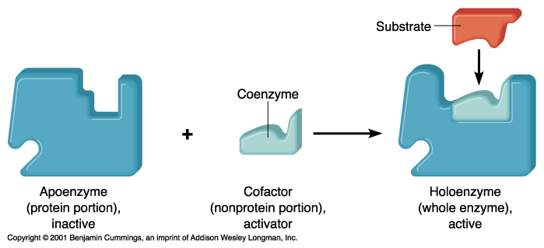
Coenzymes
a protein part called an apoenzyme : that gives it its specificity (i.e. exactly what reaction it will catalyze) binds with coenzyme to form haloenzyme
a non-protein group called a coenzyme: which may help out the reaction by accepting or donating atoms (e.g. H⁺).
  Vitamins: act as coenzymes or are converted into coenzymes

