Slide 1
*Lunch events on Thursdays @ Library!
*Success homework help with Mr. Loveday (M-Th after school @ Library)
*FLEX – You can choose where to be most days. Our next all-grade-8s session is Sept 29th
*BARC permission forms – please return to the office

Slide 2
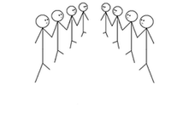
Icebreaker: know your neighbours
Make two lines. Stand facing a partner. -Introduce yourselves -The teacher will ask a question. You have 1 minute to both answer. -One line moves down (so you have a new partner)
-Introduce yourselves. Get a new question.

Slide 3
Describe your perfect day

Slide 4
What do you imagine yourself doing after high school?

Slide 5
What is the strangest gift you’ve ever given or received?

Slide 6
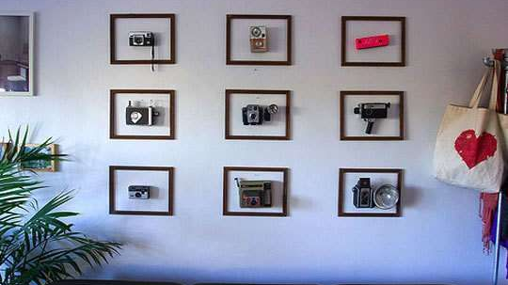
I can’t picture my life without…. (then explain!)

Slide 7
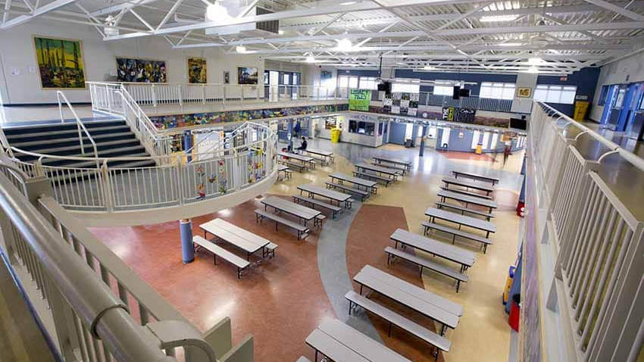
Have you found welcoming places at school to eat lunch or hang out? Explain.

Slide 8
Today’s Activity: Core Competency Self-Assessment & Goal Setting

Slide 9
Who?
What?
Grades 8-12
Set goals in one of three areas:
- Personal/Social Responsibility - Communication - Learning/Thinking
When?
Set a goal in September Review/adjust it in January Reflect on it in June

Slide 10
Start with a wish/an idea
Make groups of ~4 Appoint one note-taker (point form is fine) You will have 60 seconds for a “brain dump” of as many ideas as possible
Think of possible SOCIAL goals (how you interact with others)
Finish the sentence: This year, I want to….

Slide 12
Turn these into SMART goals
S = Specific (what to do and how to get there)
M = Measurable (how will you know if it’s working?)
A = Achievable (is this realistic?)
R = Relevant (how will this make a difference?)
T = Timely (when will this happen?)

Slide 13
I want to… | SMART Goal
Make new friends
I will join a team/club by the second week in October. In the club and in my classes, I will start a conversation with one new person each week. Evidence: ___
Take better care of
myself – Sleep
I will learn about good sleep habits and choose some strategies. I will try these for two weeks, then re-assess. I will plan my homework time so that I can be finished working by 9:00 PM each day. Evidence: ____
Take better care of
myself - Technology
For the month of October, I won’t use my phone during class except as a work tool. To support this goal, I will silence notifications and leave my phone in my backpack or on a charger. I will schedule 1 hour/day at home of no-tech time. I will leave my phone in the charger and set a timer.

Slide 14
Another brain-dump:
Think of possible LEARNING goals (for a particular subject, or about your learning habits)
Finish the sentence: This year, I want to….

Slide 16
I want to… | SMART Goal
Get better at French
Improve my math grade
Become a stronger reader

Slide 17
What do I need to do?
In your P1 class next week, you will be given time to create a SMART goal for the semester. You will submit this online, through the Core Competency Team.
This weekend:
Think about goals that are meaningful to you
Download TEAMS to your device
Your goal-setting is due Thurs 21 Sept. - put this in your planner!
Your goal will be e-mailed to you and your family. You will report on your goal in January

Slide 18
Take a short break! Class starts at 9:25
If you have questions for staff or student helpers, stick around and ask!
We can also help you check your binder/agenda.

