Slide 1
CRAP Detection

Slide 2
“Every man should have a built-in automatic crap detector operating inside him.” Ernest Hemingway, 1954
CRAAP ~ WEBSITE EVALUATION
Notes:
Bring in chrome books for assignment

Slide 3
Intro Videos ~
https://www.youtube.com/watch?v=35PBCC5TKxs
Notes:
First video ~ quick…. Get students asking questions.
Second video ~ more in depth information.

Slide 4
CRAP TEST
The CRAP test is a way to evaluate a source based on the following criteria:
Currency
Reliability
Authority
Purpose/Point of View
Click Above ~ CRAAP Test
Notes:
https://www.youtube.com/watch?v=aGi5TzrZ5T8
Alternative website for re-teach if necessary

Slide 5
CURRENCY
When was the information published or posted?
Has the website been updated recently? How can you tell?
Is the source current enough for your topic?
Are the links still active?

Slide 6
RELIABILITY
Is the site sponsored?
What is the organization?
Is the information supported or referenced?
Is the source reputable?
Is the information comparable to other sources?
Is the information linked to other reputable sites?

Slide 7
AUTHORITY
Is the author identified?
Can you contact the author?
What credentials does the author have?
What is the website extension?
Is there supporting documentation (graphs, charts, illustrations or other supporting documentation)?
Is it poorly written with grammar and spelling mistakes?

Slide 8
PURPOSE/POINT OF VIEW
What is the purpose of the site? (Inform, sell, persuade)
Is the information fact or opinion?
Is the site trying to sell you something?
Are there advertisements on the website?

Slide 9
OTHER WAYS TO FACT CHECK
Snopes and FactCheck.org

Slide 10
CRAAP Test in action
https://www.youtube.com/watch?v=lhwB4zQD4XA

Slide 11
Example
https://www.youtube.com/watch?v=aem3JahbXfk

Slide 12
Go to the DHMO homepage: http://www.dhmo.org
Answer the following questions
1. List three characteristics of DHMO.
2. What are some of the risks associated with DHMO?
3. What does the Environmental Protection Agency have to say about DHMO?
4. Should DHMO be a banned substance?

Slide 13
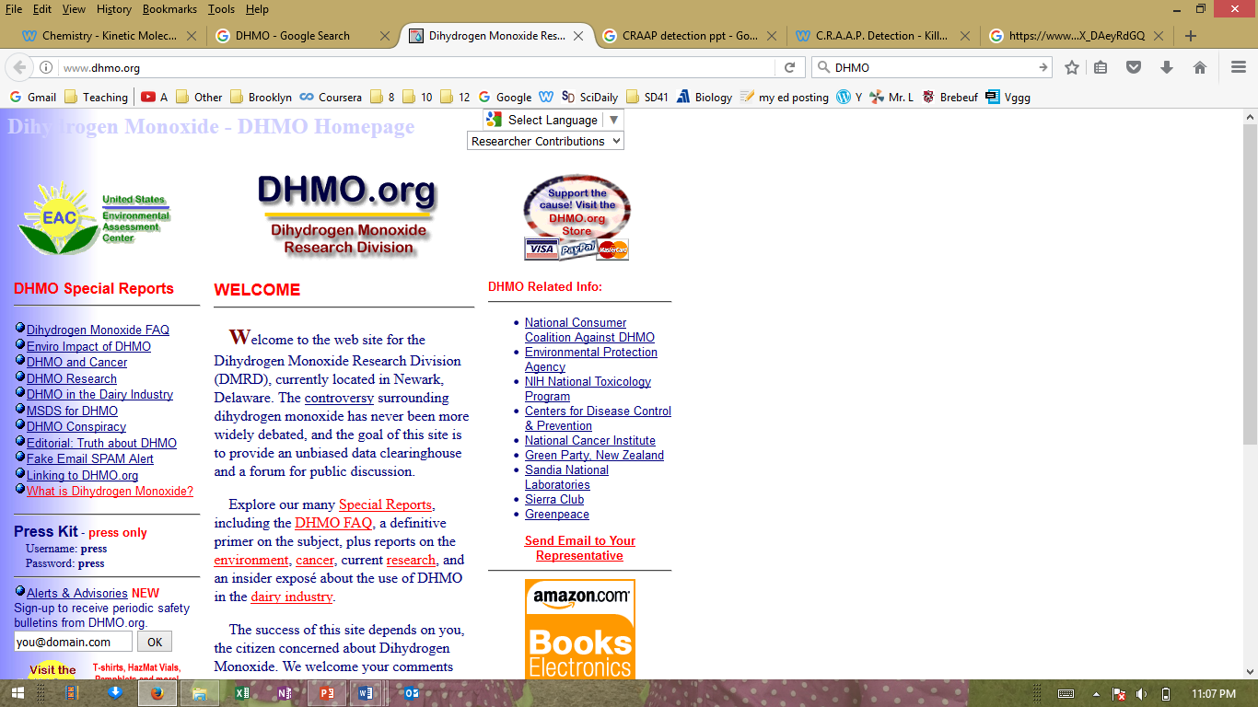

Slide 14
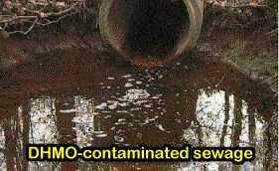

Slide 15
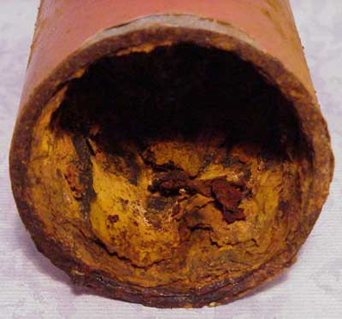
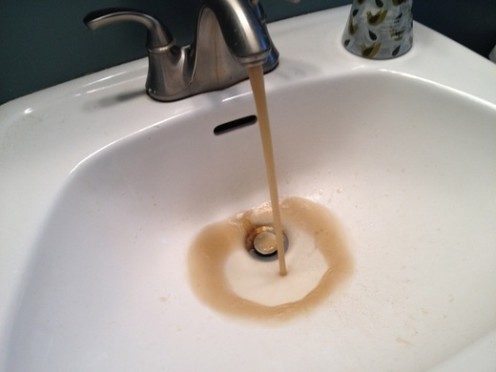
Rusting pipes

Slide 16
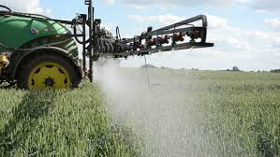
Deliberately Sprayed on Crops

Slide 17
What is DHMO?
What is Dihydrogen Monoxide?

Slide 18
