Slide 1
CRAAP Detection

Slide 2
“Every man should have a built-in automatic crap detector operating inside him.” Ernest Hemingway, 1954
CRAAP ~ WEBSITE EVALUATION
Notes:
Bring in chrome books for assignment

Slide 3
CRAP TEST
The CRAP test is a way to evaluate a source based on the following criteria:
Currency
Reliability
Authority
Accuracy
Purpose/Point of View
Notes:
https://www.youtube.com/watch?v=aGi5TzrZ5T8
Alternative website for re-teach if necessary

Slide 4
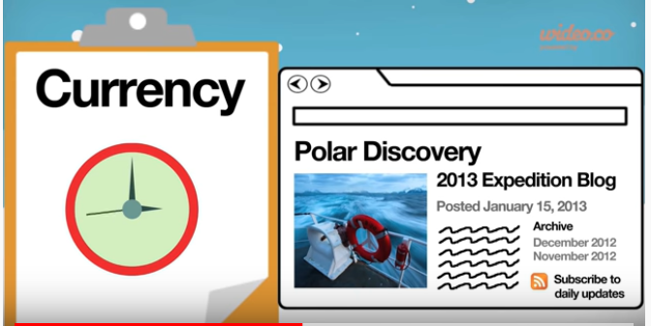
CURRENCY
Is the information up to date?
When was the information published or posted?
Has the website been updated recently? How can you tell?
Is the source current enough for your topic?
Are the links still active?

Slide 5
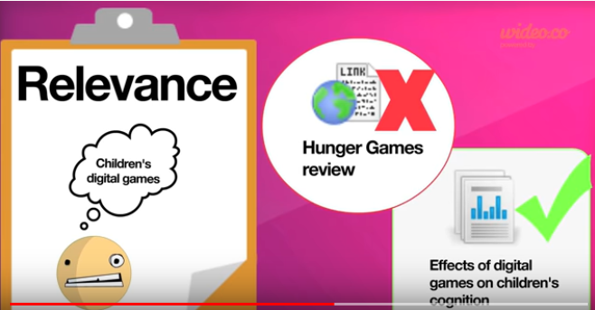
RELEVANCE
Does the information relate to your research topic?
Is it indepth enough for academic use?

Slide 6
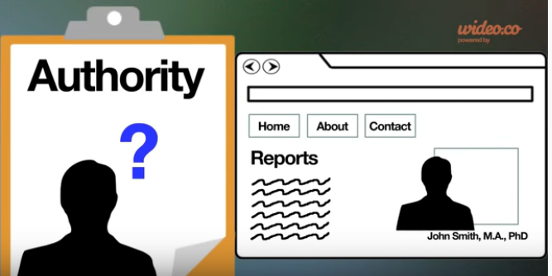
AUTHORITY
Is the author identified?
Can you contact the author?
What credentials does the author have? Is the author qualitfied to write about the topic?
Look for subpages like "About Me" and try looking up author in Google.
Good authors list their contact info.
What is the website extension?

Slide 7
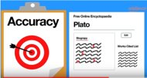
Accuracy
Is information reliable, error-free and supported by evidence?
Make sure the author has cited their work
Is there supporting documentation (graphs, charts, illustrations or other supporting documentation)?
Is it poorly written with grammar and spelling mistakes?
Is the information comparable to other sources?
Is the information linked to other reputable sites?
What is the organization?
Is the information supported or referenced?
Is the source reputable?

Slide 8
PURPOSE/POINT OF VIEW
What is the purpose of the site? (Inform, sell, persuade)
Is the information presented objectively?
Is the information fact or opinion?
Is the site trying to sell you something, entertain, or persuade?
Do you need to subscribe to get more info?
Are there advertisements on the website?
Is the site sponsored?
What is the organization?

Slide 9
OTHER WAYS TO FACT CHECK
Snopes and FactCheck.org

Slide 10
CRAAP Test in action
https://www.youtube.com/watch?v=lhwB4zQD4XA
https://www.youtube.com/watch?v=aem3JahbXfk

Slide 11
Go to the DHMO homepage: http://www.dhmo.org
Answer the following questions
1. List three characteristics of DHMO.
2. What are some of the risks associated with DHMO?
3. What does the Environmental Protection Agency have to say about DHMO?
4. Should DHMO be a banned substance?

Slide 14
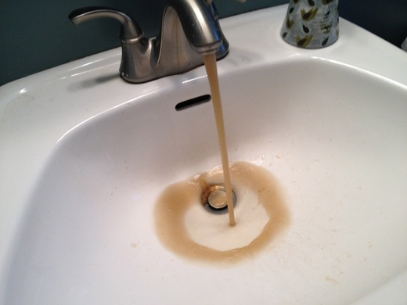
Rusting pipes

Slide 15
Deliberately Sprayed on Crops

Slide 16
What is DHMO?
What is Dihydrogen Monoxide?

