Slide 1

Welcome Back Bulldogs!

Slide 2
Health and Safety
Health Check - Do it daily! Don’t come to school sick.
Masks – Wearing a mask is a personal choice. A person’s choice is to be supported and respected.
Hand Hygiene – Wash and/or sanitize hands frequently.
Personal Space – Respect one another’s personal space.
Vaccination – BC Centre for Disease Control guidance is that vaccines are important protection and encourages everyone to keep up to date.

Slide 3
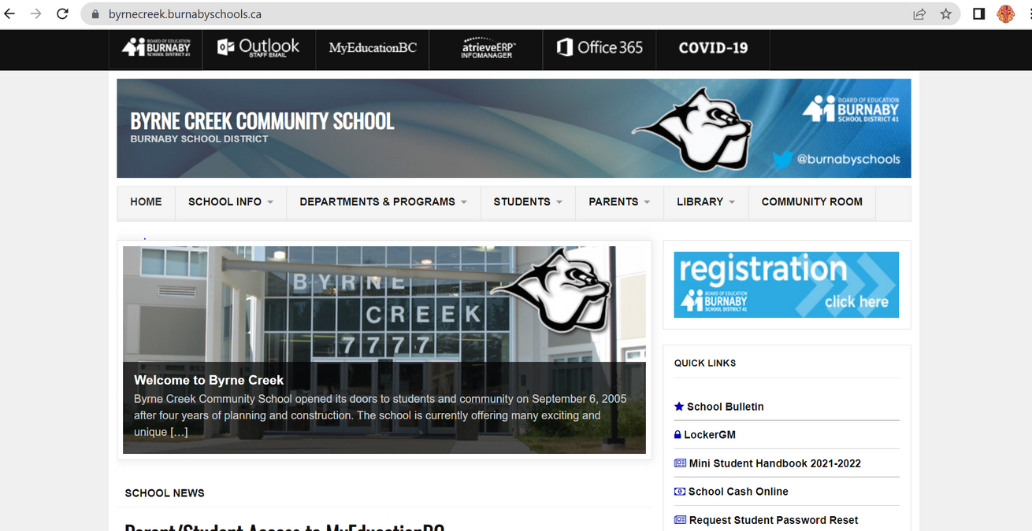
Login Information
If you are a new student to Byrne Creek, you will need the following to login to a computer:
ID (student number)
Password
Then go to the Byrne Creek Website!

Slide 4
Important:
If you need to request either a MyEducation password reset or complete a course change/correction form you will need to update your Office365/computer login password.
All grade 8-12 students have an Office365 account.
To update your Office365/computer login password go to http://ssp.burnabyschools.ca

Slide 5
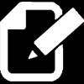
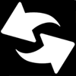

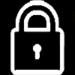
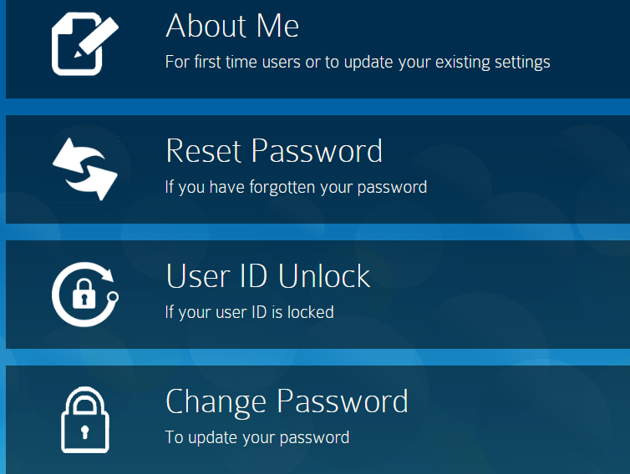
SD41: Self-Serve Password Reset
Choose the Change Password Option

Slide 6
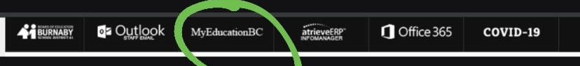

Login information
To log in to MyEd BC you will need:
ID (student number)
Password - new students will receive an email with their password
MyED BC will have all the information you need for grades, schedules, your time-table and more!

Slide 7

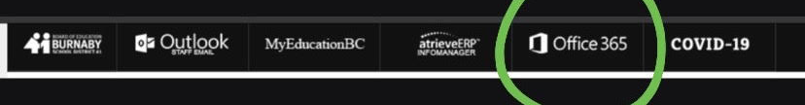
Login information
To access Office 365 you will need:
- ID (student #@edu.burnabyschools.ca)
- Password (same as computer login password)
Office 365 will give you access to:
Byrne Creek School Email
Microsoft
Teams
Microsoft
Word
OneDrive Power Point Excel

Slide 8
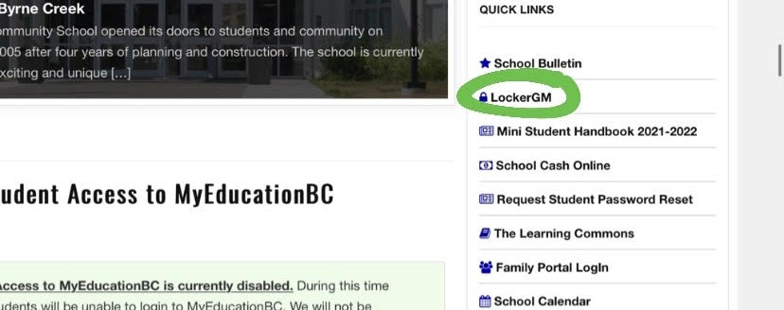
Login information
Selecting a Locker!
To select a locker you will need:
- ID (student number)
- Password (student number)
To select your locker, go to the quick links and click "Locker GM". Then put your ID and Password, and choose your locker!

Slide 9
Bell Schedule

Slide 10
Flex Time
Monday – Thursday from 8:37 to 9:05am
Fridays from 8:37 to 9:25am
See teachers as needed for questions / extra help / completing projects, assignments, tests
Collaborate with peers
Flexible time to meet your learning needs

Slide 11
Course Corrections
Grade 8s - Only for students with incomplete timetables. Please see your counsellor in Student Services to complete your timetable.
Grade 9-12s – any requested changes must be submitted on the online form by September 8th at 3:00pm.
Students should continue to follow their assigned schedule and check MyEd regularly for updates.

Slide 12

Course Correction Request Form
All requests must be submitted online using this form.
The form can only be submitted once. Forms are due by 3pm on Friday, September 8th.
Scan the QR Code to access the Course Correction Form.

Slide 13
Photo Day
Wednesday,
September 6th

Slide 14
Have a Great Semester!

